Slide 1

Axon

Slide 2

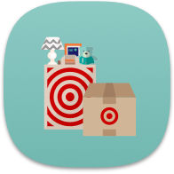









What is Axon?
Axon is a platform aggregation layer that provides datasets and key real time fulfillment metrics to tenants and consumers to drive Fulfillment operations.
Axon consumes data from multiple sources to enable specific views or use cases for store level and aggregated data points.
ePick
MPM
Workload Prioritization
Houston
gPack
myDay
SPACE
Greenfield
Capacity Management

Slide 3
Axon’s Objective:
To monitor store fulfillment events and create real-time metrics and reporting that enables different parts of the store fulfillment process to make adjustments in order to fulfill guest orders effectively and on time.
Supported Projects
Technology Stack
Name | Description
MPM – My Performance Mobile | Mobile app that reports real time data for stores.
Houston | Web platform representing store operations
My Day fulfillment | Mobile app to report worked progress for stores
Components | Technologies
Computational Frameworks | Kafka Streams, Spring, Micronaut, Node JS
Database | PostgreSQL
Languages | Java, Kotlin, JavaScript, Groovy, Python
Testing | Kotest, Spock
Deployment | VELA, Target Application Platform (TAP)

Slide 4



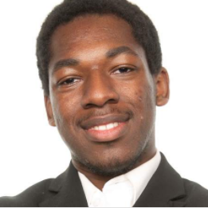
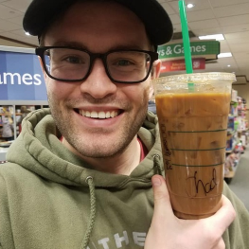


Meet the Axon team
Ali Obler
Lead Product Owner
Angeli Corral
Sr. Engineering Manager
Baskar Natarajan
Lead Engineer
Abdul Ashwood
Engineer
Jack Morgan
Sr. Engineer
Nancy Selvam
Engineer
Eric Jensen
TLP

Slide 5




Why is Axon important?
Ensures Data
Alignment
Provides Consistent
Stability
Unlocks Future
Use Cases
Can Expand to
Additional Nodes
Axon alleviates metric discrepancies when comparing multiple fulfillment applications by providing core data to multiple sources.
Axon is able to organize data in a centralized location to ensure logic and patterns do not have to be repeated.
Built on tried and tested patterns with high availability, durability and reliable caching and fallbacks.
Axon can act as a layer to protect stores from upstream failures that can cause disruption and/or failures.
Tenants and consumers will be able to focus on iterating and improving their algorithms without worrying about where to gather their data from, the accuracy of the data and the stability of the data.
Different tenants and personas may be interested in different data points and metrics. Axon can join different datasets from multiple sources to quickly present a story in real time.
Axon’s data and patterns can become portable if a contract is established and abstracted.

Slide 6
