Slide 1

Dynamic Batching
Idea Owner: Kapil Gangwal
Collaborators:
Grant Nafziger (Betamax)
Matthew Witte (WOPr)
Kapil Gangwal (WOPr)
Stores and Properties Innovation Week 2025

Slide 2


What Is Batching & What Problem Are We Solving?
The Problem
Once a TM claims a batch, no additional items can be added, even if there’s still cart space and plenty of time before SLA.
This forces TMs to:
Return to PTH/SHIP
Claim a brand-new batch
Walk the floor again for items they could have picked in the same trip
Result: Extra travel, Underutilized carts, and Lost efficiency.
What is a Batching?
Batching groups guest order items into optimized sets — called batches — based on rules like max orders, items, weight, volume etc.
WOPr creates and prioritizes these batches, and TMs pick them using ePick app.
Goal: Reduce walking trips, More dense batches to improve pick efficiency.

Slide 3

The Dynamic Batching Idea
The Concept
Give TMs a simple, optional way to pick a few more nearby items while they’re already on the floor.
How It Works
When a TM finishes picking a batch, A new button appears asking TM: “Can you pick more items?”
TM can say Yes or No — full flexibility.
If TM selects Yes →
WOPr provides a small set of additional items.
(for prototype we used WOPr’s existing claim endpoints)
TM picks those items into the same cart, in the same trip.
In the same flow TM can select more items or end.
WOPr provides a small set of additional items that:
Do not exceed cart weight/volume limits
Do not risk SLA performance
Are close to the TM’s current location (using existing item coordinates)

Slide 4
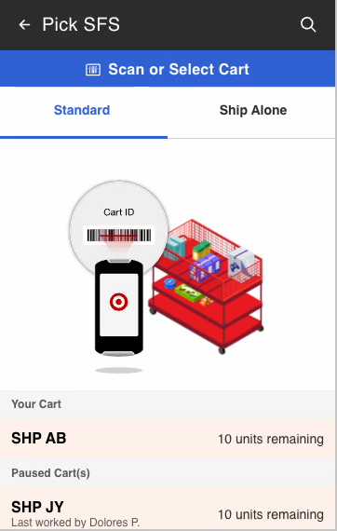

Prototype Demo
(Innovation Week Build)
What You’ll See
A quick walkthrough of our Innovation Week prototype showing how the “Do more work right now?” flow works end-to-end.
This version is not polished and needs refinement before any real store testing — but it proves the core concept and shows how Dynamic Batching could work in practice.

Slide 5

Benefits of Dynamic Batching
Increased Efficiency
TMs can pick more items while already on the floor → fewer total trips.
This creates a human-in-the-loop enhancement to maximize batching efficiency.
Optimized Resource Utilization
Better use of cart space, TM time, and existing workflows.
Enhanced Flexibility
TMs can choose when to take more work, based on body load, cart space, and comfort.
Optional flow ensures safety and SLA protections remain intact.
Fills the Technology Gap
Technology can’t perfectly optimize every scenario — but TMs can safely fill the remaining gap using real-time judgment.
Improves TM Experience with Batch Size
Stores often share that batch sizes feel too big or too small for their needs. Dynamic Batching gives TMs more control, allowing them to adjust workload and batch size in the moment to what works best for them and their store.

Slide 6

Supporting Metrics (Shows Huge Potential)
Under-Filled Carts
~65% of GM (OPU) and Standard (SFS) batches are full and only ~38% of Grocery (OPU) batches are “full”
“Full” Doesn’t Mean Full
Most “full” batches hit business caps (orders/TCINs/units)
These caps do not reflect actual cart capacity
Safety Capacity Still Available
~85% of all batches have space left under weight and volume limits
Indicates strong potential to safely add more items
Time Left to Pick
~57% times GM batches finish 11+ minutes early & ~95% times Standard batches start 2+ hours.
What These Metrics Indicate?
These are clear indicators of huge batches have space + time remaining
Clear opportunity to improve efficiency with Dynamic Batching

Slide 7
Thank You!
For Questions, Reach out:
Kapil Gangwal
kapil.gangwal2@target.com
#iw25-dynamic-batching

