Slide 1


Code Monkeys 2016-11-03
Code testing, and why
YOU NEED IT
Tim Booth vs. Martin Jones

Slide 2

Testing basics
What constitutes testing?
When should you test?
What do you gain from doing it “properly”?
“I can't test my code yet because I'm not completely sure what it's supposed to do!”
  We disagree:
  The discipline of testing helps us to think more deeply about the behaviour we want. (paraphrasing EPDFB).

Slide 3

Testing Terms
Test Framework
Test Suite
Regression
Unit Test
Continuous Integration

Slide 4

Useful Software
Python: Unittest, Nose
Perl: “use Test;”
Java: JUnit
C/C++: It's a can of worms, but there are many cans to choose from.
BASH scripts: There's a thing called “shunit2”. Or just test using Python.

Slide 5
Martin's Example
def find_common_kmers(dna, k, threshold):
result = []
for start in range(len(dna)):
kmer = dna[start:start+k]
if dna.count(kmer) >= threshold:
result.append(kmer)
return result
$ python3
>>> from find_common_kmers import find_common_kmers
>>> print(find_common_kmers('atgaatgc', 3, 2))
???
>>> print(find_common_kmers('atgaatcg', 3, 2))
???

Slide 6
Martin's Example
def find_common_kmers(dna, k, threshold):
result = []
for start in range(len(dna)):
kmer = dna[start:start+k]
if dna.count(kmer) >= threshold:
result.append(kmer)
return result
$ python3
>>> from find_common_kmers import find_common_kmers
>>> print(find_common_kmers('atgaatgc', 3, 2))
['atg', 'atg']
>>> print(find_common_kmers('atgaatcg', 3, 2))
['g']

Slide 7

Hacking time!

Slide 8
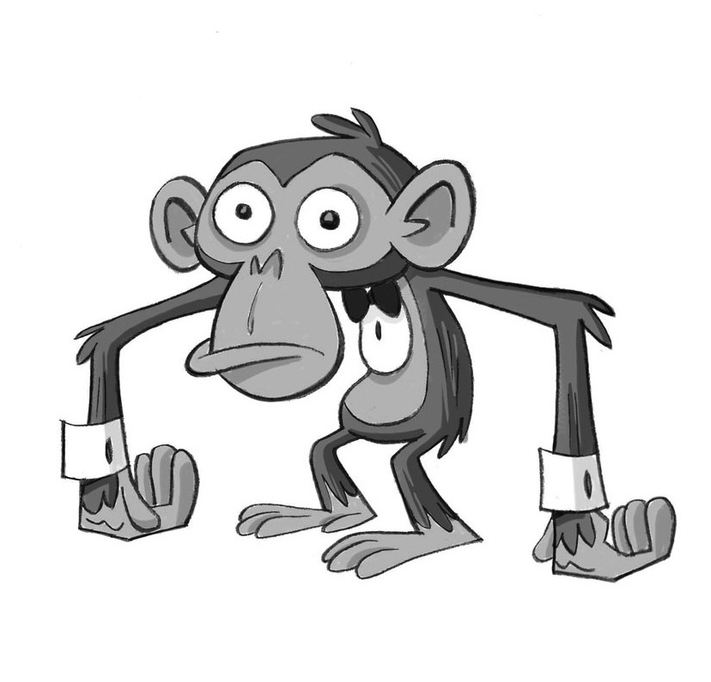
unittest.mock
from [unittest.]mock import patch, Mock
patch - Replaces functions etc. within a module (eg. to follow)
Mock - a special object that pretends to be other objects
There's also a MagicMock - a “super” Mock class. We'll deal with Mock first.
Even though the classes come under “unittest”, you can use them with Nose or just on their own.

Slide 9
unittest.mock
https://docs.python.org/3/library/unittest.mock.html
Let's have a play... (see examples folder)

Slide 10
Further Example
from __future__ import print_function
import sys
from collections import Counter
def find_common_kmers(dna, k, threshold):
c = Counter([ dna[n:n+k] for n in
range(len(dna) - k + 1) ])
return [ kmer for kmer in c if
c[kmer] >= threshold ]
dna, k, thresh = sys.argv[1:]
ofh = open("list_of_%smers.txt" % k, 'w')
for kmer in find_common_kmers(dna, int(k), int(thresh)):
print( kmer, file=ofh )

Slide 11
Further Example
from __future__ import print_function
import sys
from collections import Counter
def find_common_kmers(dna, k, threshold):
c = Counter([ dna[n:n+k] for n in
range(len(dna) - k + 1) ])
return [ kmer for kmer in c if
c[kmer] >= threshold ]
def main():
dna, k, thresh = sys.argv[1:]
ofh = open("list_of_%smers.txt" % k, 'w')
for kmer in find_common_kmers(dna, int(k), int(thresh)):
print( kmer, file=ofh )
if __name__ == '__main__': main()

Slide 12
Testing it with Mock()
>>> from find_common_kmers3 import main
>>> from unittest.mock import patch
>>> patch('sys.argv', '-- atgaatgccccc 3 2'.split()).start()
['--', 'atgaatgccccc', '3', '2']
>>> omock = patch('builtins.open').start()
>>> omock.mock_calls
[]
>>> main()
>>> omock.mock_calls
[call('list_of_3mers.txt', 'w'),
call().write('atg'),
call().write('\n'),
call().write('ccc'),
call().write('\n')]
>>> omock.call_args
call('list_of_3mers.txt', 'w')
>>> ''.join([ c[1][0] for c in omock.mock_calls if c[0] == '().write' ])
'atg\nccc\n'

Slide 13
That's all, folks.

