Slide 1





Understanding the Lightning Network
LNP201 - Chapter 1.1 - By Fanis Michalakis
Fanis Michalakis - EN - V.001 - 2024-08 - Plan₿ Network’s PGP: 5720 CD57 7E78 94C9 8DBD 580E 8F12 D0C6 3B1A 606E
IA Translated
(Not yet reviewed)

Slide 2

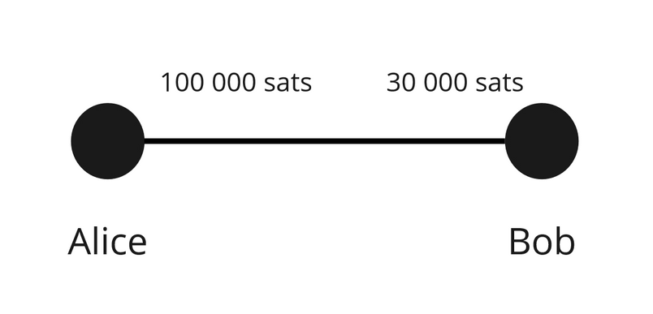
LNP 201 - Chapter 1 - Understanding the Lightning Network
The Lightning Network = network of payment channels
Capacity = 130 000 satoshis
Satoshi ?
1 bitcoin = 100 000 000 satoshis
1 satoshi = 0,00 000 001 bitcoin
Fanis Michalakis - EN - V.001 - 2024-08 - Plan₿ Network’s PGP: 5720 CD57 7E78 94C9 8DBD 580E 8F12 D0C6 3B1A 606E
IA Translated
(Not yet reviewed)

Slide 3
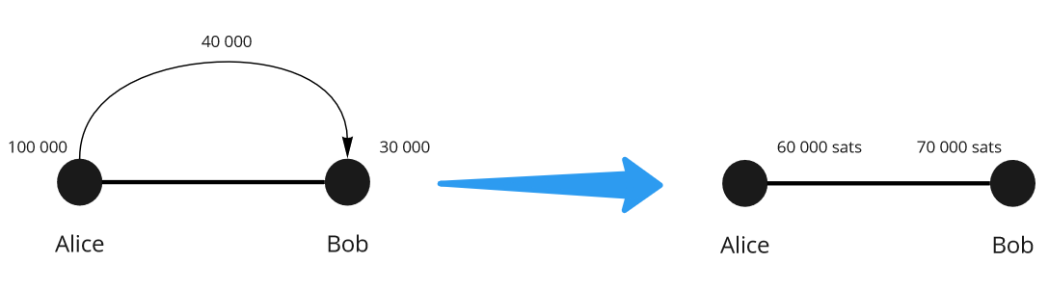

LNP 201 - Chapter 1 - Understanding the Lightning Network
Capacity = 130 000 satoshis
Capacity = 130 000 satoshis
Transaction
because 40 000 < 100 000
Fanis Michalakis - EN - V.001 - 2024-08 - Plan₿ Network’s PGP: 5720 CD57 7E78 94C9 8DBD 580E 8F12 D0C6 3B1A 606E
IA Translated
(Not yet reviewed)

Slide 4
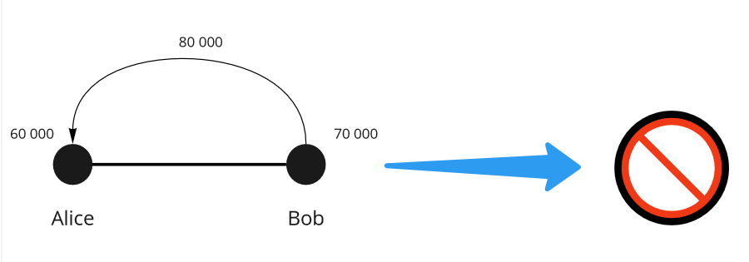

LNP 201 - Chapter 1 - Understanding the Lightning Network
Transaction
Because 80 000 > 70 000
Fanis Michalakis - EN - V.001 - 2024-08 - Plan₿ Network’s PGP: 5720 CD57 7E78 94C9 8DBD 580E 8F12 D0C6 3B1A 606E
IA Translated
(Not yet reviewed)

Slide 5
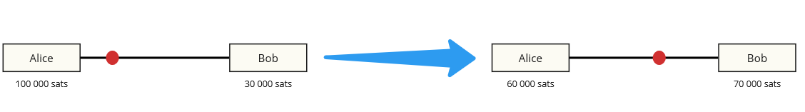
LNP 201 - Chapter 1 - Understanding the Lightning Network
“Cursor” representation
Fanis Michalakis - EN - V.001 - 2024-08 - Plan₿ Network’s PGP: 5720 CD57 7E78 94C9 8DBD 580E 8F12 D0C6 3B1A 606E
IA Translated
(Not yet reviewed)

Slide 6

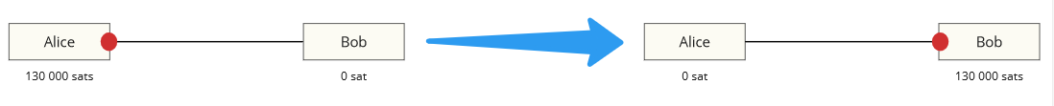

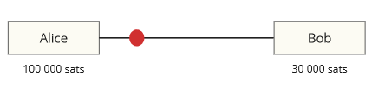
LNP 201 - Chapter 1 - Understanding the Lightning Network
To retain:
The capacity of a channel is fixed
It defines the maximum that can be sent at once in the channel, if all the liquidity is on the same side
But Bob can then send the funds back to Alice, and so on. This is the limit for a single transaction
We can send as much as we have on our side of the channel
Here Alice can send at most 100 000 satoshis to Bob and Bob can send at most 30 000 satoshis to Alice
Fanis Michalakis - EN - V.001 - 2024-08 - Plan₿ Network’s PGP: 5720 CD57 7E78 94C9 8DBD 580E 8F12 D0C6 3B1A 606E
IA Translated
(Not yet reviewed)

Slide 7
LNP 201 - Chapter 1 - Understanding the Lightning Network
Thank you
Fanis Michalakis - EN - V.001 - 2024-08 - Plan₿ Network’s PGP: 5720 CD57 7E78 94C9 8DBD 580E 8F12 D0C6 3B1A 606E
IA Translated
(Not yet reviewed)

