Slide 1
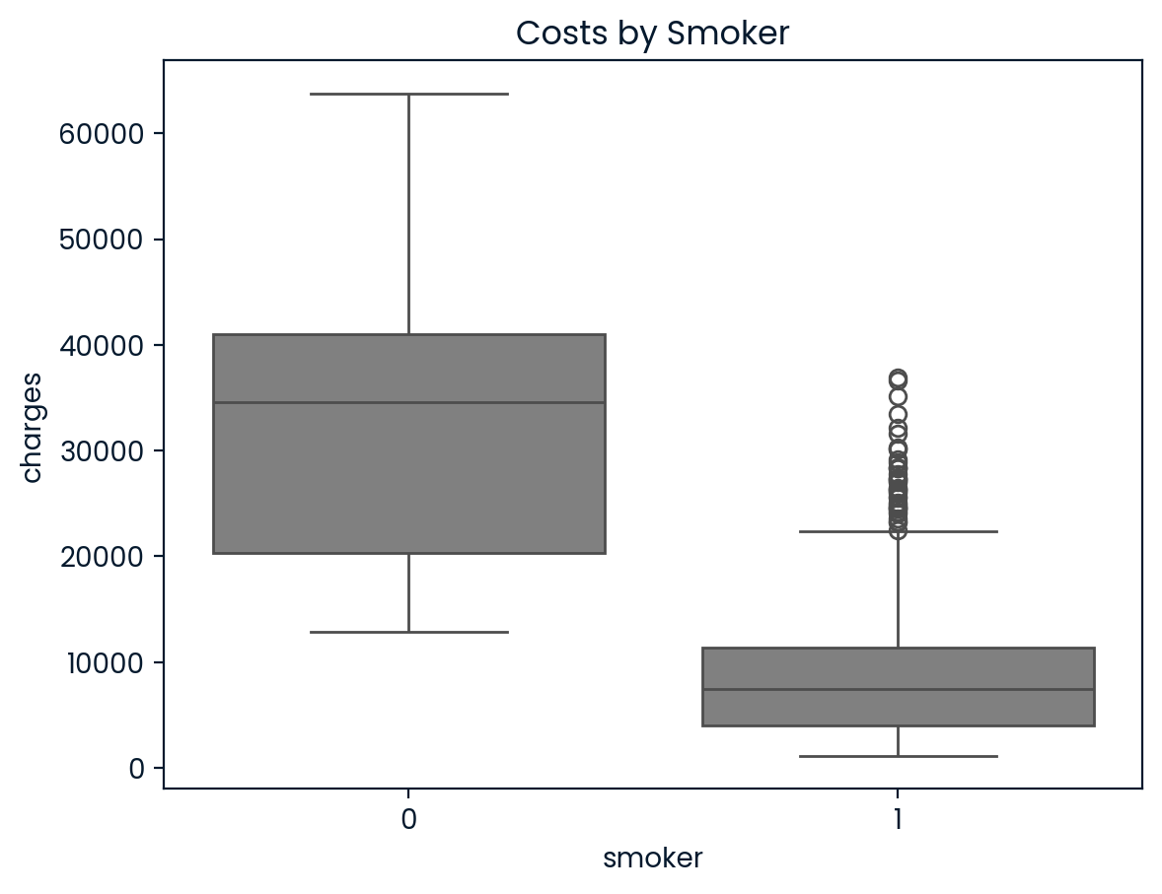
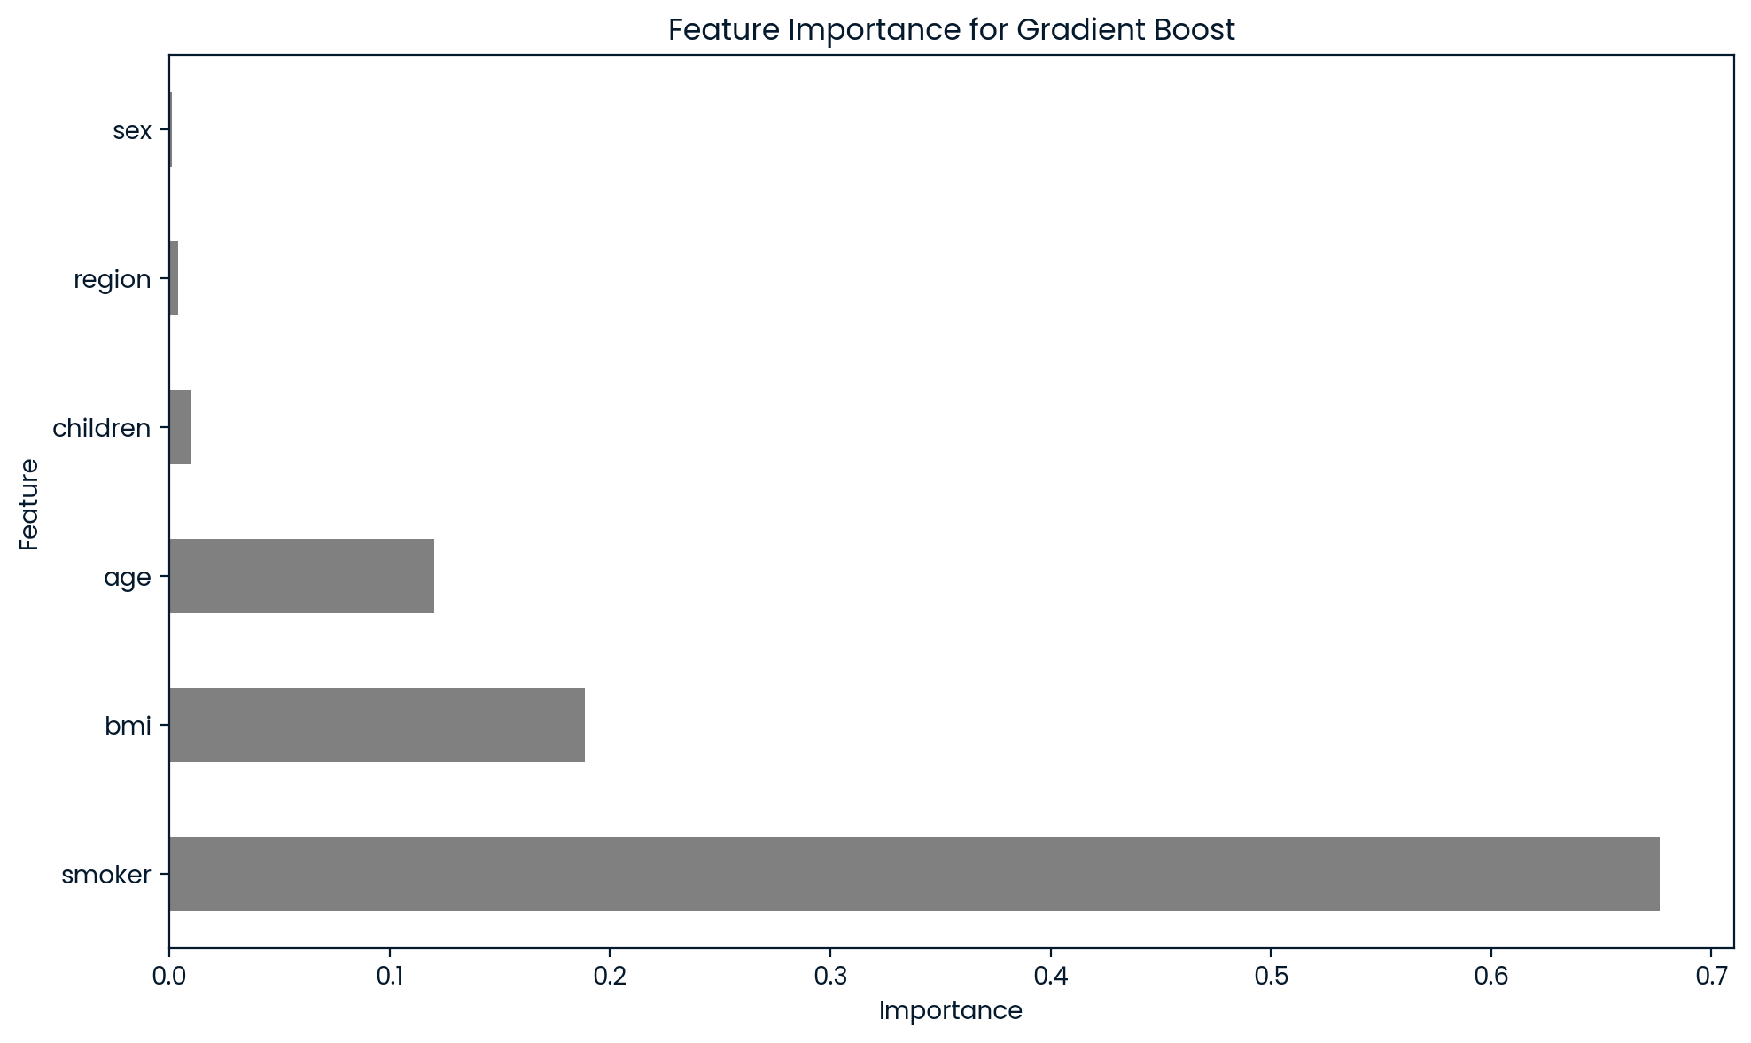
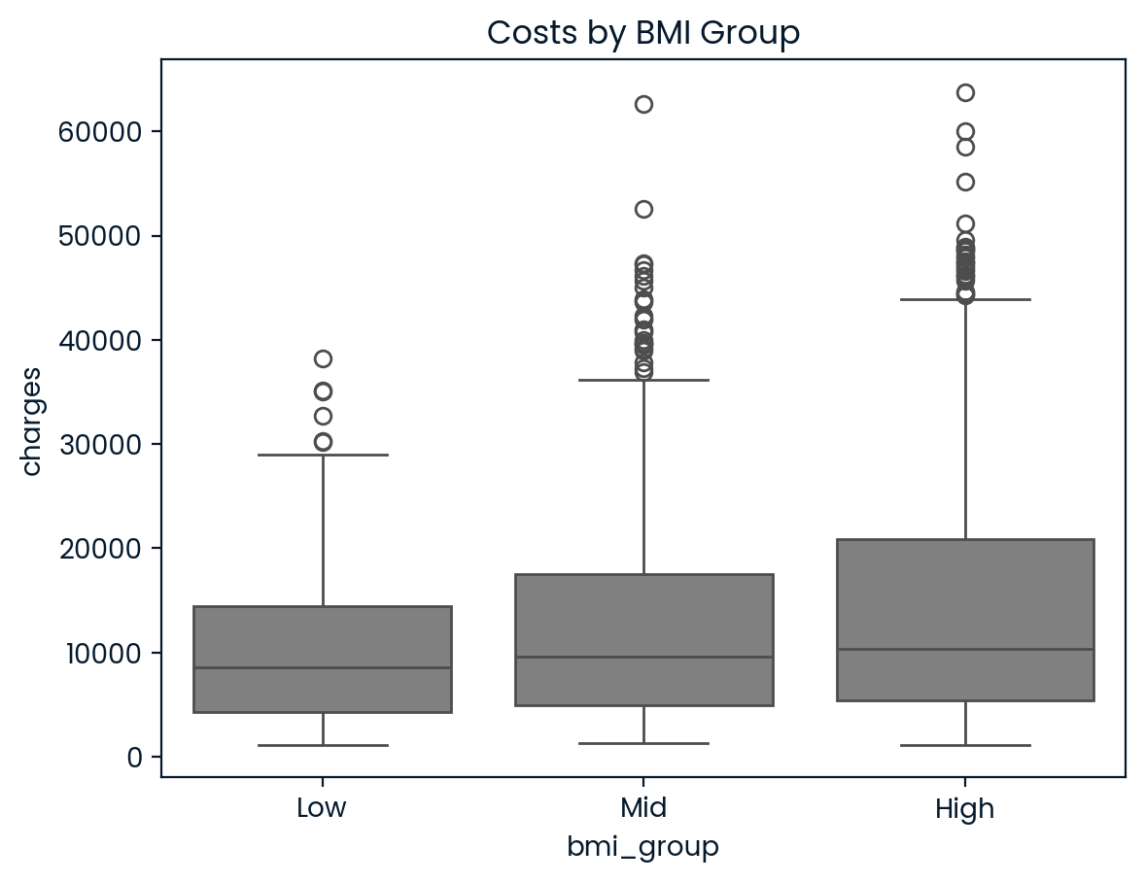
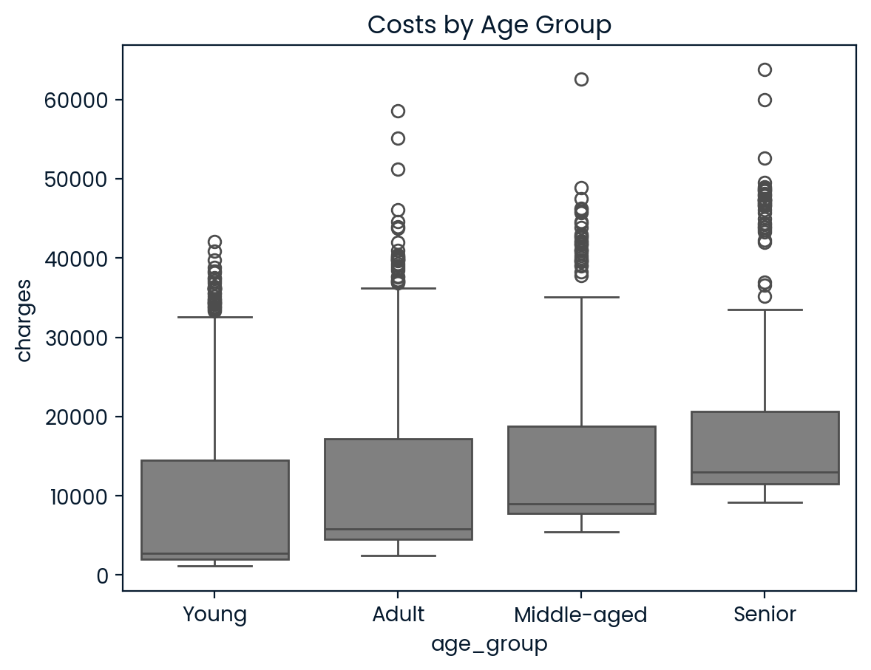
Predicting Medical Charges
Objective: Build a regression model that predicts medical insurance charges for customers based on their profile
Methodology:
Data Exploration
(Data Visualization & Cleaning)
Feature Engineering
(Trends, Correlation, Normalization)
Regression Modeling
(Linear, Random Forest, Gradient Boosting)
Model Selection
(RMSE, MAE, R²)
Model Performance / Selection:
Model | RMSE | MAE | R²
*Gradient Boosting | 4136.93 | 2369.29 | 0.88
Random Forest | 4565.32 | 2699.10 | 0.85
Linear | 5618.83 | 3921.55 | 0.75
*Gradient boosting highest performing model
Data Insights:
Medical charges for smokers are ~3.8x that of non-smokers
Being a smoker is the most significant feature for predicting medical charges
BMI and age are high on feature importance (higher BME and older age leads to higher medical charges)
Sex, region, and children have much lower feature importance
Feature Importance for Gradient Boosting

