Slide 1
ShopEasy Marketing Analysis

Slide 2
Agenda
Overview
Current Trends
Conversion
Engagement
Customer Reviews
Summary

Slide 3
Overview
Goal: Identify areas of improvement to increase
Conversion Rate
Engagement
Customer Satisfaction
Key Performance Indicators (KPIs)
Conversion Rate
Customer Engagement Rate
Customer Feedback Score
Customer Sentiment Score

Slide 4
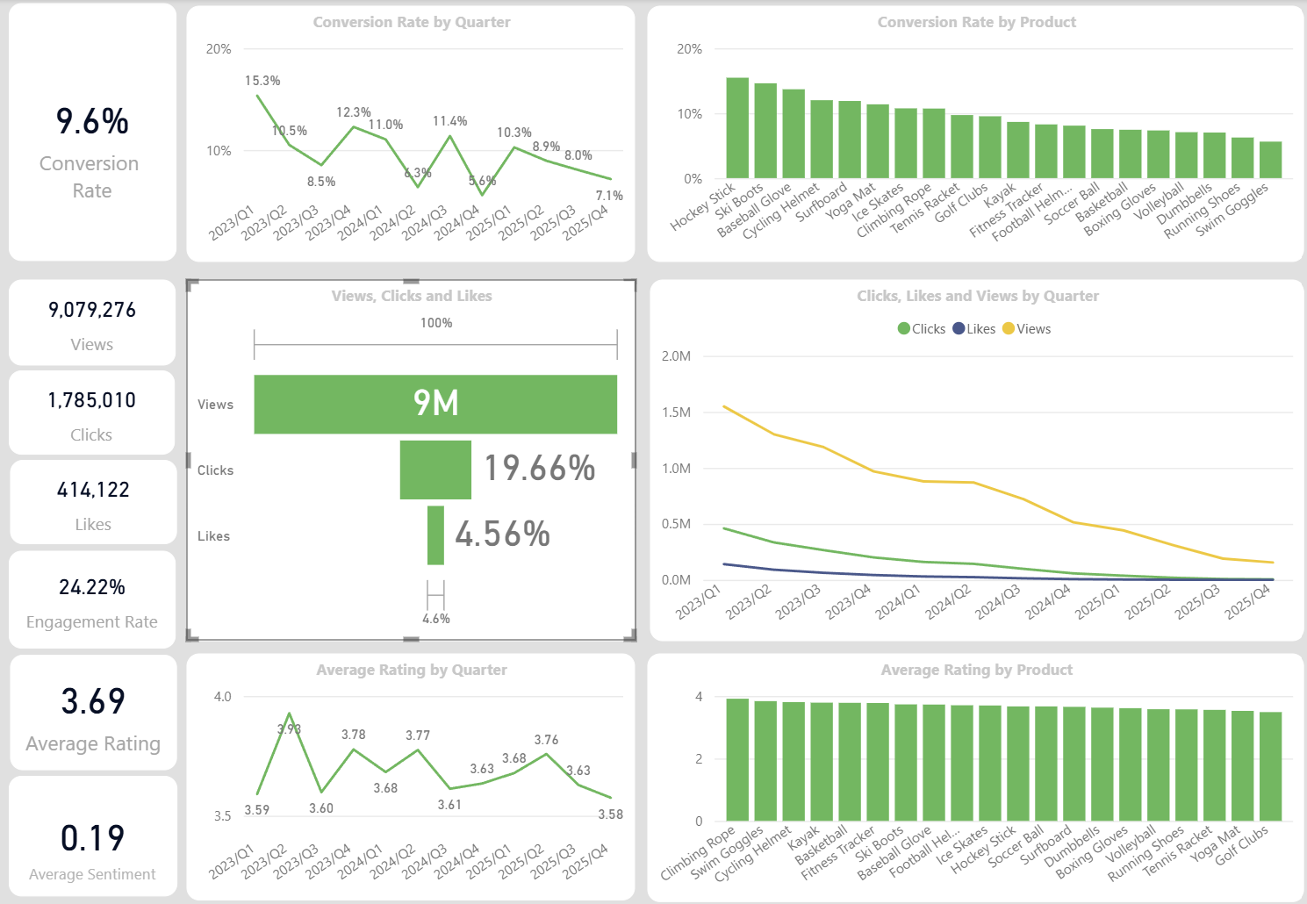
Current Trends
Decreased Conversion Rates
Conversion rates steadily declining from 15.3% to 7.1%
Declining Customer Engagement
Large decline in customer engagement overall, decreasing from 31.9% in 2023 to 6.56% in 2025
Consistent Customer Satisfaction
Product ratings remained consistent on average at ~3.7, “mildly positive”

Slide 5
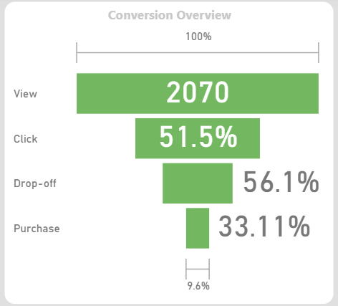
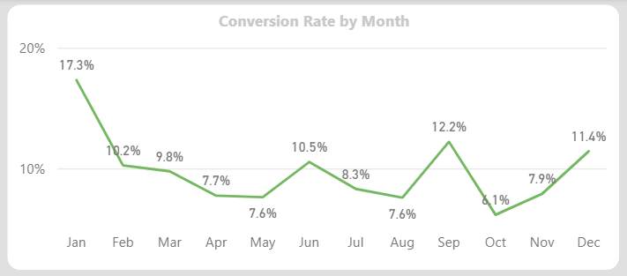
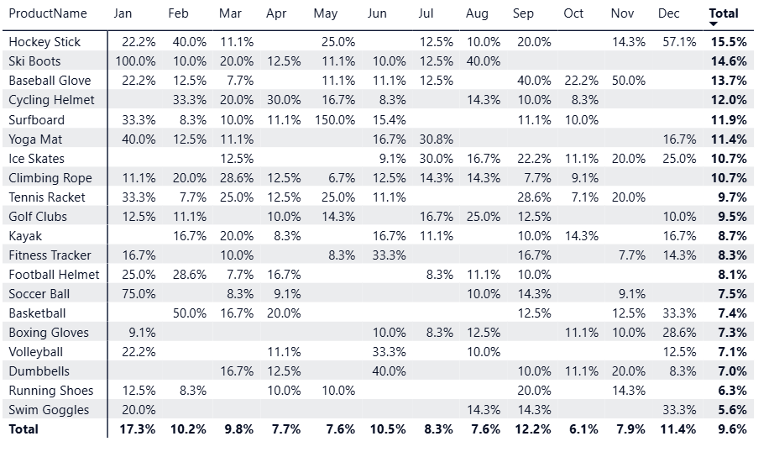
Conversion
Conversion Trend
Conversion rates varied throughout the year, with peaks in January, September, and December
Lowest Conversion
Month: October, 6.1%
Product: Swim Goggles, 5.6%
Highest Conversion
Month: January, 17.3%
Product: Hockey Stick, 15.5%
Areas of Improvement:
Seasonal sales / time-sensitive discounts
Employ scarcity marketing to capture interest
Upgrade payment options to integrate with Shopify, PayPal, Apple Pay, etc. to streamline checkout and increase purchases

Slide 6
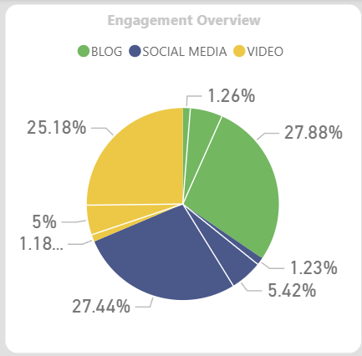
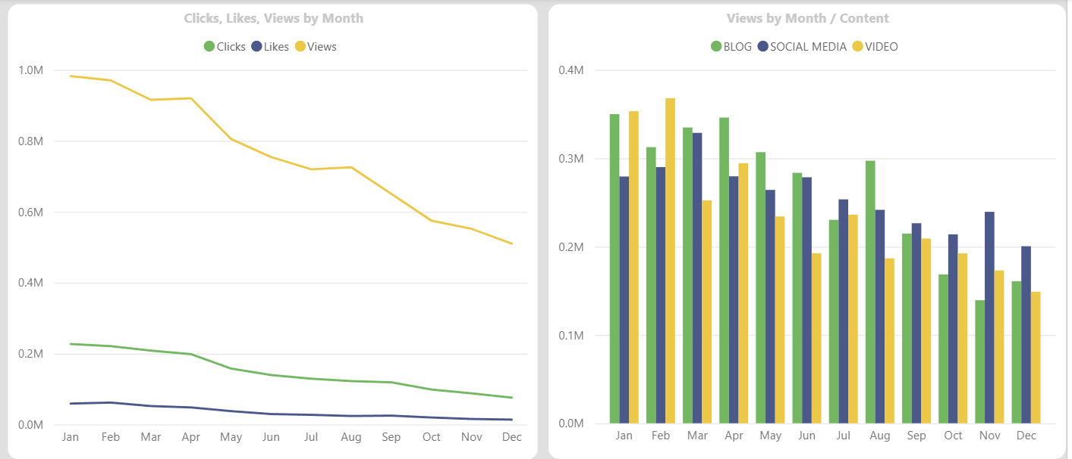
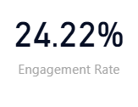
Engagement
Customer Engagement Trend
Large decline in customer engagement each month, particularly views
Content Type
Blogs stood out in first half of the year, however, all content types performed equally over the course of the analysis timeline, with social media showing the most consistency
Areas of Improvement:
Employ seasonal marketing strategies to consistently capture blog and video engagement in second half of the year
Experiment with new content formats: collaborate with influencers, engage with audience, competitor research

Slide 7
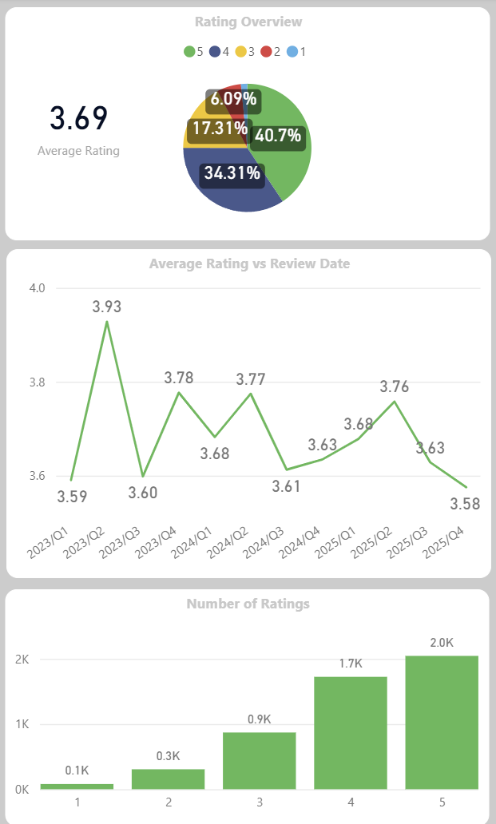
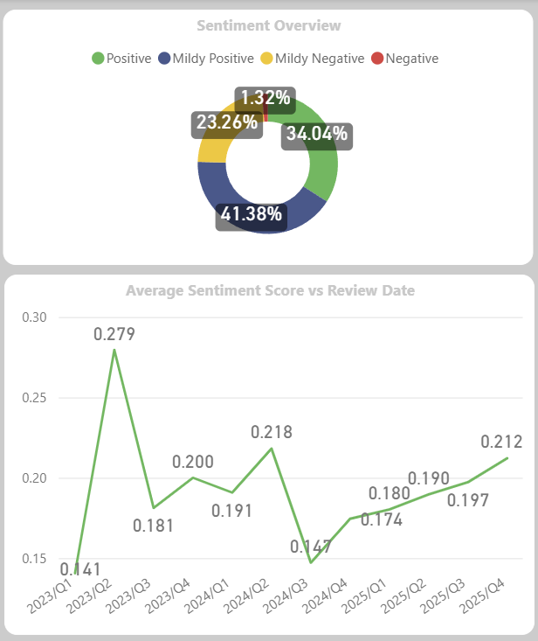
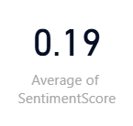
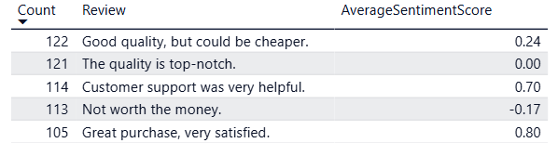
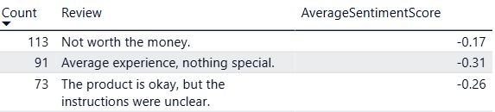
Customer Reviews
Customer Ratings Distribution
Majority of ratings are positive (4 - 5), making up ~75% of total ratings
Neutral ratings (3) made up ~17% and low ratings (1 - 2) consisted of ~8% of total ratings
Sentiment Analysis
Common sentiments overall indicated high quality of products; however, price was consistently a point of contention
Large number of “mildly negative” to “negative” reviews indicate need for clearer instructions
Areas of Improvement
Provide Instructions/Guide page for each product
Emphasize quality of products to justify high price point
Consider discounts for first time customers, time-sensitive sales, and/or free shipping
Overview of Common Reviews
Most Common Mildly Negative to Negative Reviews

Slide 8
Summary
Goal
Increase Conversion Rates
Insight
Conversion rates steadily declining over last 3 years
Conversion rates varied throughout the year, with peaks in January, September, and December
Action
Employ scarcity marketing to capture interest
Upgrade payment options to integrate with Shopify, PayPal, Apple Pay, etc. to streamline checkout and increase purchases
Seasonal sales / time-sensitive discounts
Goal
Increase Customer Engagement
Insight
Large decline in customer engagement each month
Blogs stood out in first half of the year
Social media showed the most consistency over time
Action
Employ seasonal marketing strategies to consistently capture blog and video engagement in second half of the year
Experiment with new content formats: collaborate with influencers, engage with audience, competitor research
Goal
Analyze Customer Feedback
Insight
Majority of ratings are positive
Common sentiments overall indicated high quality of products
Price was consistently a point of contention
Action
Provide Instructions/Guide page for each product
Emphasize quality of products to justify high price point
Consider discounts for first time customers, time-sensitive sales, and/or free shipping
Large number of reviews indicate need for clearer instructions

Slide 9
Thank you
Asia Chavez
GitHub/Asia-Chavez

