Slide 1
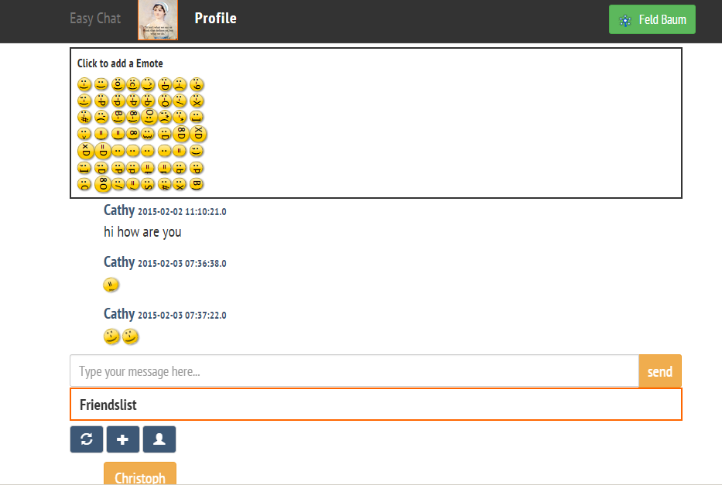
EasyChat Instant Messaging
Marco Dung
Christoph Krämer
Ying Li
06.02.2015
Product Developers: Marco Dung, Christoph Krämer, Ying Li
Software Lab: Unternehmensgründung & Neue Medien
Supervision: Dominik Renzel & Petru Nicolaescu
06.02.2015, RWTH Aachen

Slide 2
Agenda
Product Features
Target User
Advantages
Demo
Further Enhancements

Slide 3
Product Features
Profile Management
update profile
picture link
visibility
Contact Management
add contacts
delete contacts
view contact profiles
Mission
Enabling simple but compact instant messaging
Request Management
send contact requests
receive contact requests
request overview
Message Management
messages to offline users
chat history
funny icons

Slide 4
Target User
End Users
who enjoy simplicity
who appreciate user-friendliness
Developers
who like working with Restful API
who are fans of open source softwares

Slide 5
Advantages
simple but compact
user-friendly interface
code available for study
privacy by registration with OpenID Connect
responsive web design

Slide 6
Demo
Registration with OpenID Connect
Sign in
Add contacts
Delete contacts
Send messages

Slide 7
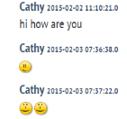


Further Enhancements
Sending messages to groups
Search history with key words
Apps for mobile devices
Different language versions
Integration with other services like ADAC etc.
?
sign in
Anmelden
登录

