Slide 1
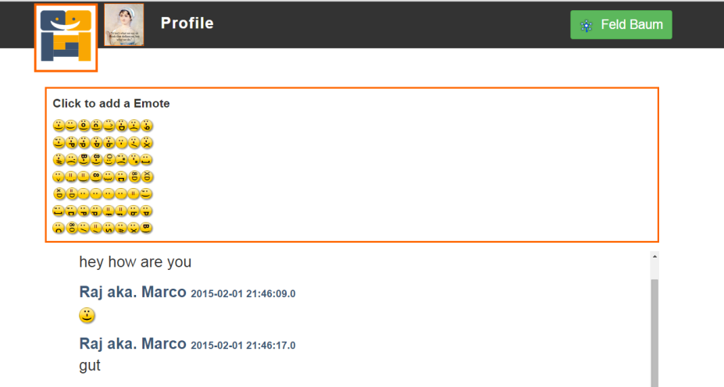
FamcyChat Instant Messaging
Development Team: Marco Dung, Christoph Krämer, Ying Li
06.02.2015, RWTH Aachen University

Slide 2
Product Features
Profile Management
update profile
picture link
visibility
Contact Management
add contacts
delete contacts
view contact profiles
Mission
Enabling simple but compact instant messaging
Request Management
send contact requests
receive contact requests
request overview
Message Management
messages to offline users
chat history
funny icons

Slide 3
Target Groups
End Users
who enjoy simplicity
who appreciate user-friendliness
Developers
who like working with Restful APIs
who are fans of open source software

Slide 4
Advantages
simple but compact
user-friendly interface
code available for reuse
latest industry-standard authentication with OpenID Connect
Responsive Web Design

Slide 5
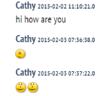

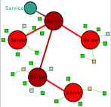
Further Enhancements
Sending messages to groups
Seaching history with key words
Apps for mobile devices
Different language versions
Integration with other services like IRC
?
sign in
Anmelden
登录

Slide 6
Thank you for your attention!

Slide 7
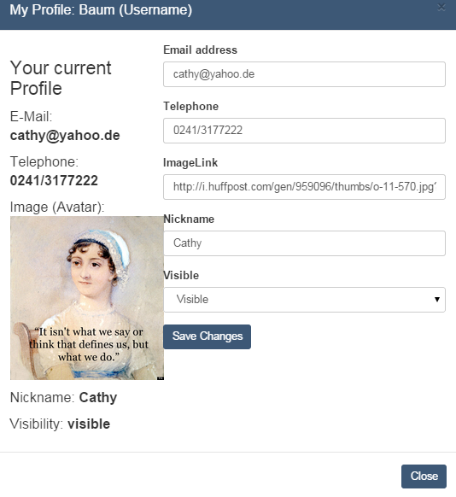
Profile Management
Profile Management
update profile
picture link
visibility

Slide 8

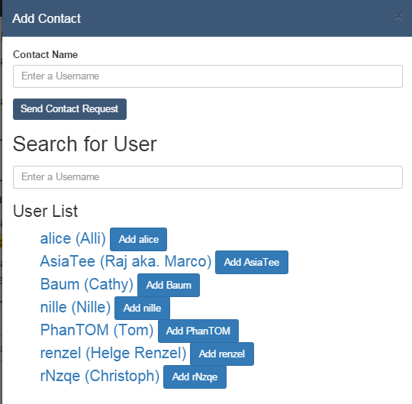

Request Management
Request Management
send contact requests
receive contact requests
request overview

Slide 9
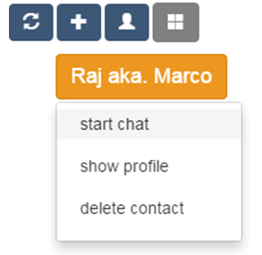
Contact Management
Contact Management
add contacts
delete contacts
view contact profiles

Slide 10
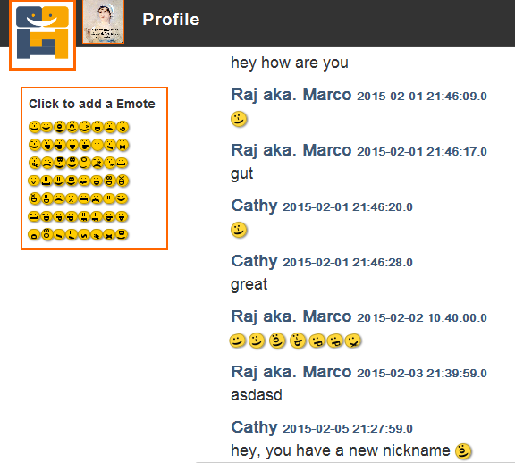
Message Management
Message Management
messages to offline users
chat history
funny icons

