Slide 1
Don't Be Fooled By DEBT
Got DEBT
Project Description/Outline: The project will outline how Americans interact with federal debt and deal with it in the years 2018–2022.
Joyce Ghali
Chelsea Hitzler
Tiffany Welle
Felipe Pinheiro
Tyler Vo

Slide 2
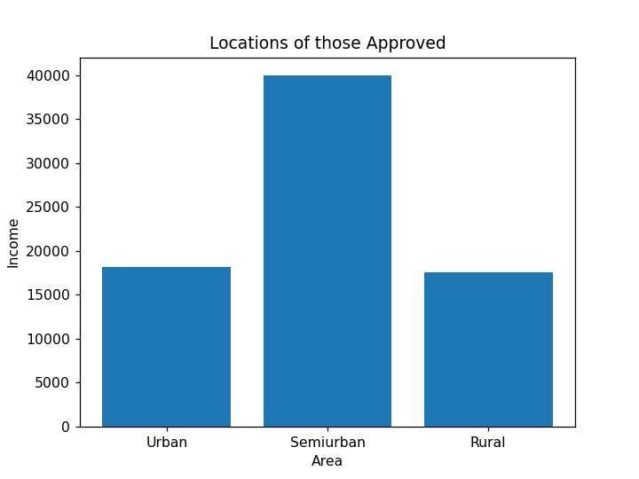
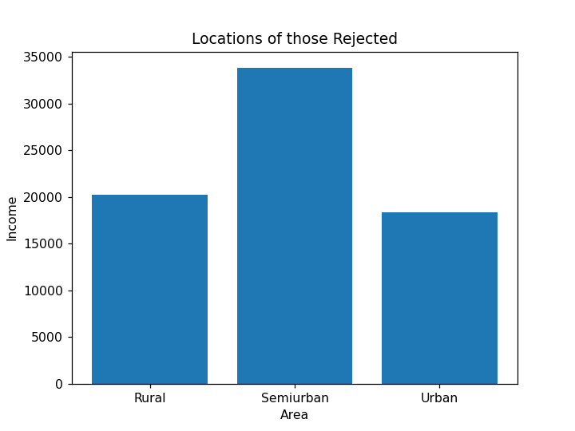
Does the location of the applicant determine approval?
The average incomes for those approved and rejected were taken, and measured against each other

Slide 3
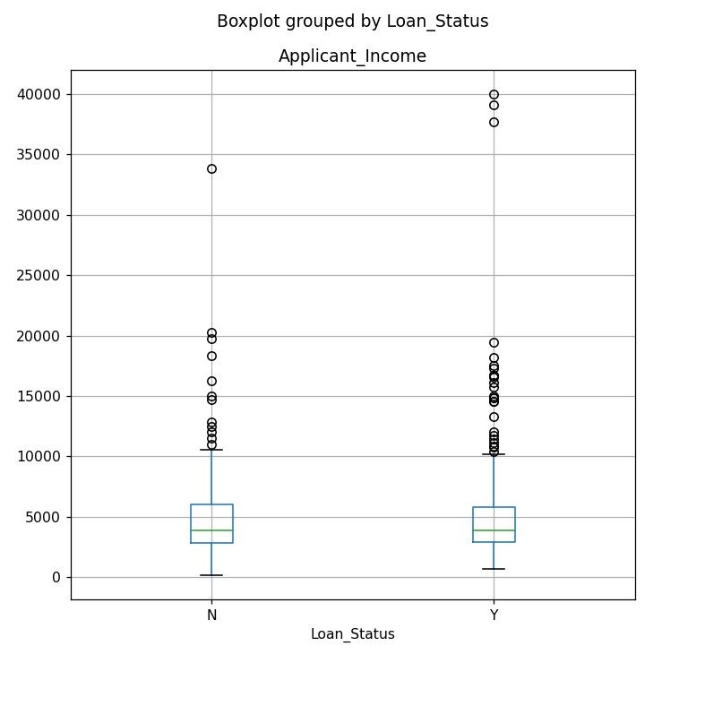
There was no statistical significance found between household demographics and acceptance status
The Americans approved for loans are making an average of $5,201.09 per month
The Americans rejected for loans are making an average of $5,218.15 per month
Result: statistic=0.891, pvalue=0.345

Slide 6
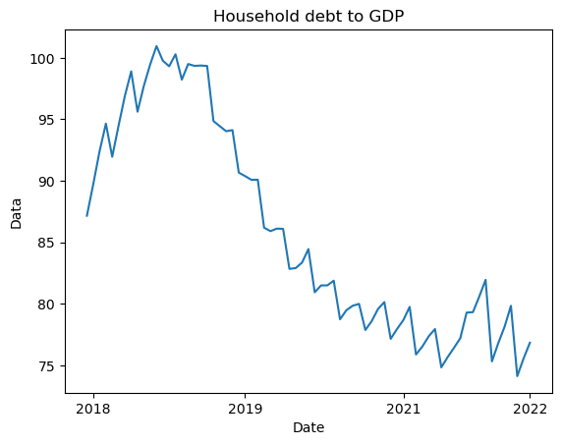
Does household debt affect total federal debt?
21.8% of the public debt, or $6.87 trillion, is owned by another arm of the federal government itself.
Low interest rates have induced Americans to pick up their borrowing to a record level, and fewer are finding themselves with severe credit problems such as bankruptcy, foreclosure or debt collection proceedings.

Slide 7
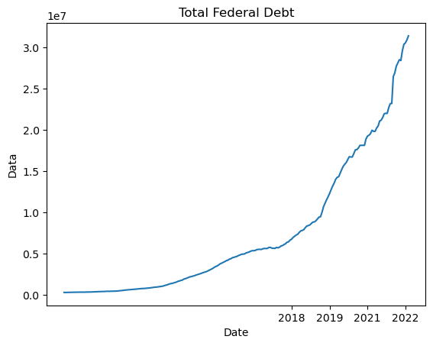
Does household debt affect total federal debt?
Since the government almost always spends more than it takes in taxes and other revenue, the national debt continues to rise.
The Congressional Budget Office expects the U.S. government's debt financing costs to increase dramatically by 2052 as a result of rising interest rates and mounting budget deficits.
For several years, the nation’s debt has been bigger than its gross domestic product, which was 26.13 T in the 4th quarter of 2022

Slide 8
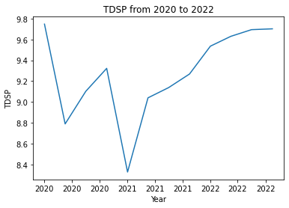
Are Americans consistent in paying their debt?
The graph shows a decreasing trend in the TDSP from 2020 to 2022. TDSP is an important economic indicator that measures the amount of income households are using to pay their debts, including mortgages, credit cards, car loans, and other types of debt
TDSP: Total Debts Service Payments.
We can see that TDSP has been increasing steadily over the years, with a slight dip in 2020 due to the pandemic, but has since increased again in 2021. This indicates that Americans are taking on more debt and using a larger portion of their income to pay off that debt.

Slide 9
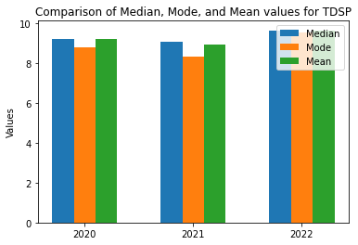
TDSP Values between 2020 and 2022
The median and mean values for 2022 are higher than those of 2020 and 2021, and the mode value for 2022 is the highest among the three years. This could suggest that the data distribution is becoming skewed towards higher values, which may indicate that more households are experiencing higher levels of debt service payments than their disposable personal income.

Slide 10
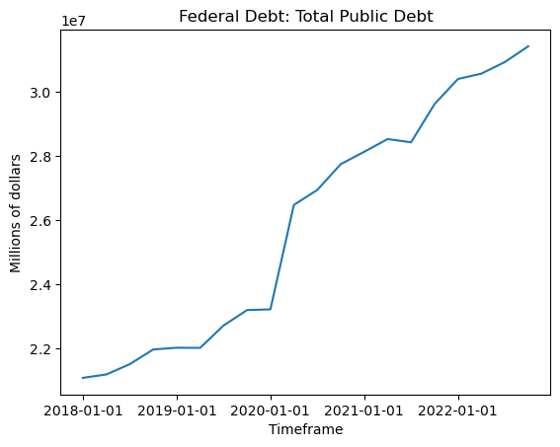
What is the total federal debt? What’s the percentage change from 2020 to 2021?
Does anyone know the total federal debt towards the end of 2022?
Total federal debt
as of December, 1, 2022 is $31,419,689.
The total federal debt has increased at an incredible rate throughout the years of 2018-2022.
There is an abnormal increase during the years of 2020 and 2021 approximately 3 million dollars
Does anyone know why there is an abnormal increase during the periods 2020 and 2021
$22,000,000 is the minimum of the graph*

Slide 11
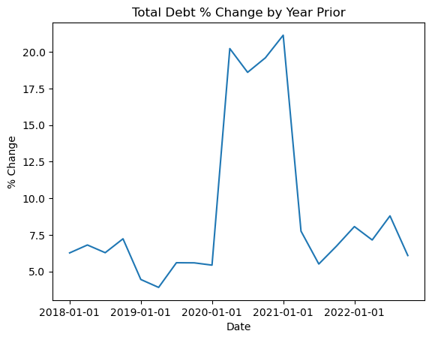
Percentage change from the year from 2020 to 2021
What do you think the percent change from 2020 to 2021 would be?
The percent change for 2020 to 2021 is approximately 15%
Any guess at what the average percent change is?
The average percent change throughout the graph is 9%
As you can see the total federal debt has increased at an alarming rate. But the rate of change is below the average which shows the increase of debt has finally stabilized after the 2020-2021 spike

