Slide 1
UMDIC2022 - Cybersecurity
Ben Nordmann and Jay Siliphet

Slide 2
The Model
Random Forest Classification Model
Accuracy rate of approximately 99.5%
Multiple iterations to narrow feature selection
Trained on iscxIDS2012 data set

Slide 3
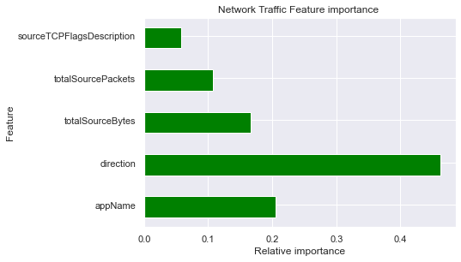
Feature Importance

Slide 4
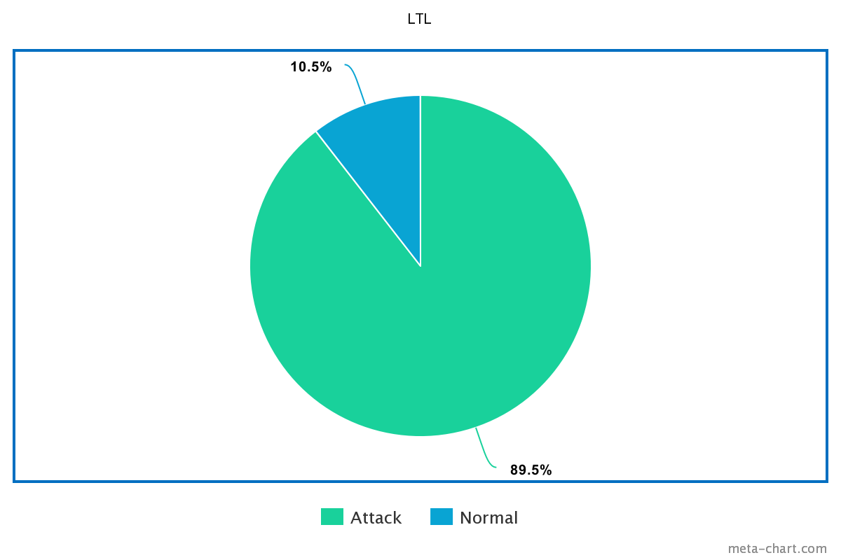
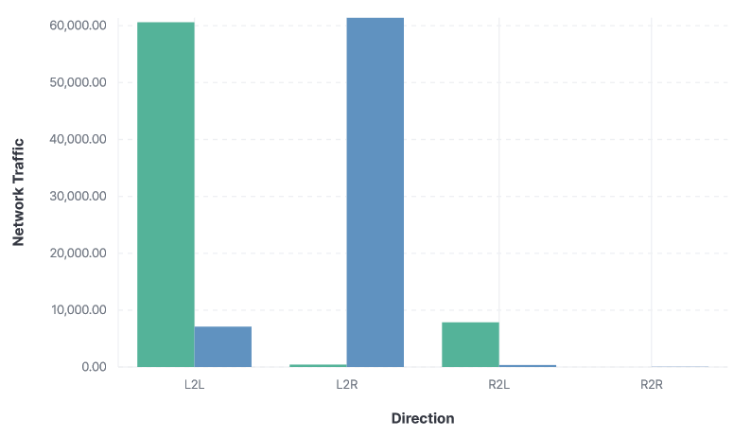
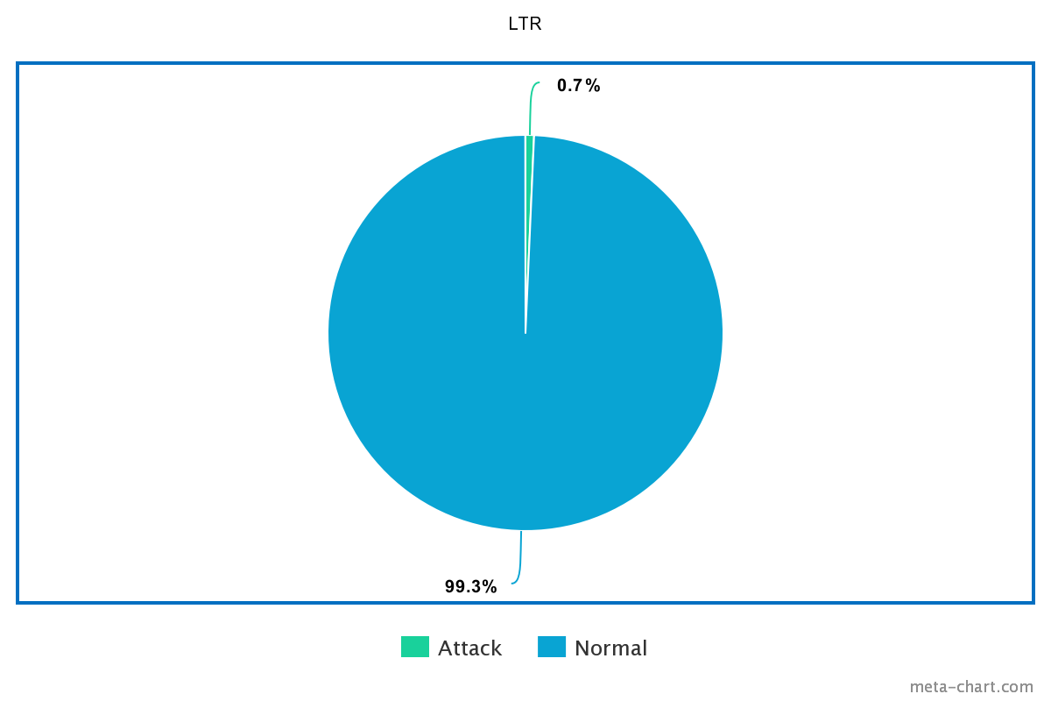
Direction

Slide 5
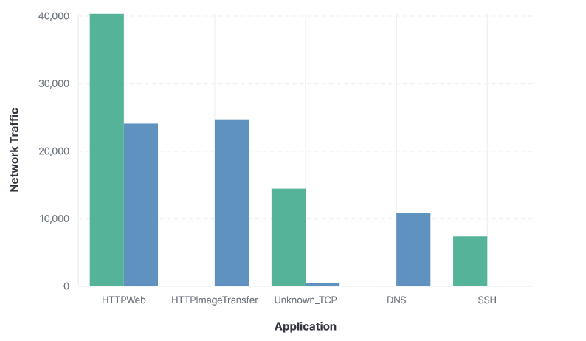
appName

Slide 6
Cyber Kill Chain
Dataset does not appear to show port scans
Weaponization occurs outside the network
The attacker escalates to command and control almost immediately

Slide 7
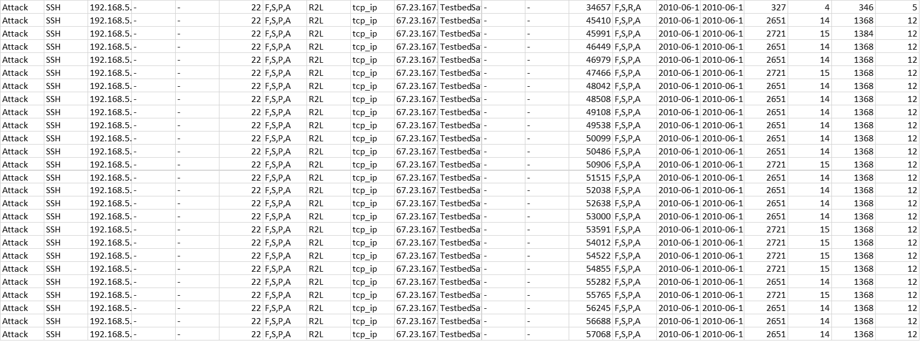
Initial Attack
Notes:
First attack occurs at 2010-06-12T11:34:15
From the initial SSH attack, over 2087 SSH attacks occur. The attacker appears to first gain control after an attack against SMTP. Shortly after the attack appears to begin pivoting to whatever applications they can find before

Slide 8
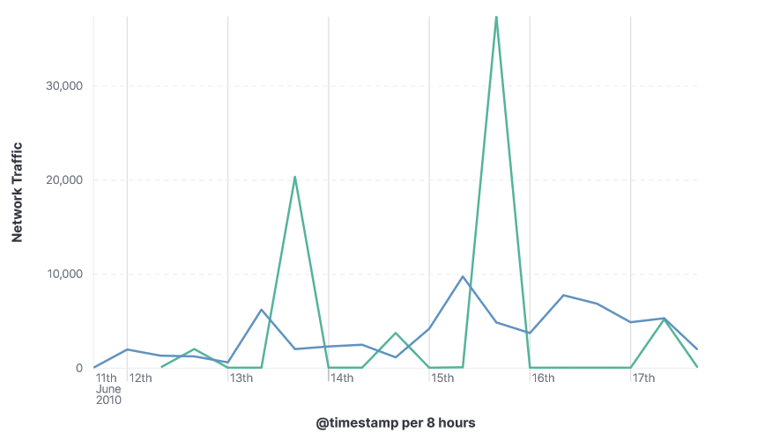
C2 and Actions on Objectives

Slide 9
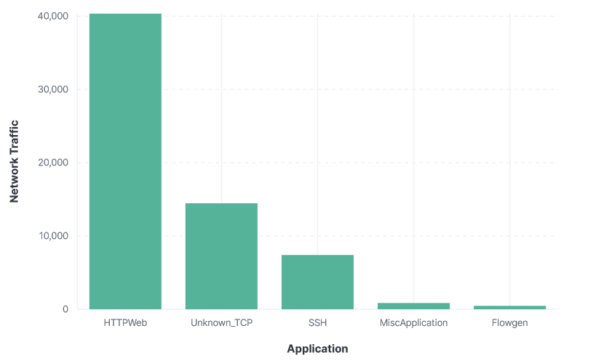
Policy Recommendations

Slide 10
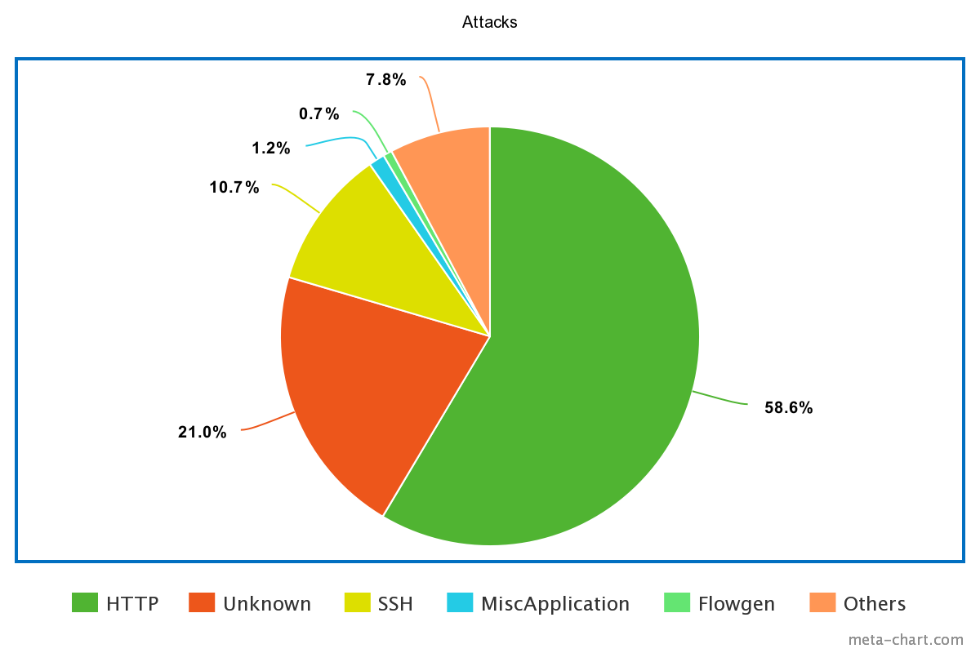
HTTP

Slide 11
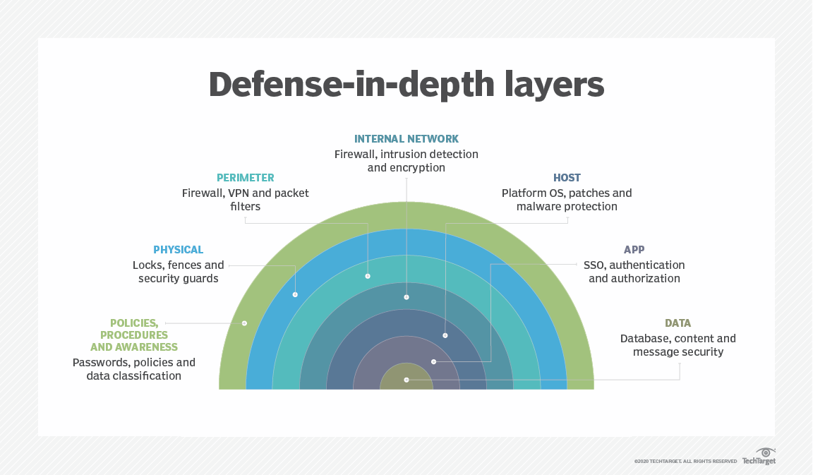
SSH

Slide 12
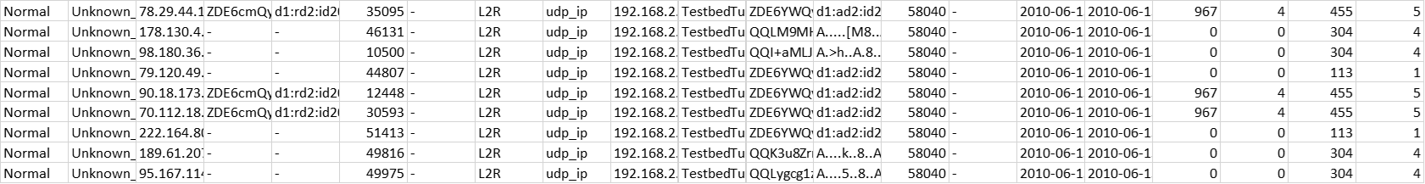
Unknown TCP
Attacks are made against not commonly used ports
All unused ports should be blocked

Slide 13
ICMP
Security professionals often recommend blocking ICMP
ICMP has helpful uses in network troubleshooting
Recommend rate limiting ICMP to prevent abnormal ICMP usage

Slide 14
Telnet
Incredibly vulnerable protocol
Network traffic is sent in clear text
Should always be disabled

