Slide 1
Joanna Wiśniewska
Solar panels - energy production and usage analysis
tutor: Krzysztof Ziółkowski

Slide 2
Project’s goal is to show:
production and export during year (daily)
usage total (sum of usage own and import) during year (daily)
mean production vs. mean usage total (monthly)
mean for each factor (monthly)
maintenance usage level
occupied and free days
usage total with free days on zero level
yearly figures (sum of values)
level of indicator of usage own
if production covers energy usage

Slide 3
Terms used in project
Production – how many energy solar panels produced
Export – how many energy was send to power plant
Import – how many energy was taken from power plant
Usage total – consumption of energy
Usage own - consumption of energy from solar panels directly
Indicator u o – what is the percetage of usage own to usage total
Maintenance usage level – consumption of energy by house’s devices
Occupied and free days – days when people live and when they are absent
kWh – kilowatt hour
Comment:
- Solar panels’ data are taken from private household from year 2022.
- There is a mixed heating system used there - electricity and wood.

Slide 4
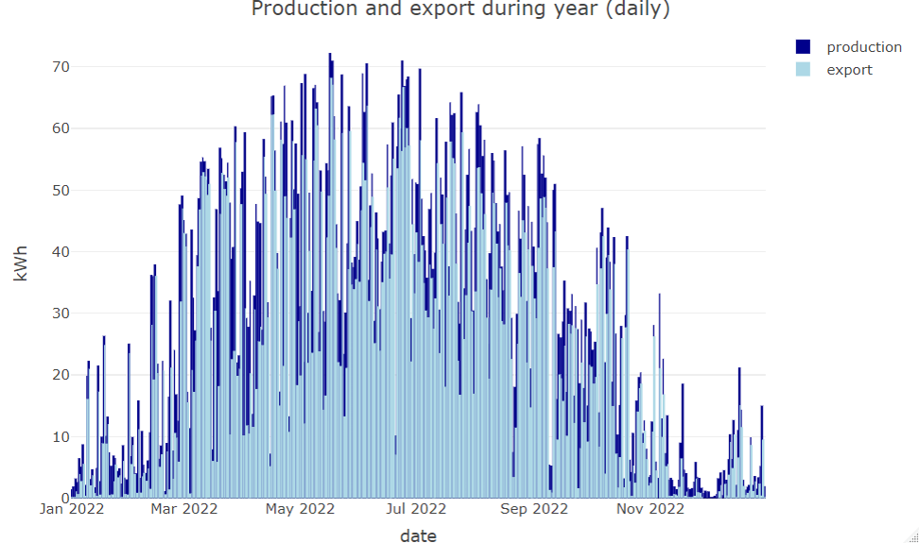
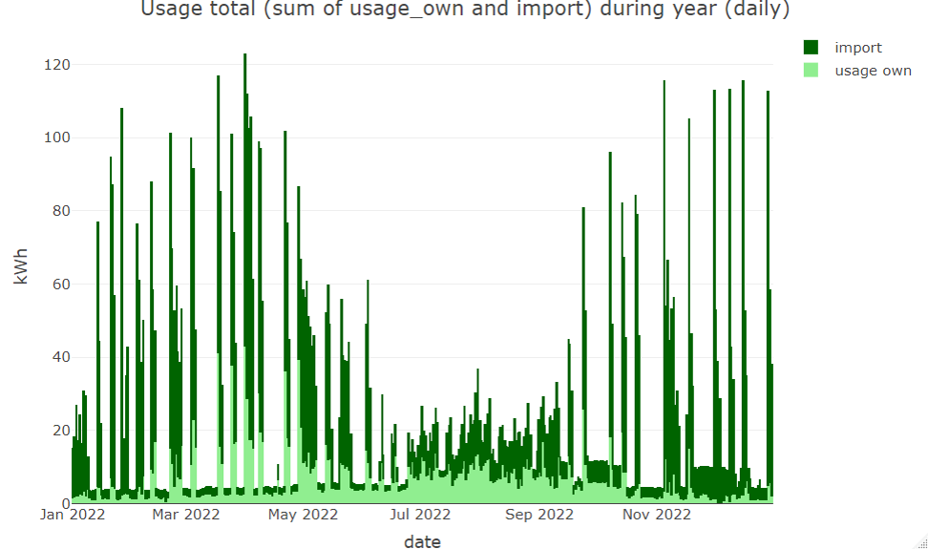
Graphs presenting yearly data
Conclusion:
Most of produced energy is exported to power station
Conclusion:
Most of energy is imported from power station
Usage without high peaks is from 5th of June till 15th of September (non-heating season)

Slide 5
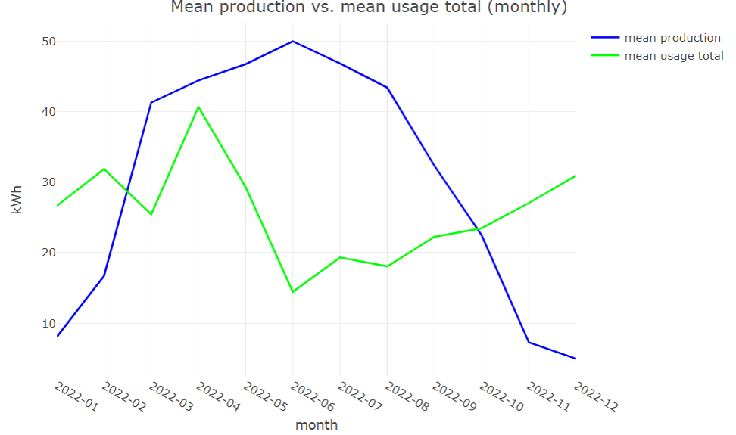
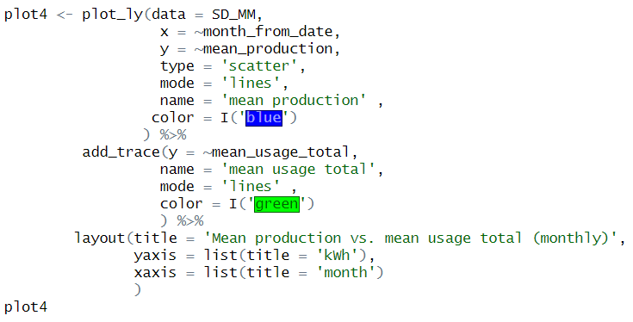
Part of code + graph
mean production
mean usage
Highest*:
Highest:
June, July
Lowest:
November, December
February, December
Lowest:
June, August
* April shouldn’t be taken as highest due to wood shortage at that time.

Slide 6
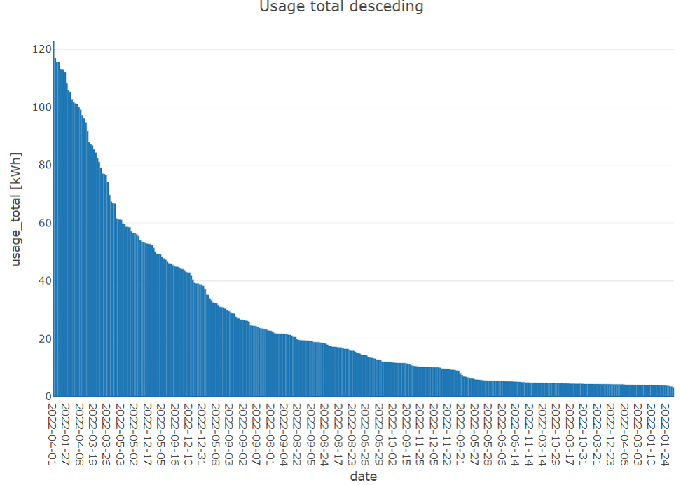
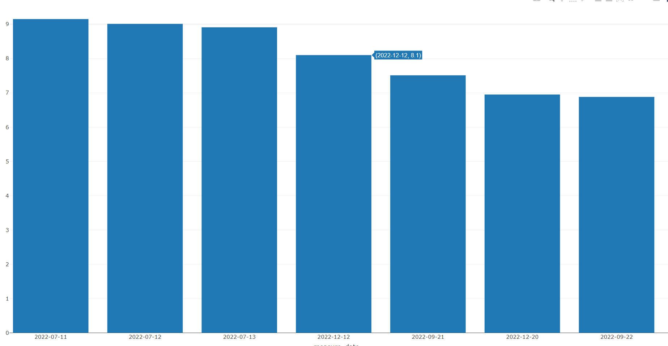
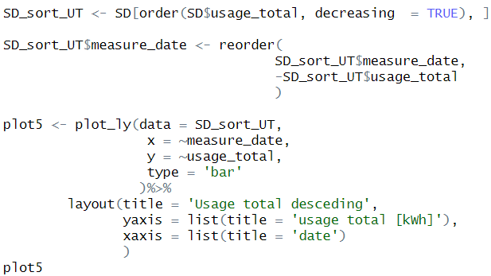
Part of code + graph
non-heating season
heating season
Conclusion:
Maintenance usage level is estimated on 8.2 kWh per day as this number is between dates of heating and non-heating season

Slide 7
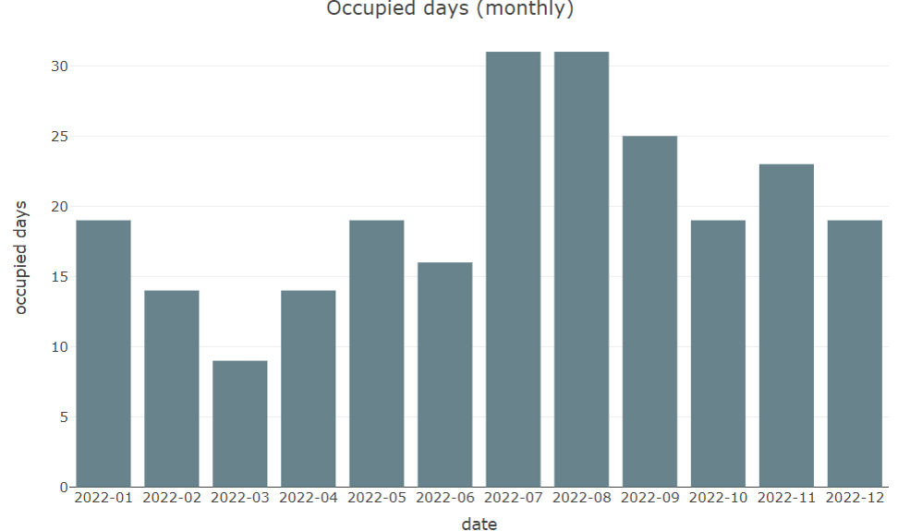
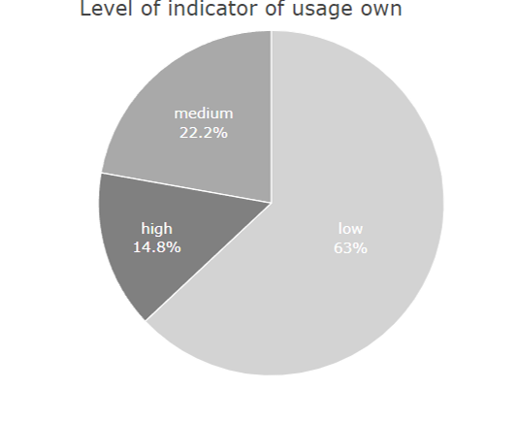
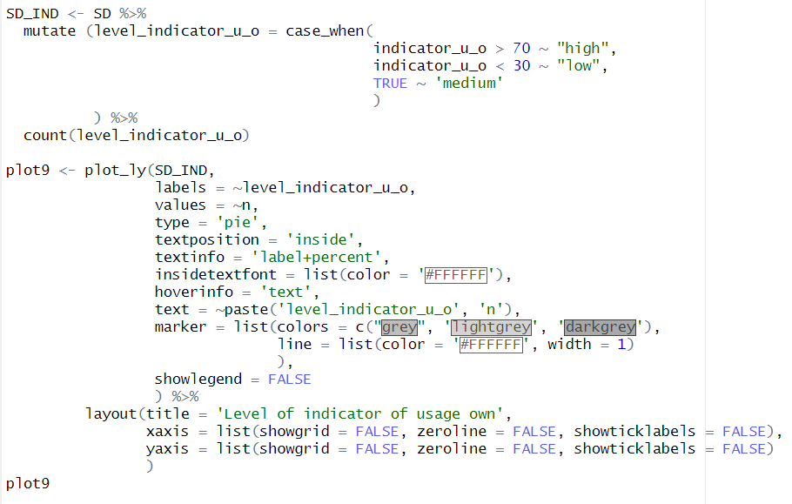
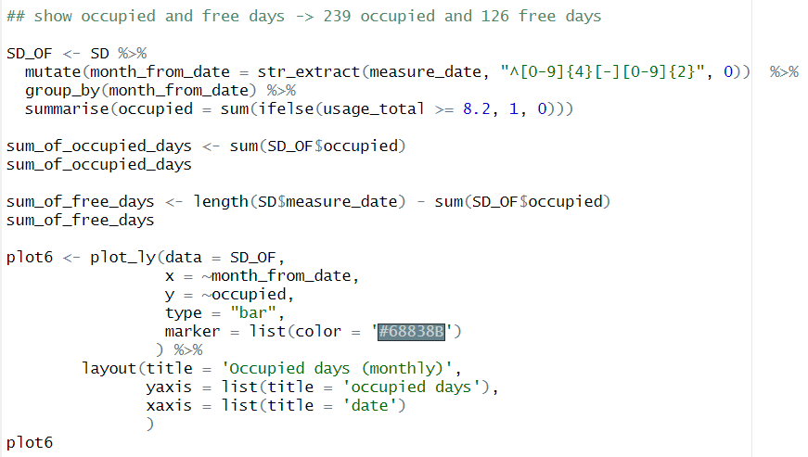
Part of code + graph

Slide 8
Summary
Solar panels
Produced energy covers usage
House is heated on 70% of a year
House maintanance takes less than 8.2 kWh per day
People spend there 60% of a year
Indicator of own use is mostly (60%) on low level

