Slide 1
Machine Learning
Asieh Daneshi 2024

Slide 2
Reminder what is the purpose of machine learning?
Finding the patterns and predicting what happens for the new data

Slide 3

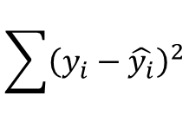

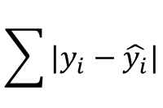


y
y= mx+a
$$residual={|y}_{1}−\hat{{ y}_{1}}|$$
$$y_{1}$$
$$\sum{|y_{i}−\hat{y_{i}}|}$$
$$\hat{y_{1}}$$
or
$$\sum{{\left(y_{i}−\hat{y_{i}}\right)}^{2}}$$
x
$$x_{1}$$
Linear regression :
y= mx+a

Slide 4

What if we have multiple features?
Multiple linear regression :
$$y=a+m_{1}x_{1}+m_{2}x_{2}+…$$
For what kind of data we can use linear regression?
y
y
Linearity
x
x

Slide 5

Independency
$y_{i}=m{(x}_{i}−x_{i−1})$+b
Normality

Slide 6
Homoskedasticity

Slide 7
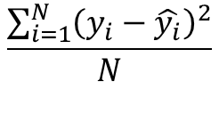
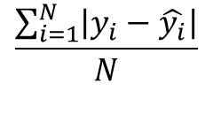
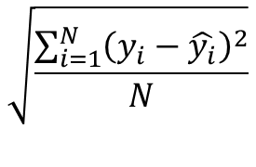
How to evaluate our model?
With “mean absolute error (MAE )”
$$\frac{\sum_{i=1}^{N}{\left|y_{i}−\hat{y_{i}}\right|}}{N}$$
Or better with “mean squared error (MSE )”
$$\frac{\sum_{i=1}^{N}{{\left(y_{i}−\hat{y_{i}}\right)}^{2}}}{N}$$
$$\sqrt{\frac{\sum_{i=1}^{N}{{\left(y_{i}−\hat{y_{i}}\right)}^{2}}}{N}}$$
Even better with “root mean squared error (RMSE )”

Slide 8
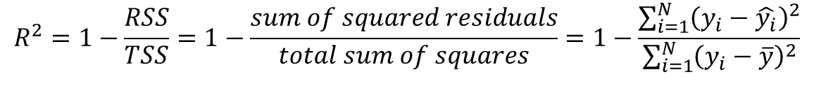
$R^{2}:$ Coefficient of determination
$$R^{2}=1−\frac{RSS}{TSS}=1−\frac{sum of squared residuals}{total sum of squares}=1−\frac{\sum_{i=1}^{N}{{\left(y_{i}−\hat{y_{i}}\right)}^{2}}}{\sum_{i=1}^{N}{{\left(y_{i}−\overline{y}\right)}^{2}}}$$

