Slide 1
Machine Learning
Asieh Daneshi 2024

Slide 2

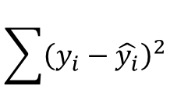

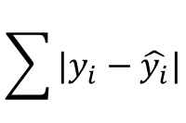


y
y= mx+a
$$residual={|y}_{1}−\hat{{ y}_{1}}|$$
$$y_{1}$$
$$\sum{|y_{i}−\hat{y_{i}}|}$$
$$\hat{y_{1}}$$
or
$$\sum{{\left(y_{i}−\hat{y_{i}}\right)}^{2}}$$
x
$$x_{1}$$
Linear regression :
y= mx+a

Slide 3

What if we have multiple features?
Multiple linear regression :
$$y=a+m_{1}x_{1}+m_{2}x_{2}+…$$

