Slide 1
Machine Learning
Asieh Daneshi 2024

Slide 2

Input layer Hidden layers Output layer
x0
w0
x1
w1
.
.
.
.
.
.
Neuron
Output
Activation function
xn
wn
bias

Slide 3
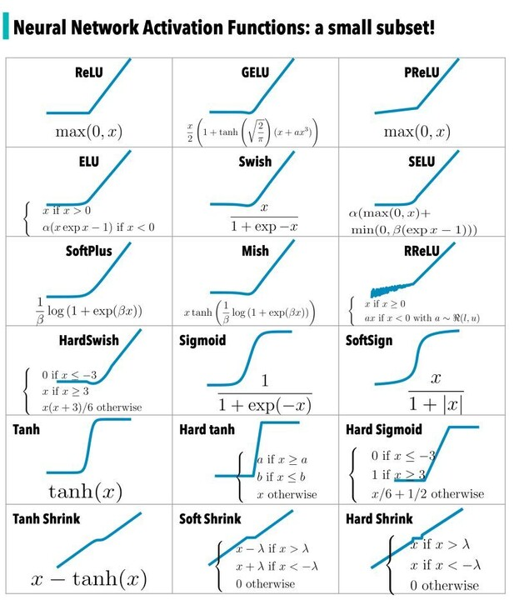
What is activation function?
https://www.linkedin.com/pulse/activation-functions-heba-al-haddad/

Slide 4

Reminder
Model
. . .
Loss

Slide 5

Reminder
$$L_{2} Loss=sum \left({\left(Y_{predicted}−Y_{real}\right)}^{2}\right)$$
We want to go this direction, because we want to decrease our loss
Gradient Descent

Slide 6

Backpropagation
$$w_{0,new}=w_{0,old}+α^{∗}$$
Learning rate
It adjusts how quickly our algorithm converges
As we get closer to the minima, the slope of this quadratic plot decreases. Therefore, weight (w) must update.
When we adjust all the weights, then we can calculate the loss, and if the loss is more than what we were expecting, we adjust our model to solve the issue! (remember, we are still in the training phase)
W0
W1
Wn

Slide 7
So far we scikitlearn solved all our machine-learning problems!
Thanks scikit! :D
For NN we need other libraries. One of them is Tensorflow!
First, we build our model, consisting of input layer, hidden layer(s), and output layer!
It means that we have a sequence of layers
(multi-layer NN)
Number of neurons!
nn_model=tf.keras.Sequential([
tf.keras.layers.Dense(num_nodes, activation='relu',input_shape=(10,)),
tf.keras.layers.Dropout(dropout_prob),
])
Activation function
Number of inputs
Randomly drops some nodes (neurons) and doesn’t consider them in training phase!

Slide 8
Example:
nn_model=tf.keras.Sequential([
tf.keras.layers.Dense(num_nodes, activation='relu',input_shape=(10,)),
tf.keras.layers.Dense(num_nodes, activation='relu',input_shape=(10,)),
tf.keras.layers.Dense(1, activation='sigmoid’)
])
nn_model=tf.keras.Sequential([
tf.keras.layers.Dense(16, activation='relu',input_shape=(10,)),
tf.keras.layers.Dense(16, activation='relu'),
tf.keras.layers.Dense(1, activation='sigmoid’)
])
Remember that we had 10 features
After building the structure of our network, we need to compile it! Attention: compiling is not training!
nn_model.compile(optimizer=tf.keras.optimizers.Adam(lr), loss='binary_crossentropy',metrics=['accuracy'])
There are different optimizers, loss functions, and metrics. Just google them and try them!

Slide 9
You can use the following piece of code to plot the loss when your network is evolving and watch it dynamically
def plot_loss(history):
plt.plot(history.history['loss'], label='loss')
plt.plot(history.history['val_loss'], label='val_loss')
plt.xlabel('Epoch')
plt.ylabel('Binary crossentropy')
plt.legend()
plt.grid(True)
plt.show()
The same goes for accuracy
def plot_accuracy(history):
plt.plot(history.history['accuracy'], label='accuracy')
plt.plot(history.history['val_accuracy'], label='val_accuracy')
plt.xlabel('Epoch')
plt.ylabel('Accuracy')
plt.legend()
plt.grid(True)
plt.show()

Slide 10

Let’s train our model:
history=nn_model.fit(
Xtrain, Ytrain, epochs=100, batch_size=32, validation_split=0.2, verbose=0
)
You remember that we had a training set, a validation set, and a test set. In NN, we just mix the training set with the validation set and let the model split it by itself. In other words, we just have a training set and a test set. But, with “validation_split” we tell our model to use a part of training set for validation. Here “0.2” means that 20 percent of the training set is used for validation.
We don’t feed the whole dataset to our model at once, but rather we feed it in batches!
Epochs are number of repetitions, and verbose=0 means that we don’t want to see the whole process, but rather just the final output!

