Slide 1
Machine Learning
Asieh Daneshi 2024

Slide 2

Input layer Hidden layers Output layer
x0
w0
x1
w1
.
.
.
.
.
.
Neuron
Output
Activation function
xn
wn
bias

Slide 3
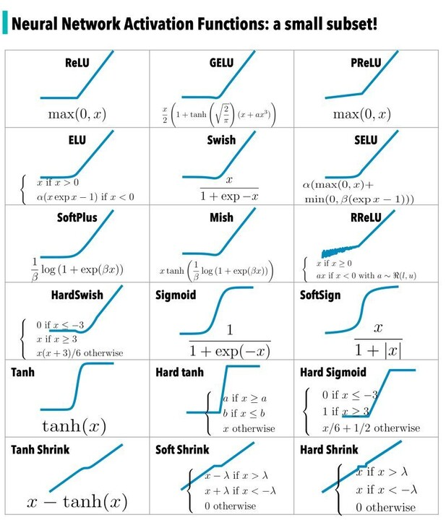
What is activation function?
https://www.linkedin.com/pulse/activation-functions-heba-al-haddad/

Slide 4

Reminder
Model
. . .
Loss

Slide 5

Reminder
$$L_{2} Loss=sum \left({\left(Y_{predicted}−Y_{real}\right)}^{2}\right)$$
We want to go this direction, because we want to decrease our loss
Gradient Descent

Slide 6

Backpropagation
$$w_{0,new}=w_{0,old}+α^{∗}$$
Learning rate
It adjusts how quickly our algorithm converges
As we get closer to the minima, the slope of this quadratic plot decreases. Therefore, weight (w) must update.
When we adjust all the weights, then we can calculate the loss, and if the loss is more than what we were expecting, we adjust our model to solve the issue! (remember, we are still in the training phase)
W0
W1
Wn

Slide 7
So far we scikitlearn solved all our machine-learning problems!
Thanks scikit! :D
For NN we need other libraries. One of them is Tensorflow!

