Slide 1
Machine Learning
Asieh Daneshi 2024

Slide 2

Naïve Bayes
 | Diagnosed with depression | Diagnosed healthy
Depressed | 6 | 4
Healthy | 2 | 88
=10 depressed
=90 healthy
$$p\left(depressed | diagnosed with depression\right)=\frac{6}{6+2}=0.75$$
Bayes Rule:
$$p\left(A | B\right)=\frac{p\left(B | A\right).p\left(A\right)}{p\left(B\right)}$$
likelihood
prior
posterior
evidence
Notes:
Artificial intelligence enables computers and machines to do human-like tasks without human intervention.
Machine learning is dedicated to a specific problem.
Data science has overlaps with both AI , and ML, but I can say its major difference with AI is that it needs human interverntion.

Slide 3
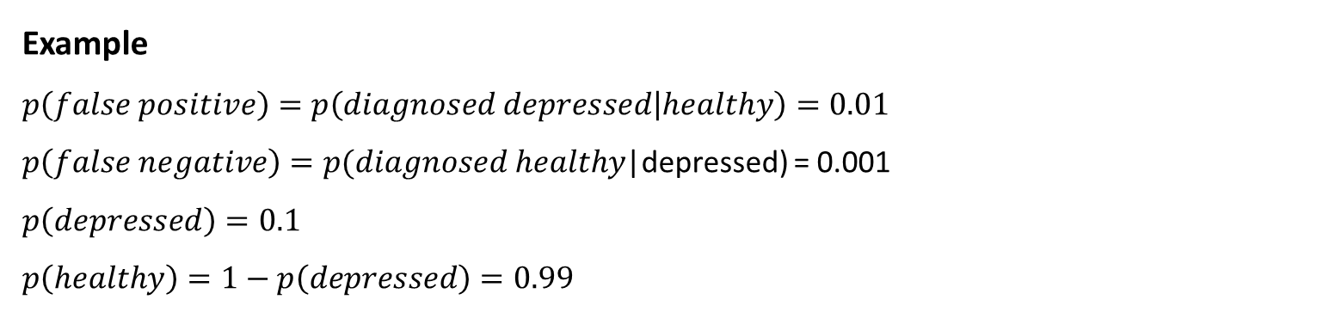
Example
$$p\left(false positive\right)=p\left(diagnosed depressed | healthy\right)=0.01$$
$p\left(false negative\right)=p(diagnosed healthy$|depressed) = 0.001
$$p\left(depressed\right)=0.1$$
$$p\left(healthy\right)=1−p\left(depressed\right)=0.99$$
 | Diagnosed with depression | Diagnosed healthy
Depressed | ? | 0.001
Healthy | 0.01 | ?
Sum of each row must be 1
 | Diagnosed with depression | Diagnosed healthy
Depressed | 1-0.001=0.999 | 0.001
Healthy | 0.01 | 1-0.01=0.99

Slide 4
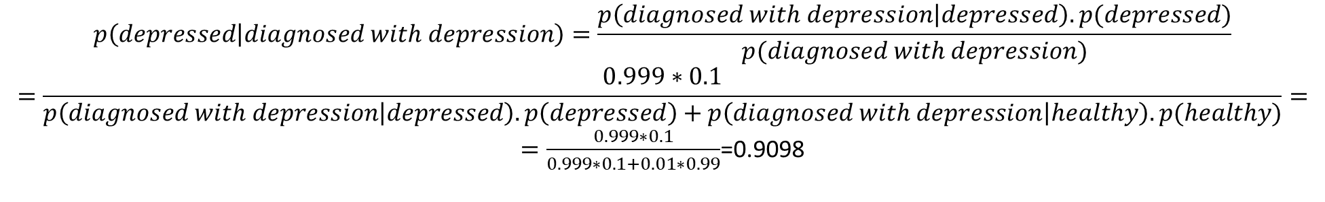
If diagnosed with depression, what is the probability of being really depressed?
$$p\left(depressed | diagnosed with depression\right)=\frac{p\left(diagnosed with depression | depressed\right).p(depressed)}{p(diagnosed with depression)}$$
$$=\frac{0.999∗0.1}{p\left(diagnosed with depression | depressed\right).p\left(depressed\right)+p\left(diagnosed with depression | healthy\right).p(healthy)}=$$
$=\frac{0.999∗0.1}{0.999∗0.1+0.01∗0.99}$=0.9098

Slide 5
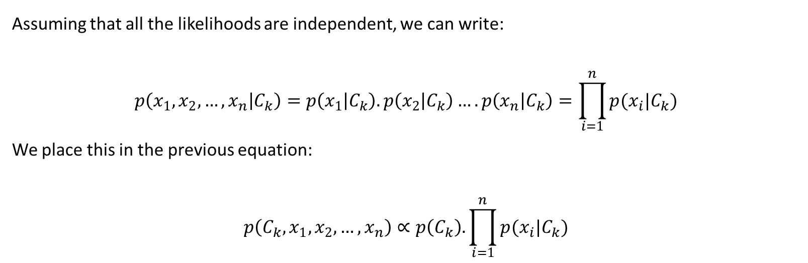
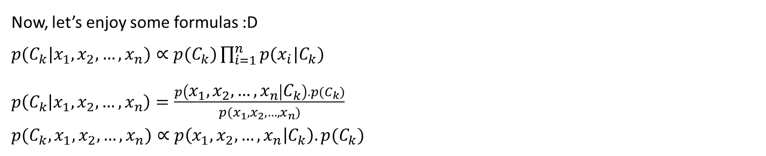
Now, let’s enjoy some formulas :D
$p(C_{k}|x_{1},x_{2},…,x_{n})∝p(C_{k})\prod_{i=1}^{n}{p(x_{i}|C_{k})}$
$p\left(C_{k} | x_{1},x_{2},…,x_{n}\right)=\frac{p\left(x_{1},x_{2},…,x_{n} | C_{k}\right).p(C_{k})}{p(x_{1},x_{2},…,x_{n})}$
$p(C_{k},x_{1},x_{2},…,x_{n})∝p\left(x_{1},x_{2},…,x_{n} | C_{k}\right).p(C_{k})$
Assuming that all the likelihoods are independent, we can write:
$$p\left(x_{1},x_{2},…,x_{n} | C_{k}\right)=p\left(x_{1} | C_{k}\right).p\left(x_{2} | C_{k}\right)….p\left(x_{n} | C_{k}\right)=\prod_{i=1}^{n}{p(x_{i}|C_{k})}$$
We place this in the previous equation:
$$p\left(C_{k},x_{1},x_{2},…,x_{n}\right)∝p\left(C_{k}\right).\prod_{i=1}^{n}{p(x_{i}|C_{k})}$$

Slide 6
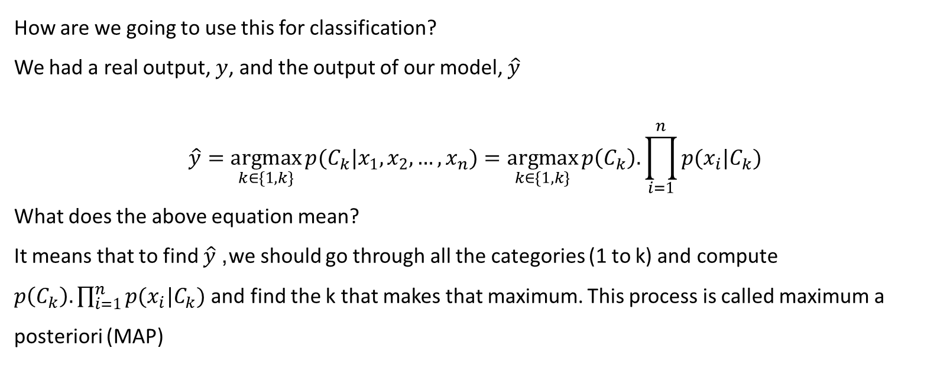
How are we going to use this for classification?
We had a real output, $y$, and the output of our model, $\hat{y}$
$$\hat{y}=\underset{k∈\{1,k\}}{argmax}{p(C_{k}|x_{1},x_{2}, …, x_{n})}=\underset{k∈\{1,k\}}{argmax}{p\left(C_{k}\right).\prod_{i=1}^{n}{p(x_{i}|C_{k})} }$$
What does the above equation mean?
It means that to find $\hat{y}$, we should go through all the categories (1 to k) and compute $p\left(C_{k}\right).\prod_{i=1}^{n}{p(x_{i}|C_{k})}$ and find the k that makes that maximum. This process is called maximum a posteriori (MAP)

Slide 7

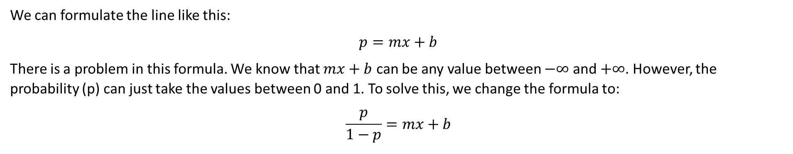


Logistic regression
Imagine that we have one feature (x), and y represents the labels, which are two categories.
$$y$$
+ + + + +
$$\hat{y}=mx+b$$
+ + + +
$$x$$
We can formulate the line like this:
$$p=mx+b$$
There is a problem in this formula. We know that $mx+b$ can be any value between $−∞$ and $+∞$. However, the probability (p) can just take the values between 0 and 1. To solve this, we change the formula to:
$$\frac{p}{1−p}=mx+b$$
Notes:
Artificial intelligence enables computers and machines to do human-like tasks without human intervention.
Machine learning is dedicated to a specific problem.
Data science has overlaps with both AI , and ML, but I can say its major difference with AI is that it needs human interverntion.

Slide 8
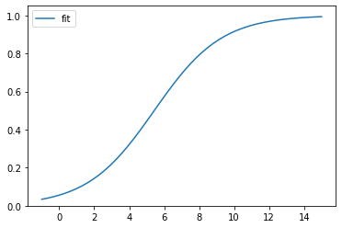
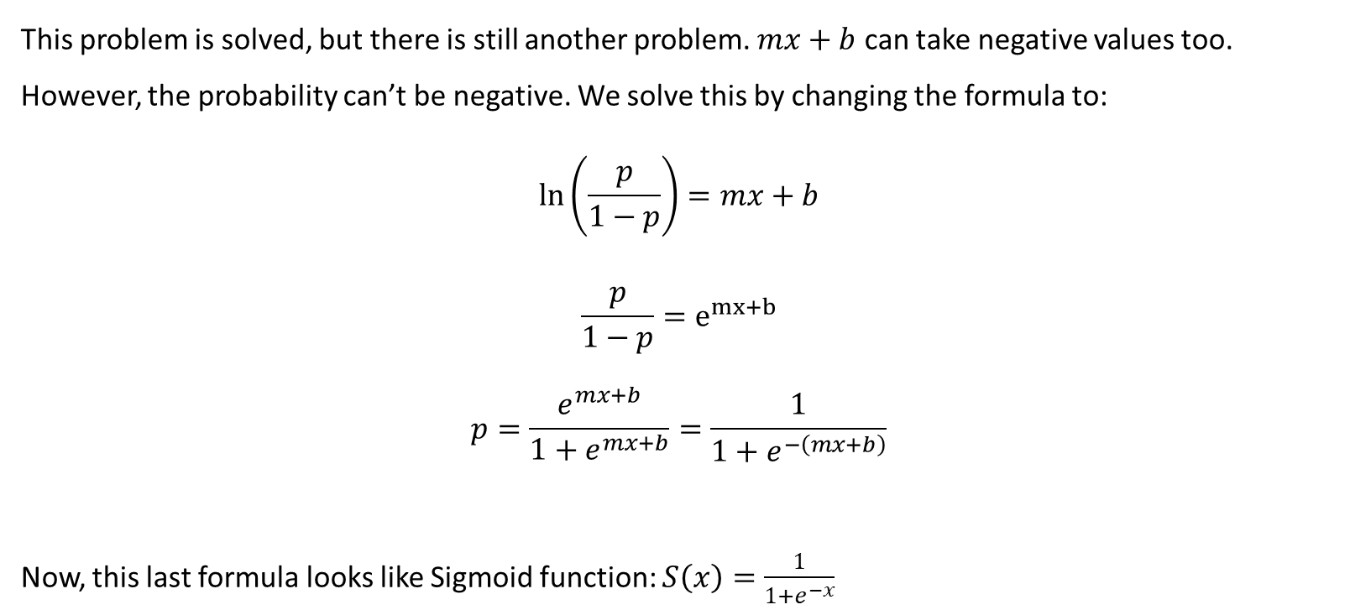
This problem is solved, but there is still another problem. $mx+b$ can take negative values too. However, the probability can’t be negative. We solve this by changing the formula to:
$$\ln\left(\frac{p}{1−p}\right)=mx+b$$
$$\frac{p}{1−p}=e^{mx+b}$$
$$p=\frac{e^{mx+b}}{1+e^{mx+b}}=\frac{1}{1+e^{−\left(mx+b\right)}}$$
Now, this last formula looks like Sigmoid function: $S\left(x\right)=\frac{1}{1+e^{−x}}$

Slide 9
If we only have one feature (x) in our classification, we call it “logistic regression”, otherwise, when we have several features, we call it multiple regression.

