Slide 1
Study of the Transcriptome of Wheat Varieties with Differing Protein Content

Slide 2
PCA
PCA PLOT OF THE 108 SAMPLES

Slide 3
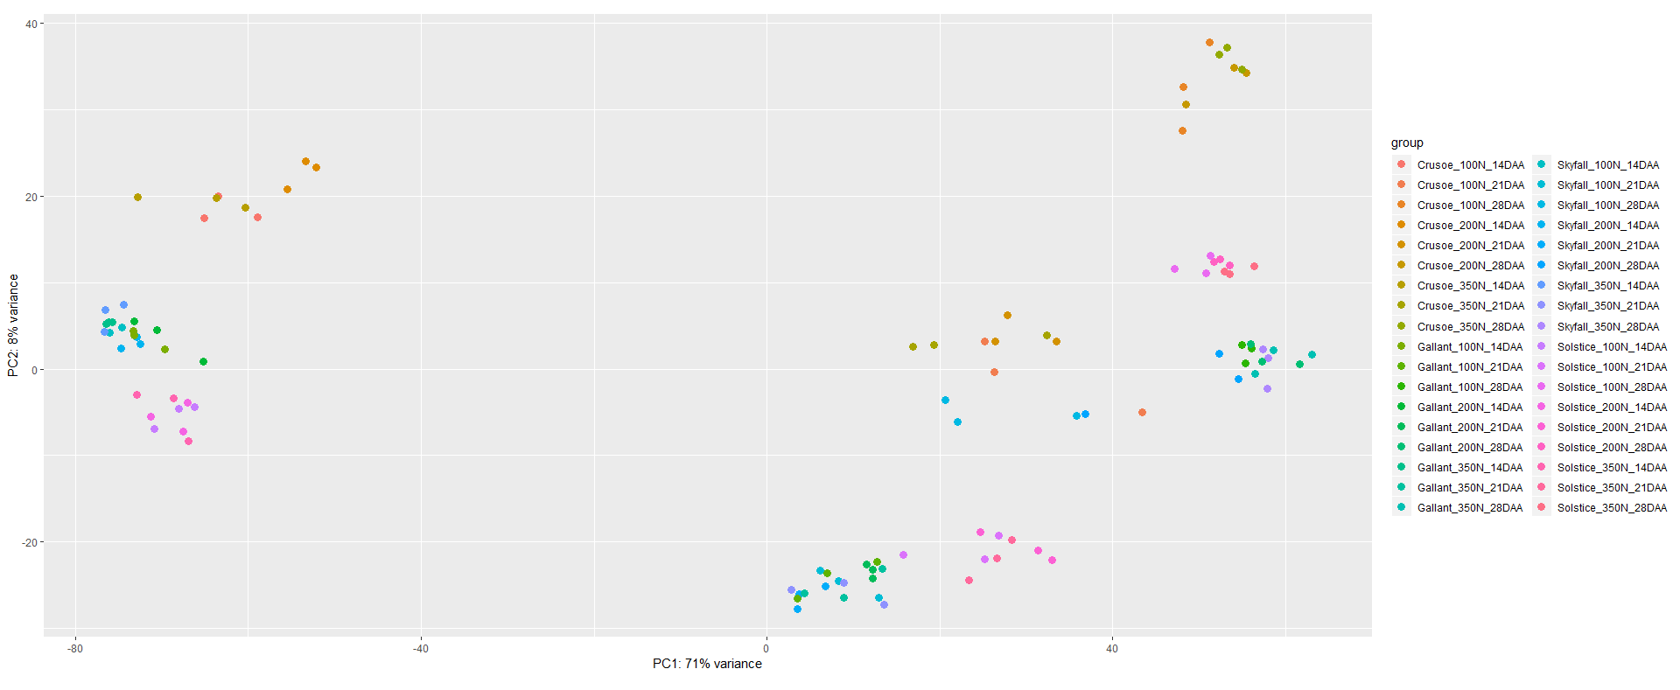
PCA coloured based on group (combination of variety, N level and stage/time)
Main separation due to stage/time, secondary separation due to variety and then due to N level.

Slide 4
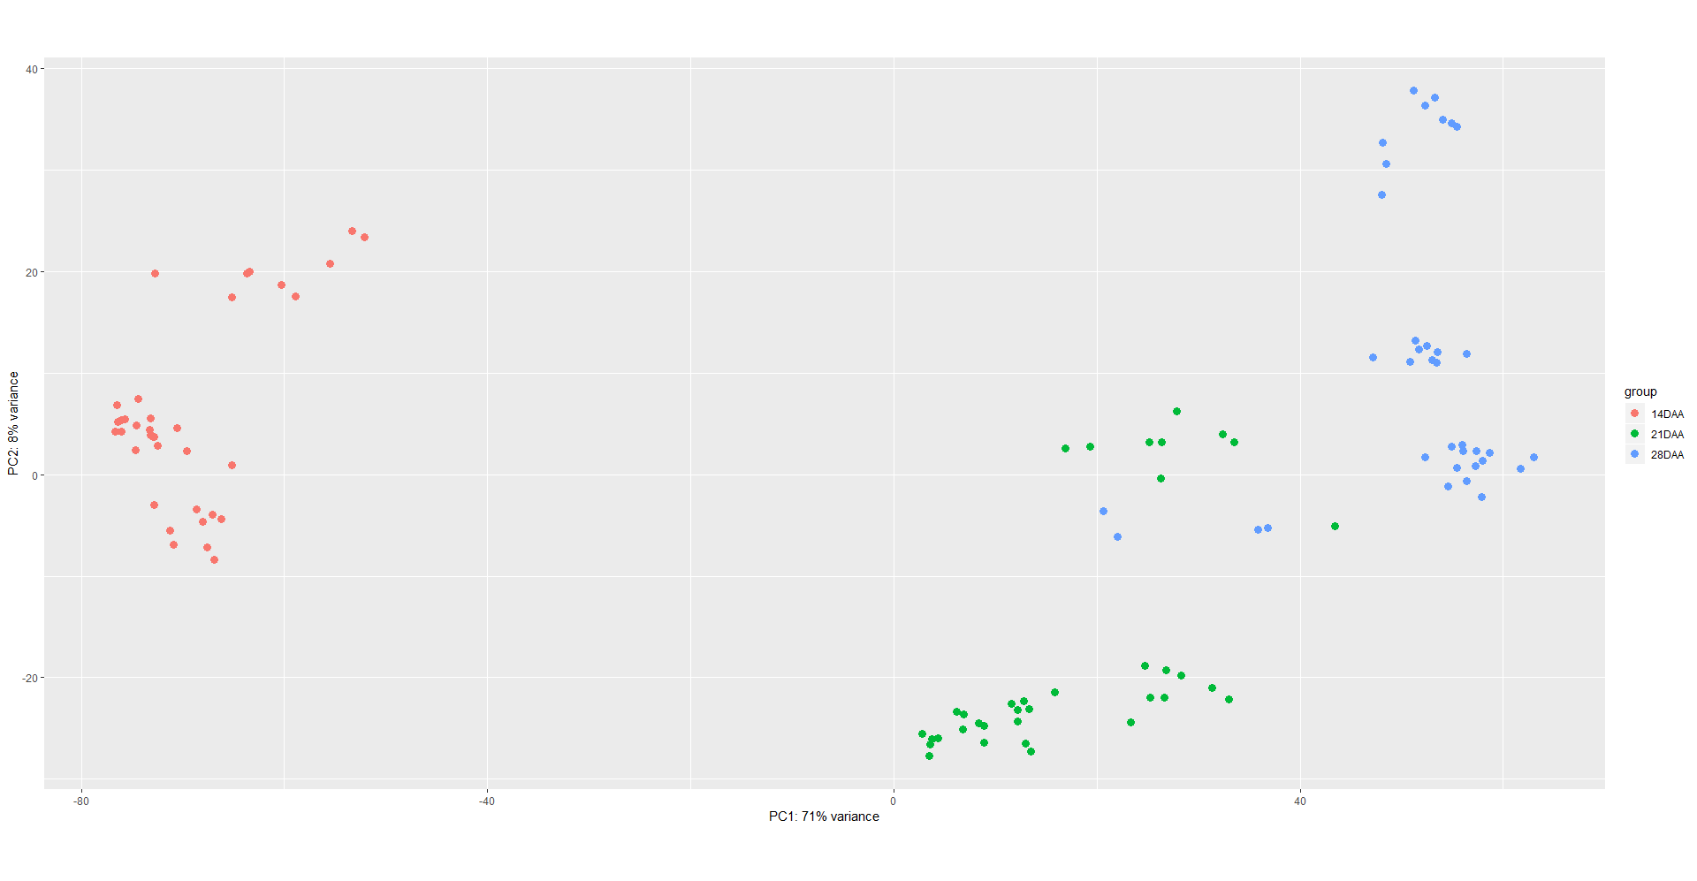
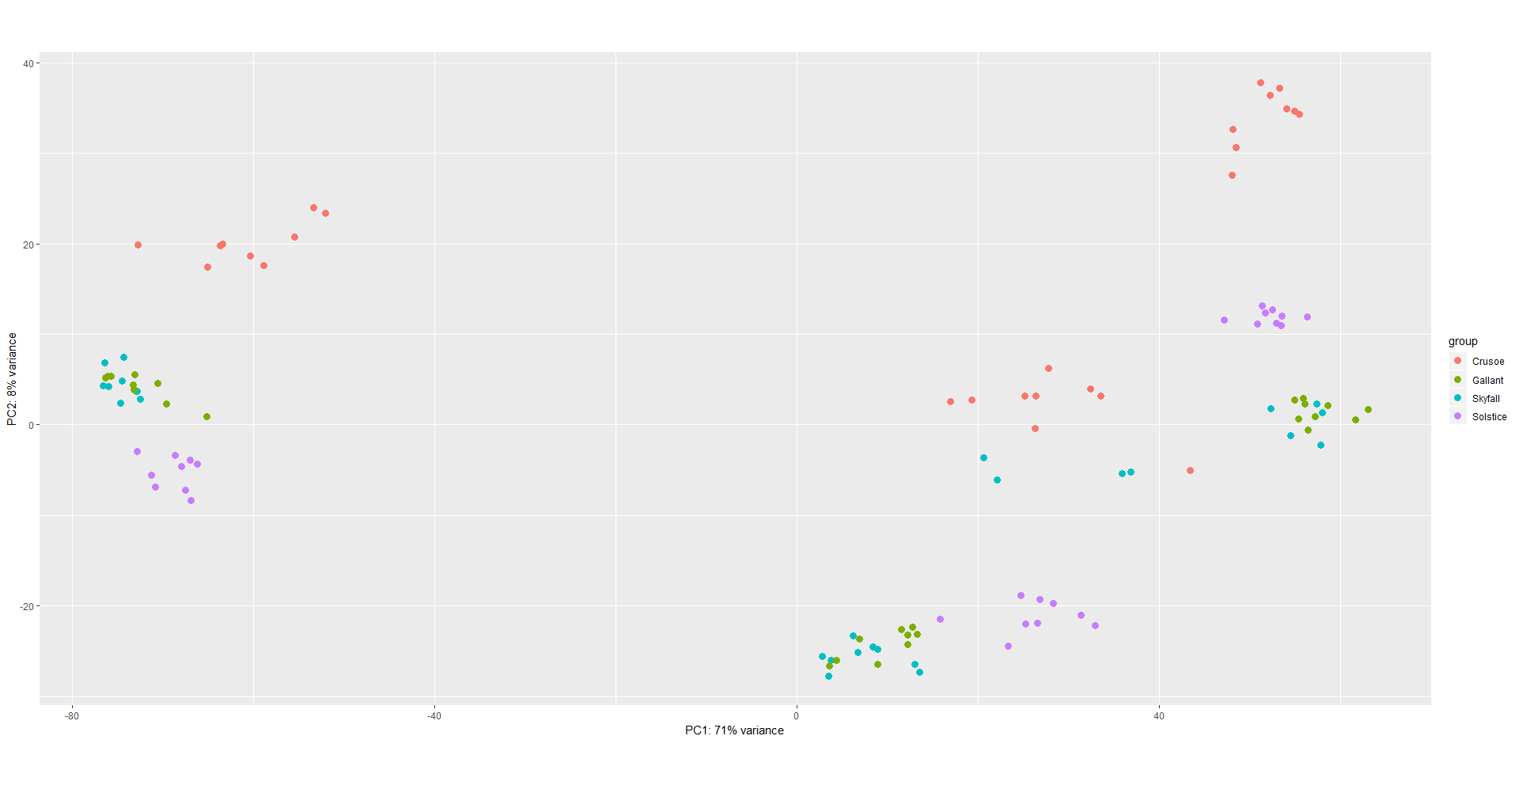
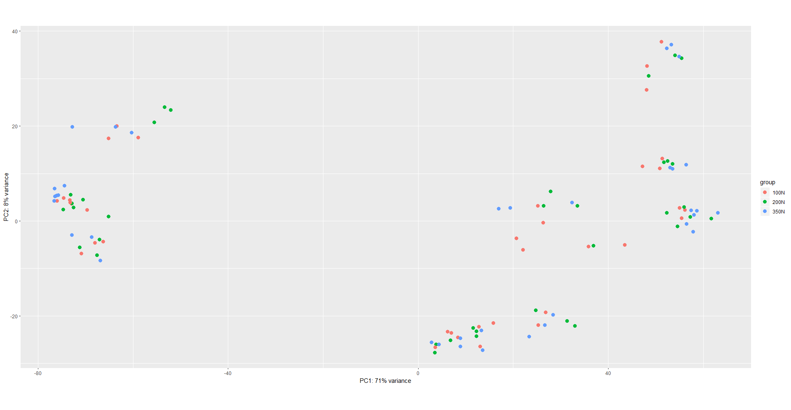
PCA coloured based on each factor

Slide 5
Genes DE between Gallant and Skyfall

Slide 6
Genes DE between Gallant and Skyfall
There are 9,859 genes DE on average, i.e. across all times and N levels, between Gallant and Skyfall.
5,082 upregulated in Skyfall
4,777 upregulated in Gallant

Slide 7
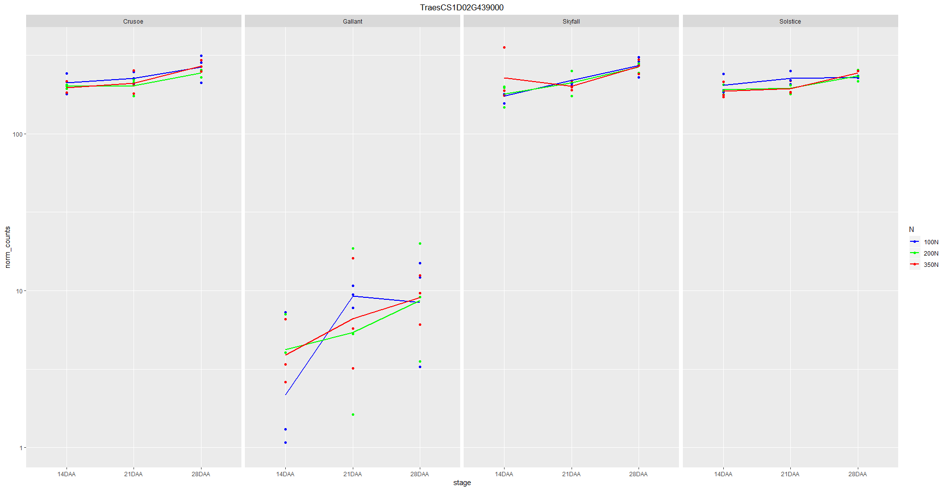
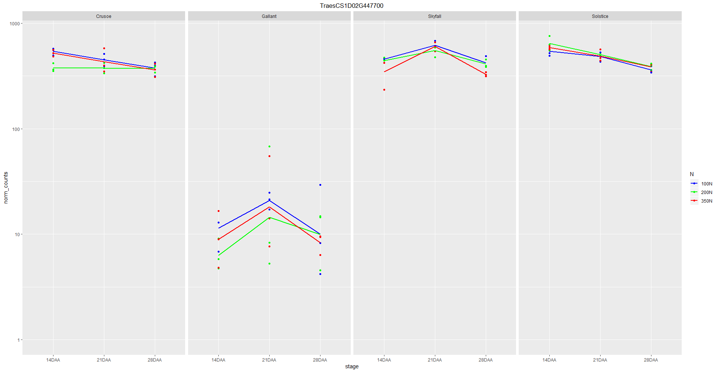
Example of genes upregulated in Skyfall

Slide 8
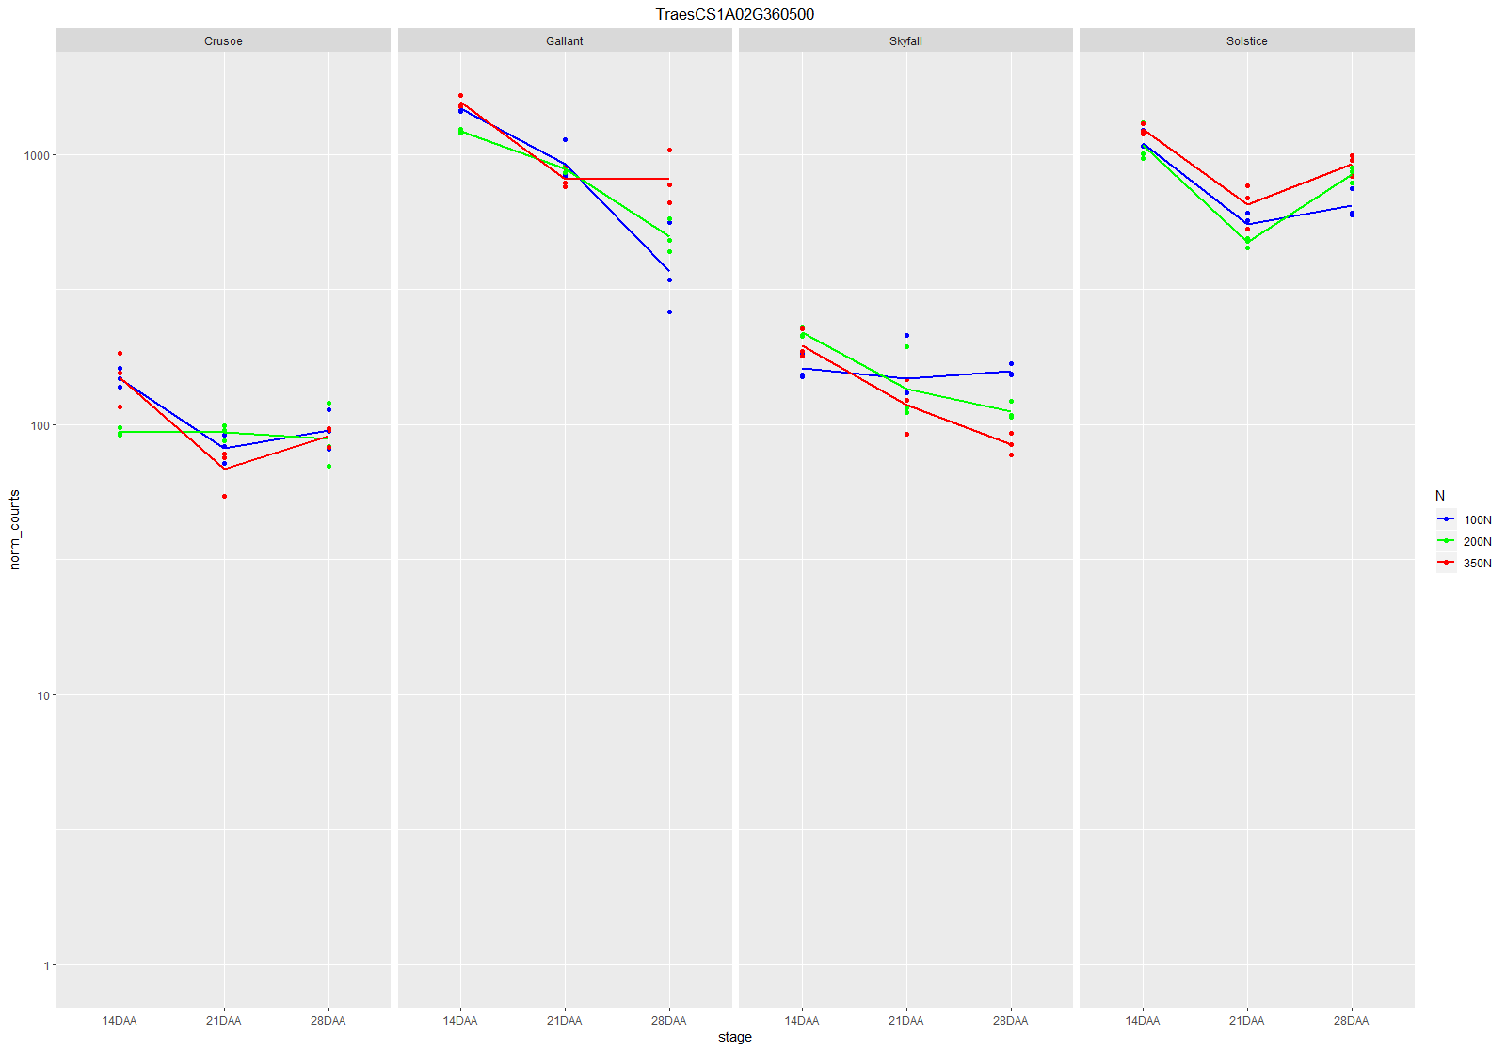
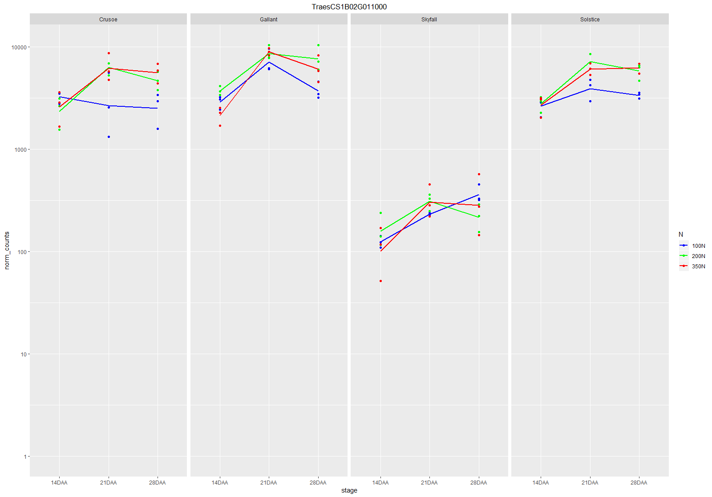
Example of genes upregulated in Gallant

Slide 9
Genes DE between Gallant and Skyfall in 100N

Slide 10
Genes DE between Gallant and Skyfall in 100N
There are 5,424 genes DE on average in 100N across all times, between Gallant and Skyfall.
2,828 upregulated in Skyfall
2,596 upregulated in Gallant
Widespread overlap between the overall and 100N DEGs
4,533 (83.5%) of the 100N DEGs are also DE across all N levels and times
891 (16.5%) genes DE between Gallant and Skyfall in 100N only

Slide 11
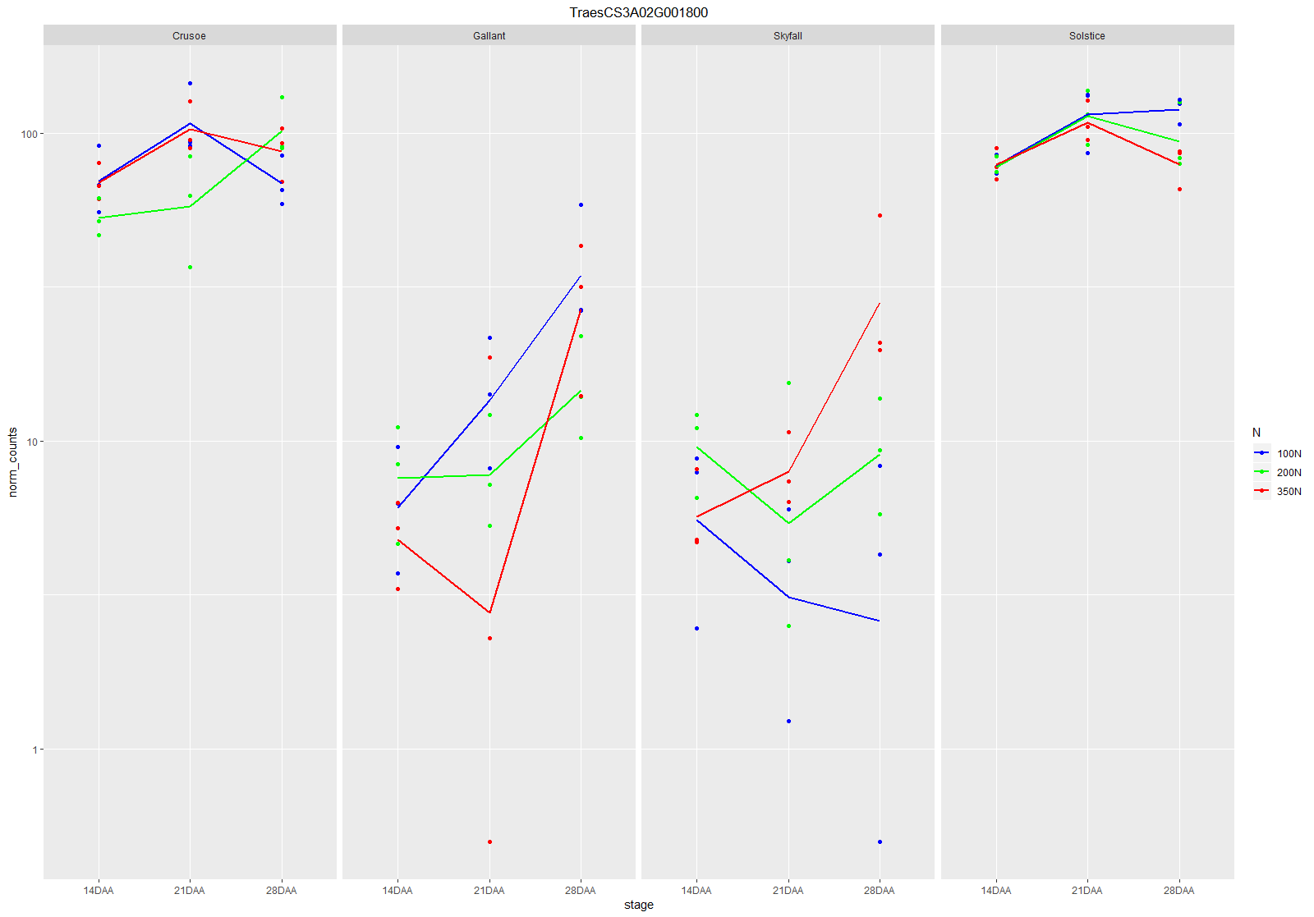
Example of gene DE between Skyfall and Gallant in 100N only

Slide 12
Genes DE Crusoe and all other varieties

Slide 13
Genes DE between Crusoe and all other varieties
There are 19,871 genes DE on average, i.e. across all times and N levels, between Crusoe and all other varieties.
10,815 upregulated in Crusoe
9,056 upregulated in the Skyfall, Gallant and Solstice

Slide 14
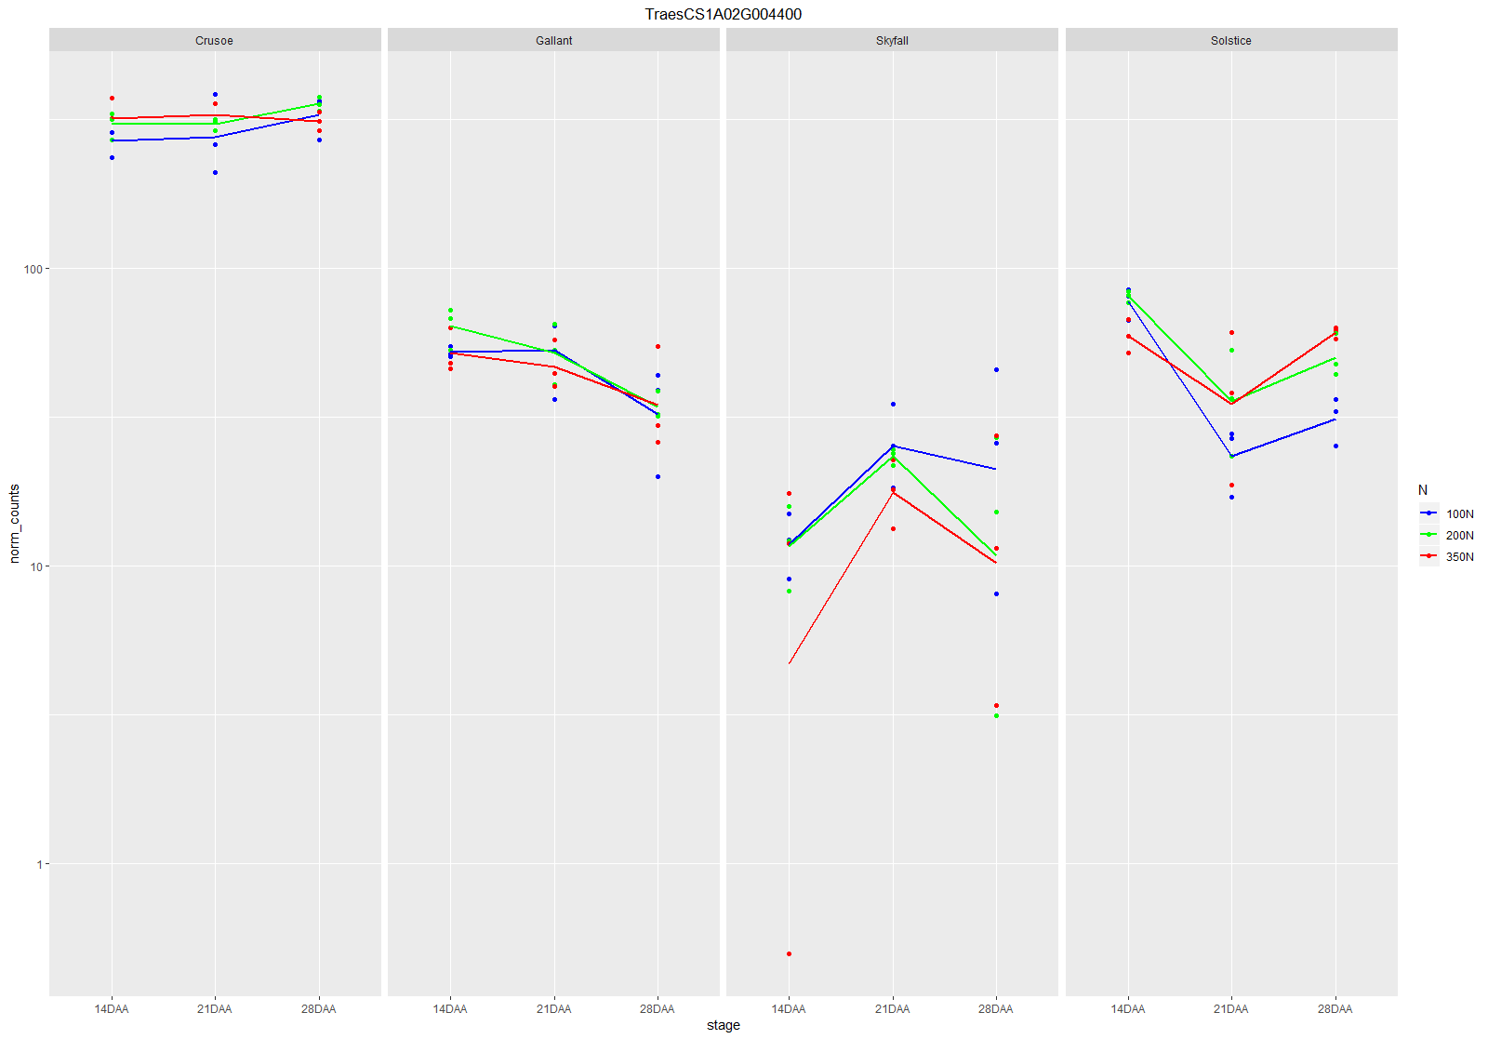
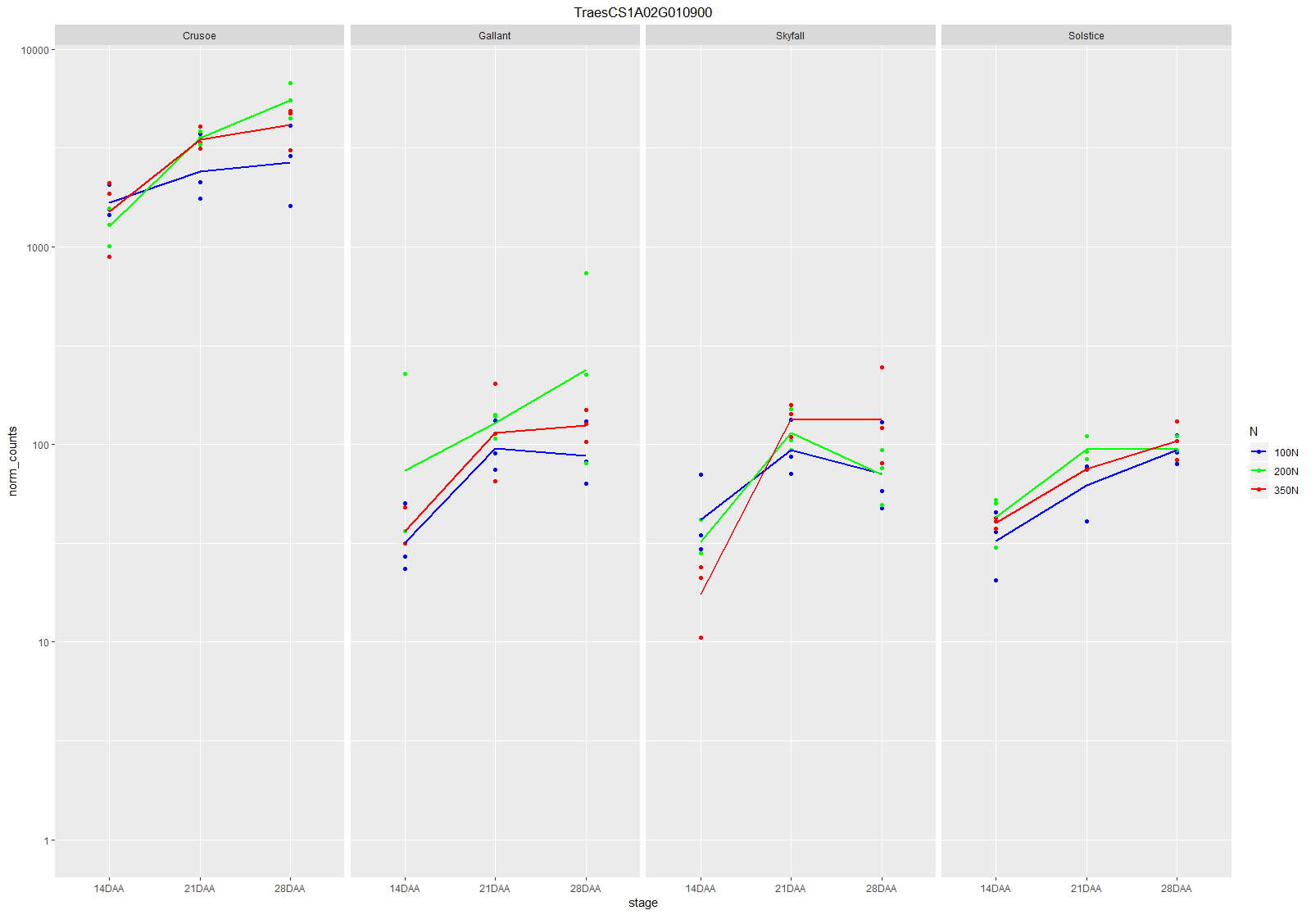
Example of genes upregulated in Crusoe

Slide 15
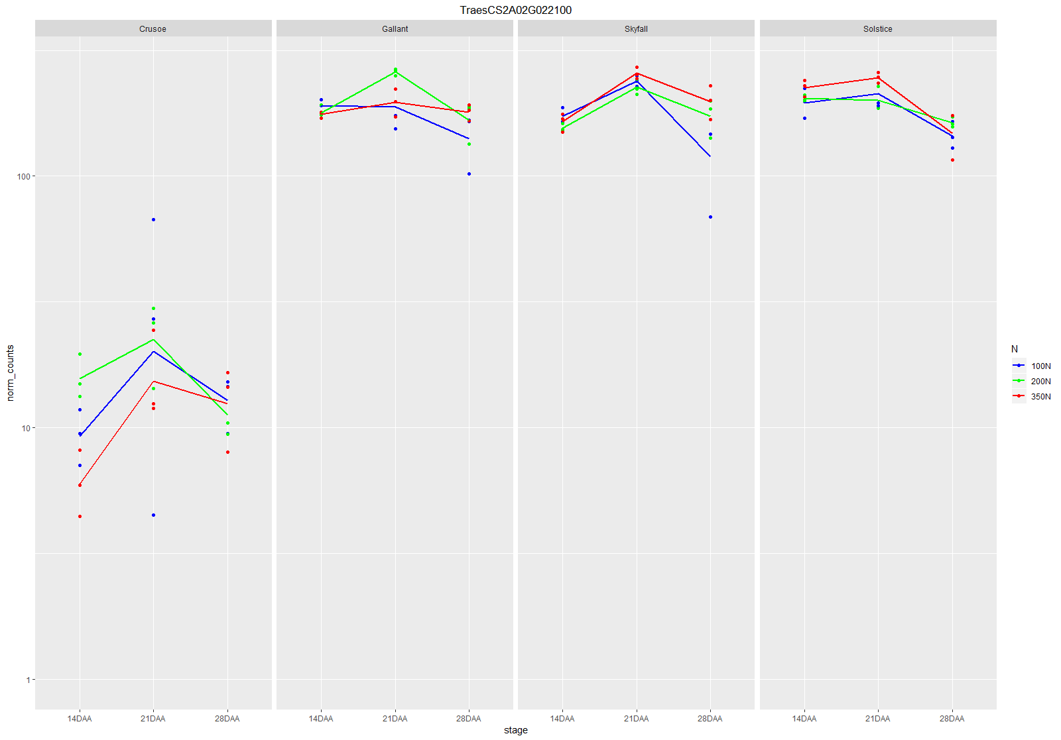
Example of genes downregulated in Crusoe

Slide 16
Genes DE Crusoe and all other varieties in 100N

Slide 17
Genes DE between Crusoe and all other varieties in 100N
There are 7,843 genes DE on average in 100N across all times, between Crusoe and the other varieties.
4,160 upregulated in Crusoe
3,683 upregulated in Skyfall, Gallant and Solstice
Widespread overlap between the overall and 100N DEGs
7,388 (94%) of the 100N DEGs are also DE across all N levels and times
455 (6%) genes DE between Crusoe and the other varieties in 100N only

Slide 18
Genes DE between N levels

Slide 19
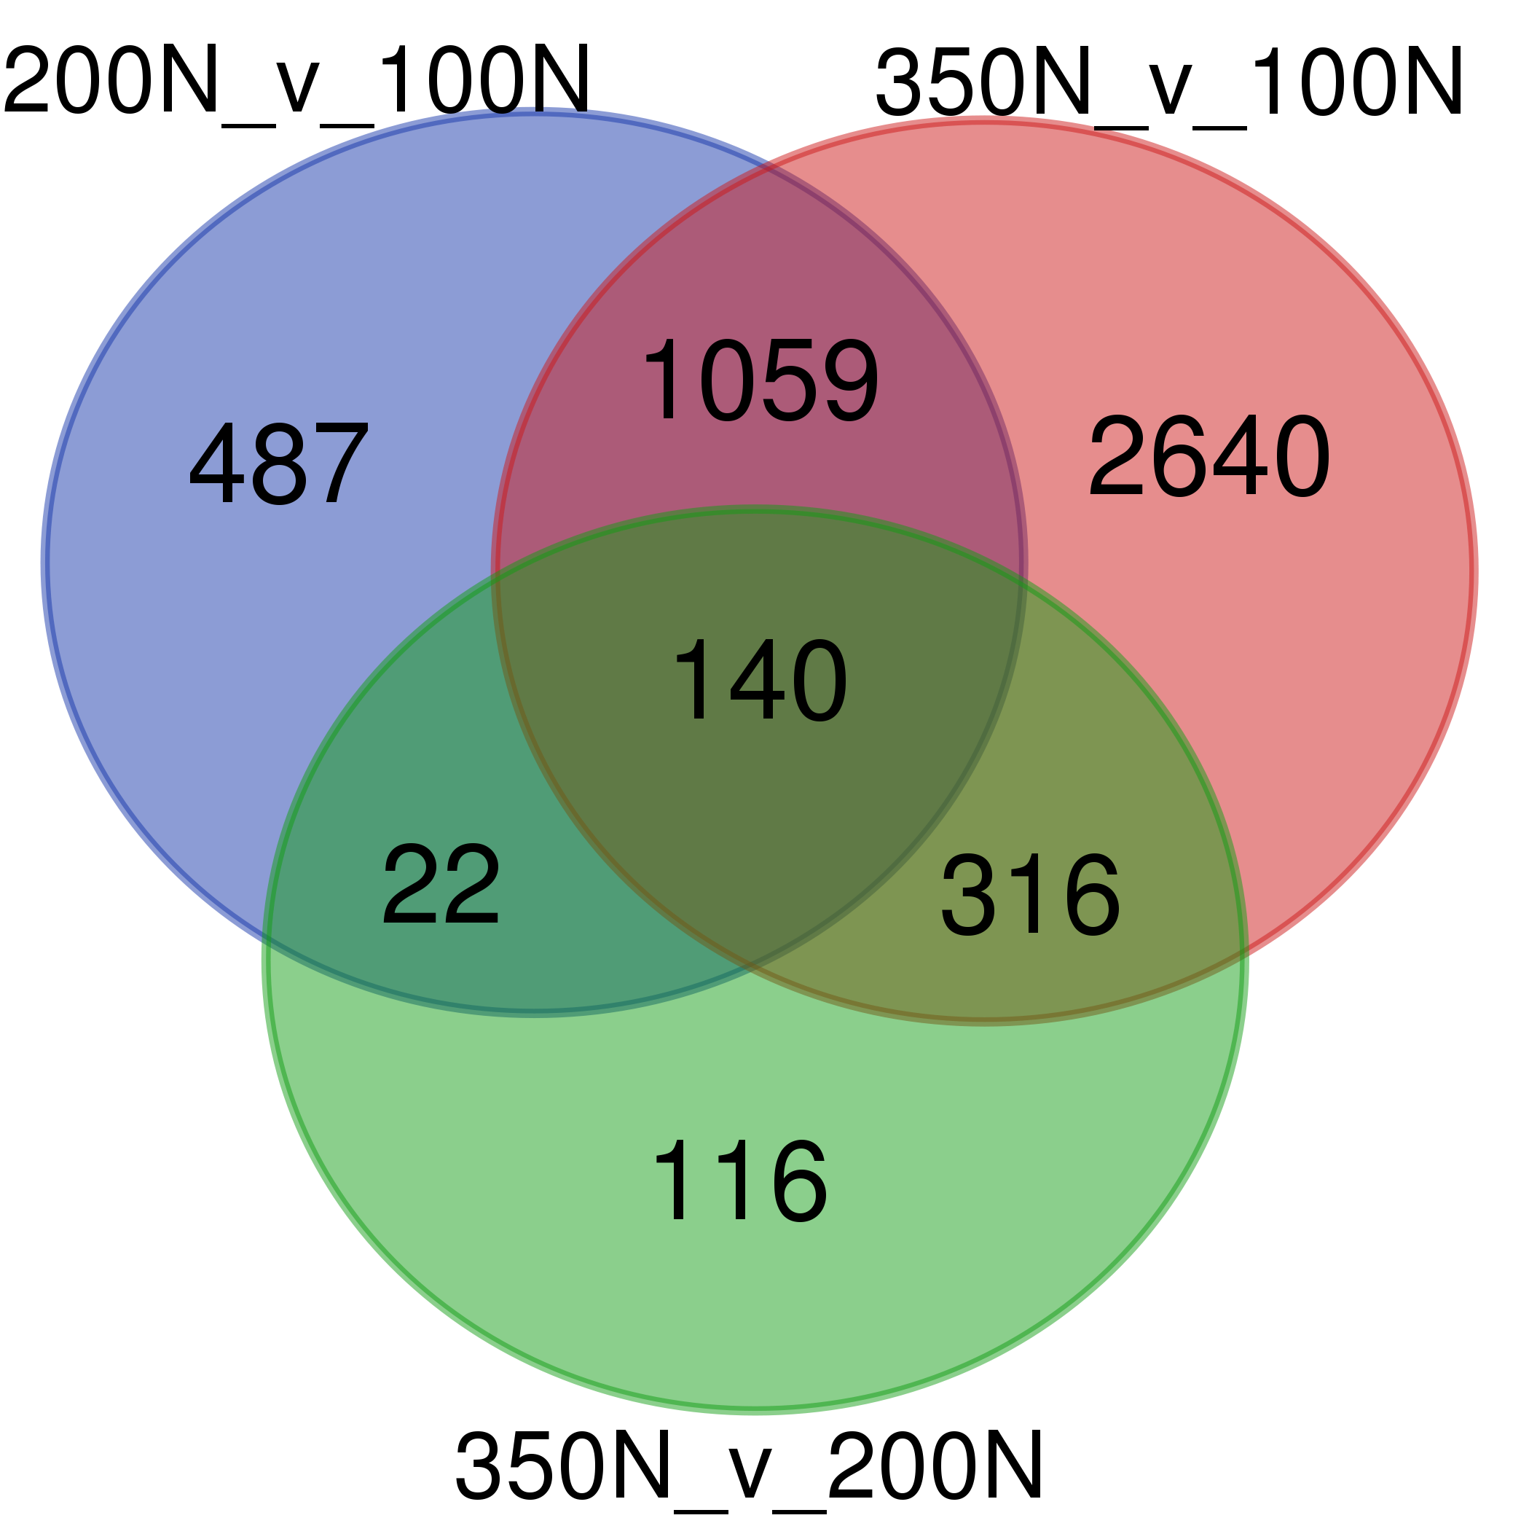
Genes DE between N levels
Performed the three contrasts between the three N levels.
Contrast | Total DEGs | Upregulated in high N (350N or 200N) | Upregulated in low N (100N or 200N)
200N vs. 100N | 1,708 | 761 | 947
350N vs. 100N | 4,155 | 1,982 | 2,173
350N vs. 200N | 594 | 392 | 202

Slide 20
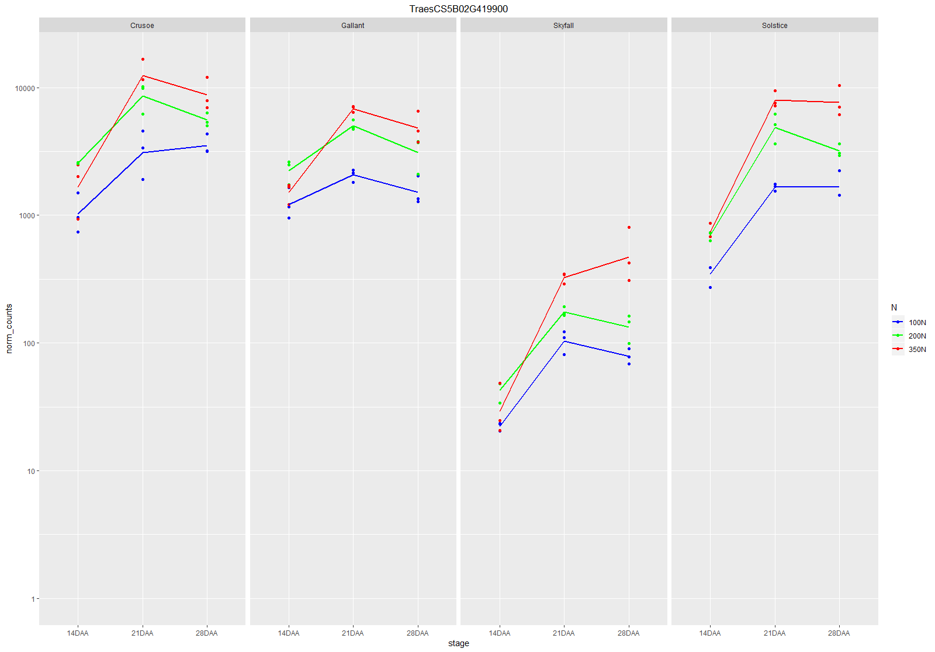
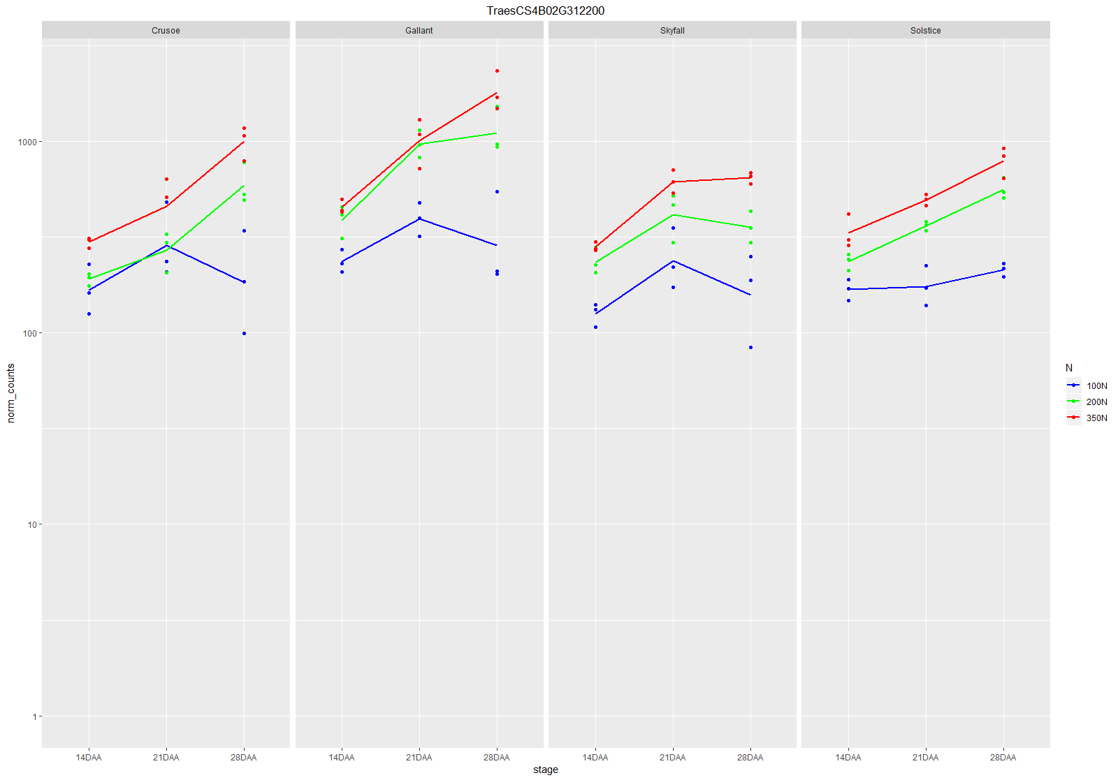
Example of genes DE in all contrasts

Slide 21
Analysis of storage proteins

Slide 22
Storage proteins in wheat IWGSC reference
Storage proteins identified in the wheat IWGSC reference as being annotated with the “nutrient reservoir activity” GO term (replacement of the obsolete ‘storage protein’ term
Total storage proteins | Not expressed [sum=0] | Lowly expressed [max <= 10] | Expressed
361 | 124 | 123 | 114

Slide 23
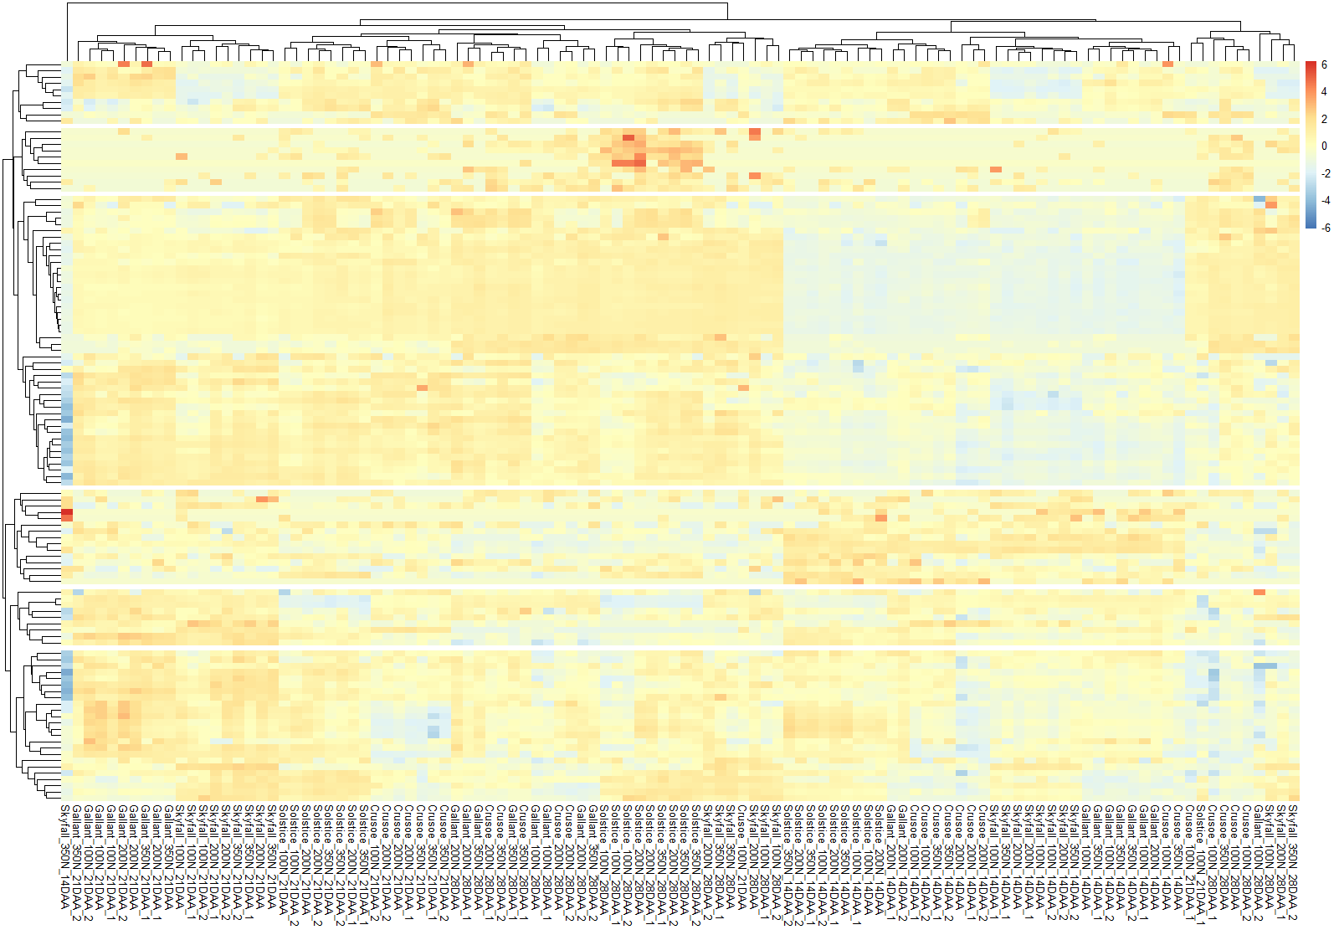
Clustering of storage proteins
1
10 genes
2
10 genes
3
46 genes
114 genes divided into 6 clusters (arbitrary number)
4
15 genes
5
9 genes
24 genes
6

Slide 24
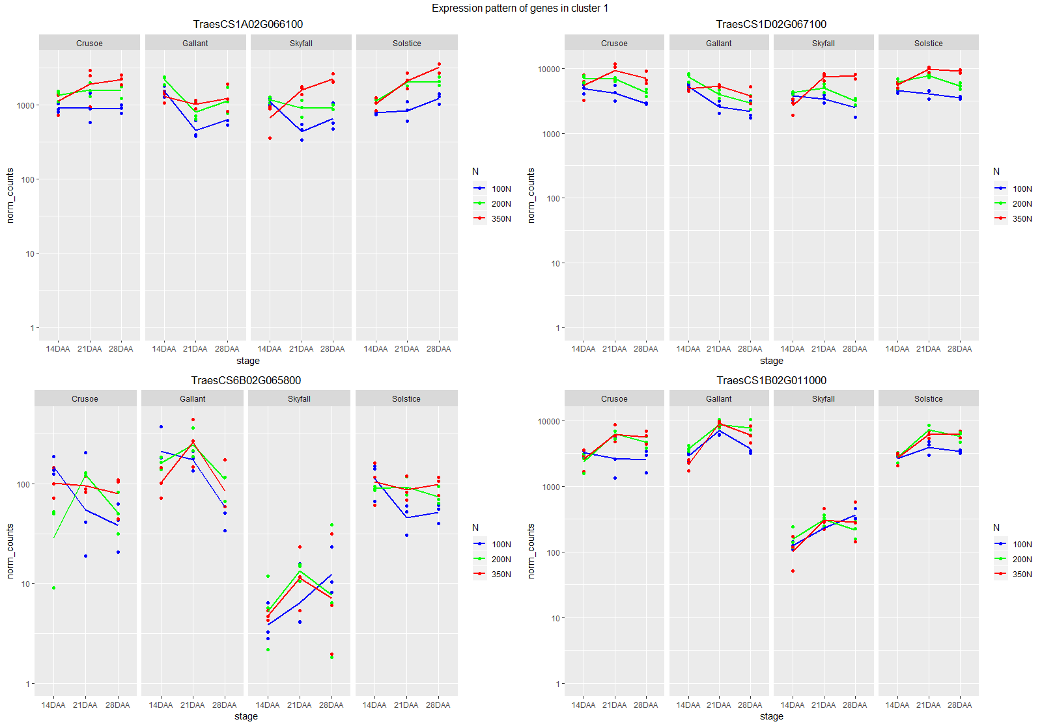
Expression pattern of genes in cluster 1
QUITE STABLE ACROSS VARIETIES
LOWER EXPRESSION IN SKYFALL

Slide 25
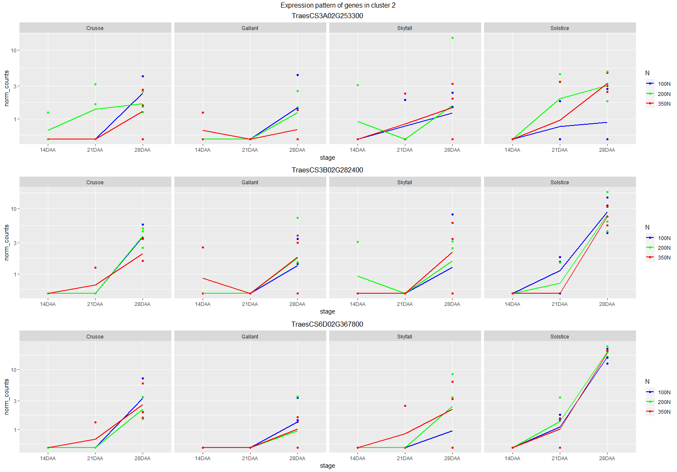
Expression pattern of genes in cluster 2
LOWLY EXPRESSED AND UPWARD TREND IN TIME

Slide 26
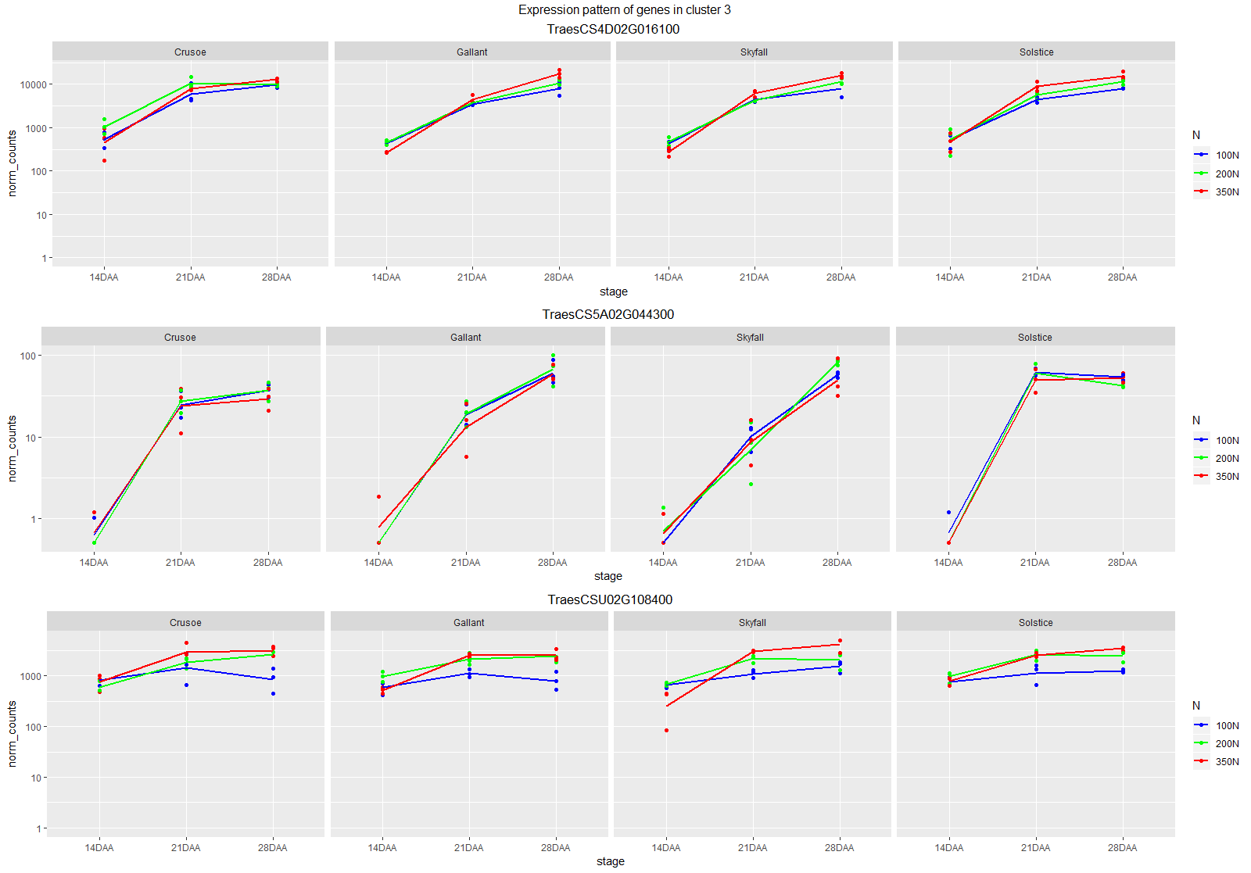
Expression pattern of genes in cluster 3
UPWARD TREND IN TIME

Slide 27
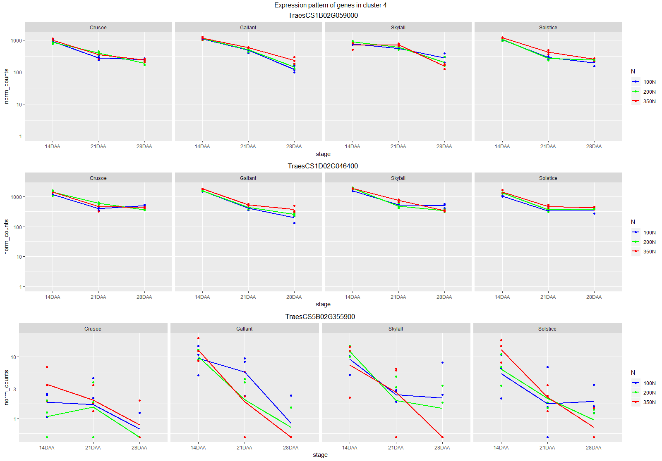
Expression pattern of genes in cluster 4
DOWNWARD TREND IN TIME

Slide 28
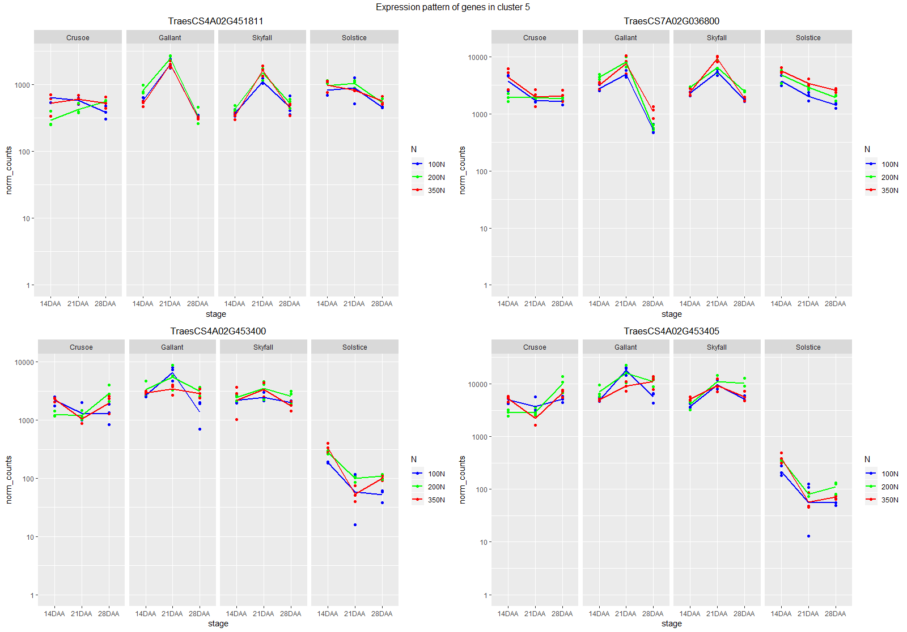
Expression pattern of genes in cluster 5
GALLANT AND SKYFALL PEAK AT 21 DAA AND SOLSTICE DOWNWARD TREND
GALLANT AND SKYFALL PEAK AT 21 DAA AND SOLSTICE LOWER EXPRESSION

Slide 29
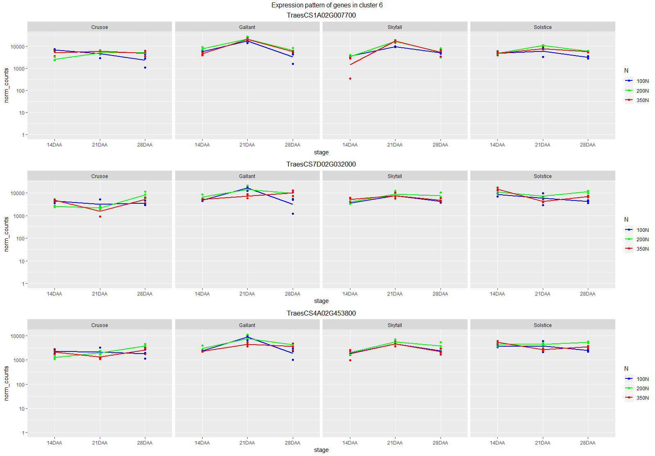
Expression pattern of genes in cluster 6
GALLANT AND SKYFALL PEAK AT 21 DAA

Slide 30
Analysis of Gliadins/LMW glutenins

Slide 31
Storage proteins in wheat IWGSC reference
Genes annotated with InterPro domain IPR001954
57 genes in total, 56 of them expressed in the experiment (all except TraesCS1B02G009877)
All genes annotated with GO:0045735 “nutrient reservoir activity”
All genes annotated with IPR036312 “Bifunctional inhibitor/plant lipid transfer protein/seed storage helical domain superfamily”

Slide 32
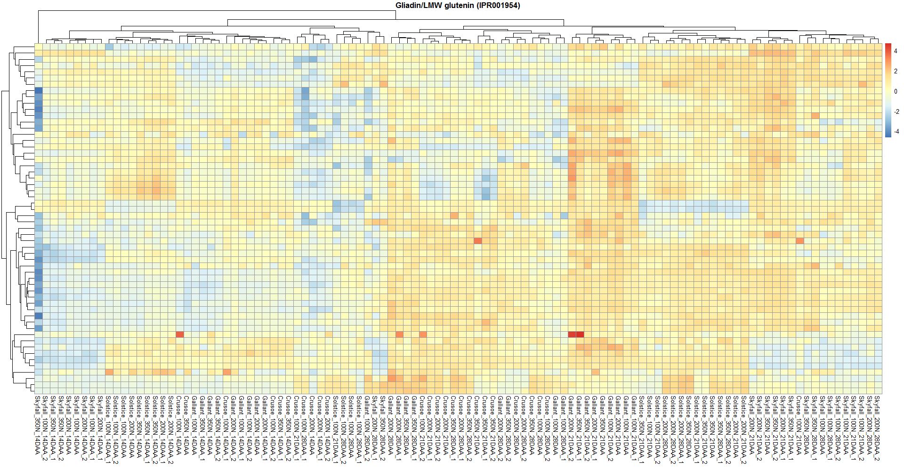
Clustering of Gliadins/LMW glutenins

Slide 33
Analysis of “Bifunctional inhibitor/plant lipid transfer protein/seed storage helical domain superfamily”

Slide 34
Storage proteins in wheat IWGSC reference
Genes annotated with InterPro domain IPR036312
Includes the 57 gliadins/LMW glutenins
No other genes annotated with GO: 0045735 present
Total storage proteins | Expressed
651 | 272

Slide 35
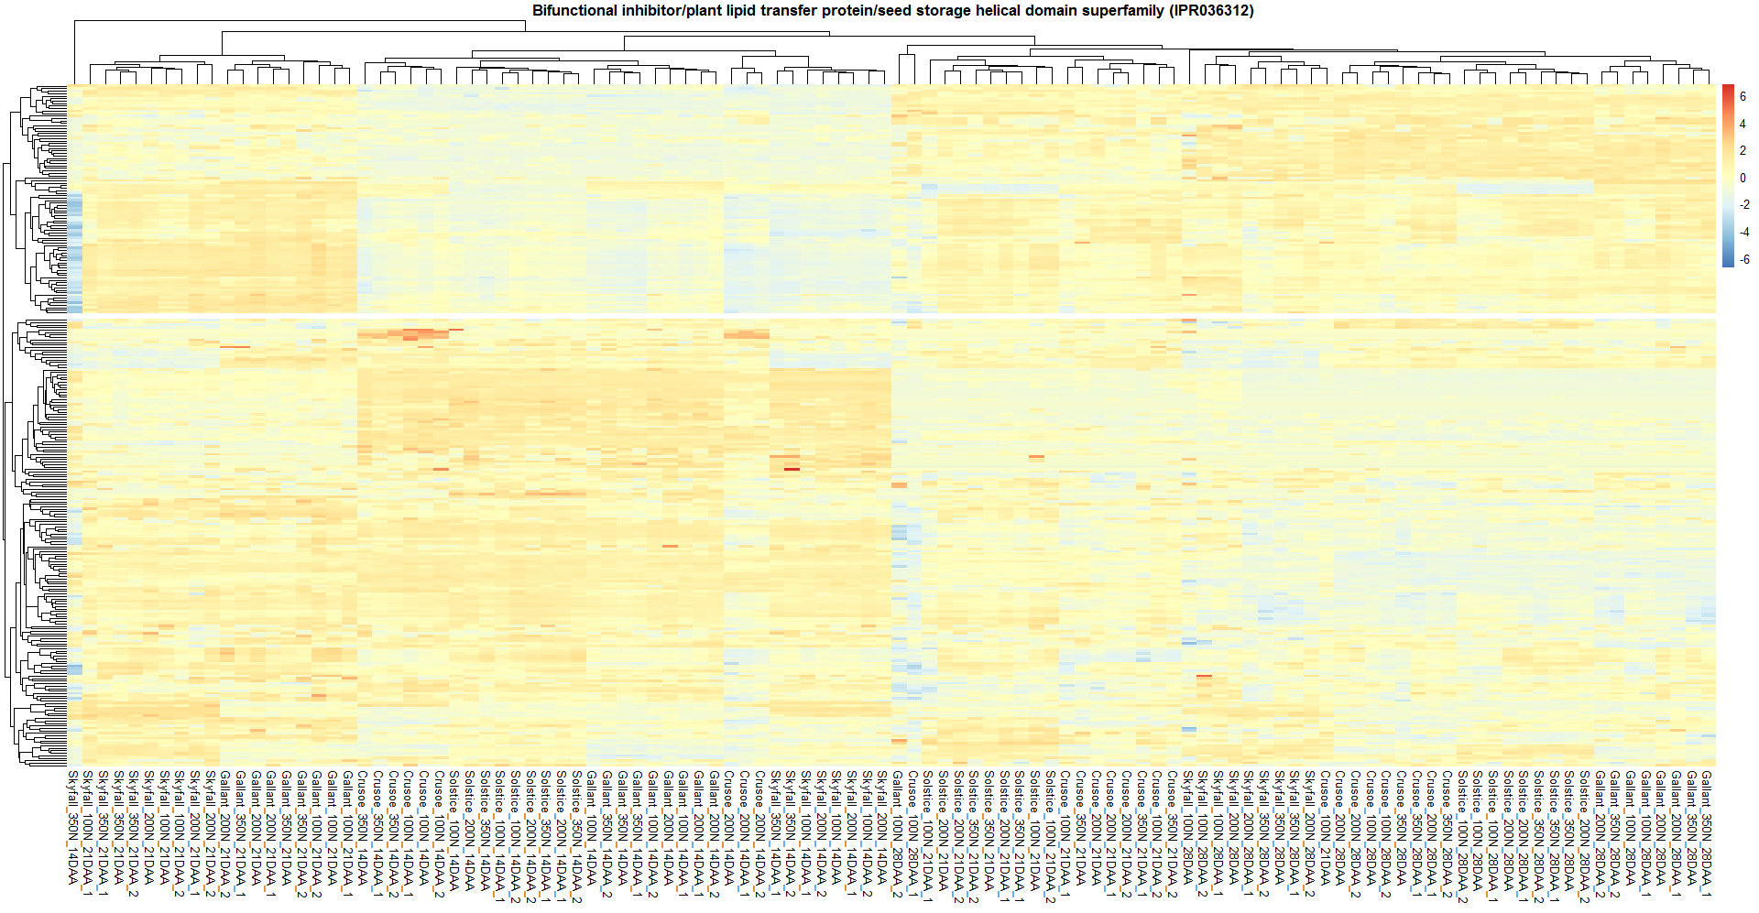
Clustering of IPR036312 superfamily
Low at 14 daa
Low at 28 daa and 21 daa in Crusoe and Solstice

