Slide 1



Hyundai & Michelin
From data to the perfect tire
How Michelin's digital manufacturing guarantees the quality of the Primacy 5 Energy for the new Hyundai Tucson 2027
Plant visit · On-Line Measurement (OLM) · MAC & BNS lines
Notes:
Opening message: Hyundai is not only buying a tire, it is buying a digitally controlled manufacturing process. Today we show how data, analytics and automation make every tire measured, monitored and corrected in real time.

Slide 2



Our digital factory in three ideas
Every tire reaching your assembly line has been turned into data, analysed and corrected while it was being built
1 · Digitise everything
2 · Analyse in real time
3 · Close the loop
3D laser sensors turn every tire component into a digital profile. 100% of production, no sampling, no contact.
Our industrial data platform and advanced analytics detect drifts before they become defects, and alert the right people instantly.
A rules engine acts automatically: it adjusts the machine, stops it or sets the product aside. Quality is built in, not inspected in.
Data → Insight → Action, in seconds, on every tire.
Notes:
If the audience remembers one slide, it is this one. The three steps are the backbone of the whole presentation: digitise, analyse, act.

Slide 3


Partners in innovation since 2017
Hyundai and Michelin already share a data-driven vision of the tire
2017
2022
Today
2027
First agreement
Second agreement
Third agreement
New Tucson
5 years. Exclusive co-developed tire for the IONIQ 5, shared testing methods and technology exchange.
3 years. Next-gen EV tires, more sustainable materials and real-time tire monitoring for autonomous driving.
3 years. Low rolling resistance, high performance, virtual tire development and SmartGrip braking technology.
Primacy 5 Energy 235/45 R20 as original equipment on the new Hyundai Tucson 2027.
Already original equipment on your premium range: HN-marked tires for Hyundai N and GOE-marked tires for Genesis.
Notes:
Public sources: 2017 agreement (IONIQ 5), June 2022 MoU (premium EVs, real-time tire monitoring) and a third three-year agreement announced by Hyundai Motor Group / Kia. Confirm the signing date of the third agreement before the meeting. Key link: the real-time monitoring we co-develop for your vehicles is the same philosophy we apply inside our plants.

Slide 4



Our digital journey
From manual sampling to self-correcting production lines
OLM today
Next phase
Predictive & AI
Closed loop
Advanced analytics, digital twins and AI to anticipate issues.
Real-time analytics
Rules engine corrects the process automatically.
Connected
Live dashboards, statistical control and smart alerts.
Sampling
Machines connected to an industrial data platform (PI System, since 2017).
Manual checks on a few tires per shift. Defects found late.
Notes:
The OLM system we show today sits on steps 3 and 4: real-time analytics and closed-loop control. Michelin's Digital Manufacturing programme has used the PI System since 2017 and is now moving into a second phase based on advanced analytics. The next step is predictive quality with AI.

Slide 5




A group-wide transformation
OLM is one piece of Michelin's Plant 4.0 programme, deployed across our factories
€60M
2017
3×
annual gains reported by Michelin from digitalisation and AI in its plants (2023)
start of our Digital Manufacturing platform built on the PI System
more operating robots targeted by 2025 under Plant 4.0
Digital twins
Predictive maintenance
Computer vision
Robotics + AI
to simulate and tune processes
to avoid unplanned stops
for automated quality control
for safer, more consistent work
Figures as publicly reported by Michelin (European Rubber Journal, AVEVA PI World).
Notes:
Context slide: this is not an isolated project but part of Michelin's group-wide digital transformation. The €60M and robot figures are self-reported by Michelin in 2023 press coverage; quote them as such. Update with internal figures if available.

Slide 6



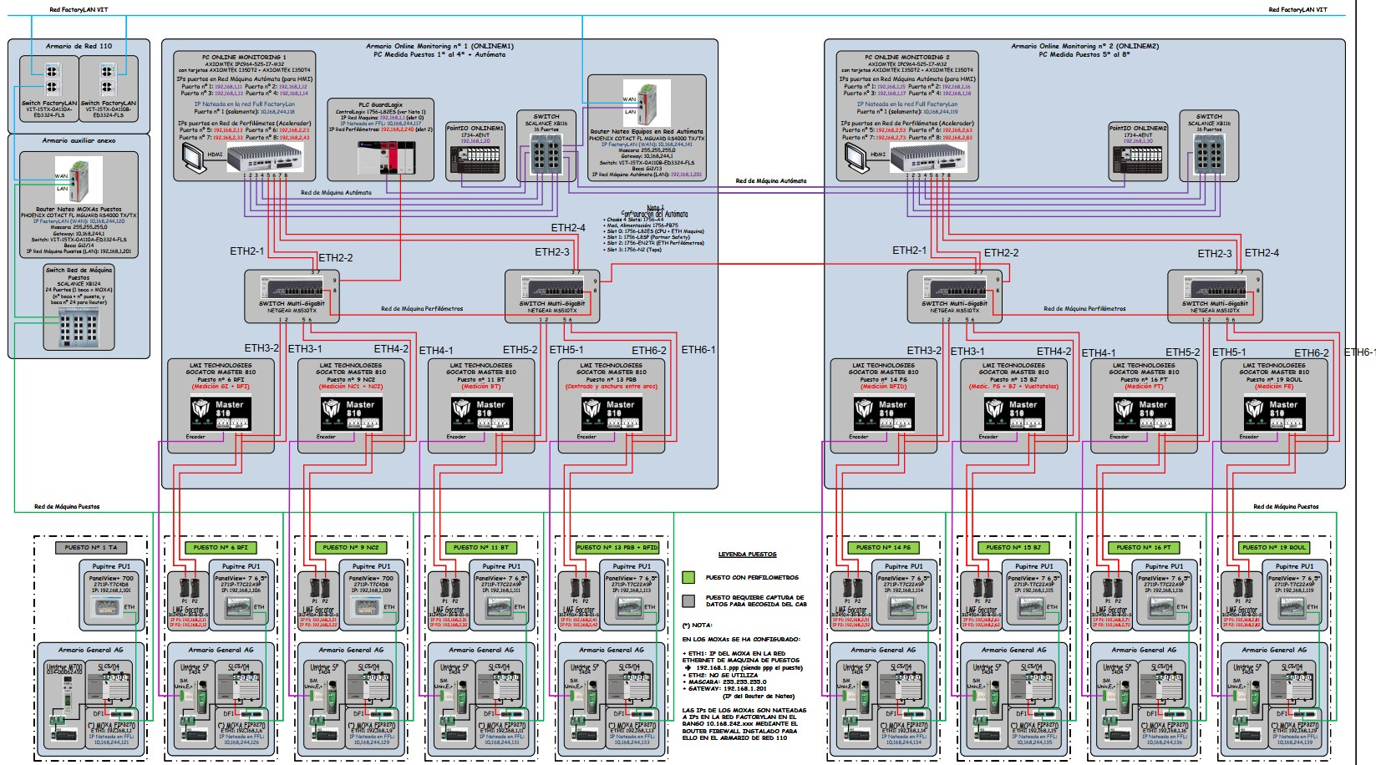
The digital data chain behind every tire
From the laser sensor to an automatic decision, in real time
Capture
Edge
Data platform
Analytics
Decision
Action
16 3D laser sensors on 8 stations
1 measurement PLC + 4 analysis PCs
PI System: every value stored and time-stamped
PI Vision dashboards, SPC, rolling medians
R4P rules engine
Adjust, block, segregate, alert
One architecture, many lines. The same data chain runs on the MAC machines and on the BNS line, and can be replicated on any machine in the network.
Notes:
Walk left to right: capture, edge computing, the PI data platform, analytics, decision and action. The architecture image is the MAC5 network: 8 stations, 16 sensors, 1 PLC, 4 PCs.

Slide 7
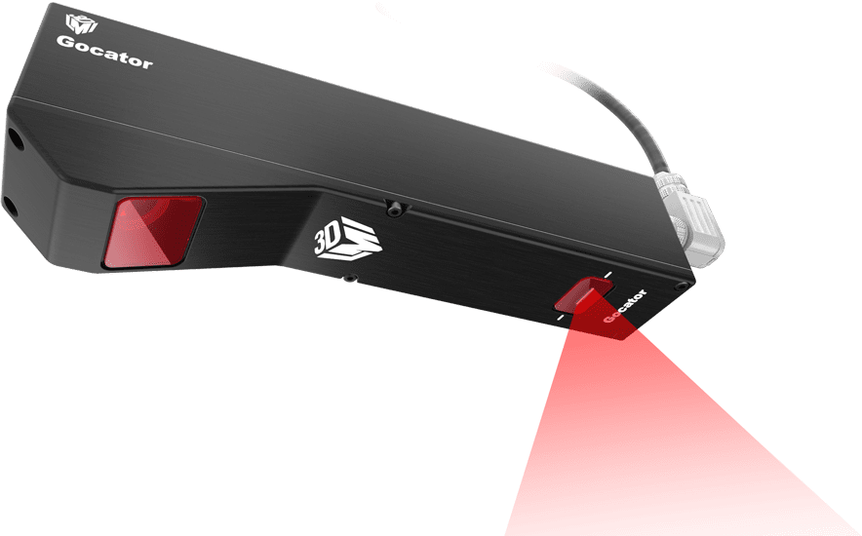


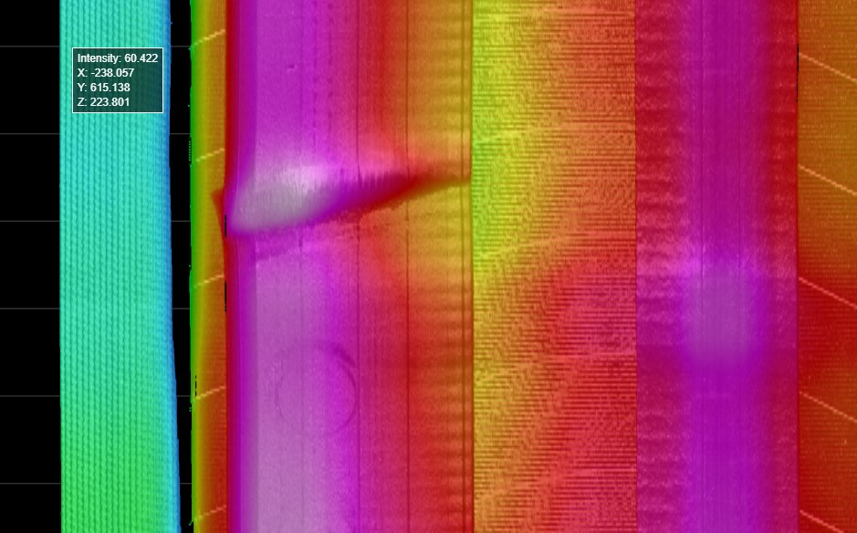
Every tire gets a digital fingerprint
3D laser profiling turns each component into millions of data points
Gocator 3D laser profilers (LMI)
Up to 5,000 profiles per second, micron-level repeatability, no contact with the product.
3D relief of a component
Shape irregularity detected
Splice and overlap control
Each colour is a height: anomalies the human eye cannot see stand out immediately.
Notes:
Gocator 2400 series specs from the original technical deck: scan rate up to 5 kHz, repeatability in microns depending on model. Images from the MAC stations: P5 (RFI, GI), P10 (BT) and P15 (BJ). A first demonstrator already flagged incorrectly applied (poorly stitched) products.

Slide 8

Advanced analytics in real time
Statistical process control on every measurement, visible to everyone
Individual value for every single tire
Rolling median of the last 20 to reveal drift early
Upper and lower limits always on screen
One source of truth for operators, quality and engineering
PI Vision dashboard · MAC3 · P14: width and edge position vs target
Notes:
The rolling median filters noise and shows the trend, so we act on a drift before any tire is out of tolerance. This is statistical process control running live, not in a weekly report.

Slide 9


Smart alerts before a defect exists
The right person is notified instantly, on screen and on mobile
Alert raised
The trend crosses the defined threshold.
Instant notification
On the dashboard and on the owner's phone.
Alert cleared
The value returns to target; the event is logged.
Notes:
The chart shows the full cycle: the median enters alert, the owner is notified, action is taken, and the median exits the alert. Everything is stored in the alert history. Alerts reach mobile phones (Android, iPhone) and are routed to the right team, e.g. process (CARE) or maintenance (TECH).

Slide 10

Closed-loop control: the line corrects itself
R4P rules engine: from measurement to action without waiting for anyone
Real example on the line
1. The edge position drifts to the lower limit.
2. Automatic correction (ODM) is activated.
3. The machine adjusts itself, no operator needed.
4. The value returns to its theoretical target.
Measure
Decide
Act
The sensor measures the component.
The rules engine compares it to target.
Adjust the machine, block it or set the product aside.
Notes:
The strongest slide for a carmaker: the system does not just warn, it acts. Example from the BJ regulation screen: the edge gauge (trusquin) reaches the lower limit, the ODM correction activates and the value returns to target. If correction is impossible, the rule blocks the machine or segregates the product.

Slide 11
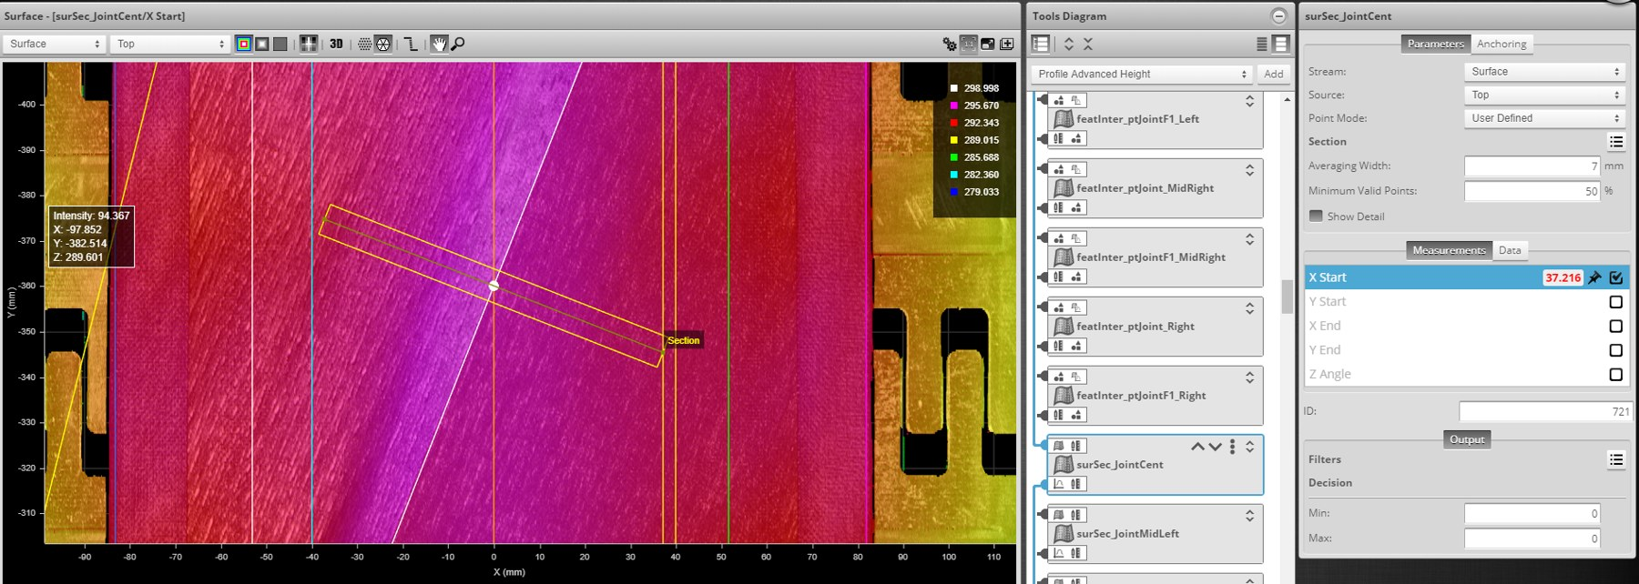
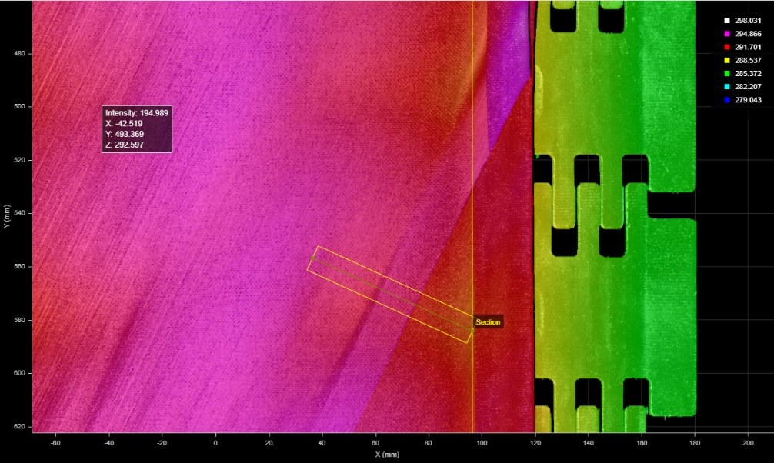
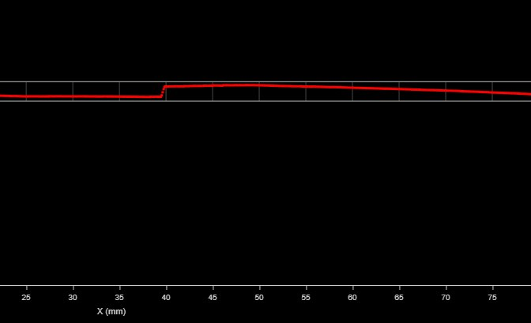
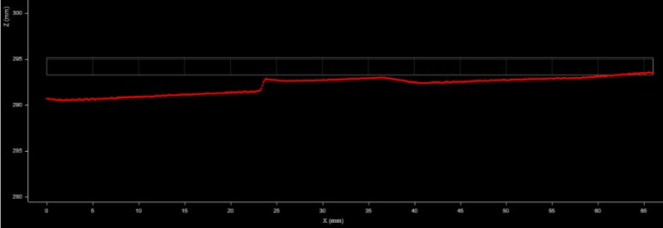
Proof on the line: a bad splice caught by the data
The OLM demonstrator flagged poorly stitched splices that would otherwise have gone unnoticed
NOK · poorly stitched splice
OK · conforming splice
The cross-section shows a step at the joint: alert raised.
Smooth cross-section after correction: the product is released.
Notes:
Real result from the demonstrator (BNS line): the 3D scan of the splice (soldadura) shows a step in the cross-section when the product is poorly stitched (mal plaqué). The system raised the alert; after correction the profile is smooth. This is the concrete proof that the data catches defects the eye does not see.

Slide 12
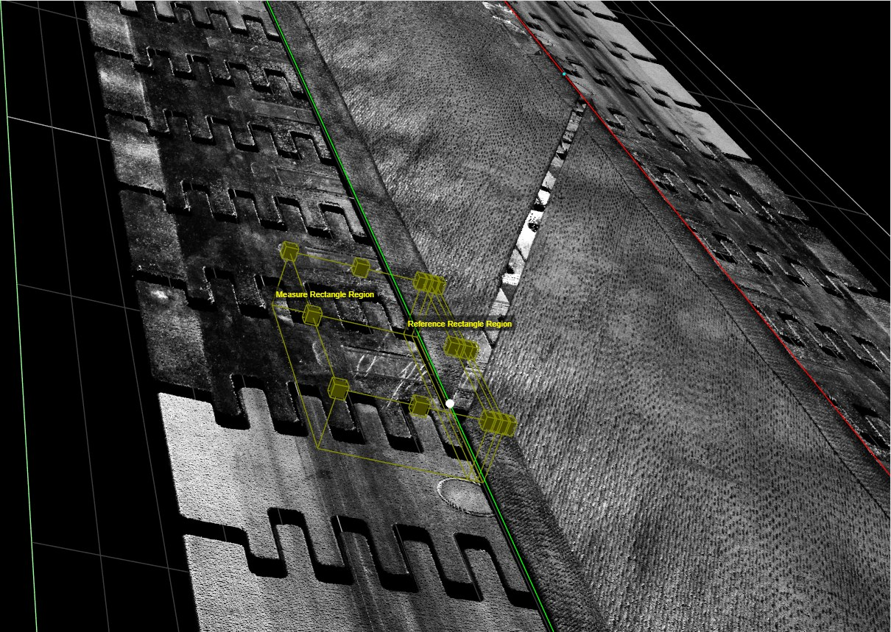
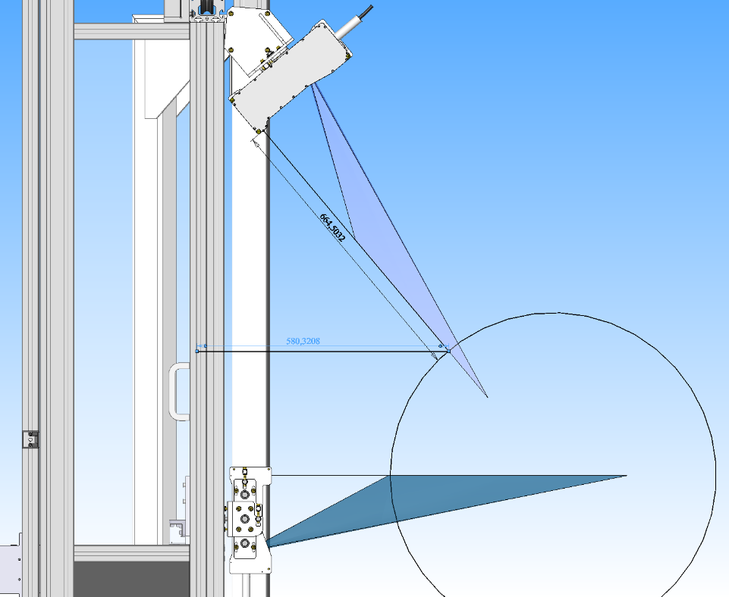
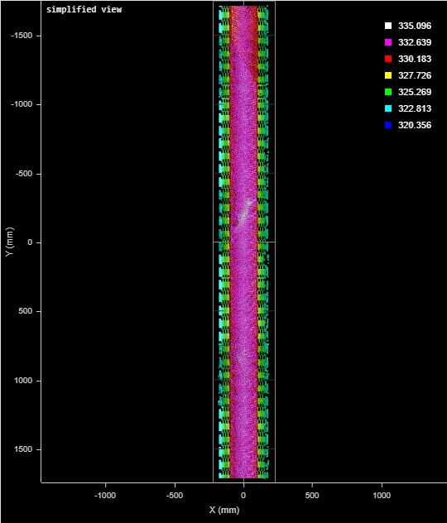
Built once, scaled across lines
The same digital platform now measures the NST1 and NST2 strips on the BNS line
Gocator 2650 sensor mounting · 3D strip scan · NST1 & NST2 control view
Notes:
Scalability message: sensors, data platform, dashboards and rules are standard building blocks, so each new line is faster to digitise. BNS uses a Gocator 2650 class 3R laser profiler, installed at 1,244 mm from the product, beyond the 1,180 mm nominal ocular hazard distance (NOHD): safe for operators.

Slide 13
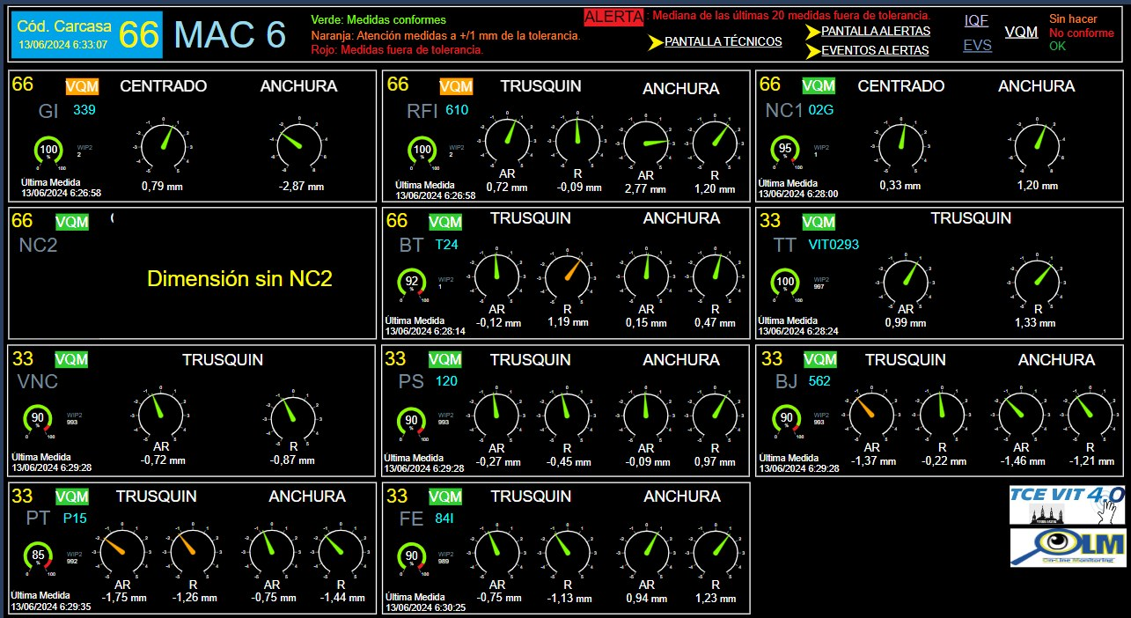

Full digital traceability
Every station at a glance, every measurement and alert stored in the PI System
Whole machine on one screen
Alert history
Ready for audits
Each station green when conforming, with its latest values (MAC6 overview).
When it started, when it ended and what was done.
Objective data to analyse any issue together with you.
Notes:
For a carmaker, traceability is critical: if a question ever arises on a batch, we have the measurement data from its production.

Slide 14
Primacy 5 Energy for the new Tucson 2027
Developed for your vehicle, built inside this digital ecosystem
MODEL
Michelin Primacy 5 Energy
SIZE
235/45 R20
VEHICLE
Hyundai Tucson 2027
CODE
5759 · CAI 514126A
Every unit you receive is measured and controlled to match the tire you homologated.
Notes:
Bring it back to the product: Hyundai homologates one tire; our digital process makes sure the thousands they receive are identical to it.

Slide 15



What this means for Hyundai
Consistent quality, fewer incidents and a partner ready for the future
Consistent quality
Fewer incidents in your plant
Every Primacy 5 Energy matches the homologated tire: same geometry, same behaviour on the Tucson.
Defects are stopped at our machine, not on your assembly line or with the end customer.
Data transparency
Ready for what comes next
Traceable measurements and alerts, ready to review together and share as quality KPIs.
The same real-time data culture that drives our joint R&D on EVs and tire monitoring.
Notes:
Translate technology into buyer and quality benefits. Stress the link with our joint R&D: real-time monitoring is exactly what we develop together for your vehicles.

Slide 16

Next steps
See our digital factory in action
1
Plant visit: MAC and BNS lines with OLM running live.
2
Workshop with your quality team to define shared digital quality KPIs.
3
Joint monitoring of the Primacy 5 Energy during the Tucson 2027 launch.
MOTION FOR LIFE
Notes:
Close with a concrete ask. Adjust the next steps to the real goal of the meeting.

