Slide 1

Quality decided in real time
Hyundai
Notes:
Open calmly and with pride. The title sums up the promise: quality is not inspected at the end, it is decided at every second of production.

Slide 2


Hyundai & Michelin
A successful long-term partnership for performance and innovation
Hyundai
Trusted partners for new technologies
Michelin Primacy 5 Energy 235/45 R20
Fitted on the new Hyundai Tucson 2027
Code 5759 · CAI 514126A
Each of these tires is born in the digital environment we are presenting to you today.
Notes:
Personalised for Hyundai: connect with their product from the very start. Same message as the Tucson 2027 leaflet (Primacy 5 Energy 235/45 R20, code 5759, CAI 514126A). The sentence at the bottom bridges to the rest: everything they will see applies to the tires on their Tucson.

Slide 3
What if every tire could tell us how it was made?
Today it does. Let us show you how.
Notes:
Curiosity hook: ask the question and wait two seconds. A question opens the listener's mind far more than a statement. Then: 'Today it does. Let us show you how.'

Slide 4
Two ways to control quality
Traditional control
Our digital control
1 sample
per shift, manually
100 %
of products, automatically
Hours
to discover a deviation
Seconds
to detect a drift
After
we react once the defect already exists
Before
corrected before the defect exists
Notes:
Contrast principle: first the traditional model, which the customer knows well; then ours. No criticism of anyone: the contrast speaks for itself and anchors the perceived value.

Slide 5
Our system in a single cycle
Four steps revolving around IQF, our quality indicator
01
See 3D laser profilers
Every product measured in 3D on every tire.
01
See
02
Understand PI System · PI Vision
Real-time data and images, with trends and alerts.
IQF
04
02
Anticipate
Understand
03
Decide R4P
Rules engine that corrects the process automatically.
03
04
Anticipate Dataiku · AI
Advanced analytics to find patterns and stay ahead.
Decide
Notes:
Mental map of the whole presentation. The brain remembers a simple, circular structure better: See, Understand, Decide, Anticipate. At the centre, IQF: the whole system works to protect our quality indicator. Tools for each step: Gocator laser profilers (see), PI System and PI Vision (understand), R4P (decide), Dataiku and AI (anticipate).

Slide 6
See
Every tire, turned into data
01
Notes:
First step of the cycle: See. Keeping the four-verb structure throughout helps the customer follow and remember the message.

Slide 7

We measure every product
3D laser profilers at every machine station
See
Understand
Decide
Anticipate
100 %
of products measured
3D
complete profile of every component
16
laser sensors on 8 MAC stations
3D scan on the MAC: each colour is a height
Notes:
Gocator 3D laser profilers (LMI): up to 5,000 profiles per second and micron-level repeatability depending on the model. On the MAC: 8 stations, 16 sensors, 1 PLC and 4 PCs. Explain the colour map: each colour is a height; an abnormal relief stands out immediately.

Slide 8
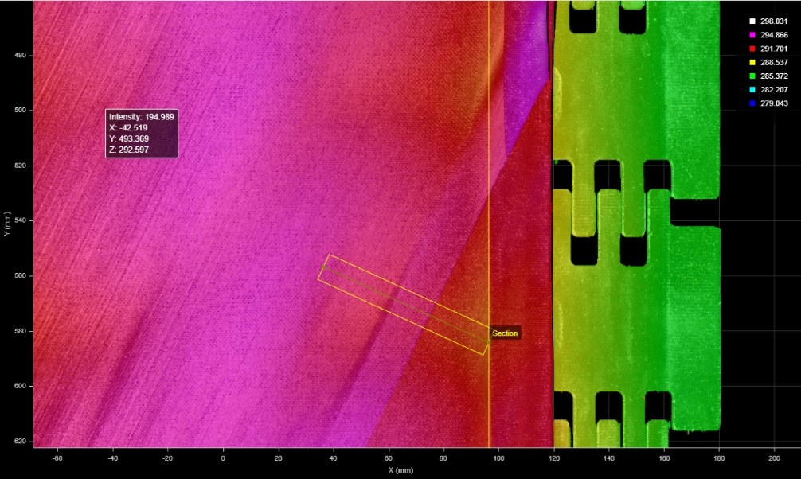
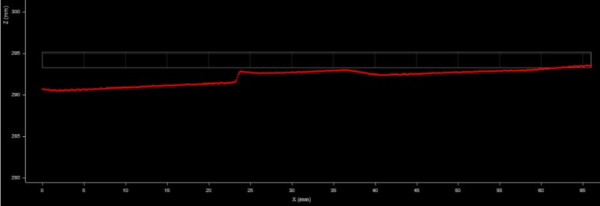
How we measure an NST splice on BNS
From the 3D map to the figure that defines splice quality
See
Understand
Decide
Anticipate
1
3D map
of the NST strip splice
1
2
Measurement section
drawn across the splice
2
3
Profile
quantifies the splice
Variables monitored continuously
Splice overlap
Splice height
Splice offset
Splice quality
3
Notes:
How an NST splice is measured on the BNS line: the profiler generates a 3D map of the splice (1), a measurement section is drawn across the splice (2) and the resulting profile (3) quantifies it. On the BNS62 screen these measurements are monitored continuously: overlap, height, offset and splice quality.

Slide 9
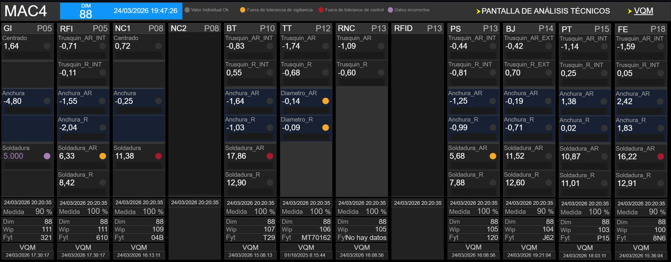
Every station, every measurement, live
MAC4 OLM screen: twelve stations, P05 to P18
See
Understand
Decide
Anticipate
2
1
3
4
1
Twelve stations
from P05 to P18
2
Status code
OK · watch · control
3
Splices
measured at every station
4
100 % measured
every tire measured
Notes:
Real MAC4 screen (March 2026). Each column is a machine station (GI, RFI, NC1, BT, TT, PS, BJ, PT, FE...), with its edge position (trusquín), width, diameter and splice measurements. The colour code distinguishes watch and control limits, and the '100 % measured' indicator confirms every tire is measured.

Slide 10
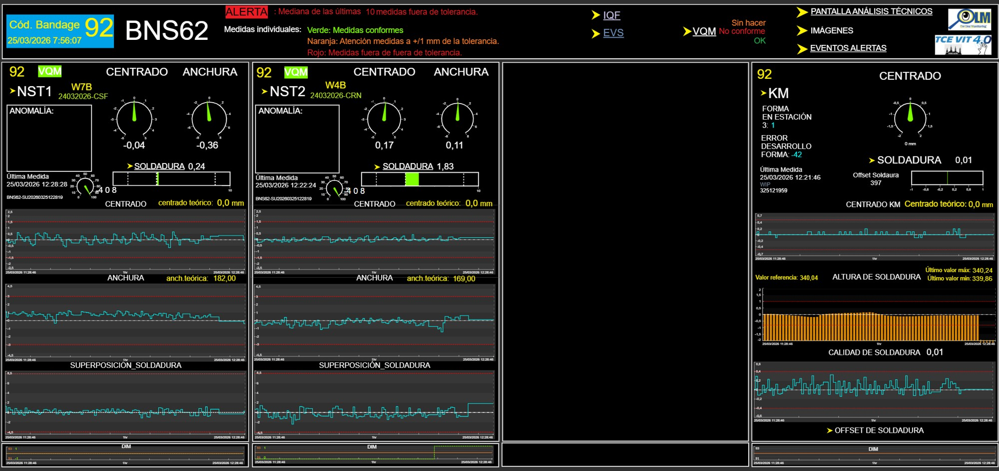
The whole line at a glance
BNS62 OLM screen: NST1, NST2 and KM
See
Understand
Decide
Anticipate
1
Alert and colours
green, orange, red
1
3
2
2
Every station
centring, width, splice
3
One click
IQF, images, alerts
4
4
KM splice
height, quality, offset
Notes:
Real BNS62 screen (March 2026). At the top, the alert rule and colour code (1). Each block is a station with centring, width and splice (2). From the screen itself you can access IQF, images and alert history (3). On the KM, splice height, quality and offset are monitored (4).

Slide 11
Understand
From data to trend, in real time
02
Notes:
Second step: Understand. Data alone is useless; what matters is reading it in time and making sure the right person knows.

Slide 12

We see the drift before the defect
Real PI Vision screen · MAC3 · station P14
See
Understand
Decide
Anticipate
1
Every tire
its individual value
4
1
2
3
2
The trend
median of the last 20
3
The limits
tolerances always visible
4
The target
theoretical reference value
Notes:
Walk through the numbers on the real screen. Full transparency: this is the screen our teams use. The median of the last 20 measurements filters noise and shows the trend; tolerances and the theoretical value are always visible.

Slide 13
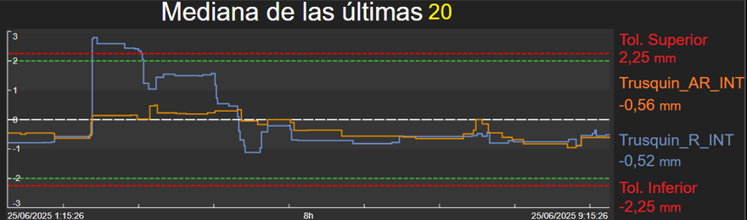
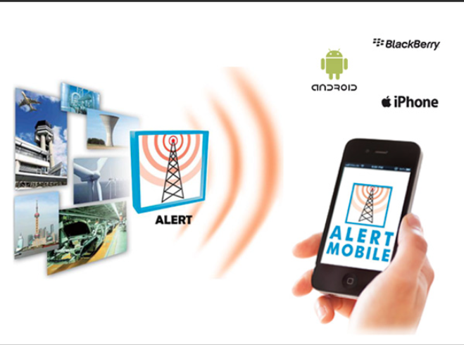
Alert before the defect exists
The trend crosses the limit and the right person knows instantly
See
Understand
Decide
Anticipate
1
2
1
Alert raised
the median leaves tolerance
Notification on screen and on mobile
To the process (CARE) or maintenance (TECH) owner.
2
Alert cleared
back on target and logged
Notes:
Tell the chart as a story: the trend rises and crosses the tolerance (1): the alert fires and reaches the owner's phone. Action is taken and the trend comes back (2). Alert rule: median of the last 20 measurements out of tolerance on MAC; of the last 10 on BNS. Alerts go to the right team: process (CARE) or maintenance (TECH).

Slide 14
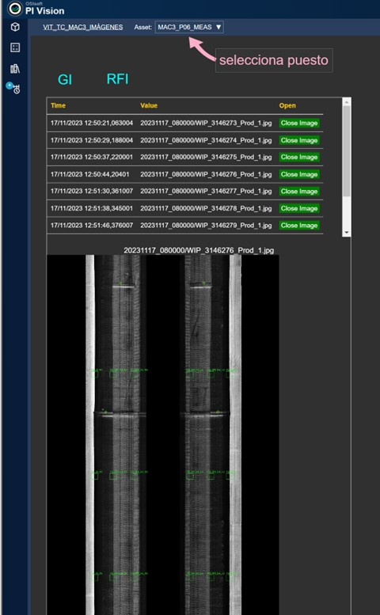

Every image and every alert, stored
PI System keeps the full history of every tire
See
Understand
Decide
Anticipate
Image of every product
retrievable by station, date and time
Alert history
station, type, start, end and duration
Foundation for AI
thousands of real images to learn from
Notes:
Traceability: in PI Vision you select a station and retrieve the image of every product with its date and time; the alert history logs station, type, start, end and duration. This archive of images and data is also the foundation on which we will train AI.

Slide 15
Decide: R4P
The engine that turns every measurement into action
03
Notes:
Climax of the presentation. From here the message changes: we don't just see and understand; the system decides and acts on its own.

Slide 16

R4P: the expert on every tire
Real-time rules engine connected to OLM measurement
See
Understand
Decide
Anticipate
Measures, decides and acts
in seconds, without waiting for anyone.
24/7
on every shift
100 %
of tires
Sec.
from measurement to action
Notes:
Metaphor: R4P is like having our best process technician watching every tire, on every shift, without getting tired. Its rules capture expert knowledge and apply it automatically.

Slide 17



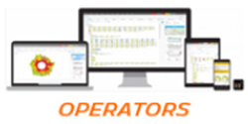
Four automatic responses
From the gentlest to the firmest, depending on the measurement
See
Understand
Decide
Anticipate
01
02
03
04
Alert
Adjust
Block
Segregate
Notifies the operator and the owner on screen and on mobile.
Corrects the machine parameter (R4P regulation) without intervention.
Stops the machine if the deviation cannot be corrected.
Will automatically remove the affected product from the line.
IN PRODUCTION
IN PRODUCTION
IN TESTING
NEXT PHASE
Notes:
Four clear options, from gentlest to firmest. Alert and adjust run today, block is in testing; automatic segregation is the next phase according to the R4P design itself. Being transparent strengthens credibility.

Slide 18
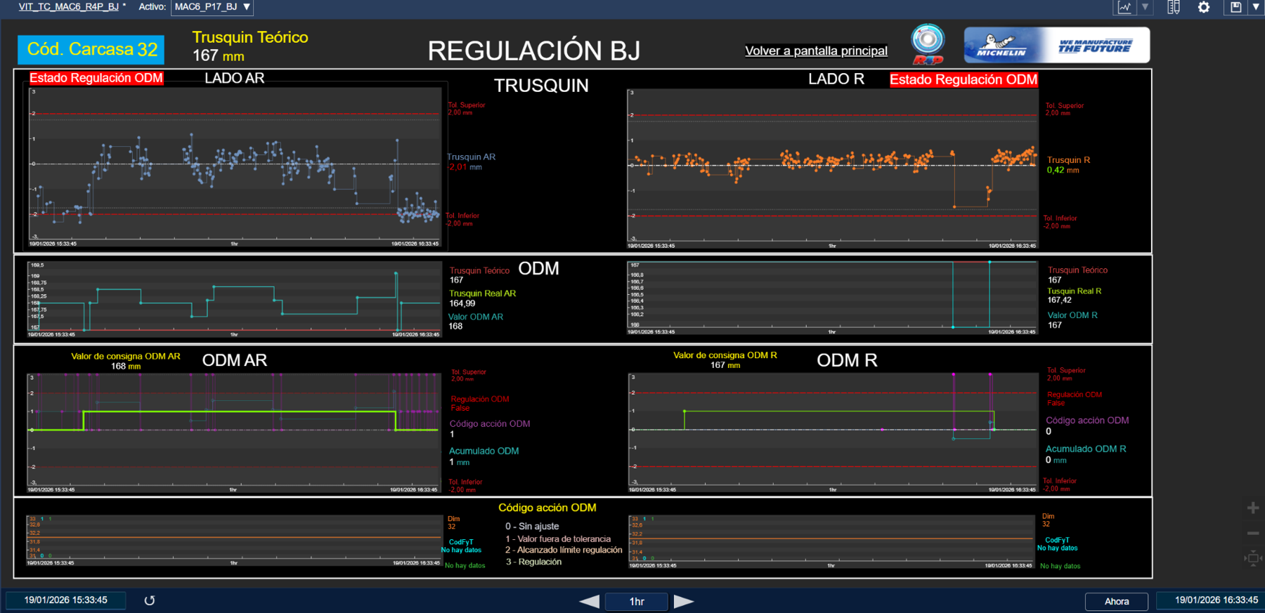
R4P in action: drift corrects itself
Real BJ regulation screen · MAC6 · station P17
See
Understand
Decide
Anticipate
1
Lower limit
the edge position reaches the limit
3
2
R4P acts
activates the ODM correction
1
4
3
Target
returns to the theoretical value
2
4
Without correction
it drifts again: the proof
Notes:
Tell the case in four steps on the real screen (MAC6, P17, January 2026). 1: the edge position (trusquín) reaches the lower limit. 2: R4P activates the ODM correction. 3: the measurement returns to the theoretical value. 4: when the correction is deactivated, the measurement drifts again. That contrast is the best proof that the correction works.

Slide 19
Why R4P makes the difference
What happens when a measurement starts to drift
See
Understand
Decide
Anticipate
Tires off target until someone acts
Without R4P
Manual correction
Drift starts
Alert fires
Tech arrives
Manual fix
R4P corrects instantly
Production is back on target immediately
With R4P
Automatic correction
Drift starts
Same rules 24/7
Quality does not depend on the shift or the time.
Expertise turned into rules
What the best technician knows, applied every time.
Every decision, logged
Full traceability in PI System.
Notes:
Key slide to sell R4P. Illustrative diagram (not real data): each circle is a tire leaving the machine. Without R4P, from the moment drift starts until someone sees the alert, reaches the machine and adjusts it, tires keep being built off target. With R4P, the rule acts as soon as the measurement deviates and production is back on target immediately. Every minute R4P saves means tires that never leave their theoretical value. And the rules are the same on every shift, with every decision logged in PI.

Slide 20
Anticipate
Advanced analytics and artificial intelligence
04
Notes:
Fourth step, the future: looking ahead builds enthusiasm and trust (future pacing). The customer also buys into where we are heading.

Slide 21
Dataiku: from millions of data points to patterns
Advanced analytics to understand every quality issue
See
Understand
Decide
Anticipate
01 Combine
02 Explore
03 Discover
04 Act
PI measurements, images and quality results (IQF)
Correlations between parameters, stations and shifts
Patterns that repeat before a drift
New rules, alerts and process improvements
A typical question
What Dataiku answers
“When a splice starts to drift, what do those tires have in common?”
Which parameters moved beforehand
Which stations, shifts or batches it concentrates in
Which new rule would have prevented it
Notes:
Dataiku is an advanced analytics and data science platform. It lets us combine PI System measurement data, images and quality results (IQF) in a single flow, and look for the patterns that repeat before a quality issue or a drift. Most valuable: it is used by our own process and quality technicians and engineers, not only data specialists. What we find becomes new rules, alerts and process improvements.

Slide 22
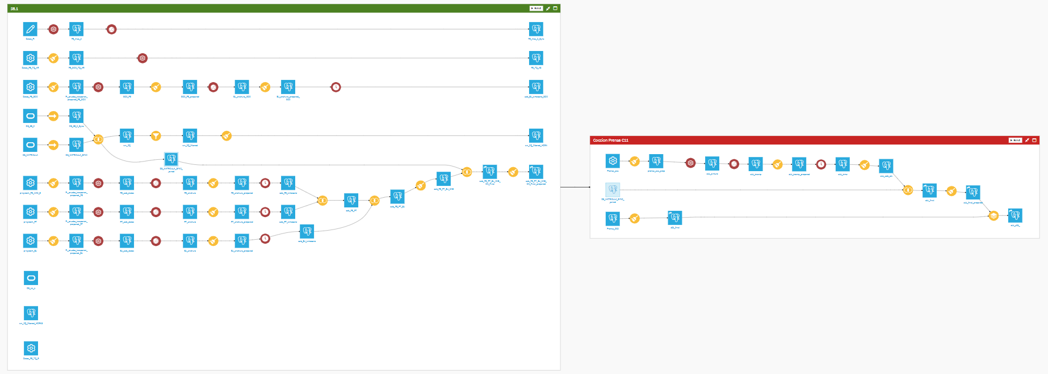
Dataiku: a real data flow
Quality characteristic CQ 38.1, from tire building to curing
See
Understand
Decide
Anticipate
Zone CQ 38.1
5
4
1
2
3
1
PI plugin
reads every station's measurements
2
Preparation
automatic cleaning
3
Join
time series across stations
4
Serial number
the tire's identity
5
C11 curing
its history is complete
Notes:
Real Flow screen from a Dataiku project dedicated to quality characteristic CQ 38.1 (green zone). Read it from left to right. 1) Sources: the PI plugin (red icons) reads each machine station's measurements directly from PI System (for example FE, PT and BJ). 2) Preparation recipes (yellow brush icons): clean and organise the data automatically, always the same way. 3) Time-series and join recipes: align the measurements of the different stations in time and combine them. 4) The serial number: links all measurements to the identity of each tire. 5) 'Cocción Prensa C11' zone: curing press data is added, so each tire has its complete history, from building to curing. The result is a table ready to search for patterns (which conditions appear before a drift or a quality issue) and to cross with IQF. The whole flow re-runs automatically when new data arrives (Build), with no manual work. The project has 154 items.

Slide 23
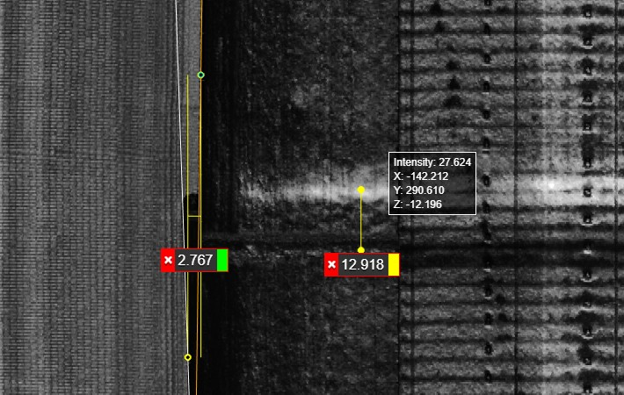
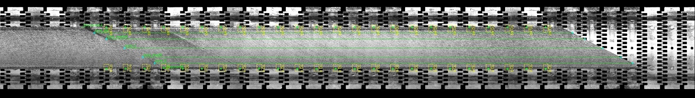
AI on our laser images
The laser measures; AI recognises what no dimension can measure
See
Understand
Decide
Anticipate
Measure: laser and dimensions
Recognise: AI
What has no dimension:
+
Surface roughness and texture
Possible foreign matter
Poorly dispersed rubber
Other product characteristics
Today and always.
Width, edge position, centring and splice, with their tolerances.
Learns what a good product looks like and flags anything out of the ordinary.
The foundation already exists: thousands of real images archived in PI, linked to their measurements and alerts.
Notes:
Key message: AI does not replace measurement. Measurements are always made with the laser profilers and their dimensions and tolerances (width, edge position, centring, splice). AI works on those same images to detect product characteristics that cannot be expressed as a dimension: surface roughness and texture, possible foreign matter, poorly dispersed rubber and other product aspects. It is trained on images of good product and flags anything out of the ordinary. The foundation already exists: thousands of real images archived in PI. Status: under study.

Slide 24
Process mastery and continuous improvement
Every turn of the cycle makes us a little better
See
Understand
Decide
Anticipate
We measure
every tire with 3D lasers
01
See
We understand
real-time trends and alerts
IQF
04
02
Anticipate
Understand
We correct
automatically with R4P
03
We learn
patterns with Dataiku and AI
Decide
Notes:
Close the technical part with the full cycle, the same as at the start (repetition = recall). Every turn adds knowledge: what we discover with Dataiku and AI becomes new R4P rules and a better IQF. It is a living system that learns.

Slide 25
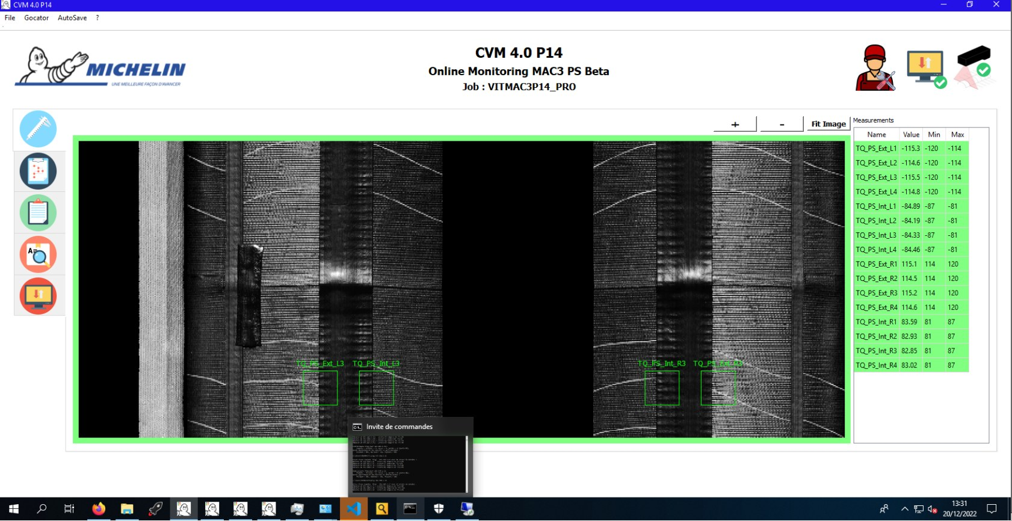
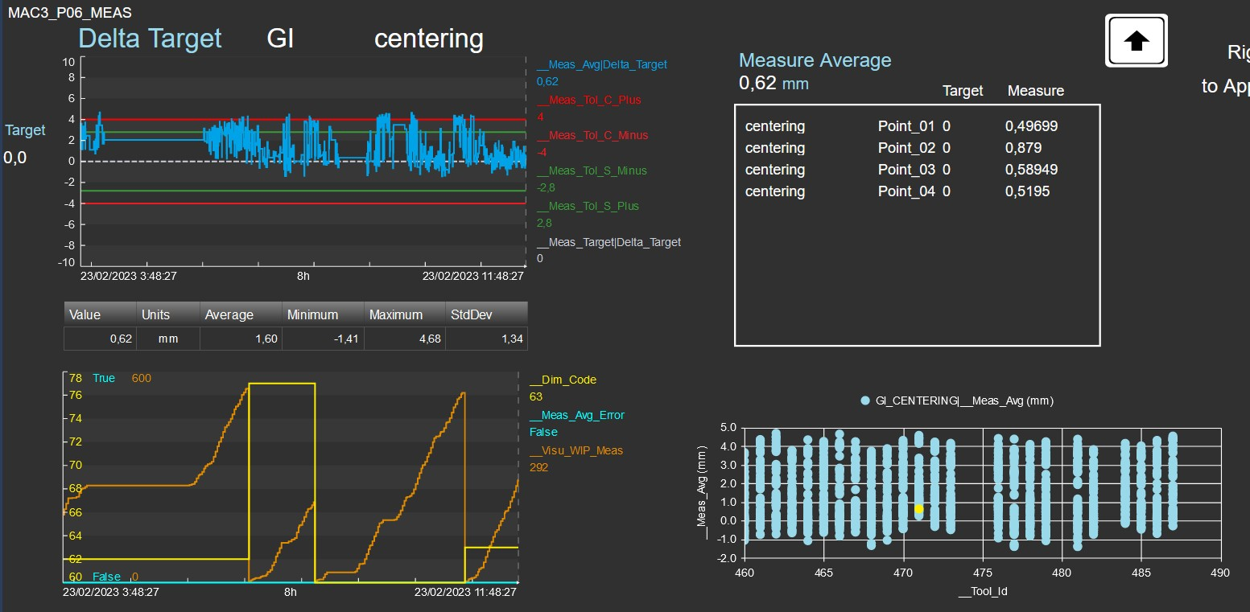
The right information for every person
The same data, turned into action at every level
Operator
Process and maintenance
Engineering and quality
Sees the status of their station in real time.
Receive the alert and act on the machine.
Analyse trends and improve rules and IQF.
Notes:
Slide about people, without overstating: the system replaces no one, it gives each role what it needs to act. Operator: real-time status of their station. Process (CARE) and maintenance (TECH) technicians: alerts on screen and on mobile. Engineering and quality: technical analysis screens to study trends and improve the rules and IQF.

Slide 26
Every tire: seen, understood, decided and better every day
See · Understand · Decide · Anticipate
Hyundai
& Michelin · Trusted partners for new technologies
Notes:
Memorable close: repeat the four verbs. Leave a silence at the end. This is the sentence we want them to remember.

Slide 27
Thank you

