Slide 1
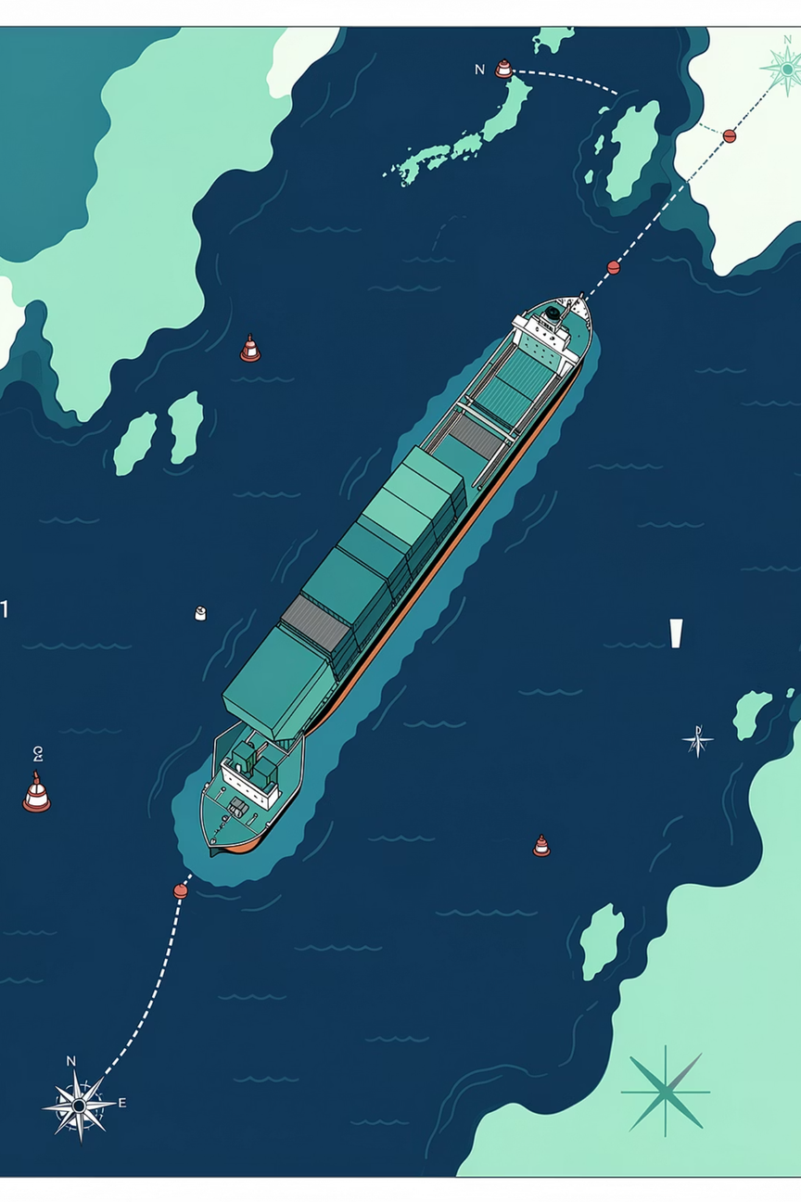

Ocean Route Safety Prediction
Team Details: 23071A0589 – K Suprith 23071A05A2 – Mohd Asif Ali Shaan 23071A05A7 – Narmala Manish 23071A05C2 – Shahed Azeem
23071A05C3 – Md Irfan
Notes:
1

Slide 2
Problem Statement
Environmental Factors
Data Challenges
Ocean navigation depends on complex environmental conditions including temperature, salinity, oxygen levels, and depth variations
Raw ocean sensor data is large, noisy, and contains numerous missing values requiring sophisticated preprocessing
Manual Analysis
Need for ML
Current manual route safety analysis is slow, error-prone, and lacks intelligent automation
A data-driven machine learning solution is essential to automatically classify routes as safe or unsafe
Notes:
2

Slide 3
Project Objective
01
02
Data Preprocessing
Feature Selection
Preprocess ocean sensor data and handle missing values systematically
Select relevant oceanographic features for modeling
03
04
Feature Engineering
Regression Training
Engineer new safety indicators: WaterCondition, DensityIndex, VisibilityRisk, SafeRoute
Train regression models to predict temperature and oxygen levels accurately
05
06
Classification Model
Model Evaluation
Train classification model to predict SafeRoute (Safe/Unsafe) classification
Evaluate using Accuracy, Precision, F1 Score, and R² Score metrics
Notes:
3

Slide 4
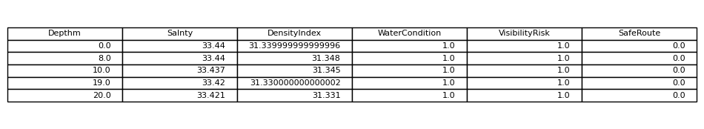
Dataset Overview
Source & Context
Dataset: Ocean Bottle Dataset (Kaggle – CalCOFI)
Region: California Current System, Pacific Ocean
Format: CSV with 75 features (6 selected for modeling)
Key Features
Depthm – Ocean depth measurements
T_degC – Temperature readings
Salnty – Salinity levels
O2ml_L – Oxygen concentration
R_TEMP – Recorded temperature
R_SALINITY – Recorded salinity
Featured Dataset
Notes:
4

Slide 5
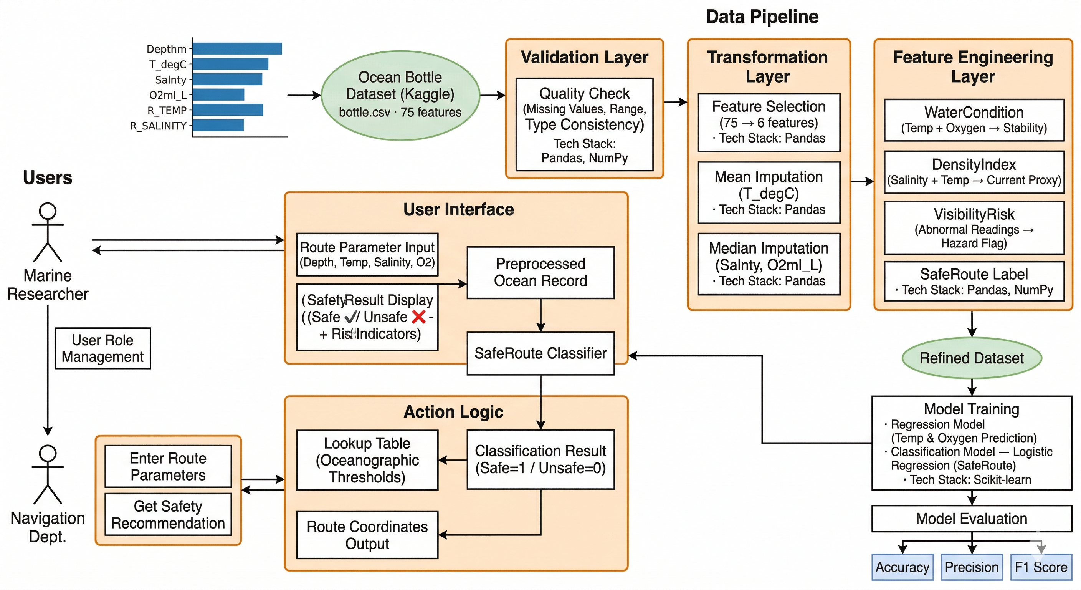
System Architecture
Notes:
5

Slide 6
Feature Engineering
Derived four new safety indicators from raw oceanographic measurements to enhance route safety prediction accuracy
1
2
WaterCondition
DensityIndex
Composite indicator based on temperature and oxygen levels to assess overall water quality and suitability for navigation
Calculated from salinity and temperature to determine water density, which affects vessel buoyancy and navigation safety
3
4
VisibilityRisk
SafeRoute
Identifies abnormal environmental conditions that could impair visibility or create hazardous navigation circumstances
Binary safety label where Safe = 1 and Unsafe = 0, derived from comprehensive environmental factor analysis
Notes:
6

Slide 7
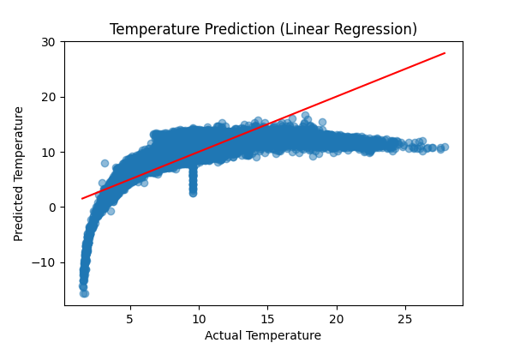
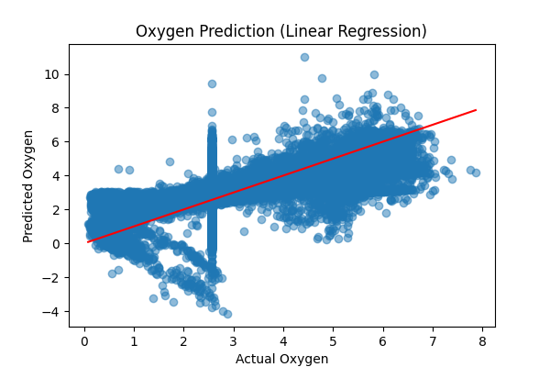
Regression Models
Temperature Prediction
Oxygen Prediction
Algorithm: Linear Regression
Train-test split: 80/20
Algorithm: Linear Regression
Train-test split: 80/20
Input Features: Depth + Salinity
Input Features: Depth + Salinity
R² Score: 0.72
R² Score: 0.64
Key Insight: Depth increase leads to decrease in both temperature and oxygen levels, reflecting known oceanographic principles
Notes:
7

Slide 8
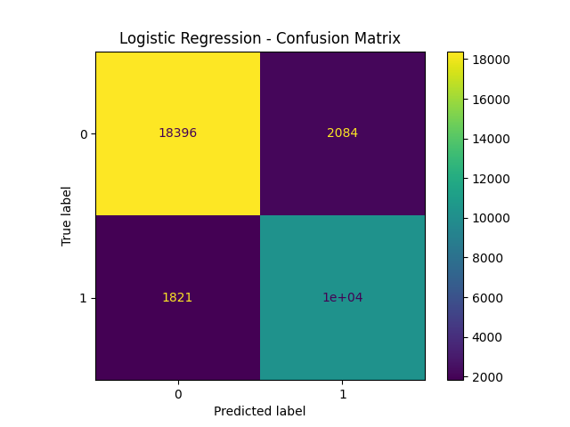
Classification Model
Algorithm: Logistic Regression
Selected for simplicity, interpretability, and efficiency in binary classification tasks
Input Features
Depthm, Salnty, DensityIndex, WaterCondition, VisibilityRisk
Output: SafeRoute
Binary classification producing Safe (1) or Unsafe (0) route predictions
Notes:
8

Slide 9
Business Use Cases
Marine Navigation
Environmental Monitoring
Risk Identification
Helps maritime operators determine optimal safe routes, reducing risks and fuel consumption while ensuring crew safety
Flags unsafe zones and hazardous conditions in advance, enabling preventive measures and route optimization
Detects abnormal ocean conditions and environmental changes, supporting marine ecosystem research and conservation efforts
Output Decision Logic
Safe Route ✓
Unsafe Route ✗
System recommends PROCEED with the planned navigation route
System recommends AVOID and suggests alternative safe routes
Notes:
9

Slide 10
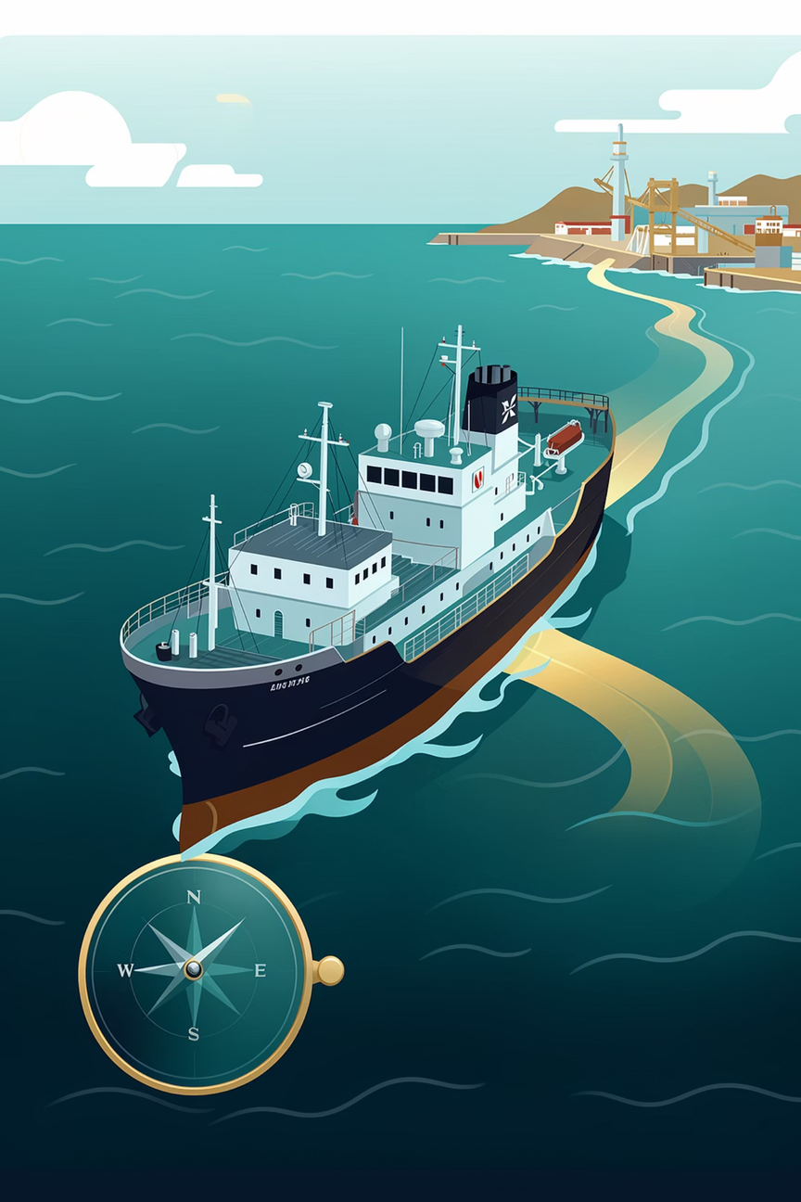
Results & Conclusion
91.5%
0.64
Classification Accuracy
Temperature R² Score
High precision in identifying unsafe routes
Regression model performance
0.72
Oxygen R² Score
Regression model performance
Conclusion
The system successfully converts raw ocean data into actionable safety decisions using machine learning. With 91.5% accuracy and strong regression performance, this approach provides a reliable framework for automated ocean route safety classification, demonstrating the practical application of ML in marine navigation and environmental monitoring.
Notes:
10

Slide 11
Thank You

