Slide 1
Software Testing
Testing Techniques

Slide 2
Black Box Testing
Functional Testing
Logical flow is tested
Consider System as Black Box
External Testing
Behavioural Testing
Opaque Testing

Slide 3
Black Box Testing
State Transition Testing
Decision Tables
Boundary Value analysis
Equivalence Partitioning

Slide 4
State Transition Testing
States are the modules
Transition happens between states
Transitions are the Jump from one state to another
Counted as switches and jumps
0 switch= 1 Jump
1 switch= 2 Jump

Slide 5
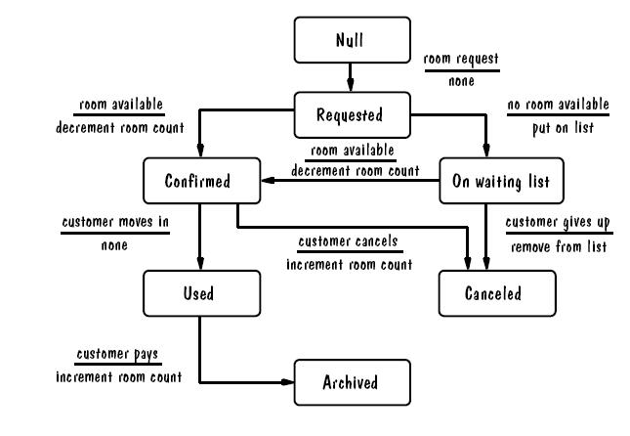
Room Booking Example

Slide 6
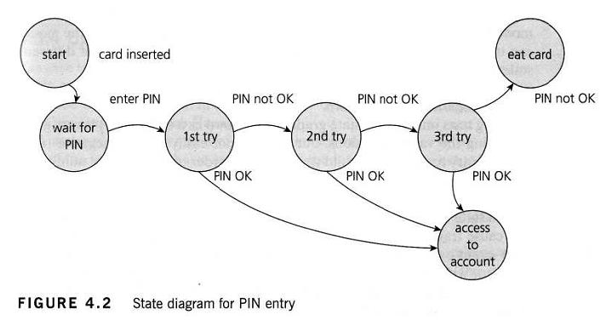
ATM example

Slide 7
Decision Table
A decision table is a good way to deal with combinations of things (e.g. inputs).
This technique is sometimes also referred to as a ’cause-effect’ table
Decision tables provide a systematic way of stating complex business rules, which is useful for developers as well as for testers.

Slide 8
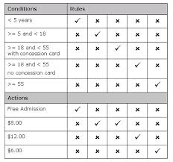
Example

Slide 9
Decision Table
Let’s take another example. If you are a new customer and you want to open a credit card account then there are three conditions first you will get a 15% discount on all your purchases today, second if you are an existing customer and you hold a loyalty card, you get a 10% discount and third if you have a coupon, you can get 20% off today (but it can’t be used with the ‘new customer’ discount). Discount amounts are added, if applicable.

Slide 10
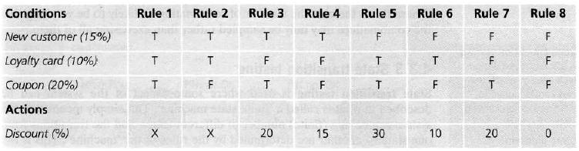
Decision Table

Slide 11
Boundary Value analysis
Testing boundary levels of scenario
To uncover corner level cases
Deviations due to poor documentation
Due to lack of communication
min-1,min,min+1 and Max-1, max, max+1
Valid BV – min,min+1,max-1,max
Invalid BV – min-1,max+1

Slide 12
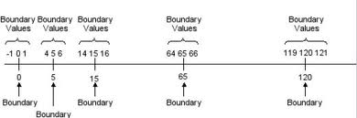
Example for BVA

Slide 13
Equivalence Partition
Equivalence partitioning (EP) is a specification-based or black-box technique.
It can be applied at any level of testing and is often a good technique to use first.
In equivalence-partitioning technique we need to test only one condition from each partition.

Slide 14
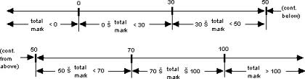
Example

Slide 15
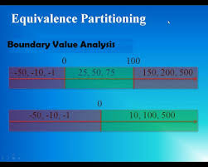
Comparison

Slide 16
White Box Testing
Clear Box Testing
Glass box, Internal Testing
Code Level testing is done
Transparent Testing
Mostly done by programmers
Coding skills are needed

Slide 17
Techniques
Path testing
Loop Testing
Statement Testing
Cyclomatic Complexity

Slide 18
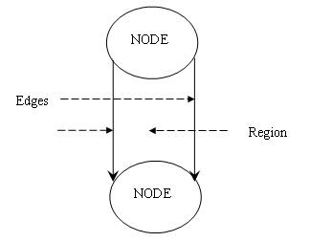
Code Graph Diagram

Slide 19
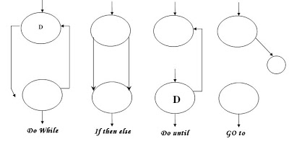
Graph for loops

Slide 20
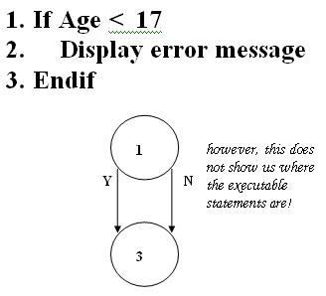
Graph for loops

Slide 21
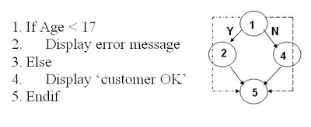
Graph for IF LOOP

Slide 22
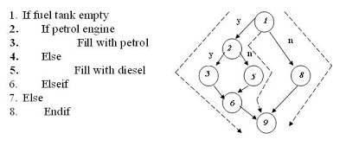
Graph for NESTED IF Condition

Slide 23
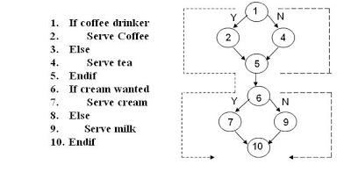
Graph for NESTED IF LOOP

Slide 24
Cyclomatic Complexity
Mc Cabe’s Formula
G= E-N+2
G=R+1
Code Coverage
No of statements executed/Total no of statements*100

