Slide 1
BANGLADESH UNIVERSITY OF PROFESSIONALS | DEPT. OF ICT
Flight Route Optimization: A* vs. DFS
Heuristic Geodesic Search on Global Flight Networks (Dhaka → Frankfurt)
PRESENTED BY:
• Asif Ahmed Rezvi (23549009030)
• Rafat Hossan Leon (23549009102)
PRESENTED TO:
• Jasiya Fairiz Raisa
Lecturer, Dept. of ICT, BUP
• Nazneen Akter
Assistant Professor, ICT, BUP

Slide 2
PRESENTATION ARCHITECTURE
Three-Part Technical Agenda
PART 1
WHAT WAS THE PROBLEM?
• Dense global flight network with 7,698 airports & 36,907 routes.
• No direct flight: Dhaka (DAC) → Frankfurt (FRA).
• Why blind search (DFS) gets trapped in loops & multi-continent detours.
PART 2
HOW WE SOLVED IT
• Formulated formal State-Space graph model.
• Engineered A* Search with spherical Haversine distance.
• Mathematical proof: Strict admissibility & consistency.
PART 3
WHY OUR SOLUTION WINS
• A* found 2-hop optimal path: 7,546 km (+1.53% of direct line).
• DFS took 12 hops: 34,291 km across 4 continents!
• Empirical results: 5.63x faster, 7.17x less RAM, 97.2% pruned.

Slide 3
PART 1: WHAT WAS THE PROBLEM?
Aviation Scale & Multi-Hop Path Dilemma
Massive Real-World Graph Scale
• 7,698 Worldwide Airports (|V| Nodes).
• 36,907 Valid Flight Routes (|E| Edges).
• Dense Cyclic Multigraph with high branching factor (>150 at major hubs).
• Spherical Earth geometry invalidates flat Euclidean formulas.
The Hardcoded Flight Dilemma
• Origin: Hazrat Shahjalal Int'l, Dhaka (DAC).
• Destination: Frankfurt am Main (FRA).
• NO DIRECT FLIGHT exists in the dataset!
• Requires connecting layovers through intermediate global hubs.
• Crucial Test: Can AI search discover optimal layovers without wandering?

Slide 4
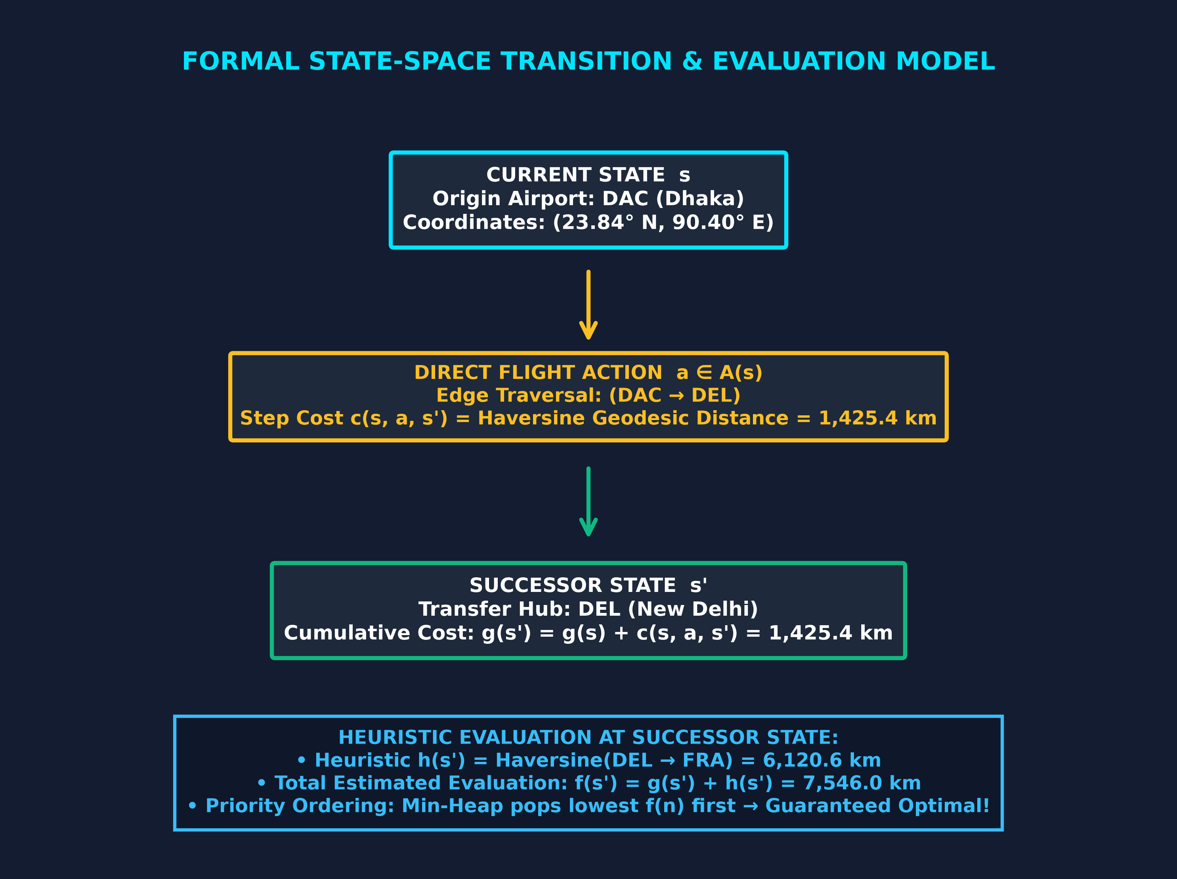
PART 1: WHAT WAS THE PROBLEM?
Why Uninformed DFS Fails on Cyclic Networks
The Blind Search Trap
• Zero Spatial Compass: DFS cannot tell East from West.
• Trapped in Cycles: Commercial routes create infinite loops without visited tracking.
• Arbitrary Branching: Dives into Bangkok, wandering across continents.
• Forced Depth Limit: Had to enforce max_depth = 12 to halt execution.

Slide 5
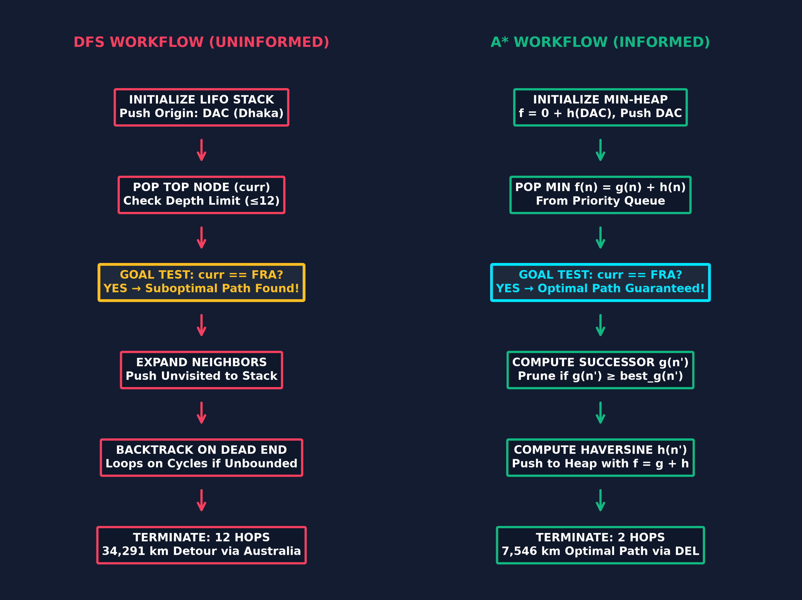
PART 2: HOW WE SOLVED IT
Engineered A* Search with Priority Evaluation
Informed A* Engine
• Priority Formula: f(n) = g(n) + h(n)
• g(n): Exact flight distance from Dhaka.
• h(n): Geodesic distance to Frankfurt.
• Min-Heap Frontier: Always expands lowest f(n) first.
• Dynamic Pruning: Discards path if g(n') ≥ best_g(n').
• Result: Pruned 97.2% of worldwide airports!

Slide 6
PART 2: HOW WE SOLVED IT
Mathematical Proof of Heuristic Optimality
Haversine Equation & Admissibility
d = 2R · arcsin( √(sin²(Δφ/2) + cos φ₁ cos φ₂ sin²(Δλ/2)) )
• Admissible Proof [h(n) ≤ h*(n)]:
Great-circle arc is the shortest geodesic on a sphere. Any real flight path ≥ arc. Heuristic NEVER overestimates true cost!
Consistency & Heuristic Tightness
• Consistent Proof [h(n) ≤ c + h(n')]:
By Spherical Triangle Inequality, direct arc to Goal ≤ edge cost + neighbor arc. No closed nodes ever re-expanded!
• Geodesic Lower Bound: 7,432 km.
A* Found Path: 7,546 km.
Phenomenal Accuracy: Only 1.53% delta!

Slide 7
PART 3: WHY OUR SOLUTION WINS
Discovered Routes: 2 Hops vs. 12-Hop Detour
A* Search (Optimal Itinerary)
• DAC (Dhaka) → DEL (Delhi): 1,425 km
• DEL (Delhi) → FRA (Frankfurt): 6,121 km
★ Total Distance: 7,546.03 km
★ Total Hops: Exactly 2 Hops (1 Layover)
★ Delta from Ideal Line: +1.53% (+114 km)
★ Fast, realistic, commercially viable route!
DFS Search (Suboptimal Detour)
• DAC → Bangkok → Singapore
→ Darwin → Brisbane → Adelaide → Sydney
→ Chongqing → Guangzhou → Chengdu
→ Zhengzhou → Taipei → FRA
✗ Total Distance: 34,290.75 km (4.54x longer!)
✗ Total Hops: 12 Hops (11 Layovers!)
✗ Absurd detour wandering across 4 continents!

Slide 8
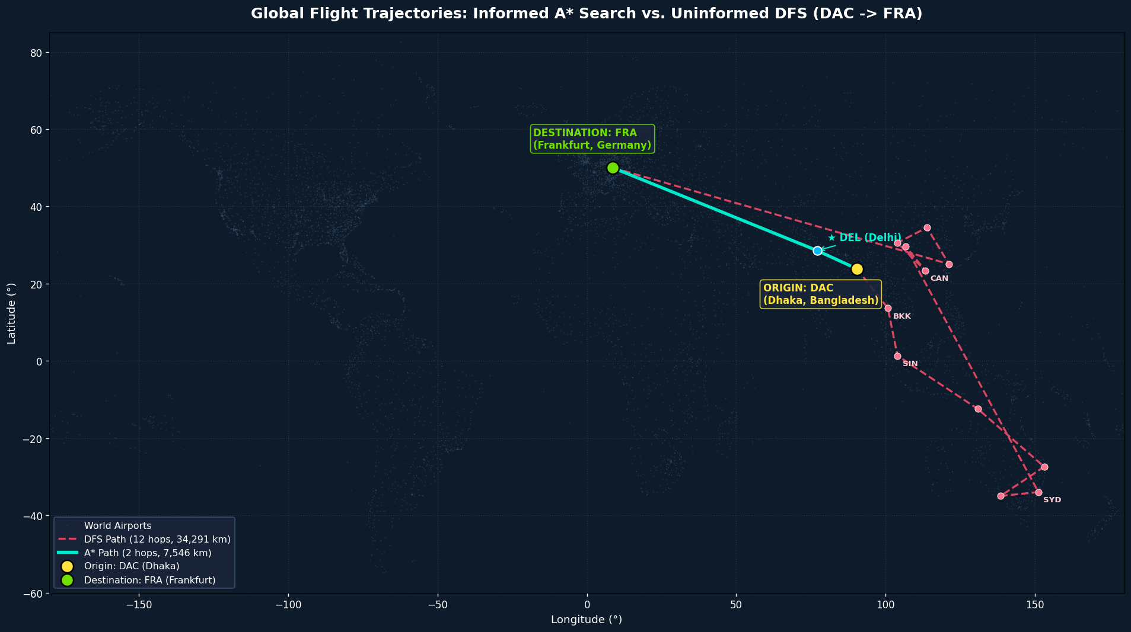
PART 3: VISUAL PROOF
Cartographic World Trajectory Projection
Visual Verdict
• Cyan Arc (A*): Precision geodesic flight directly West into Frankfurt.
• Crimson Path (DFS): Loops down to Australia and China.
• 97.2% Pruning: Ignored all irrelevant continents!

Slide 9
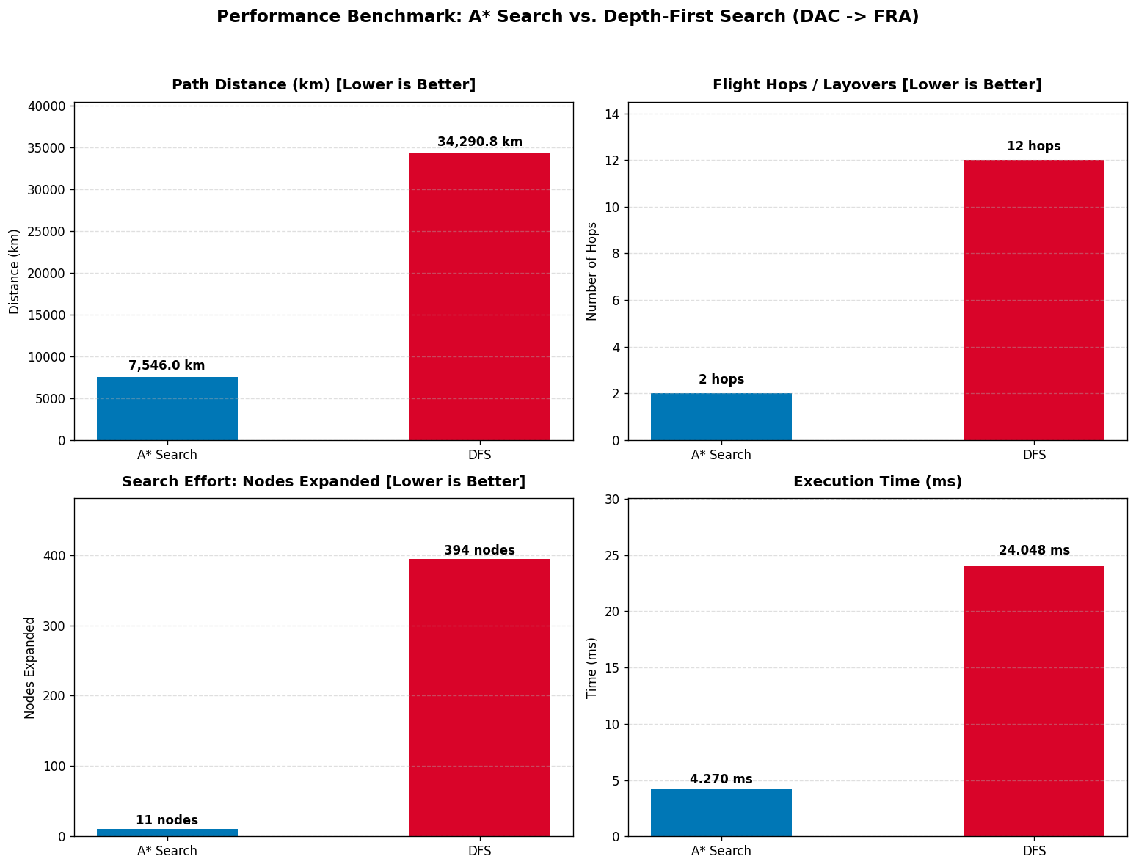
PART 3: RESULTS & EMPIRICAL EVALUATION
Rigorous Performance Benchmarks (Google Colab)
Definitive Benchmarks
Path Distance: 7,546 km vs 34,291 km (DFS is 4.54x longer)
Flight Hops: 2 hops vs 12 hops (6.0x fewer layovers)
Nodes Expanded: 11 vs 394 nodes (A* pruned 97.2%)
Execution Time: 4.27 ms vs 24.05 ms (A* is 5.63x faster)
Peak Memory: 25.0 KB vs 179.2 KB (7.17x less RAM)

Slide 10
THANK YOU!
Presented To Respected Instructors:
Jasiya Fairiz Raisa (Lecturer, ICT, BUP) & Nazneen Akter (Assistant Professor, ICT, BUP)
Presented By:
Asif Ahmed Rezvi (23549009030) & Rafat Hossan Leon (23549009102)

