Slide 1
FACE RECOGNITION ATTENANCE SYSTEM
SUBMITTED BY:
Jahid Hasan Shaown(C173029)
Emaz Uddin Ahmad(C173035)
Habibullah Md. Asif(C173089)
Submitted To:
MD. Khalilluzzaman
Assistant Professor
Dept. Of CSE,IIUC

Slide 2
Introduction
As we talk of present online based education system face recognition attendance system is very helpful to take automatic attendance. In our project we will create a model using opencv and face recognition model that will recognize a persons face and take entry time of that person. The model will recognize the persons whose picture were feed to the model.

Slide 3
Library
The library we used in this project
OpenCV
Numpy
Face Recognition

Slide 4
Features
Facial Recognition: The model will recognize any person by cross matching the facial pattern of that person with the stored image data of the database. If the pattern matches then the model will automatically recognize it.
Auto Attendance System: When the picture of the input is recognized by the model then the name of the person and the time of his entry will automatically stored in a csv file.

Slide 5
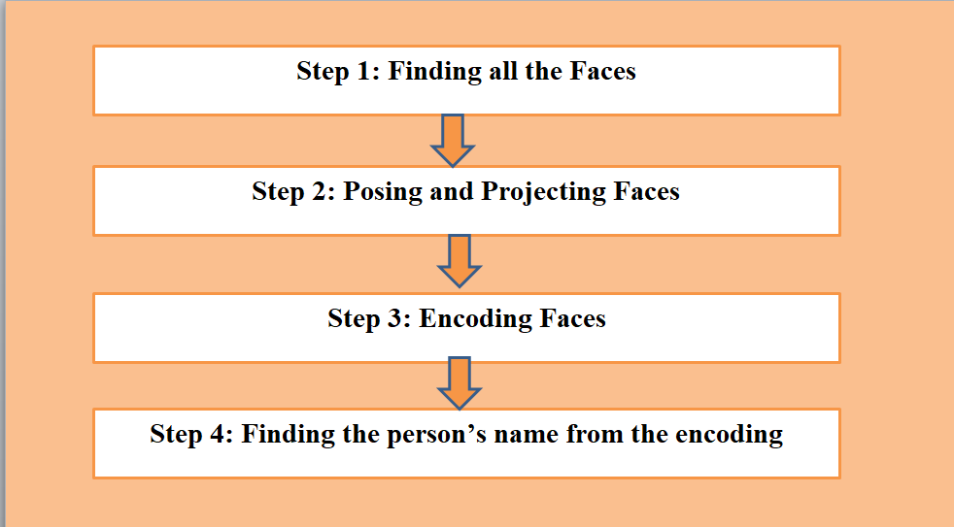
What Was Our Approach

Slide 6
Model Train & Test
We will use some sample picture to train the model and we will test the model using different pictures of those persons.

Slide 7
Input:
Here we will use some pictures as the input/dataset of our project. And we will see if any persons face matches with those image or not.

Slide 8
Output:
If any persons face matches with the image of the dataset then the system will automatically recognize it and label it with the name of the image.
In addition the time of the entrance and the name of the person will be stored in a csv file which we may consider as the attendance file.

Slide 9
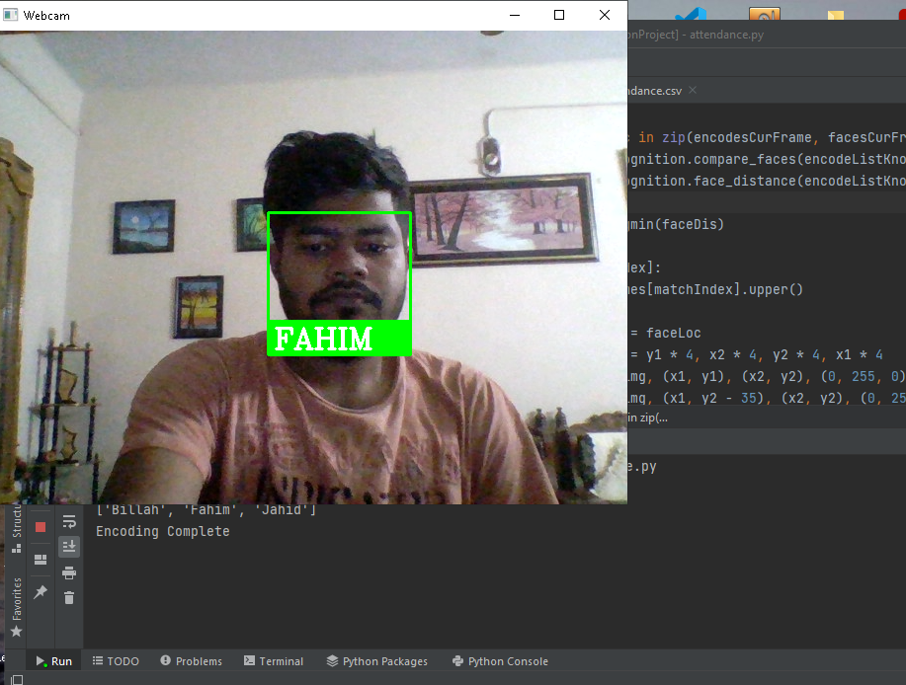
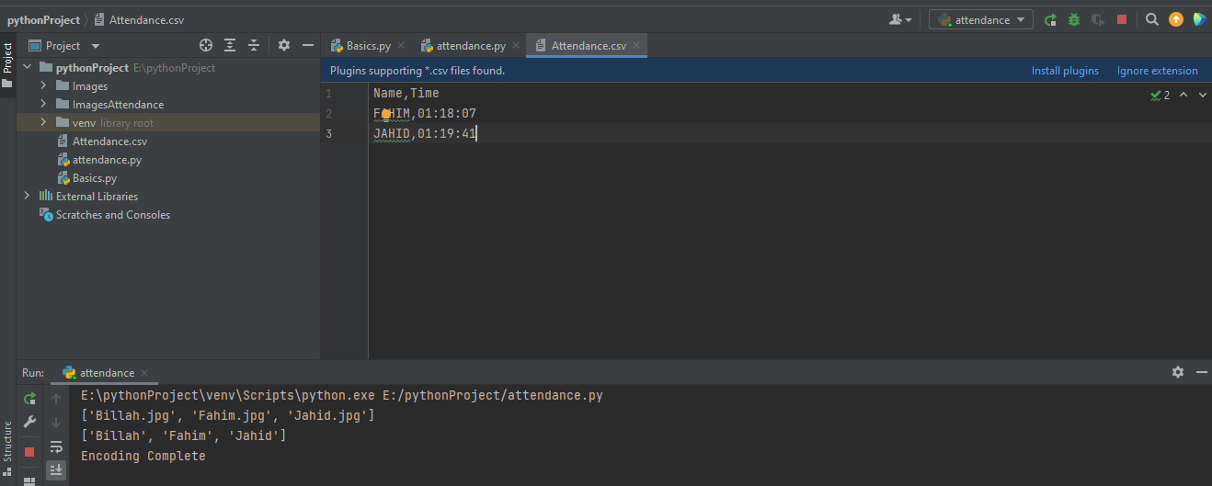
Sample Output:
Face Recognition
Auto Attendance System

Slide 10
THANK YOU

