Slide 1
The particle in a box
By Schrodinger equation
Prepared By:
Mushfikur Rahman Navin
ID: 2006190
MD Asif Hassan
ID: 2006189

Slide 2
Overview
Introduction
Objective
App interface and working procedures
Examples
Limitations

Slide 3


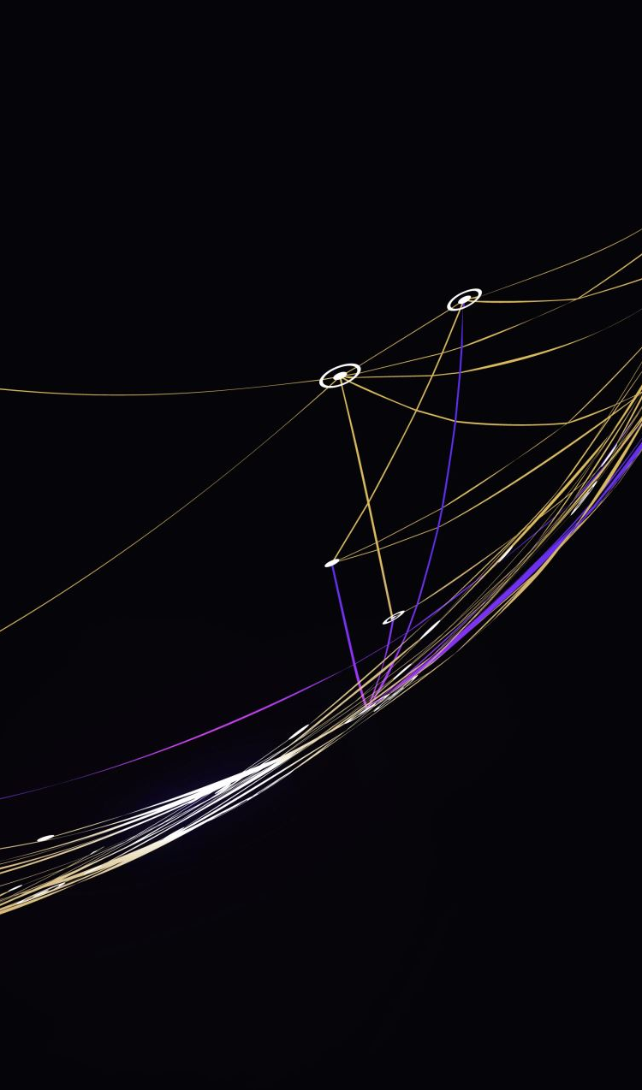
Introduction:
The behavior of the particles at the quantum scale is wave-like. As a result, a specific quantum particle can be represented as a wave function, and the Schrödinger equation can be used to correlate the wave function to the space and time coordinates. Investigating the Schrödinger equation's solutions under different boundaries and potential conditions is an effective technique to obtain important insight into quantum physics. Unfortunately, it is difficult to solve the Schrödinger equation analytically, and it can only be done for a few specific potential functions. We'll take a look at a few numerical techniques in this study, namely the finite difference method. The time-independent Schrödinger equation can have solutions provided by this method in a range of one-dimensional scenarios.

Slide 4
Objective:
Understand the basics of quantum mechanics
Derive the energy levels formula
Investigate the system's probability density and wave functions
Compare with other systems, develop computational models
Explore experimental techniques
Appreciate its significance as a model for quantum mechanics

Slide 5
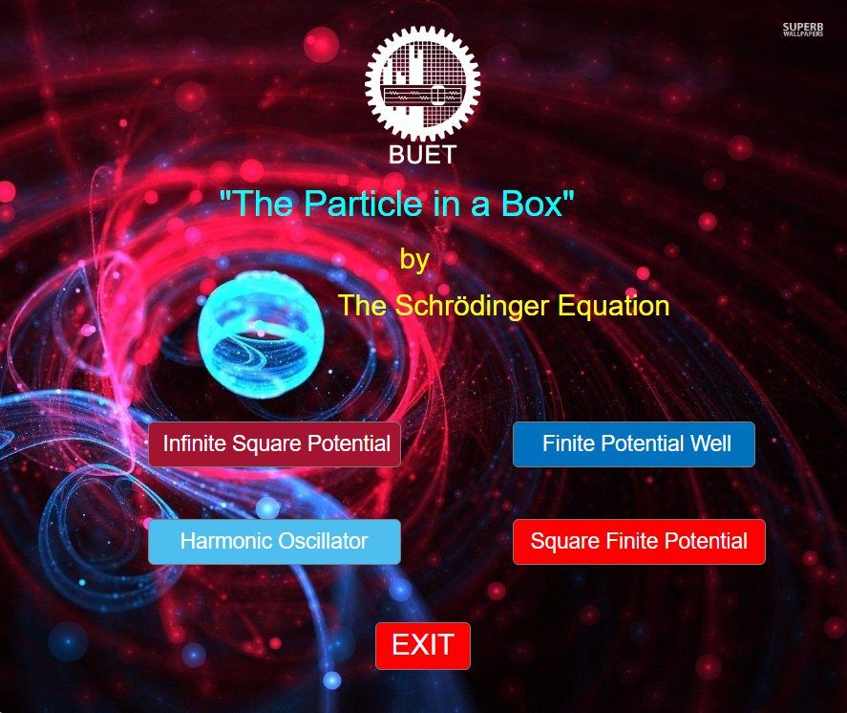
Overview of the App:

Slide 6
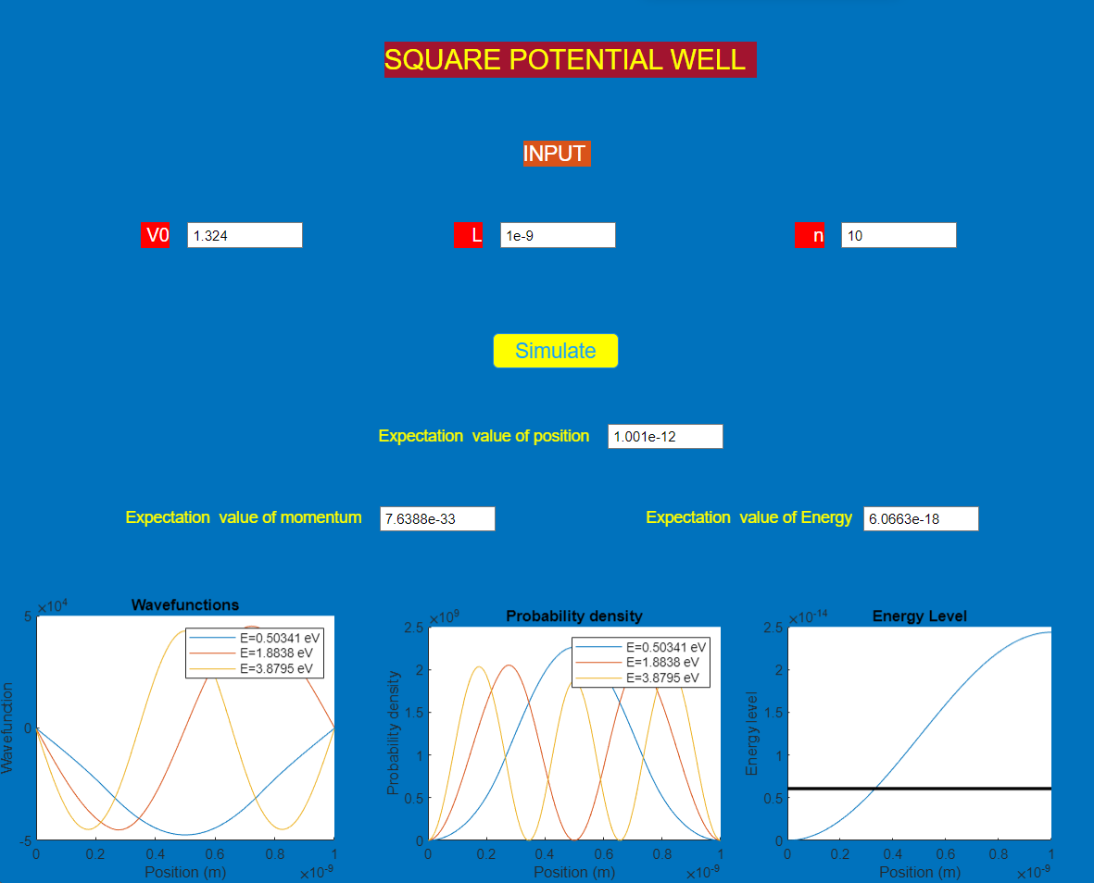
Square Potential Well:

Slide 7
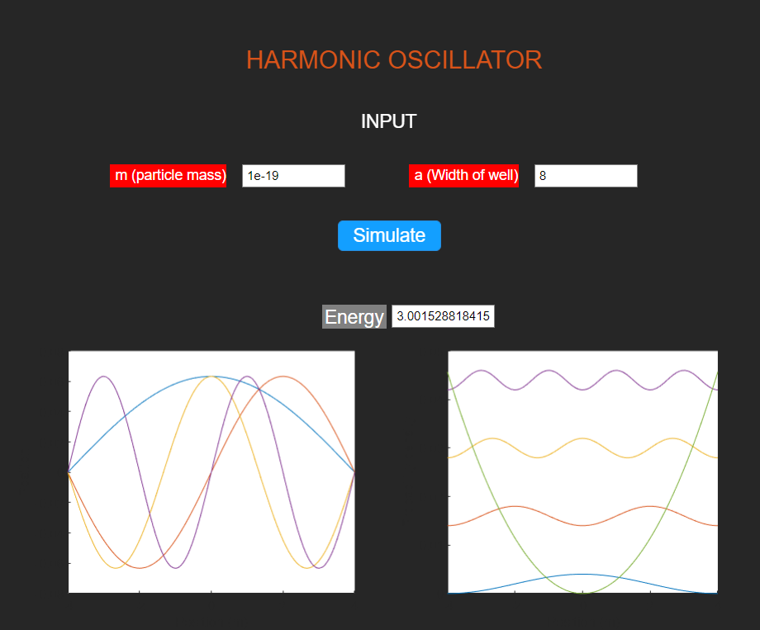
Harmonic Oscillator:

Slide 8
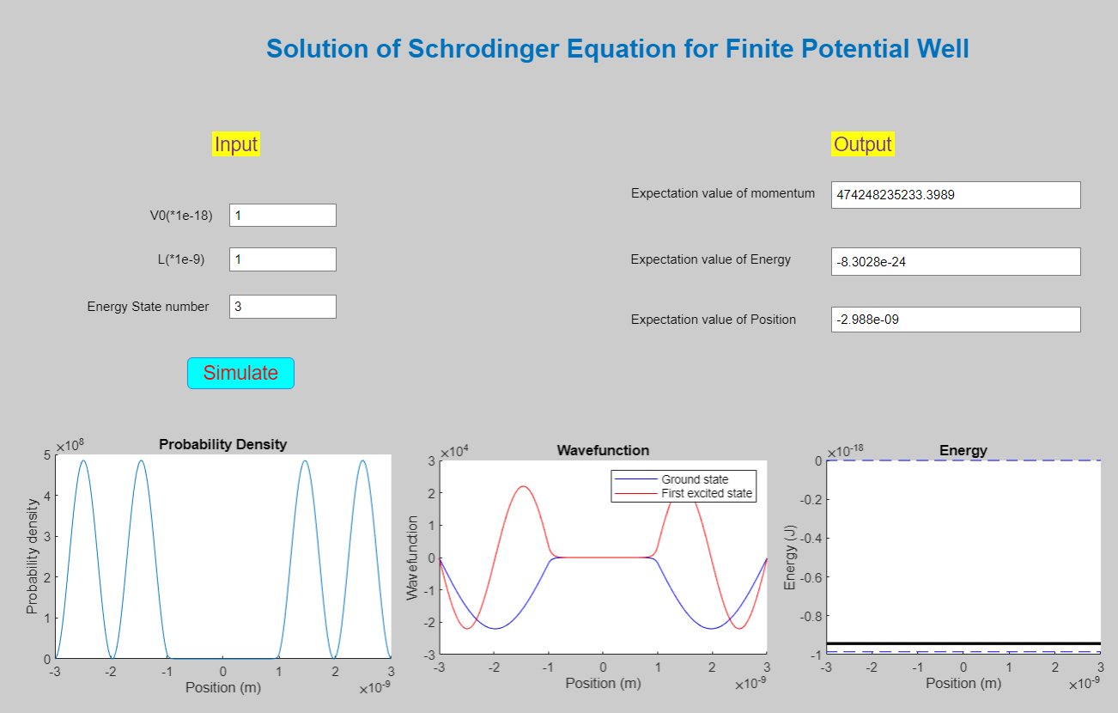
Finite Potential Well:

Slide 9
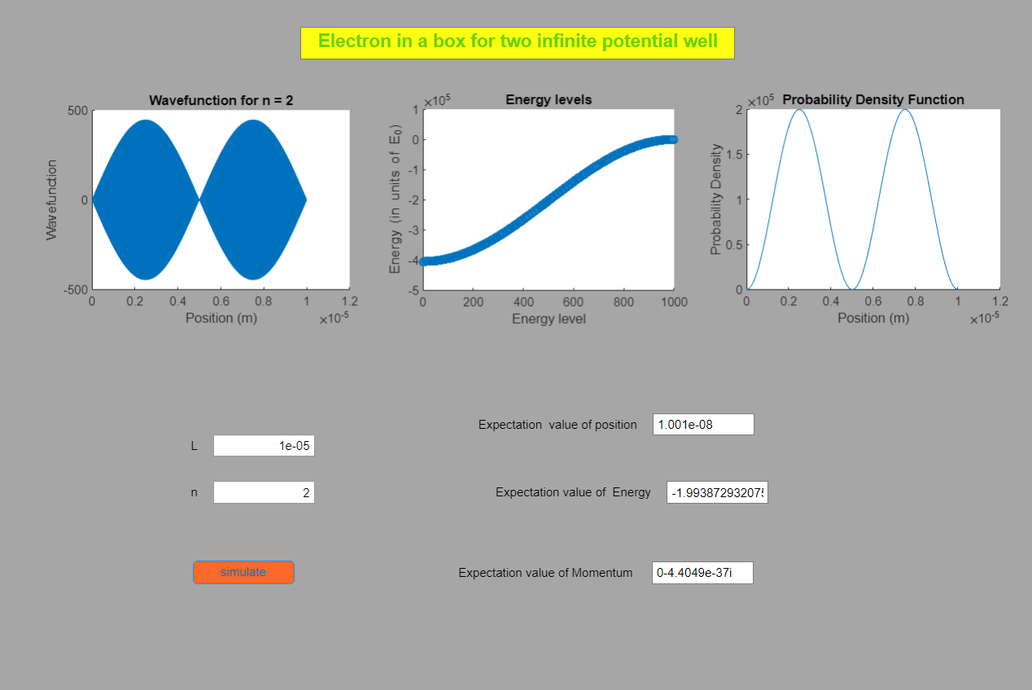
Infinite Square Well:

Slide 10
Limitations:
It cannot work for all conditions
It takes a little longer time to provide output

Slide 11
THANK YOU

