Slide 1


Slide 2

Virtual Online Academy

Slide 3
Group Members Introduction
Group ID:
F1702834E6
Group Member:
Asif Ramzan BC140402040
Adeel Ahmed BC130402634

Slide 4

INTRODUCTION OF PROJECT
Online academy is an institution reaching out of the people homes. Our mission is the provision of a first class learning experience that will equip students with the skills, ability & knowledge to successfully complete in their chosen discipline.
Online Academy provides IT education via LIVE ONLINE Training sessions where instructor shares his/her screen to students. Students can ask questions of the instructor as if they are sitting in front of teacher in real time. Teacher may reside in one part of the world but still he/she is able to facilitate and teach students living in some other part of the word.

Slide 5
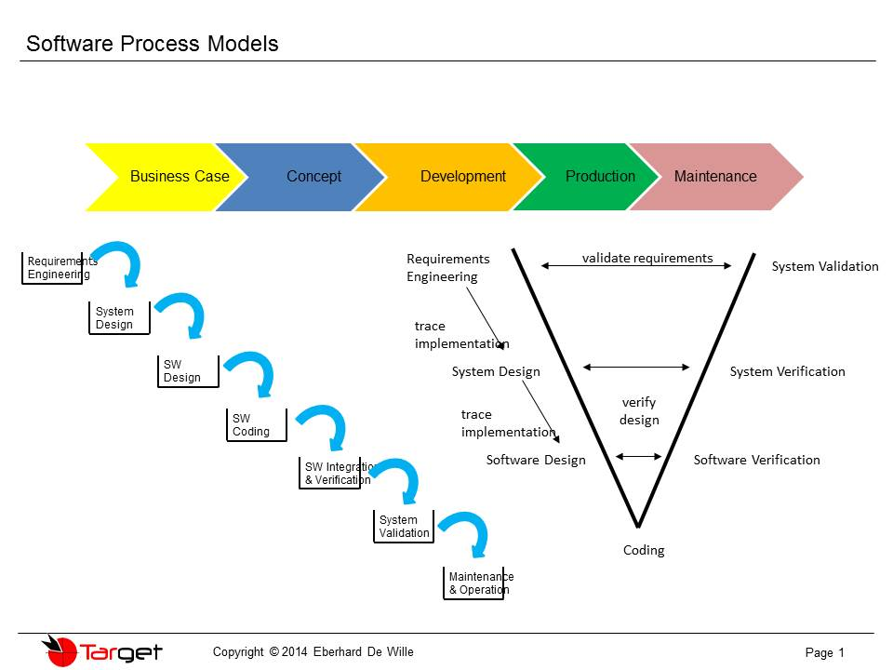

Slide 6
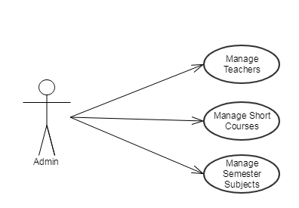
Use Case Diagram

Slide 7
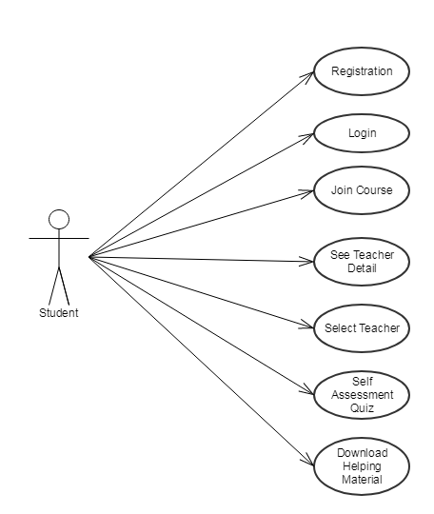

Slide 8
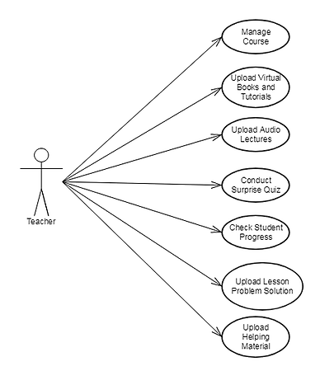

Slide 9

Business Rules Catalog

Slide 10
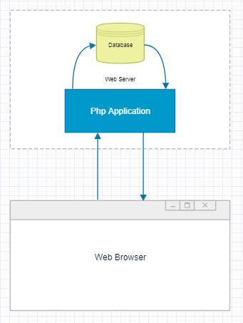
Architectural Design

Slide 11
Team Structure
Adeel Ahmed
Asif Ramzan
Frontend
Backend

Slide 12
Project Schedule
Provide the Schedule (Gantt Chart) of your
project here.

Slide 13
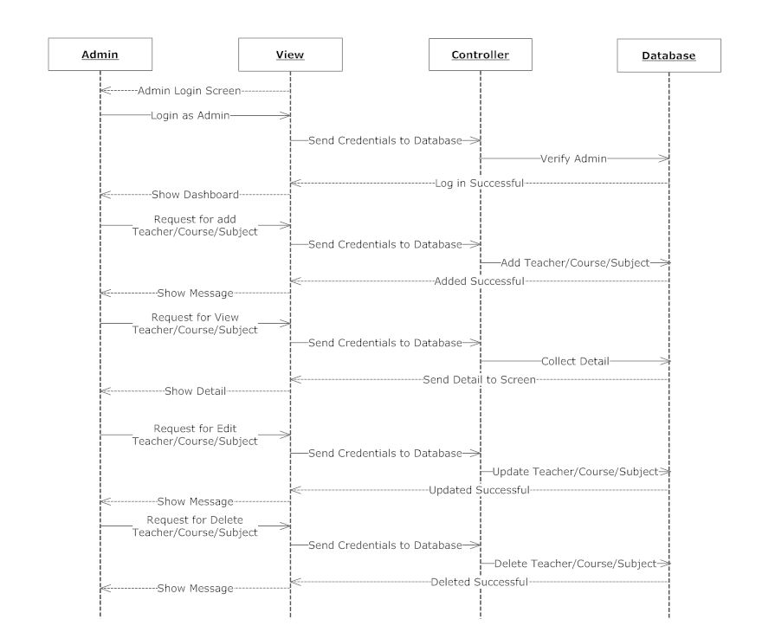
Sequence Diagrams
Admin Panel

Slide 14
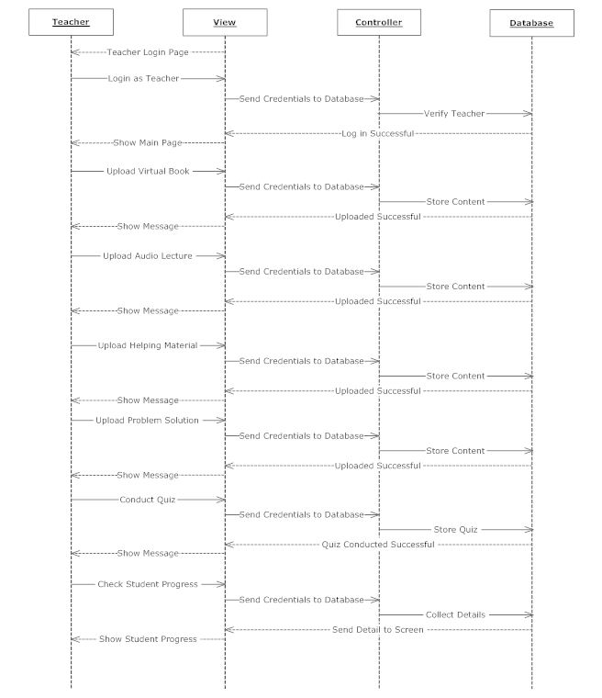
Teacher Panel

Slide 15
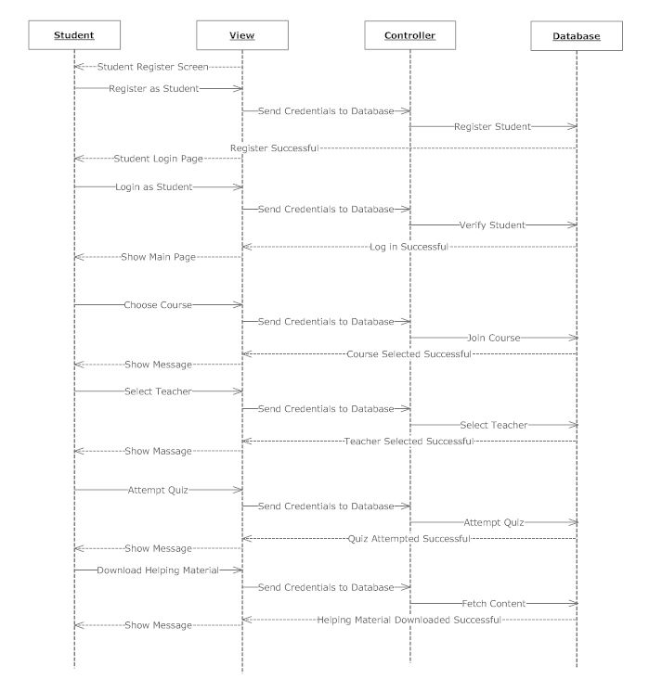
Student Panel

Slide 16
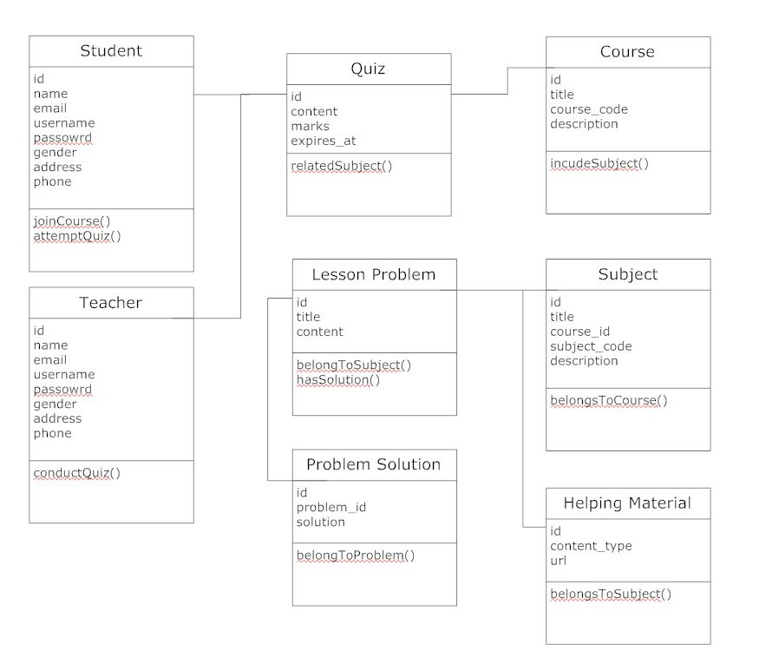
Logical Model/Class Diagram

Slide 17
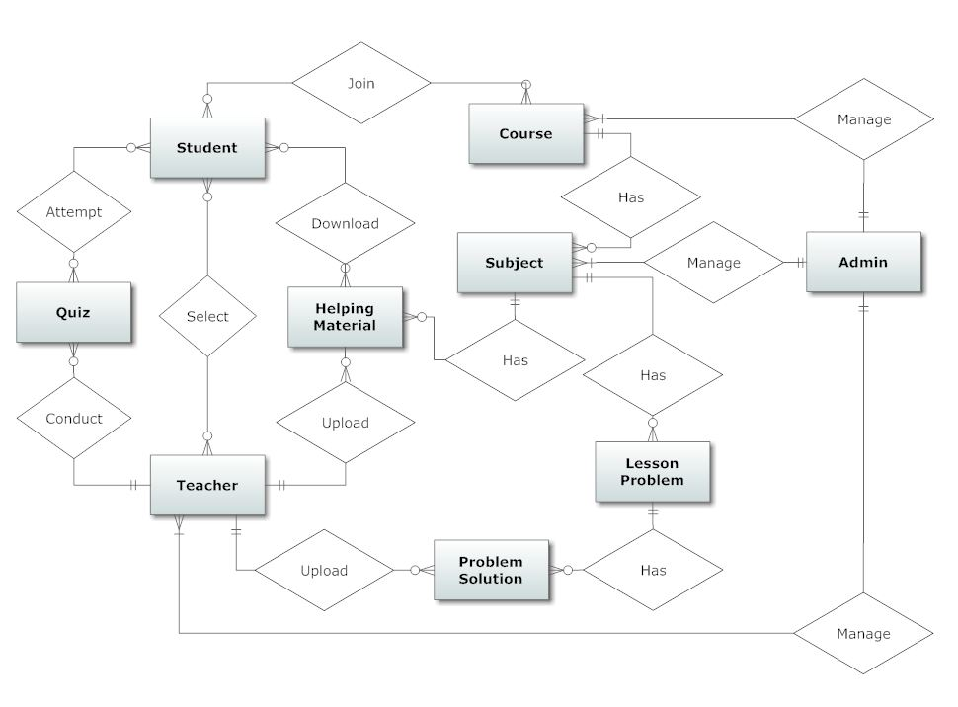
Entity-Relationship Diagram

Slide 18
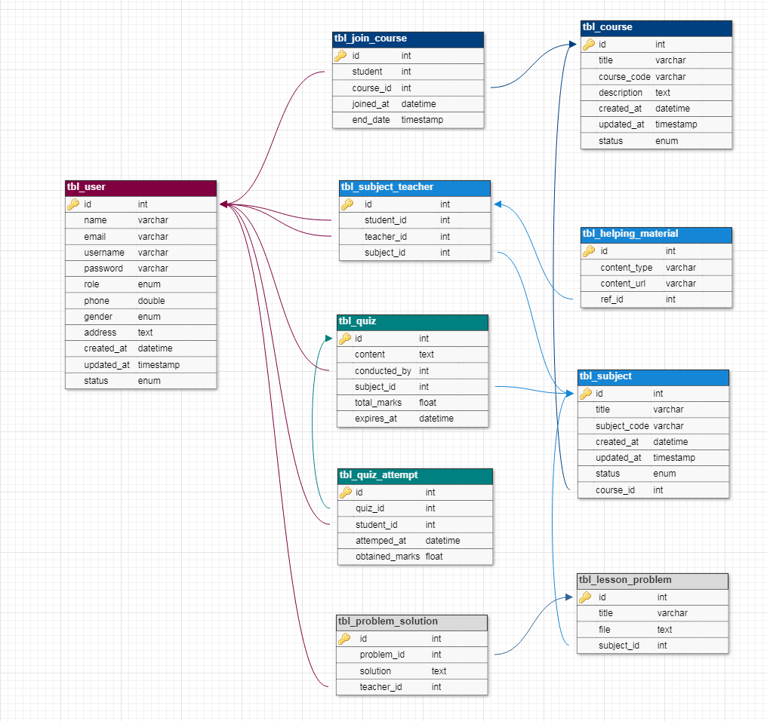
Database Diagram

Slide 19
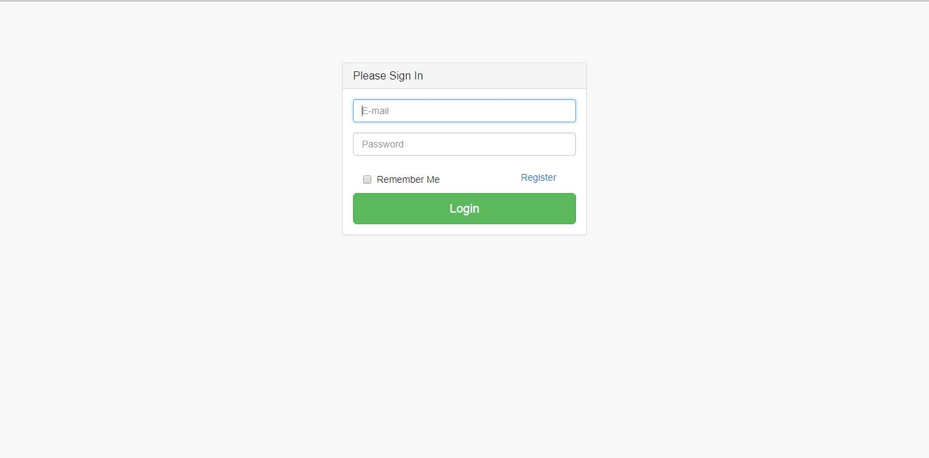
User Interfaces

Slide 20
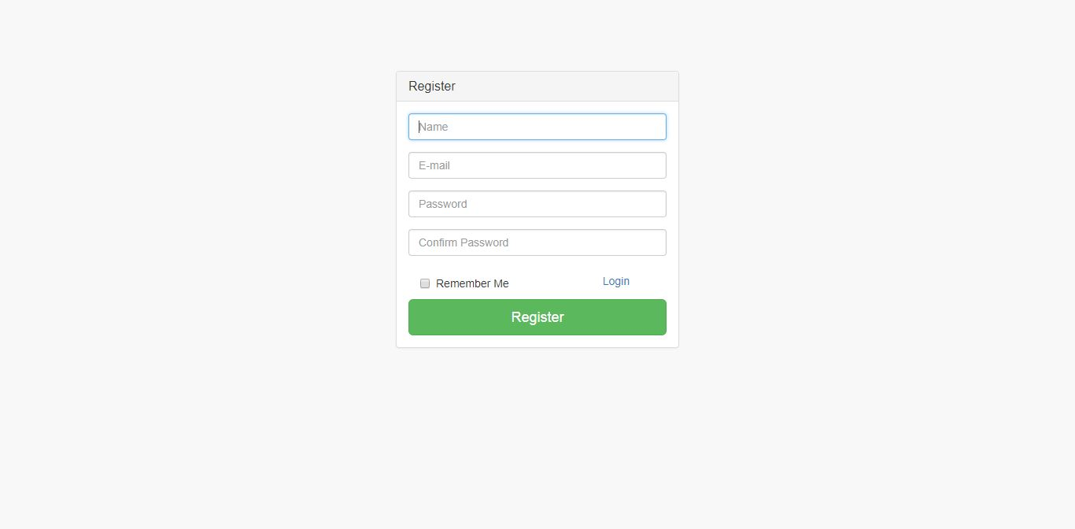

Slide 21
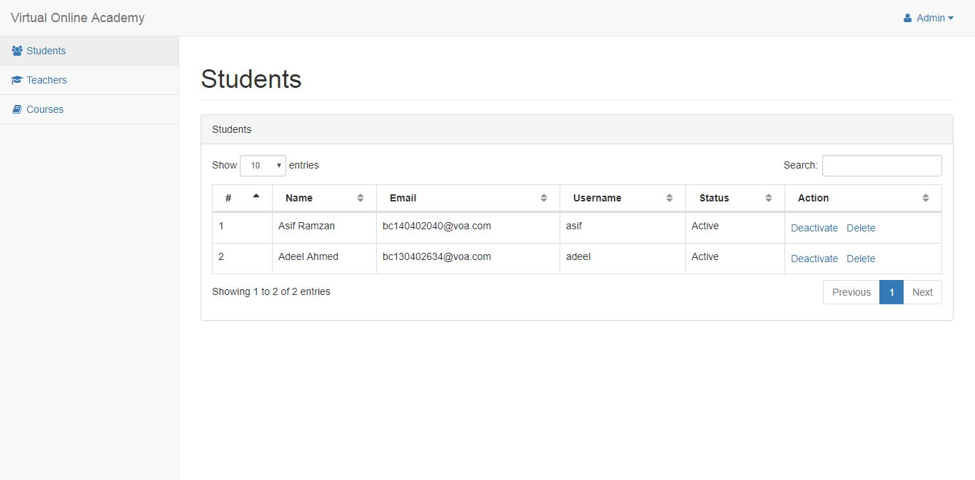

Slide 22
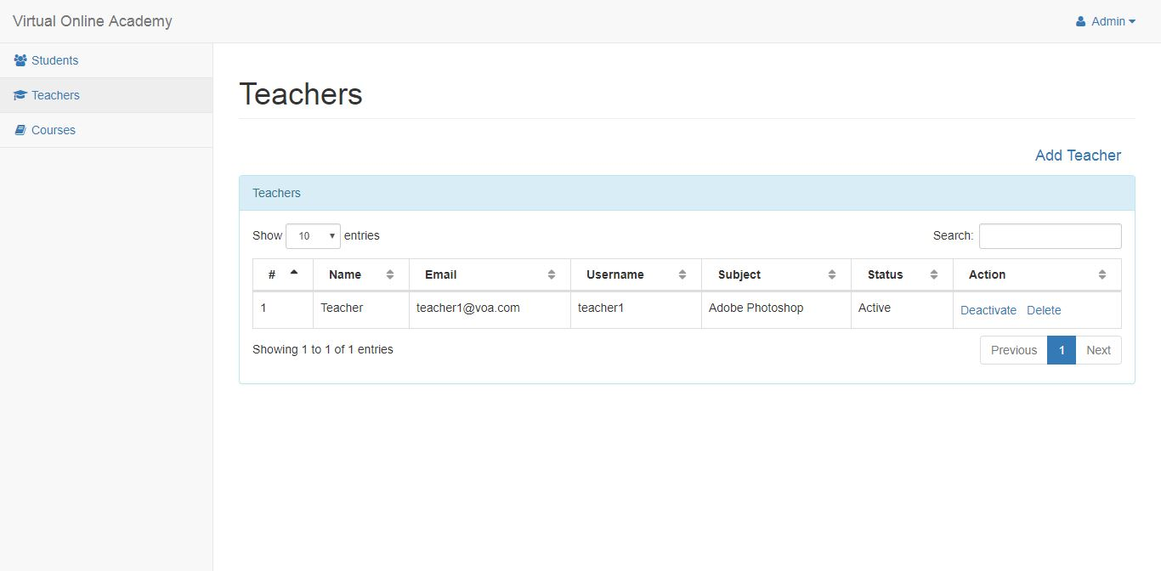

Slide 23
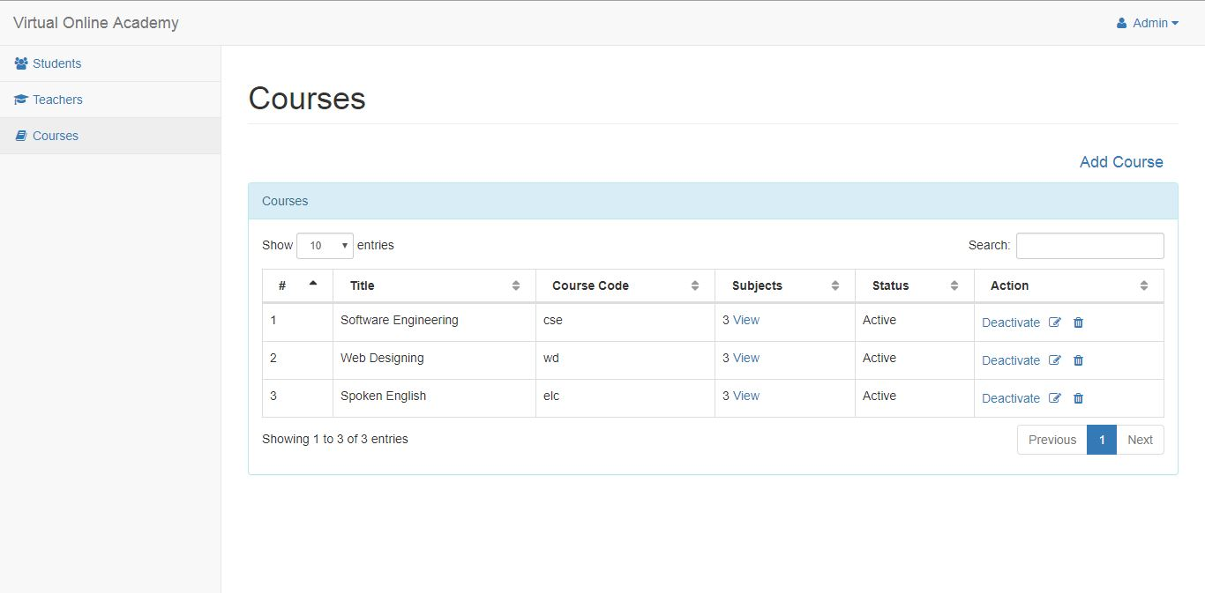

Slide 24
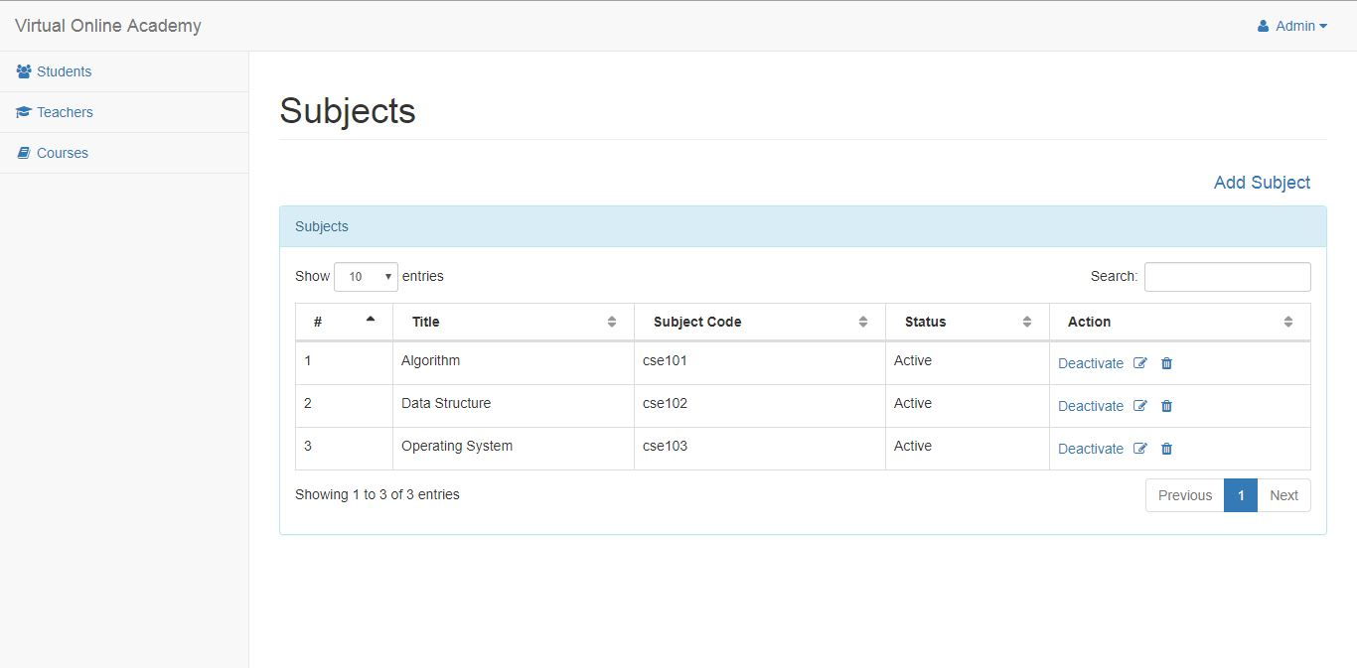

Slide 25
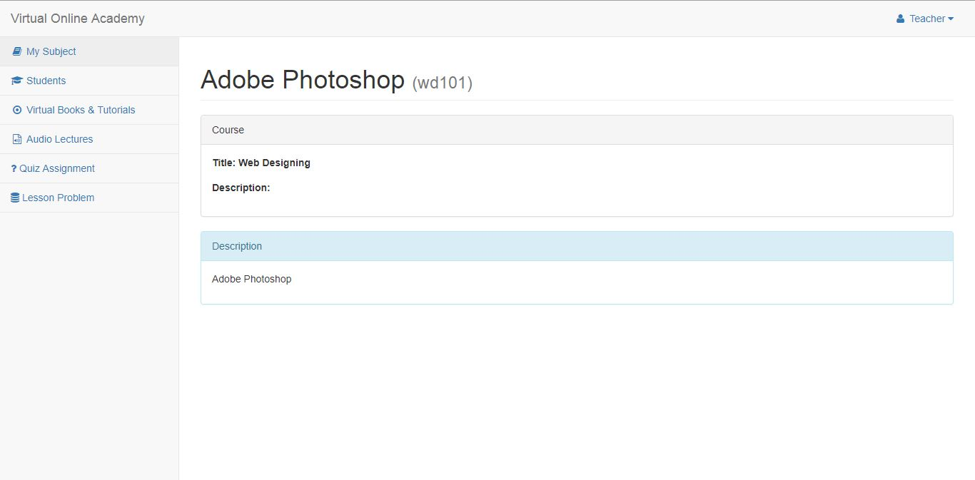

Slide 26
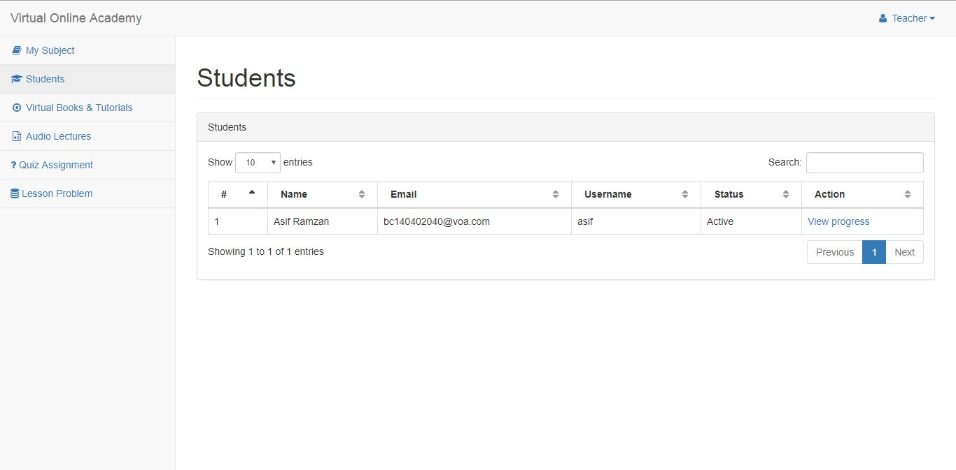

Slide 27
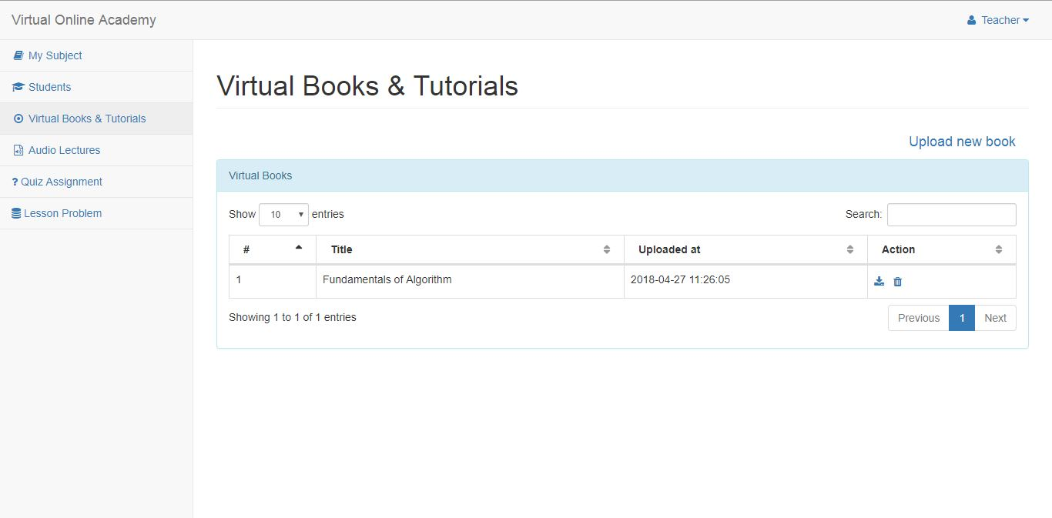

Slide 28
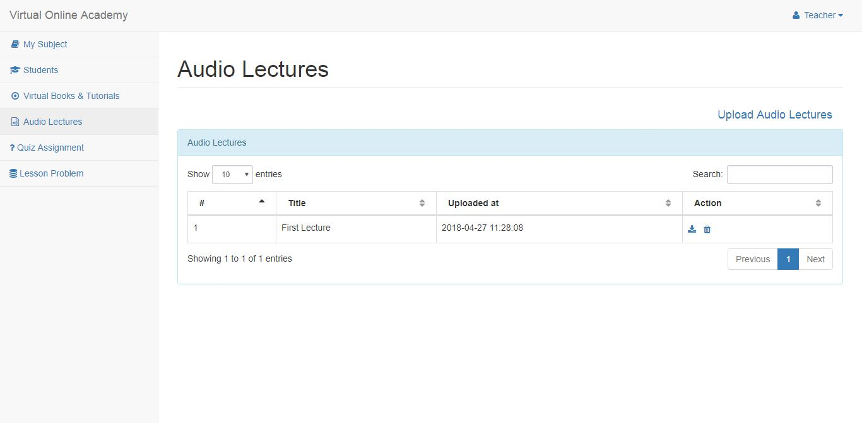

Slide 29
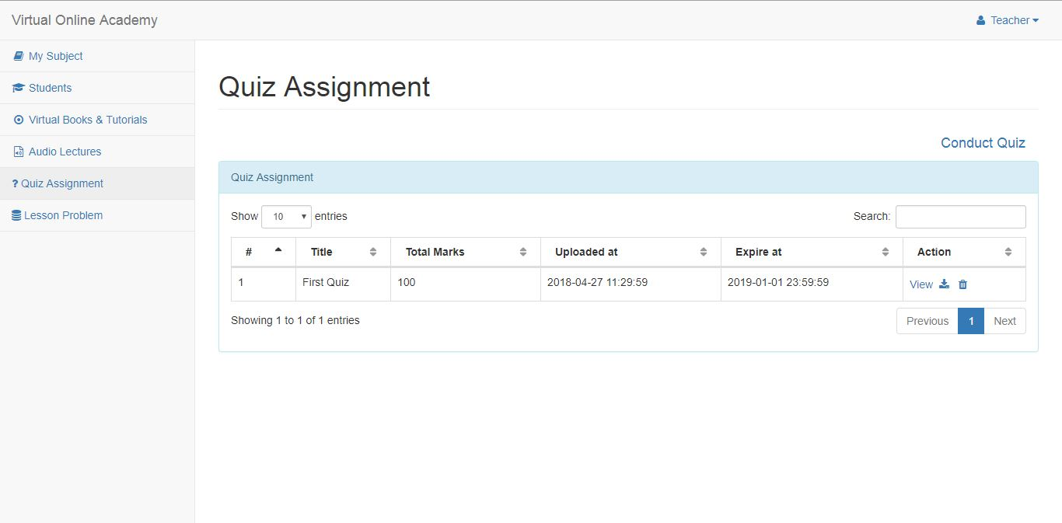

Slide 30
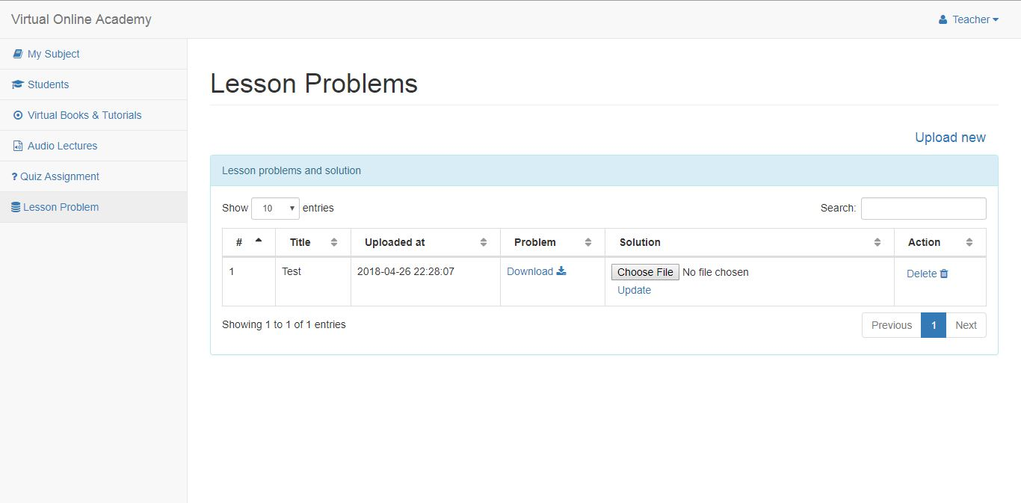

Slide 31
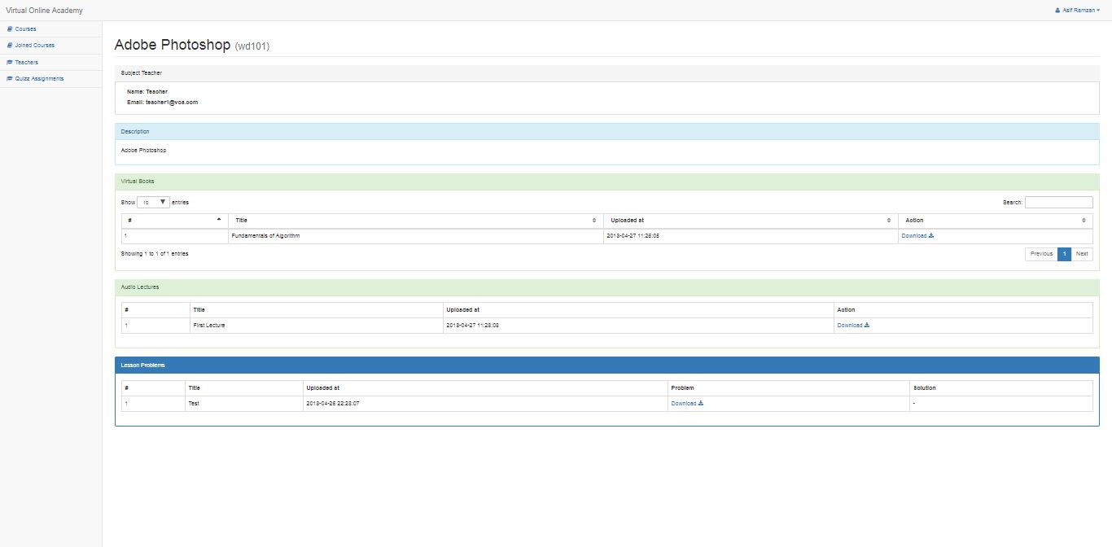

Slide 32
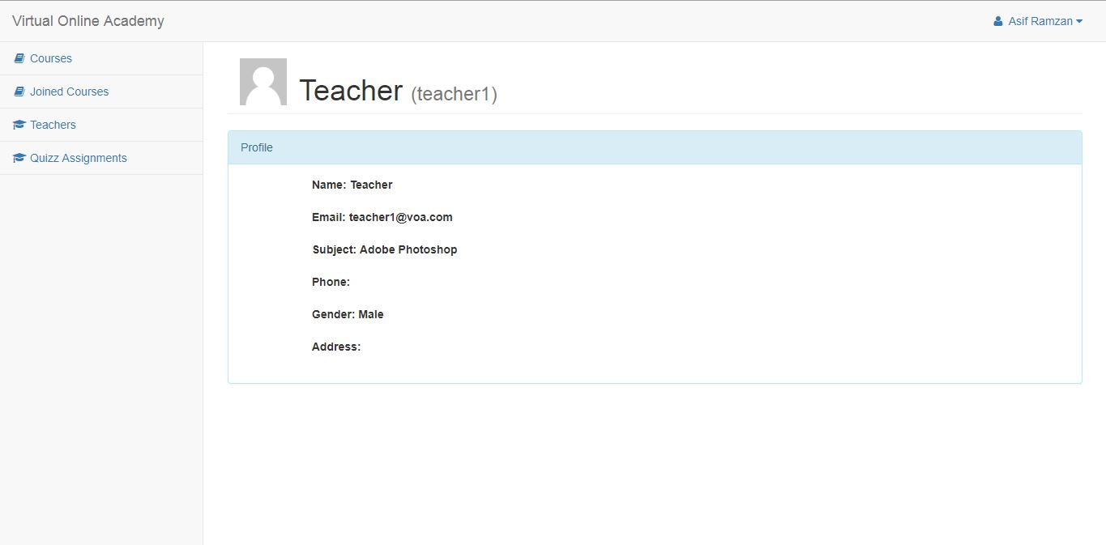

Slide 33
Tools
HTML5 & CSS3
Php Laravel
XAMPP
SublimeText

