Slide 1
Plant Leaf Disease Identification System On Android
Name: Asif Karim
Roll:210602

Slide 2
Introduction
We build an android app that is capable of identifying plant leaf disease. We showed limitation of existing works and suggested a path following which state of the art system can be create to identify plant leaf disease.

Slide 3
Literature Review
Work No | Method | Pros | Cons
1 | Used CNN and Plant Village data | Achieved 99% accuracy in training and 85.31% in test | The model suffer from overfitting for using Plant Village dataset.
2 | Used CNN to identify tomato leaf disease. It combined data of Plant Village dataset with data collected from field of Mexico. The number of sample from PlantVillage is 11000 and number of sample collected from field of Mexico is 2500.They tried to balance the dataset using smaple generated by GAN | Achieved 99.9% accuracy. It also have achieved better F1-score and recall. | 80% of data used to train the model is from PlantVillage dataset. They used GAN to make the dataset balanced and reduce element overfittng. But the model still suffers from overfitting because of the lack of variability of in sample

Slide 4
Literature Review
Work No | Method | Pros | Cons
3 | Used different version of YoloV-8 to predict Corn leaf disease and achieved best accuracy using YoloV8n. It collected image from University Research Farm Koont (URF), Pir Mehr Ali Shah Arid Agriculture University Rawalpindi (PMAS-AAUR), at different growth stages (initial, middle, and mature). The image is captured with dynamic background .They used 2675 image sample in total for 3 different class. 892 sample per class on average. | It used good quality of dataset which implies that the system can be practically integrated for real world task. It achieved 99 accuracy using YoloV8n. | The study developed model only to identify 3 different disease of Corn(blight, mosice, spot).

Slide 5
Literature Review
Work No | Method | Pros | Cons
4 | The study used CNN, Inception, YOLOv5 to predict 5 different disease class of Soybean plant. They collected image from Indira Gandhi Krishi Vishwavidyalaya, Raipur. They annoted the images with diseases class along with disease location. They have used total 3150 images. So the average number of sample per class was 630. | The image contains samples with dynamic background which helps to prevent overffiting and make the model usable in real world. They got 97% accuracy both with CNN and Inception in training. The accuracy in test was 95% for Inception and CNN. They predicted the bounding box of disease along with disease class using YOLOv5 with a accuracy of 99.2% | The study only focus on Soybean leaf disease.

Slide 6
Literature Review
Work No | Description
5 | The study showed that Plant village dataset is created in controlled lab environment . All image contains single leaf with a uniform background. Those makes it impossible to use. It showed the Plant Doc dataset has higher variability with dynamic background and of various viewpoint. They also created dataset of same kind named Plant Seg containing images of 115 diseases.
6 | The study reviewed pervious work. It mentioned that Plant Village dataset have lack of image with complex background which make it not suitable for Deep Learning model. It also reviewed Plant Doc dataset. It suggest that the dataset might have miss classification due to lack of domain experties.

Slide 7
Literature Review
Md. Jalal Uddin Chowdhury and Zumana Islam Mou and Rezwana Afrin andShafkat Kibria , “Plant Leaf Disease Detection and Classification Using Deep240Learning: A Review and A Proposed System on Bangladesh’s Perspective”
Guerrero-Iba˜nez A and Reyes-Mu˜noz A., “Monitoring tomato leaf diseasethrough convolutional neural networks.”, Electron, 2023.
Khan F and Zafar N and Tahir MN and Aqib M and Waheed H and Ha-roon Z., “A mobile-based system for maize plant leaf disease detection andclassification using deep learning”, Front Plant Sci, 2023
Divyanshu Tirkey and Kshitiz Kumar Singh and Shrivishal Tripathi , “Per-250formance analysis of AI-based solutions for crop disease identification, de-tection, and classification ”
Tianqi Wei and Xin Yu and Paul Melloy and Zhi Chen and Scott Chap-man and Zi Huang, “PlantSeg: A Large-Scale In-the-wild Dataset for Plant245Disease Segmentation”
Tanko Daniel Salka, Marsyita Binti Hanafi, Sharifah M. Syed Ahmad AbdulRahman, Dzarifah Binti Mohamed Zulperi, and Zaid Omar, “Plant leaf265disease detection and classification using convolution neural networks model:a review,

Slide 8
Objectives
To show limitation of existing work.
To show path of developing a system that can identify plant leaf disease in real world.

Slide 9
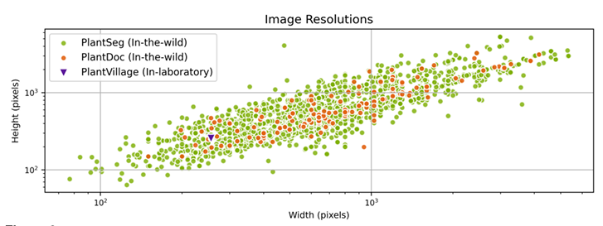
Dataset
We have studied various publicly available dataset like Plant Village, Plant Doc , Plant Seg and other data source.
A research group from University of Queens land have plotted the resolution distribution of Plant Village, Plant Doc , Plant Seg. It is shown below:

Slide 10
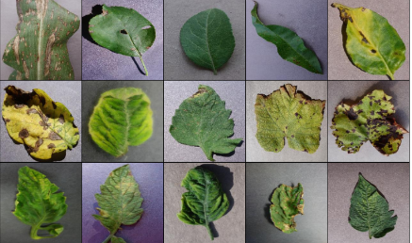
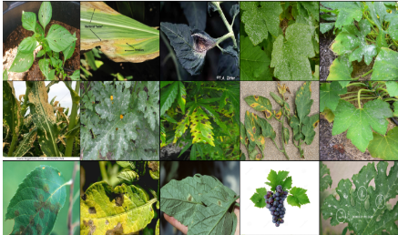
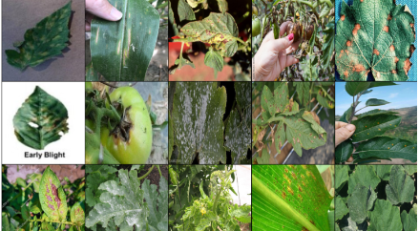
Dataset
From the following image we can see the comparsion of Plant Village and Plant Seg dataset:
Plant Village
Plant Doc
Plant Seg

Slide 11
Data Augmentation
We performed following data augmentation on train data to reduce overfitting.
Scaling into 320*320
Random Flip
Random Rotation
Random Color Jitter
For validation and test data we performed following agumentation:
Scaling into 320*320

Slide 12
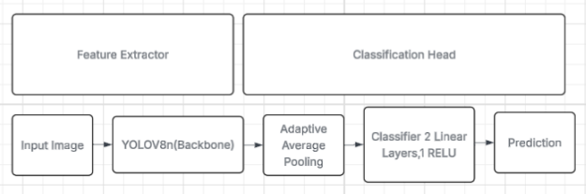
Model Architecture
We used the backbone of YOLOv8 as features extractor and used custom classification head.
The block diagram of our model:

Slide 13
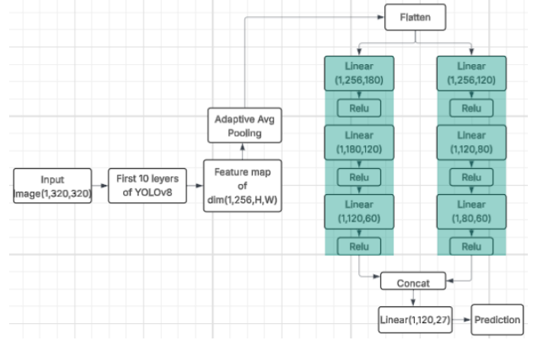
Model Architecture
Our model architecture:

Slide 14
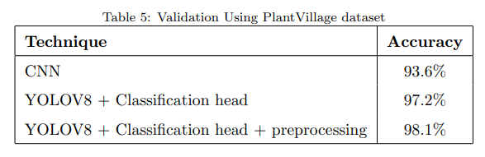
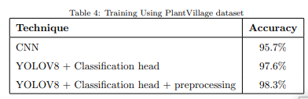
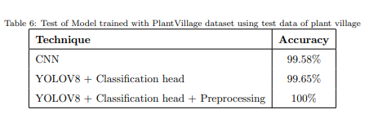
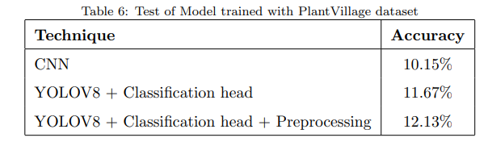
Result and Discussion
The train, validation accuracy in different method using plant village dataset is shown below:

Slide 15
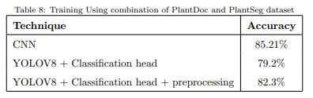
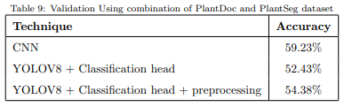
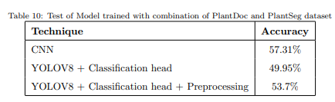
Result and Discussion
The train, validation accuracy in different method using combination of plant doc and plant seg dataset is shown below:

Slide 16
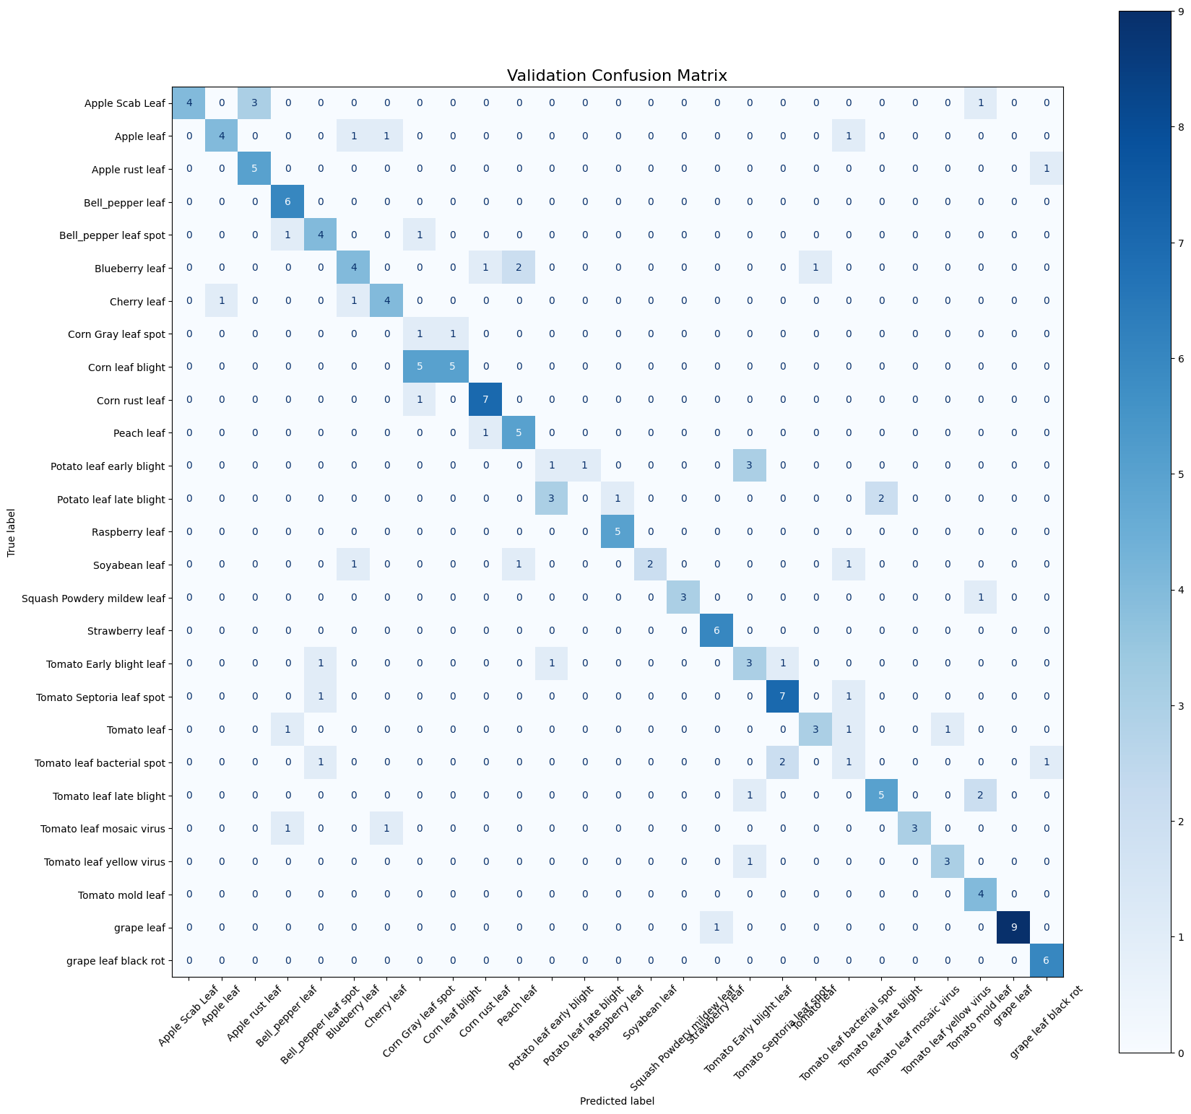
Result and Discussion
Confusion matrix for model trained with combination of Plant Doc and Planet Seg dataset:

Slide 17
Result and Discussion
Plant that have single class have more error in prediction. So we remove all the single disease class
Blueberry
Cherry
Peach
Ruspberry
Soyabean
The plant tomato also contains relatively high error. So we tried to add more data in existing class of tomato.
We also more disease class for Strawberry which had only a single class

Slide 18
Result and Discussion
We removed data of peach and soybean. Because we unable to find good quality dataset to add. We added few new classes of disease for strawberry, potato and pepper. We also added more sample existing class of tomato leaf disease. After that we found following accuracy:
Method | Accuracy
YOLOv8+classification head+preprocessing | Training | 79%
 | Validation | 63%
 | Test | 72%

Slide 19
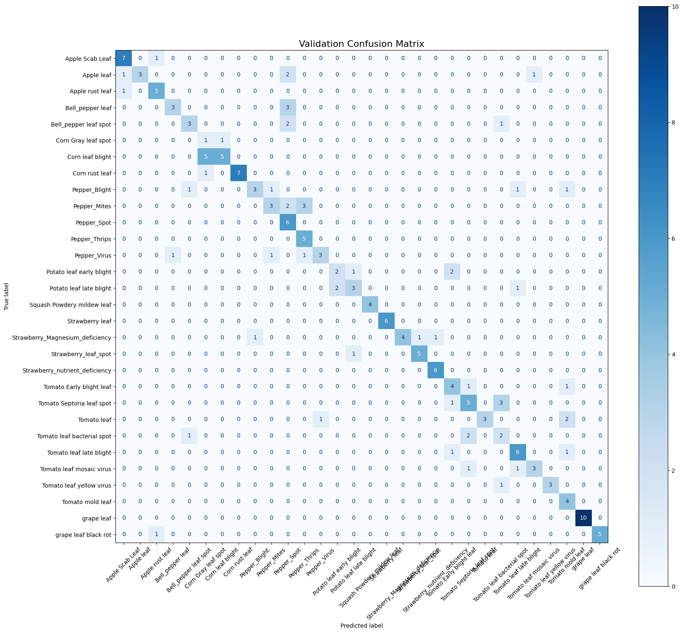
Result and Discussion
Confusion matrix for prediction with test data:

Slide 20
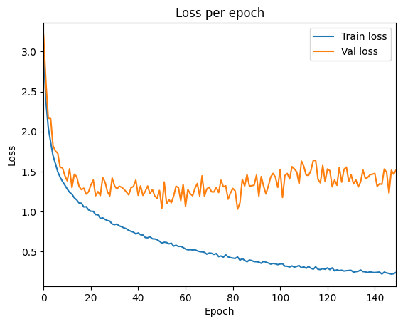
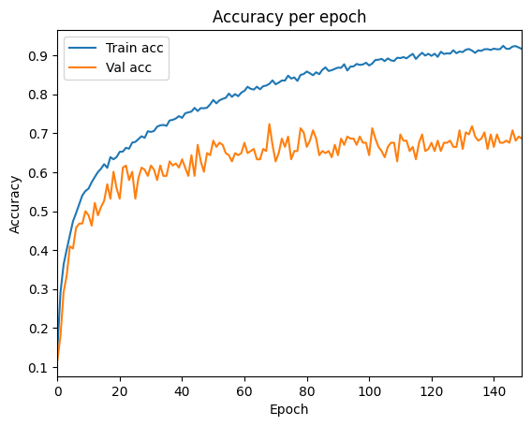
Result and Discussion
Train vs Validation loss and accuracy

Slide 21
Conclusion and Feature work
Our model achieved 71% accuracy on test data. We have shortage of good quality data. We need atleast 600-1000 image per class to make a good model. But we had only 177 image per class.

