Slide 1
Farmers Confidence System
M. Asif Rahman
ID: 151-35-1020

Slide 2
Users
Types of users:
1. Farmer

Slide 3
Features
Registration
Login
Input amount of land
Input number of day after plantation
Select crops with categories
Request For fertilizer procedure

Slide 4
System Outcomes
User Login
Auto logout
User seen Seasonal crops with categories
User seen there solution

Slide 5
Proposed Activities
Farmers must have an account.
Farmers Account.

Slide 6
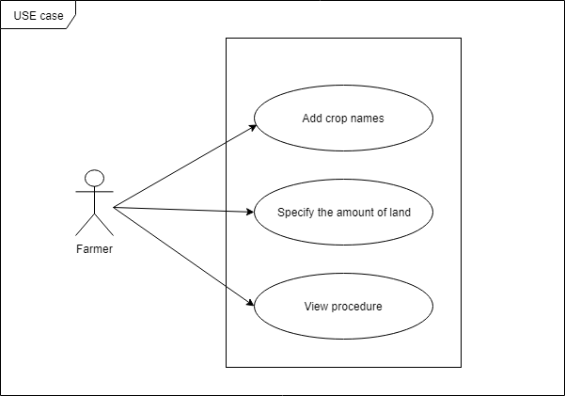
Use Case

Slide 7
Objectives of the Project
This system is to help our farmers to know about how to cultivate any crops.
Tools & Techniques:
I will use for developing this project:
Language: PHP
Bootstrap Framework
Server: XAMPP

Slide 8
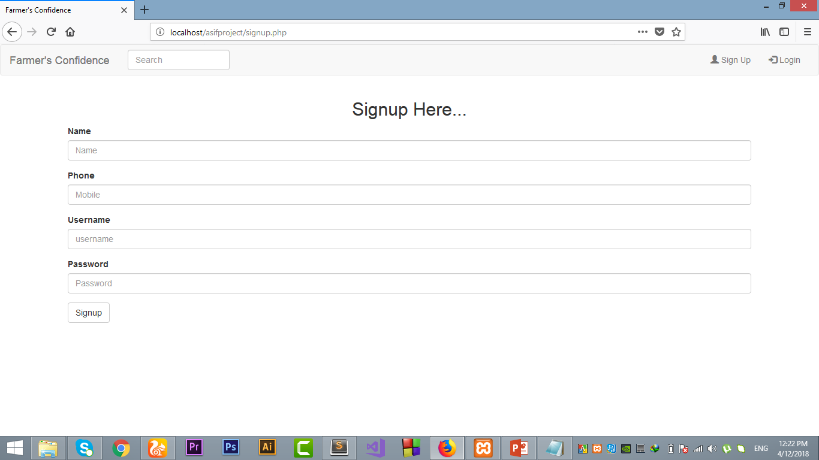
Overview

Slide 9
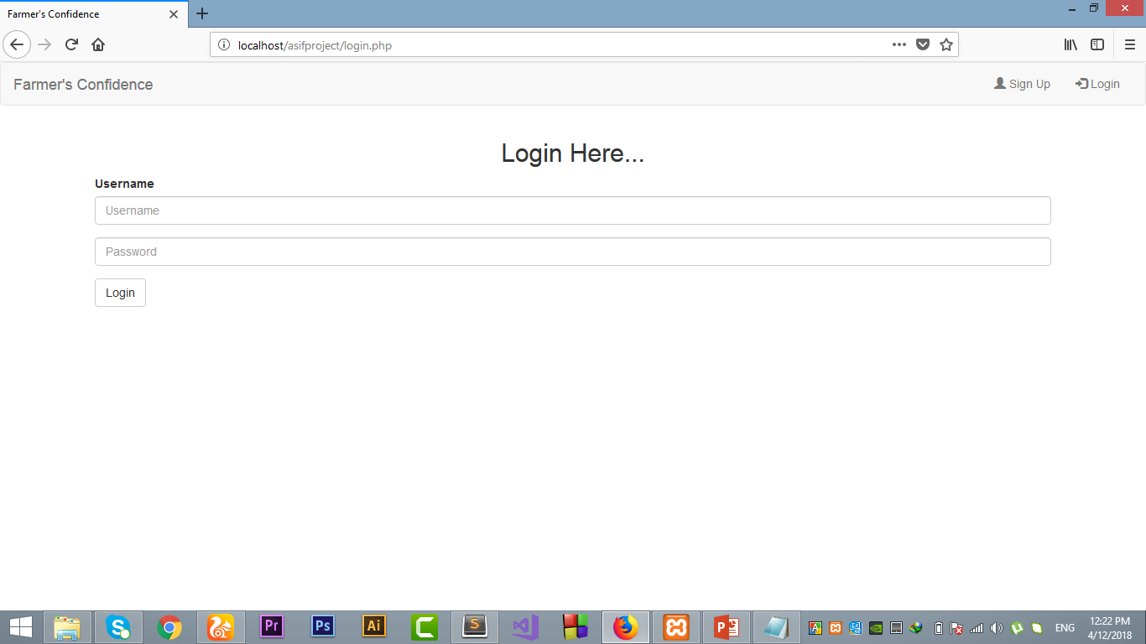
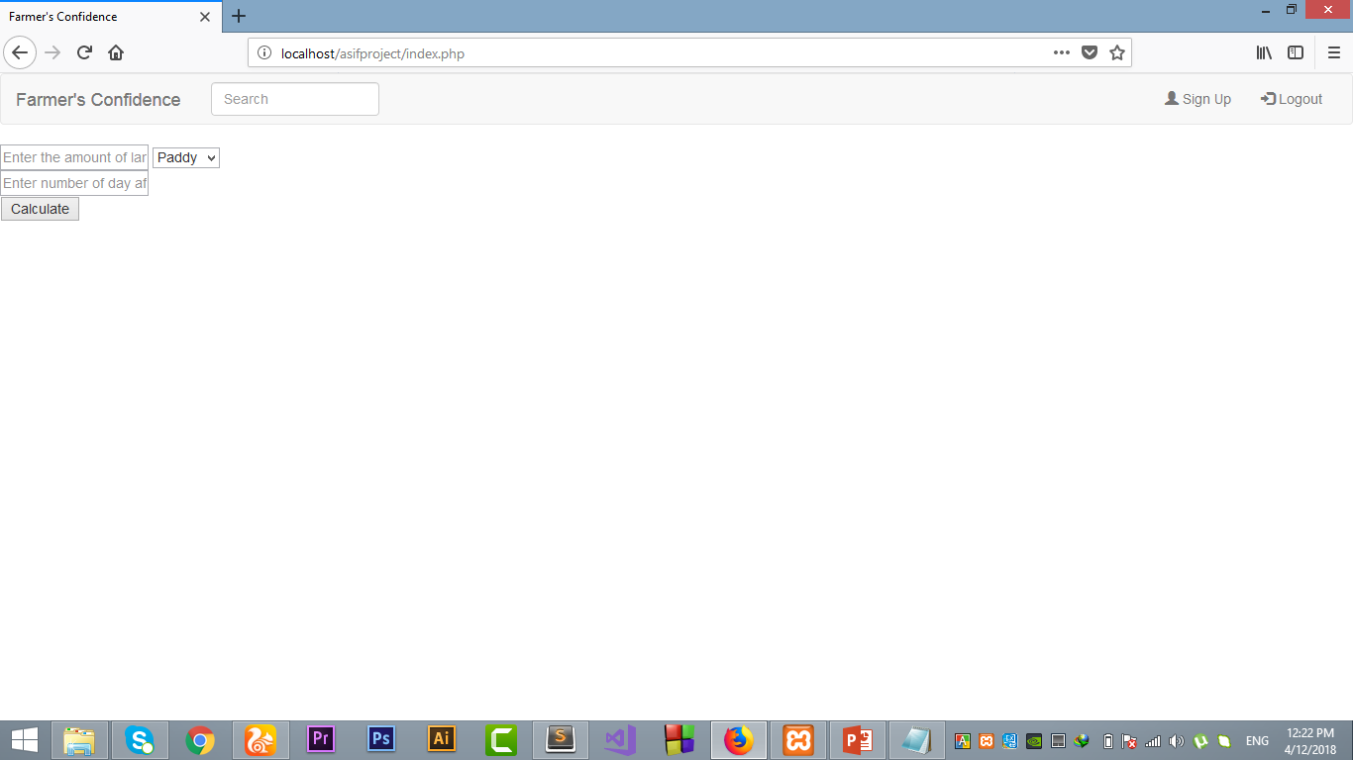

Slide 10
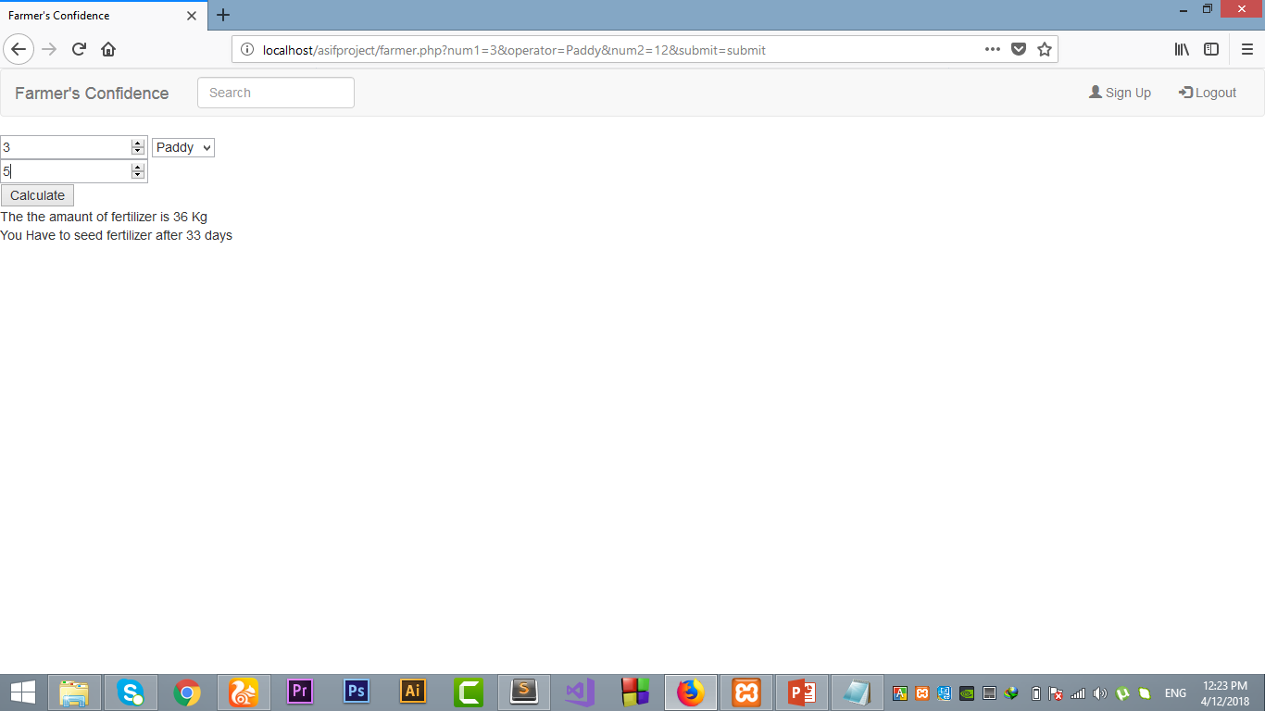

Slide 11
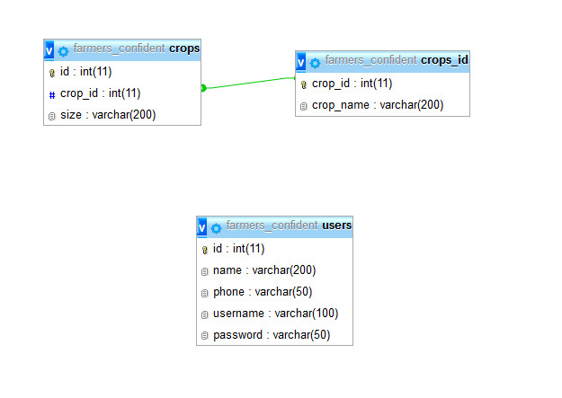
Database Design

Slide 12
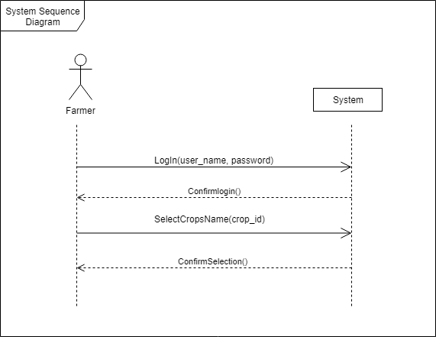
Sequence Diagram

Slide 13
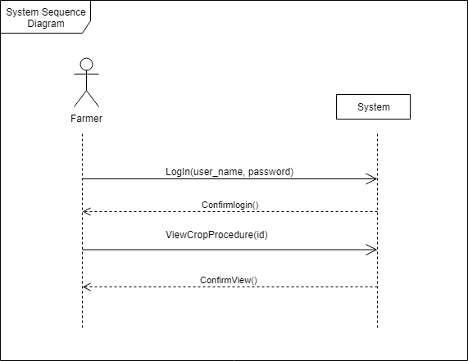

Slide 15
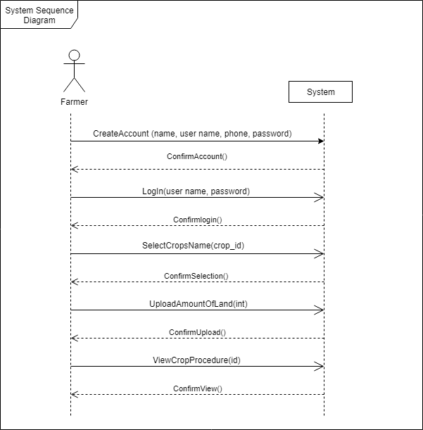

Slide 16
Why Use?
Allows for faster service
Easy , user friendly GUI
Allows increased fertilizer and profits for crops.

Slide 17
Thank You

