Slide 1

M. Asif Rahman
ID: 151-35-1020

Slide 2
Room Management Appliance System
Introduction:
The system will make easy to reserve or check room to the users whenever they need.
Every user reservation room in short time and make easy to select room and check room.

Slide 3
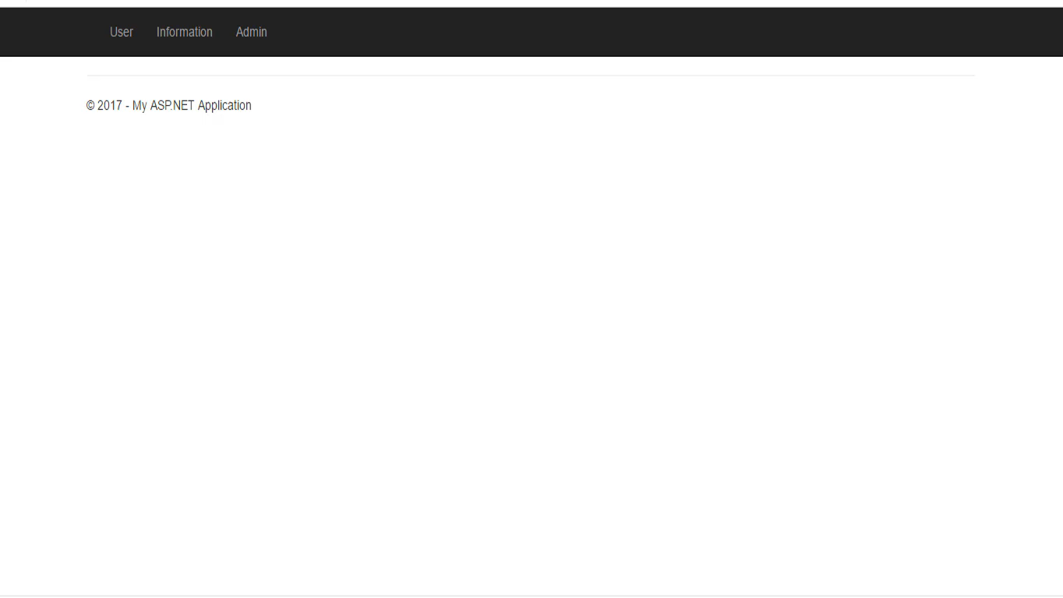
Room Management Appliance System
Video:

Slide 4
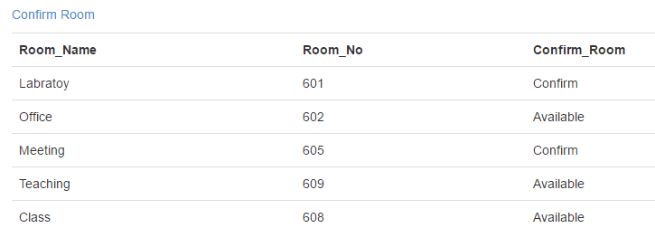
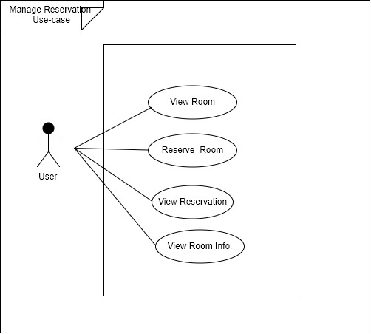
My Project With USE Case Design

Slide 5
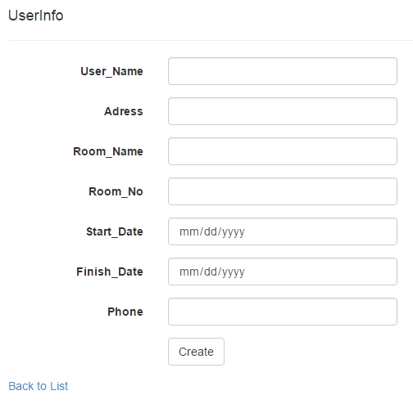
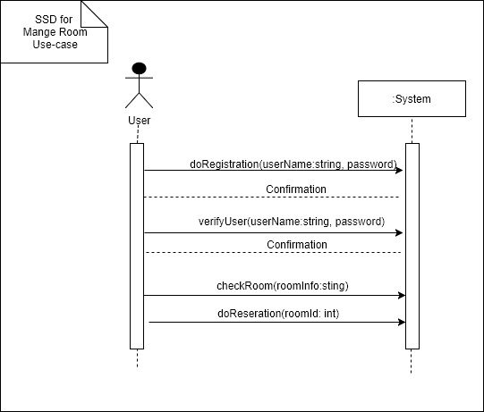
My Project With Sequence Design

Slide 6
Success And Alternative Scenario:
Success Scenario:
Web User easily show the room information & reservation without registration.
User add all information for applying room.
Alternative Scenario:
False information input
Do not seen unapproved Application
Do not do Registration

Slide 7
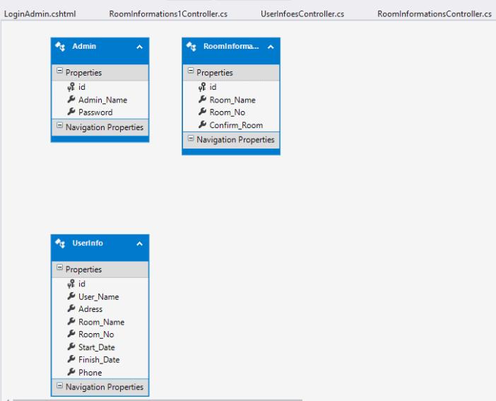
Class Diagram:

Slide 8


