Slide 1
GROUP 16 RESEARCH PROJECT
Duplicate-Aware Evaluation of
API N-Gram Malware Classification
Mal-API-2019: eight-category classification with RF, XGBoost, SVM and soft voting
Md Shohan Mia
0112230037 | Group 16
Md. Asif Sarkar
0112230921 | Group 16

Slide 2
1. OBJECTIVES
Project objectives
1
Compare local API-call patterns
2
Audit duplicates and compare split protocols
Compare weighted unigram and combined 1–3 gram TF-IDF using the same five grouped folds and fixed model settings. Measure the benefit of adding short API-call patterns.
Audit repeated sequences and conflicting labels. Compare ordinary and grouped five-fold evaluation for weighted 1–3 gram Random Forest, recording overlap and performance.
3
Evaluate the value of soft voting
4
Measure the effect of class weighting
Compare Random Forest, XGBoost and linear SVM with their equal-weight probability average. Determine whether combining the models improves held-out performance.
Compare weighted and unweighted 1–3 gram models. Report accuracy, macro precision, recall and F1, with fold variation and per-category results.
5
Classify the eight supplied malware categories
Evaluate category prediction for already-malicious samples. The current study does not test benign detection or resistance to metamorphic transformations.
2

Slide 3
2. METHODOLOGY
Data preparation and identical-sequence grouping
BUG FOUND
FIXED
Default tokenization loses single-digit IDs
Explicit tokenizer preserves numeric IDs
The earlier TF-IDF token pattern excluded single-character tokens. The corrected loader also reads all 7,107 labels and retains the first API ID of each sequence.
tokenizer=str.split and token_pattern=None preserve single-digit IDs. The example 292 7 51 produces unigrams 292, 7, 51 and bigrams 292 7, 7 51.
No exact-sequence overlap across a split
Conflicting labels require investigation
7,107 samples contain 6,518 unique full sequences, with 589 additional copies in 290 repeated-sequence groups. SHA-256 grouping keeps identical sequences together in all five folds.
33 identical-sequence groups have more than one category label. We retained all samples and labels. Matching observed behavior alone does not prove that a label is incorrect.
3
Notes:
Counts come from the completed normalized-full-sequence audit. 589 means additional copies, not 589 repeated groups. Identical observed API behavior does not necessarily imply identical malware or erroneous labels. Tokenization documentation: https://scikit-learn.org/stable/modules/generated/sklearn.feature_extraction.text.TfidfVectorizer.html

Slide 4
2. METHODOLOGY
Training and evaluation within each fold
01
Load
Load the existing Mal-API-2019 API-call traces and all 7,107 labels. No new sandbox execution or benign dataset is used.
02
Split
Create five StratifiedGroupKFold partitions from full-sequence hashes. Verify zero identical-sequence overlap and all eight categories in each fold.
03
Represent
Fit TF-IDF on the training sequences only. Transform the held-out fold with that vocabulary. Compare unigrams with combined 1–3 grams.
04
Classify
Train RF, XGBoost and linear SVM. Compare weighted unigram, weighted 1–3 gram and unweighted 1–3 gram settings.
05
Combine & evaluate
Average class-aligned probabilities with equal weights. Report accuracy and macro metrics as mean ± standard deviation across folds.
Main comparisons reuse grouped folds. A separate RF experiment compares ordinary and grouped five-fold splits using the same feature and model settings.
4
Notes:
StratifiedGroupKFold: https://scikit-learn.org/stable/modules/generated/sklearn.model_selection.StratifiedGroupKFold.html . Random seed 42. Outer training only for TF-IDF and models. SVC internal probability calibration is not group-aware, although it uses outer-training data only.

Slide 5
3. EXPERIMENTAL CORE DETAILS
Exactly what ran, on the corrected pipeline
Total samples
7,107 (verified against expected per-class counts)
Class Distribution (n = 7,107)
Classes
8 supplied malware categories
Backdoor
1001
Split
5 grouped folds; no identical sequence crosses train/test
Downloader
1001
Trojan
1001
Experiments run
Three grouped configurations × 5 folds; plus ordinary 5-fold RF (weighted 1–3 grams)
Virus
1001
Base classifiers
RF: 300 trees; XGBoost: 300 trees, depth 6; SVM: linear, C = 1
Worms
1001
Dropper
891
TF-IDF settings
str.split; min_df = 2; max_features = 50,000; fit on training only
Spyware
832
Adware
379
5
Notes:
XGBoost: learning_rate 0.1, subsample 0.8, colsample_bytree 0.8, tree_method hist, multi:softprob. RF and SVM use balanced class weights in weighted settings; XGBoost uses balanced sample weights. No hyperparameter search. All models use seed 42.

Slide 6
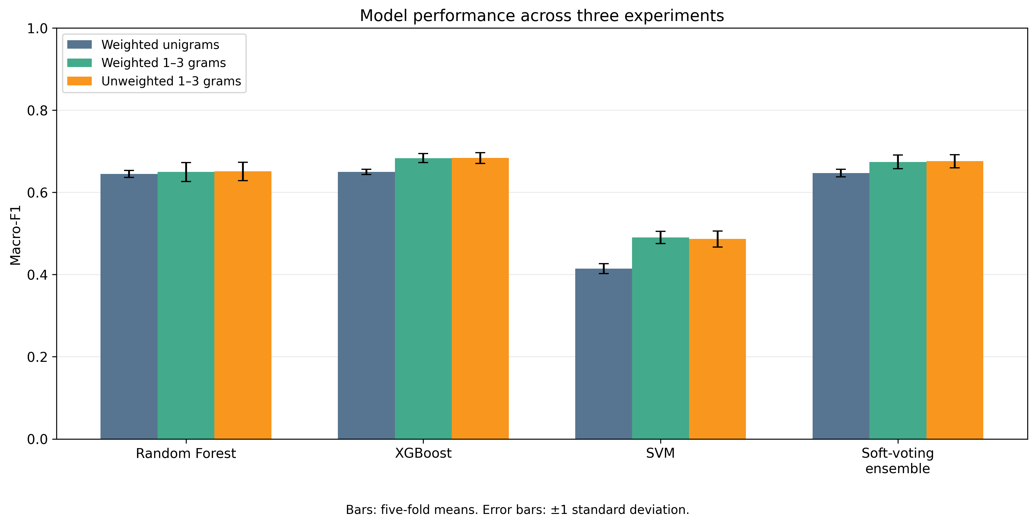
4. RESULTS
XGBoost has the highest observed mean scores
67.4%
Mean accuracy: unweighted 1–3 grams
0.6837
Mean macro-F1: unweighted 1–3 grams
Interpretation
XGBoost: 67.40% ± 1.34 percentage points accuracy and 0.6837 ± 0.0134 macro-F1. Error bars show fold standard deviations. Earlier 40% results used a different, flawed pipeline and are not a valid improvement baseline.
6
Notes:
Source: saved five-fold summary CSVs supplied by the team. Best observed CV configuration, not performance on an independent final test set. Do not attribute the old-to-new difference to a single fix.

Slide 7
4. RESULTS
All three experiments, all four models
Experiment | Model | Accuracy (%) | Macro Precision | Macro Recall | Macro F1
Weighted unigrams | Random Forest | 63.63 ± 1.31 | 0.6574 ± 0.0111 | 0.6408 ± 0.0062 | 0.6452 ± 0.0084
Weighted unigrams | XGBoost | 63.93 ± 1.18 | 0.6595 ± 0.0088 | 0.6451 ± 0.0060 | 0.6500 ± 0.0067
Weighted unigrams | SVM | 41.27 ± 1.51 | 0.4397 ± 0.0164 | 0.4249 ± 0.0099 | 0.4145 ± 0.0118
Weighted unigrams | Soft Voting Ensemble | 63.76 ± 1.17 | 0.6571 ± 0.0118 | 0.6432 ± 0.0065 | 0.6472 ± 0.0090
Weighted 1–3 grams | Random Forest | 63.97 ± 2.65 | 0.6602 ± 0.0275 | 0.6463 ± 0.0207 | 0.6498 ± 0.0231
Weighted 1–3 grams | XGBoost | 67.33 ± 1.51 | 0.6936 ± 0.0134 | 0.6781 ± 0.0108 | 0.6836 ± 0.0113
Weighted 1–3 grams | SVM | 47.54 ± 1.76 | 0.5113 ± 0.0158 | 0.4873 ± 0.0137 | 0.4902 ± 0.0149
Weighted 1–3 grams | Soft Voting Ensemble | 66.57 ± 2.07 | 0.6850 ± 0.0211 | 0.6697 ± 0.0129 | 0.6744 ± 0.0164
Unweighted 1–3 grams | Random Forest | 64.08 ± 2.58 | 0.6623 ± 0.0254 | 0.6467 ± 0.0207 | 0.6511 ± 0.0223
Unweighted 1–3 grams | XGBoost | 67.40 ± 1.34 | 0.6958 ± 0.0147 | 0.6769 ± 0.0129 | 0.6837 ± 0.0134
Unweighted 1–3 grams | SVM | 47.83 ± 2.04 | 0.5300 ± 0.0222 | 0.4755 ± 0.0191 | 0.4866 ± 0.0195
Unweighted 1–3 grams | Soft Voting Ensemble | 66.78 ± 1.66 | 0.6877 ± 0.0199 | 0.6707 ± 0.0137 | 0.6761 ± 0.0159
Highest observed means: unweighted XGBoost, 1–3 grams (67.40% accuracy; 0.6837 macro-F1). Scores are mean ± fold SD, not confidence intervals.
7
Notes:
Source: the three saved five-fold summary files. Most-common-class baseline: mean accuracy 0.1272; mean macro-F1 0.0282. Weighted unigram, weighted 1–3 gram, unweighted 1–3 gram configurations. SD describes variation across the five folds.

Slide 8
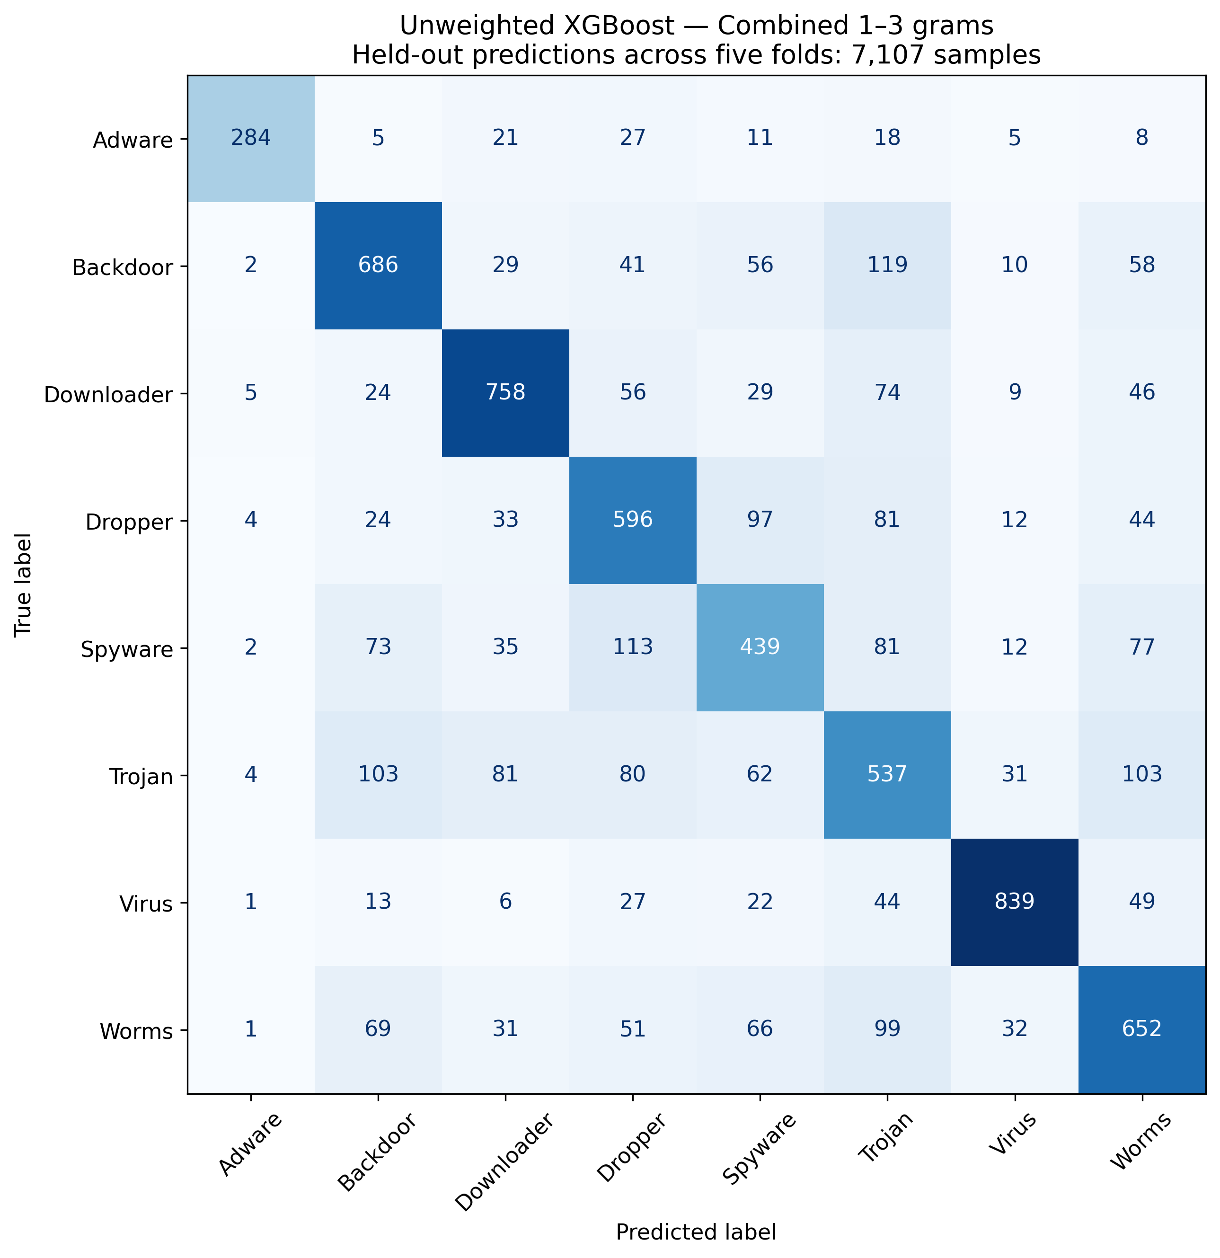
4. RESULTS
Per-category performance: unweighted XGBoost
Malware type | Precision | Recall | F1
Adware | 0.935 | 0.749 | 0.830
Virus | 0.883 | 0.837 | 0.859
Downloader | 0.762 | 0.758 | 0.759
Backdoor | 0.687 | 0.687 | 0.686
Worms | 0.627 | 0.649 | 0.637
Dropper | 0.601 | 0.668 | 0.633
Spyware | 0.561 | 0.528 | 0.542
Trojan | 0.511 | 0.539 | 0.523
Observed errors
Virus and Adware have the highest mean F1 (0.859 and 0.830). Trojan and Spyware have the lowest (0.523 and 0.542). The confusion matrix locates errors, but does not establish their behavioral cause.
Table: mean of five fold metrics. Matrix: pooled held-out counts (n = 7,107).
8
Notes:
Source: xgboost_per_class_means.csv and xgboost_confusion_matrix_counts.csv. The table averages fold metrics and is not recomputed from the pooled confusion matrix. Original supplied figures retained.

Slide 9
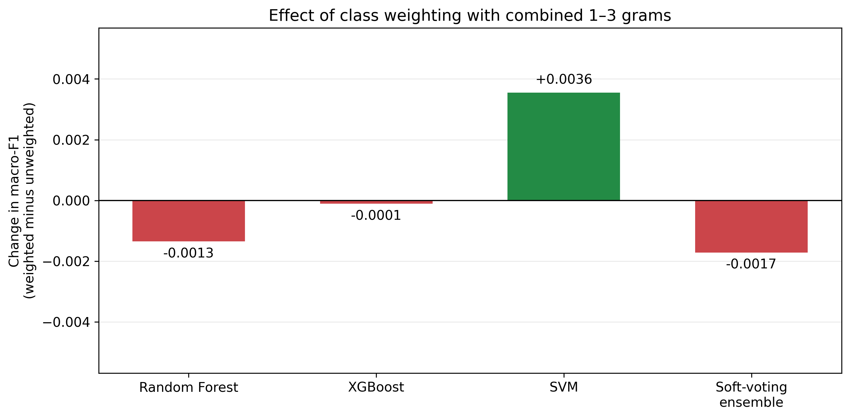
4. RESULTS
Feature, weighting and ensemble comparisons
Small overall changes from class weighting
Weighted minus unweighted macro-F1 ranges from −0.0017 to +0.0036 across models. These small mean differences do not establish equivalence or statistical insignificance. Per-category trade-offs remain relevant.
Soft voting does not beat XGBoost on average
Local n-gram features improve observed means
XGBoost has higher mean accuracy and macro-F1 in all three configurations. With unweighted 1–3 grams, macro-F1 is 0.6837 for XGBoost and 0.6761 for soft voting.
Weighted XGBoost macro-F1 rises from 0.6500 with unigrams to 0.6836 with combined 1–3 grams: +3.36 percentage points using the same grouped folds.
9
Notes:
Class weighting may change category-level performance even when macro-F1 changes little. Weighted XGBoost Adware mean recall 0.7681 versus unweighted 0.7490. No significance test or equivalence test was performed.

Slide 10
4. RESULTS
Random Forest is sensitive to the split protocol
Evaluation | Mean accuracy ± SD | Mean macro-F1 ± SD | Test sequence overlap
Grouped | 63.97% ± 2.65 pp | 0.6498 ± 0.0231 | 0 / 7,107 (0%)
Ordinary | 66.23% ± 1.05 pp | 0.6738 ± 0.0093 | 788 / 7,107 (11.09%)
Ordinary minus grouped
Accuracy: +2.259 percentage points Macro-F1: +2.405 percentage points
Same weighted 1–3 gram TF-IDF and RF settings; 300 trees; seed 42.
Test composition also changes. The difference does not isolate duplicate overlap’s causal effect. SD describes fold variation, not statistical significance.
10
Notes:
Completed experiment verified from MalAPI_Split_Comparison_20260921_123136.zip: all 7,107 held-out prediction rows, sample IDs, labels, fold assignments, overlap flags and metrics checked. Ordinary five-fold mean minus grouped: accuracy 2.258758 percentage points; macro precision 2.204661 pp; macro recall 2.412876 pp; macro-F1 2.404634 pp. Ordinary test overlap counts: 165,159,145,158,161. Shared groups: 122,113,111,110,128. No significance claim. Different partitions prevent causal attribution of the complete difference to overlap. Only weighted combined 1–3 gram Random Forest was compared. Settings record sklearn 1.6.1. Feature fitting uses each training fold only.

Slide 11
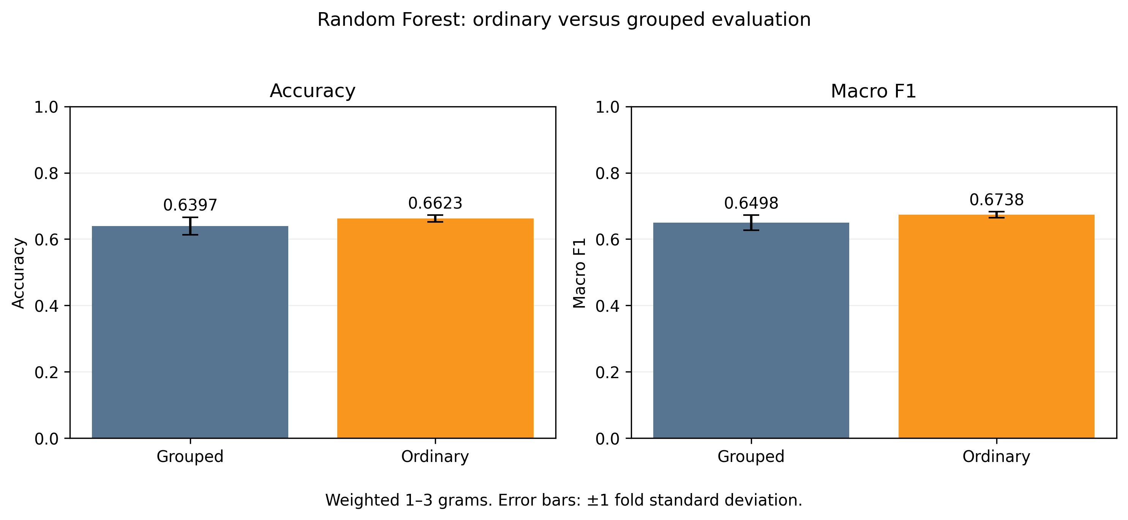
4. RESULTS
Ordinary versus grouped Random Forest
Different test partitions also affect scores; the difference is not solely attributable to duplicate overlap.
11
Notes:
Original unmodified figure supplied in MalAPI_Split_Comparison_20260921_123136.zip, ordinary_vs_grouped_rf/split_comparison.png. Weighted combined 1–3 grams and RF with 300 trees, seed 42. Five-fold means and standard deviations. Accuracy 0.6397 grouped versus 0.6623 ordinary; macro-F1 0.6498 versus 0.6738. These error bars are not confidence intervals. Test composition differs between protocols; no causal or significance claim.

Slide 12
5. LIMITATIONS
What this result still does not show
Restricted dataset and task
Identical traces with conflicting labels
Eight malware-only categories, with no benign class or metamorphic-engine labels. Results do not establish binary detection, obfuscation robustness or performance on future malware.
33 full-sequence groups have multiple labels. A deterministic classifier using only that sequence cannot distinguish those labels. External evidence is needed before correcting any labels.
Split comparison has interpretation limits
Model selection and uncertainty
Ordinary and grouped splits also change test composition and category proportions. The observed score difference does not isolate the causal effect of duplicate overlap. Near duplicates remain untested.
Fixed hyperparameters and one five-fold partition. No independent final holdout or significance test. Future tuning may improve or reduce performance; 67.4% is not a guaranteed floor.
12
Notes:
Published scores cannot be compared as controlled head-to-head results because preprocessing, model selection and splits differ. No global first or new algorithm claim.

Slide 13
6. SCOPE OF IMPROVEMENTS WITHIN 2 WEEKS
Further analysis and model comparisons
1. Completed: ordinary versus grouped RF evaluation
Measured exact-sequence overlap and compared accuracy and macro-F1 under the same model settings.
2. Analyse overlap and category-level errors
Use saved predictions to compare errors for overlapping versus unseen sequences, including Trojan and Spyware.
3. Check sensitivity to conflicting-label groups
Recalculate held-out metrics excluding the 33 conflicting-label groups; retain full-dataset results as the primary analysis.
4. Tune Random Forest with grouped validation
Compare a small search over tree depth and minimum leaf size with the fixed baseline; tune only within outer-training folds.
5. Compare two-model and three-model soft voting
Use saved probabilities to compare equal-weight RF + XGBoost voting with RF + XGBoost + SVM and XGBoost alone.
13
Notes:
Point 1 is completed; points 2–5 are proposed extensions, not completed findings or guaranteed gains. Point 2: overlap and non-overlap subsets differ in composition; report counts and per-class support and interpret descriptively. Point 3: a post-hoc sensitivity analysis of existing held-out predictions, with no relabelling or retraining; excluding groups changes the evaluation population and does not establish improvement on the original task. Point 4: restrict the RF search budget, select settings in inner grouped validation using only outer-training data, then evaluate on the original untouched outer test fold; fit TF-IDF within each inner training fold. Compare tuned versus fixed RF over the same outer folds. Point 5: average class-aligned saved out-of-fold RF and XGBoost probabilities with equal weights; compare against existing three-model equal voting and XGBoost. Treat this as exploratory analysis because the configuration was proposed after seeing current results; an independent evaluation would be needed to confirm any selected improvement.

Slide 14
7. SOURCE CODE
Source code and saved evidence
Corrected notebook: grouped five-fold experiments
https://colab.research.google.com/drive/15LGubBMgX0g2SrTR0kcktygGyAW1ZC4v?usp=sharing
Saved evidence: settings, fold assignments and per-sample predictions
Three configurations: weighted unigrams, weighted 1–3 grams, unweighted 1–3 grams
14
Notes:
Current notebook: https://colab.research.google.com/drive/15LGubBMgX0g2SrTR0kcktygGyAW1ZC4v?usp=sharing . Main result directory: /content/drive/MyDrive/MalAPI_Corrected_Results/20260919_182045 . The earlier notebook is superseded.

