Slide 1


PROJECT PHASE -I PRESENTATION ON PREDICTIVE ANALYTICS ON SOCIAL MEDIA SENTIMENT DATA
Internal Guide
Mrs. Salma Hussainnaik
Asst. Professor
Dept. of AIML
KNSIT
Presented by
MOHAMMED ASIF MOHAMMED SIDDIQ
1KN22AI025 1KN22AI030

Slide 2
Contents
Abstract
Introduction
Literature Survey
Objectives & Methodology
Block Diagram
Block Diagram Explanation
Hardware, Software Description
Code and Result
Algorithm
Applications
Plan of action
Conclusion
References

Slide 3
Abstract
This project develops an automated system to analyze and classify public sentiments from social media posts using natural language processing and machine learning. The system collects real-time text data, processes it to identify positive, negative, or neutral emotions, and generates actionable insights for understanding public opinion and trending topics. By applying advanced AI models, the approach can address language challenges such as slang and sarcasm, making sentiment analysis more accurate and valuable for decision-making and brand monitoring

Slide 4
Introduction
Social media platforms generate vast amounts of user opinions and emotions daily, making them a valuable resource for understanding public sentiment.
Sentiment analysis uses natural language processing (NLP) and machine learning to identify and categorize these opinions as positive, negative, or neutral
The project aims to automate the extraction and analysis of sentiments from real-time social media posts, comments, and reviews across major platforms
Insights gained from this analysis can help businesses and organizations track brand reputation, respond to emerging trends, and make data-driven decisions
The challenges include handling informal language, slang, emojis, and sarcasm used in online conversations, which require advanced algorithms for accurate sentiment detection

Slide 5
Literature Survey
Sl. | Title (Year) | Authors | DOI | Publication mode | Helpful insights | Limitations / notes
1 | Sentiment analysis of SIREKAP-related news headlines (2024) | Herjanto, Utomo, Saraswati | 10.18421/SAR73-06 | Journal article (SAR Journal, Vol.7, No.3, Sept 2024) | Shows end-to-end Indonesian text describes hands-on steps and evaluation with confusion matrices | Manual additions to stopword list; methods are classical ML baselines
2 | Sentiment Analysis of Serious Suicide References in Twitter Social Network (2024) | Korani & Mouhoub | 10.5220/0008894003390346 | Conference paper (ICAART 2024) | Applies SA to safety-critical domain (suicide references) | Algorithms/datasets not fully described in the excerpt we have
3 | Analisis Sentimen Ulasan Pengguna Aplikasi Sirekap… Menggunakan Algoritma Random Forest Classifier (2024) | Herjanto & Carudin | 10.23960/jitet.v12i2.4192 | Journal article (Jurnal Informatika dan Teknik Elektro Terapan) | Shows viability of RF for Indonesian app-review sentiment | Paper focuses on one algorithm; generalization beyond app-reviews unclear from citation
4 | Analisis Sentimen Pengguna Twitter Terhadap Kasus COVID-19… Menggunakan Regresi Logistik Multinomial (2023) | Prabowo, Sujaini & Rismawan | 10.26418/justin.v11i1.57450 | Journal article (Jurnal Sistem dan Teknologi Informasi – JustIN) | Demonstrates simple, interpretable classifier for multi-class tweet sentiment | Topic-specific dataset (COVID-19); domain shift may affect accuracy in other topics
5 | Sentiment Analysis of Twitter Data (2022) | Wang, Guo, Yuan & Li | 10.3390/app122211775 | Journal article (MDPI Applied Sciences) | Clear taxonomy of TSA methods; highlights challenges in short, noisy tweets and task transfer | Being a survey, no single SOTA model is offered; emphasizes open problems

Slide 6
Objectives and Methodology
Objectives
To develop an automated system for collecting and processing social media data from multiple platforms.
To apply natural language processing (NLP) techniques for cleaning and preparing textual data for analysis.
To accurately classify social media posts into positive, negative, or neutral sentiments using machine learning models.
To generate actionable insights that help organizations understand public opinion, monitor brand reputation, and identify emerging trends.

Slide 7
Methodology :
Data Collection: Extract textual data using web scraping and import datasets for analysis.
Preprocessing: Clean text by removing punctuation, tokenizing, stemming, lemmatizing, and vectorizing.
Feature Extraction: Convert text into numerical format using Count Vectorization and TF-IDF.
Model Training: Train machine learning models like XG Boost, Random Forest, Gradient Boosting, Logistic Regression ,Naïve Bayes and SVM.
Model Comparison : after training the comparison is done based on accuracy and the best fit model is known
Sentiment Classification: Categorize text into positive, negative sentiments
Result Analysis & Comparison: Evaluate model accuracy and identify the best-performing classifier
Dept of AIML

Slide 8

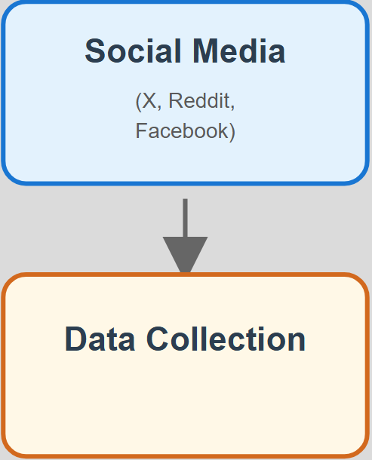
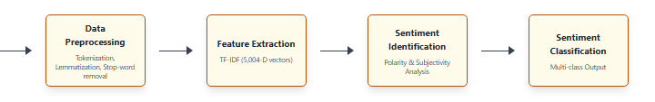
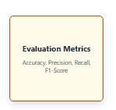
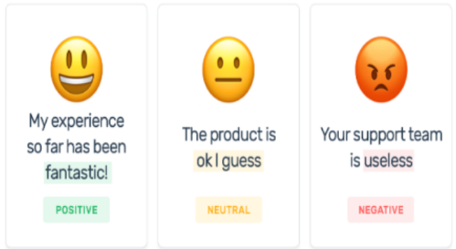
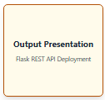
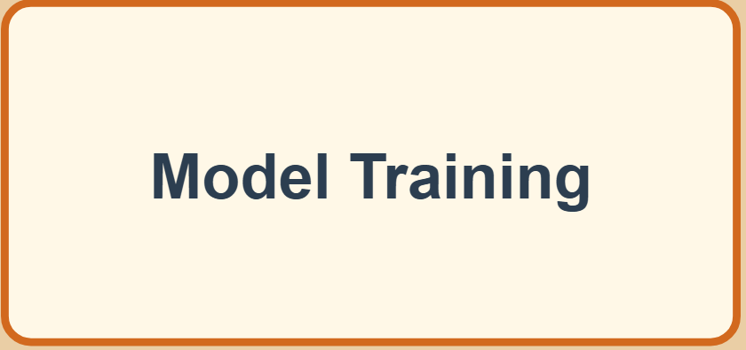
Block Diagram

Slide 9
Hardware Components Explanation
Processor : i5, i7, NVIDIA RTX (4GB,6GB)
Output Devices : Monitor (LCD)
Input Devices :Keyboard, Mouse
Hard Disk : 512GB OR ABOVE
RAM :16GB or above
Internet Connection: Required for API access and data streaming

Slide 10
Software Requirements
Programming Language:
Python – Version 3.10.9
Libraries:
NumPy, Pandas NLTK (Natural Language Toolkit), Scikit-learn,
Matplotlib, Seaborn
System : Windows 10 or 11
Development Environment:
Jupyter Notebook and VS Code (used as the primary IDE), GoogleCOLAB
Platform:
Compatible with Windows, Linux, and Mac OS

Slide 11


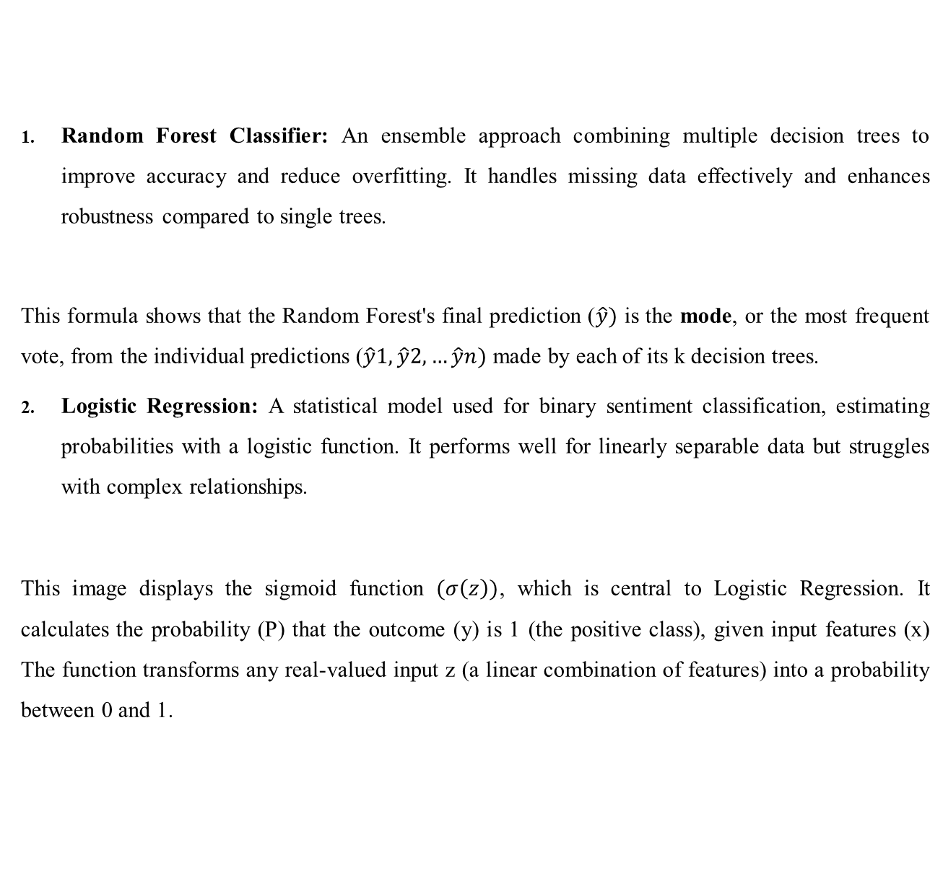
Algorithm Explanation
Random Forest Classifier: An ensemble approach combining multiple decision trees to improve accuracy and reduce overfitting. It handles missing data effectively and enhances robustness compared to single trees.
This formula shows that the Random Forest's final prediction ($\hat{y})$ is the mode, or the most frequent vote, from the individual predictions ($\hat{y}1,\hat{y}2,…\hat{y}n)$ made by each of its k decision trees.
Logistic Regression: A statistical model used for binary sentiment classification, estimating probabilities with a logistic function. It performs well for linearly separable data but struggles with complex relationships.
This image displays the sigmoid function $(σ\left(z\right))$, which is central to Logistic Regression. It calculates the probability (P) that the outcome (y) is 1 (the positive class), given input features (x) The function transforms any real-valued input z (a linear combination of features) into a probability between 0 and 1.

Slide 12


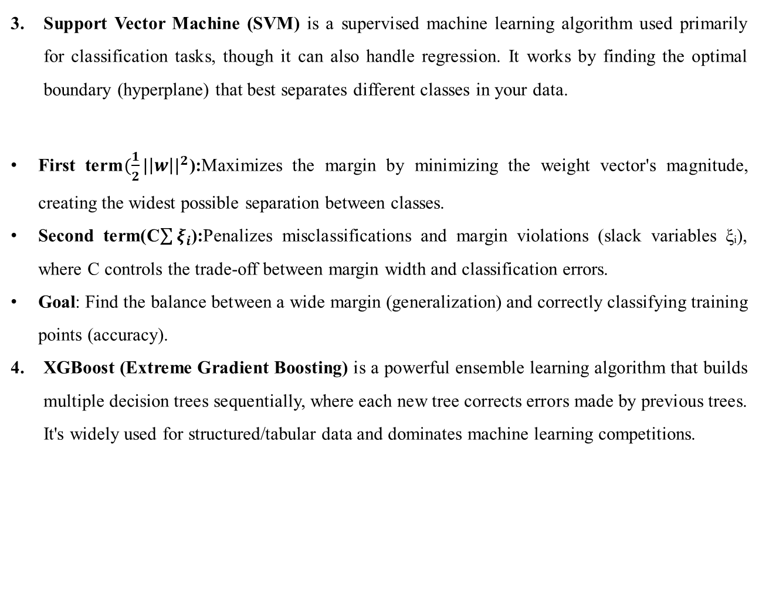
Support Vector Machine (SVM) is a supervised machine learning algorithm used primarily for classification tasks, though it can also handle regression. It works by finding the optimal boundary (hyperplane) that best separates different classes in your data.
First term$(\frac{1}{2}|\left|w\right||^{2}$):Maximizes the margin by minimizing the weight vector's magnitude, creating the widest possible separation between classes.
Second term(C$\sum{ξ_{i}}$):Penalizes misclassifications and margin violations (slack variables ξᵢ), where C controls the trade-off between margin width and classification errors.
Goal: Find the balance between a wide margin (generalization) and correctly classifying training points (accuracy).
XGBoost (Extreme Gradient Boosting) is a powerful ensemble learning algorithm that builds multiple decision trees sequentially, where each new tree corrects errors made by previous trees. It's widely used for structured/tabular data and dominates machine learning competitions.
Dept of AIML

Slide 13

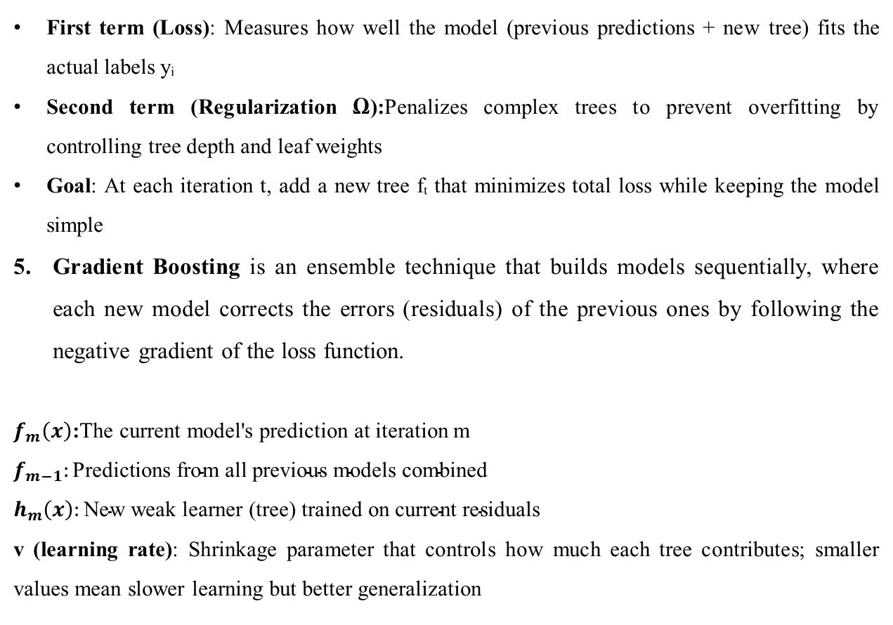
First term (Loss): Measures how well the model (previous predictions + new tree) fits the actual labels yᵢ
Second term (Regularization Ω):Penalizes complex trees to prevent overfitting by controlling tree depth and leaf weights
Goal: At each iteration t, add a new tree fₜ that minimizes total loss while keeping the model simple
Gradient Boosting is an ensemble technique that builds models sequentially, where each new model corrects the errors (residuals) of the previous ones by following the negative gradient of the loss function.
$f_{m}\left(x\right)$:The current model's prediction at iteration m
$$f_{m−1}:\text{Predictions} \text{from} \text{all} \text{previous} \text{models} \text{combined}$$
$$h_{m}\left(x\right):\text{New} \text{weak} \text{learner}\text{ (}\text{tree}\text{) }\text{trained} \text{on} \text{current} \text{residuals}$$
v (learning rate): Shrinkage parameter that controls how much each tree contributes; smaller values mean slower learning but better generalization
Dept of AIML

Slide 14
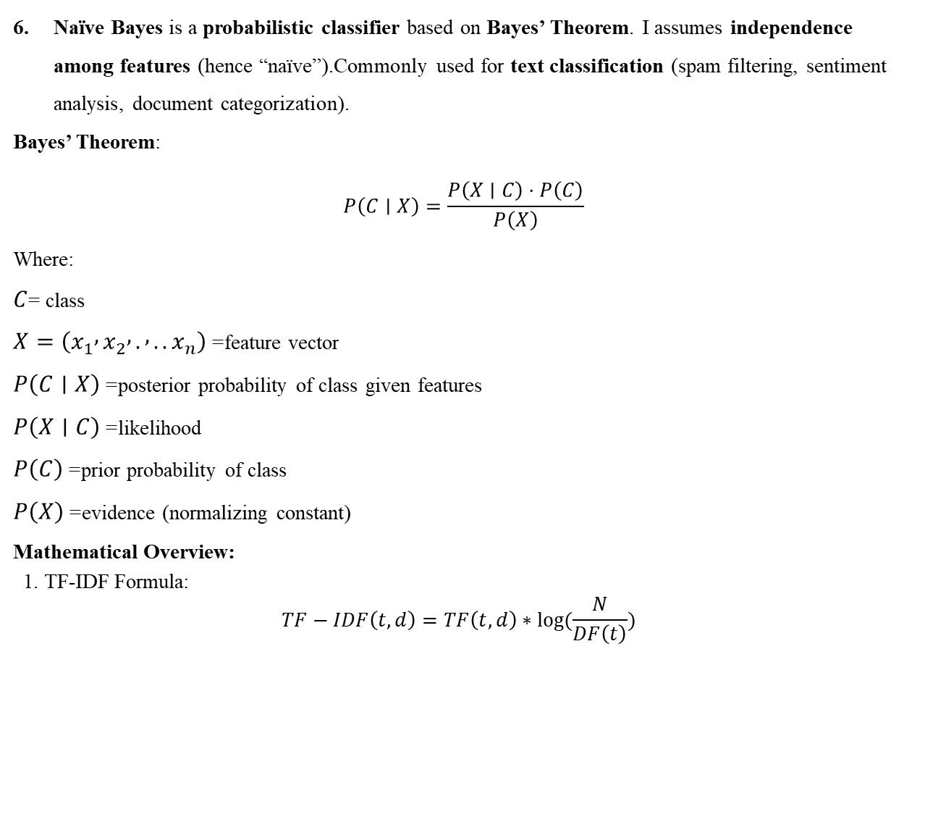
Naïve Bayes is a probabilistic classifier based on Bayes’ Theorem. I assumes independence among features (hence “naïve”).Commonly used for text classification (spam filtering, sentiment analysis, document categorization).
Bayes’ Theorem:
$$P\left(C∣X\right)=\frac{P\left(X∣C\right)⋅P\left(C\right)}{P\left(X\right)}$$
Where:
$C$= class
$X=\left(x_{1} , x_{2} , . , ..x_{n}\right)$= feature vector
$P\left(C∣X\right)$= posterior probability of class given features
$P\left(X∣C\right)$= likelihood
$P\left(C\right)$= prior probability of class
$P\left(X\right)$= evidence (normalizing constant)
Mathematical Overview:
1. TF-IDF Formula:
$$TF−IDF\left(t,d\right)=TF\left(t,d\right)∗log⁡(\frac{N}{DF\left(t\right)})$$
Dept of AIML

Slide 15
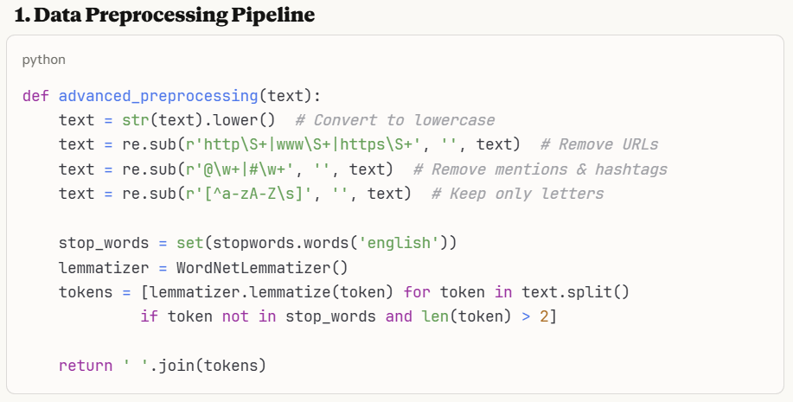
Code and Result
Sentiment_Analysis.py: This code implements a comparative machine learning pipeline that trains multiple algorithms on text data to classify sentiment (positive/negative/neutral) and identifies the best-performing model.
Dept of AIML

Slide 16
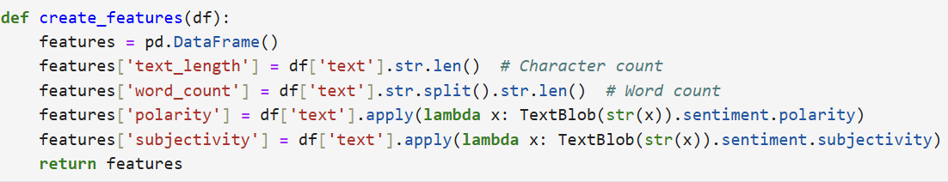
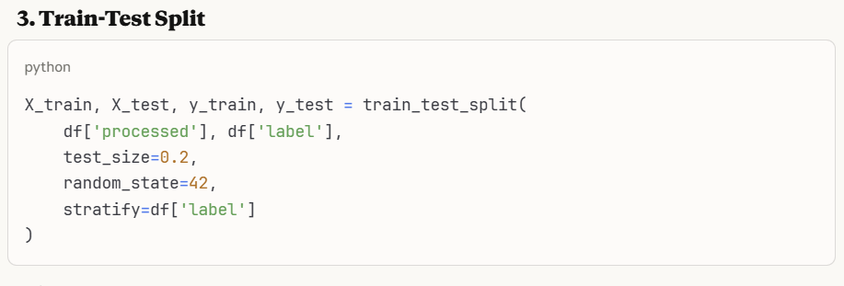
2. Feature Engineering:
Dept of AIML

Slide 17
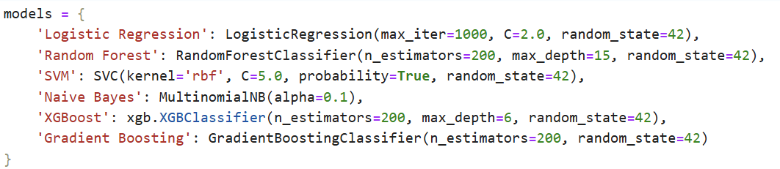
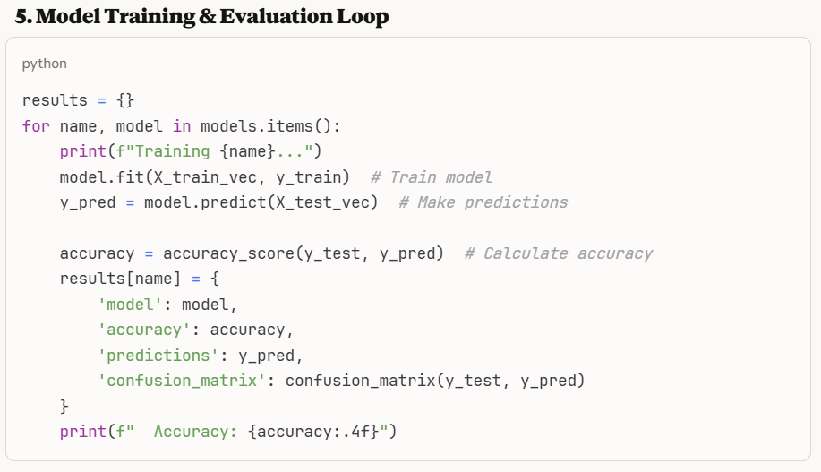
4. Machine Learning Models Setup:
Dept of AIML

Slide 18
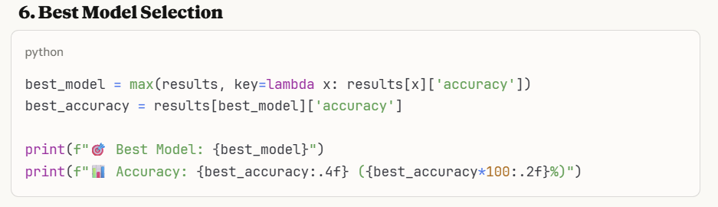
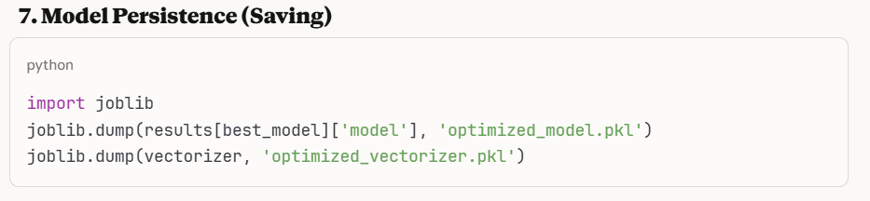
Dept of AIML

Slide 19
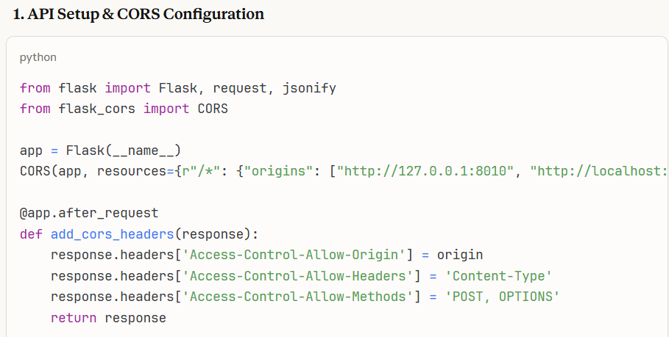
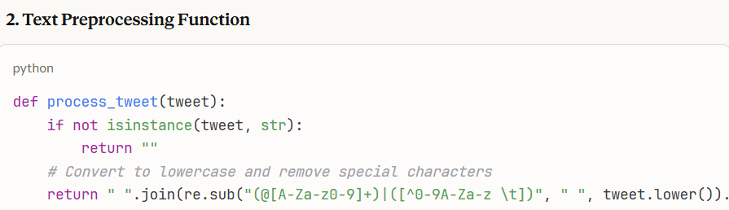
Dept of AIML

Slide 20
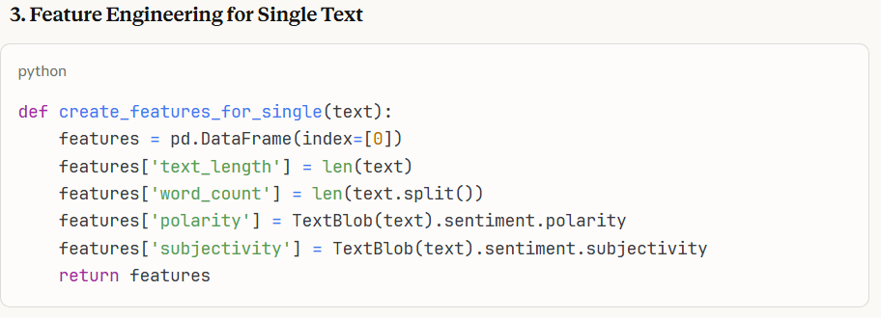

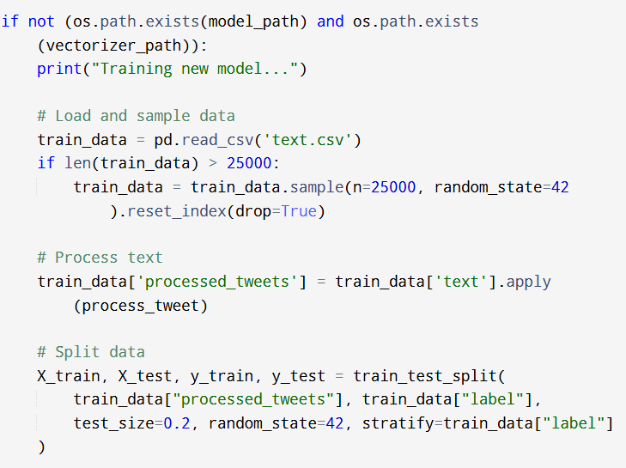
Dept of AIML

Slide 21

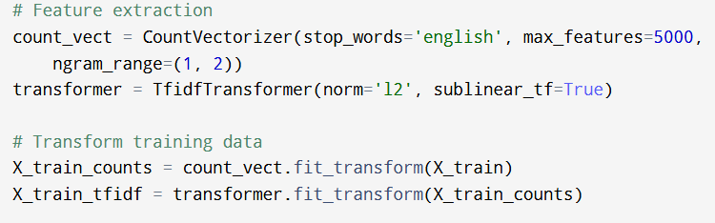

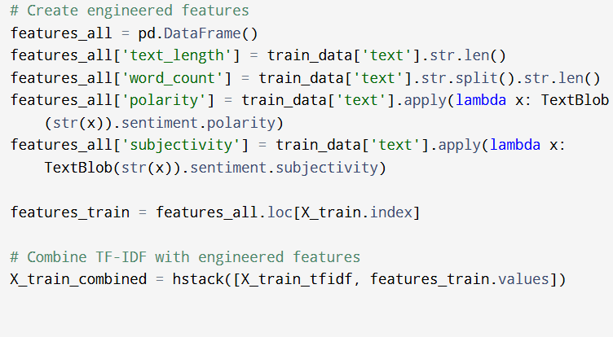
Dept of AIML

Slide 22
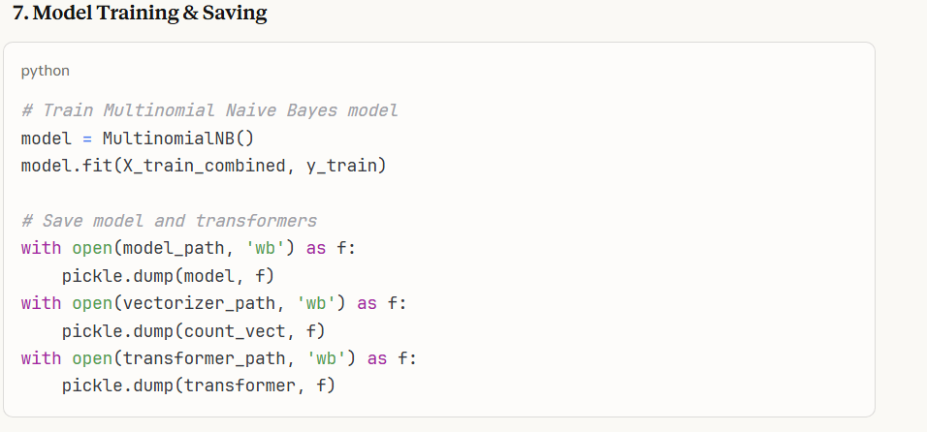
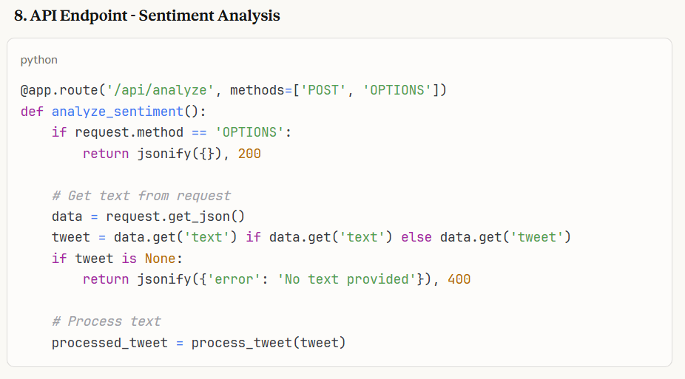
Dept of AIML

Slide 23
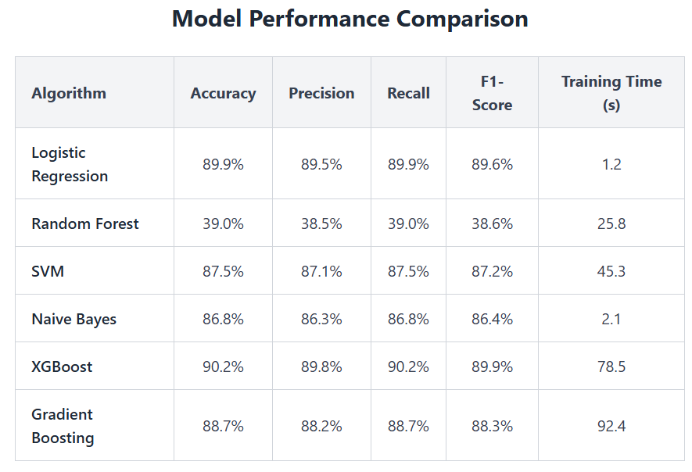
Outcomes:
Dept of AIML

Slide 24
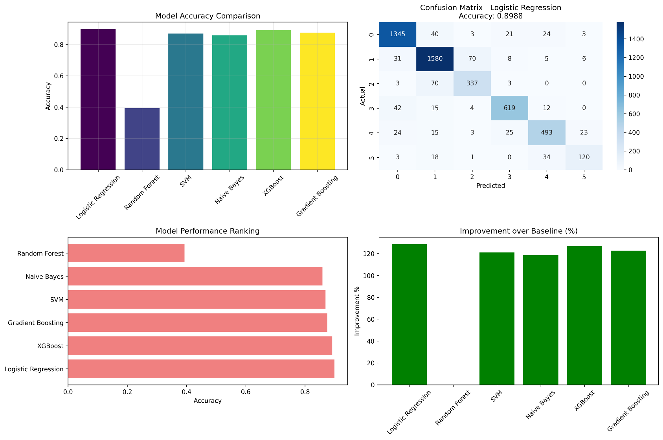
Model Comparison
Dept of AIML

Slide 25
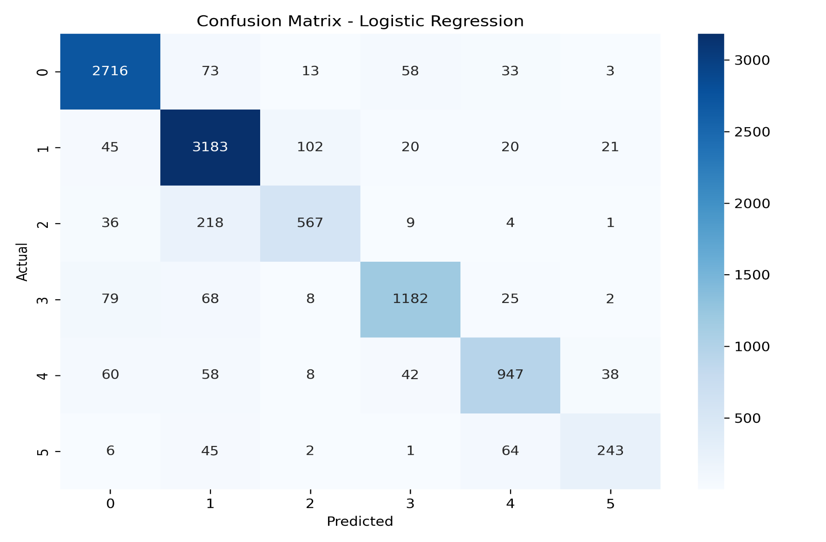
Confusion Matrix Analysis
Dept of AIML

Slide 26
Advantages: | Disadvantages:
Real-Time Feedback Enables organizations to monitor public sentiment instantly. Useful for crisis management, product launches, and campaign tracking. | Ambiguous language Words can carry multiple meanings depending on context, making it hard for algorithms to assign correct sentiment labels
Scalable Insights Analyzes thousands to millions of posts across platforms like Twitter, Facebook, Reddit. Helps detect trends, emerging issues, or viral content quickly. | Data Noise Social media data is messy—includes spam, irrelevant content, and bot activity. Requires extensive preprocessing to ensure quality analysis.
Business Intelligence Supports marketing, customer service, and product development by understanding user emotions. | Bias and Inaccuracy Models may reflect biases present in training data.
Dept of AIML

Slide 27
Applications
Real-Time Public Opinion: Track shifting sentiments on news, events, or policies.
Market Research and BI: Sentiment analysis provides a continuous feedback loop and data-driven insights that inform marketing, sales, and product strategies.
Political Campaign Monitoring: Analyze voter moods and election trends.
Product Improvement: Analyze feedback to spot common complaints or compliments, which can guide product development and innovation to better meet customer needs.
Trend and Influencer Identification: Detect emerging trends and influential voices by analyzing sentiment dynamics in social media, enabling brands to align marketing strategies and collaborate with key influencers.

Slide 28
FUTURE SCOPE
The system can be enhanced using advanced machine learning and deep learning models like LSTM, BERT, or transformers for improved prediction accuracy.
It can be expanded to perform real-time sentiment analysis on live social media data streams.
Future versions can include multi-language sentiment detection to analyze global user opinions.
Integration of emotion and topic classification can provide deeper insights into public discussions.
A real-time interactive dashboard can be developed for visualizing sentiment trends and analytics.
Predictive trend forecasting can help businesses and policymakers anticipate public reactions and market shifts.
Dept of AIML

Slide 29
Conclusion
The project on sentiment analysis of social media data demonstrates how machine learning techniques can classify public opinions as positive, negative, or neutral. It shows the power of analyzing large volumes of text to gain real-time insights into customer sentiment, helping businesses improve brand reputation, customer service, and marketing strategies. The project highlights sentiment analysis as a valuable tool for understanding consumer behavior and supporting data-driven decisions. Future improvements could focus on handling sarcasm, context, and multiple languages to enhance accuracy. This work confirms the importance of sentiment analysis in today’s digital world.

Slide 30
References
[1] H. Herjanto, A. Utomo, and D. Saraswati, “Sentiment analysis of SIREKAP-related news headlines,” SAR Journal, vol. 7, no. 3, pp. 204–212, 2024, doi: 10.18421/SAR73-06.
[2] S. Korani and M. Mouhoub, “Sentiment analysis of serious suicide references in Twitter social network,” in Proc. ICAART 2024, pp. 339–346, 2024, doi: 10.5220/0008894003390346.
[3] H. Herjanto and Carudin, “Analisis sentimen ulasan pengguna aplikasi Sirekap menggunakan algoritma Random Forest classifier,” J. Inform. dan Tek. Elektro Terapan, vol. 12, no. 2, pp. 4192–4201, 2024, doi: 10.23960/jitet.v12i2.4192.
[4] A. Prabowo, H. Sujaini, and T. Rismawan, “Analisis sentimen pengguna Twitter terhadap kasus COVID-19 menggunakan regresi logistik multinomial,” J. Syst. Teknol. Inform. (JUSTIN), vol. 11, no. 1, pp. 57–66, 2023, doi: 10.26418/justin.v11i1.57450.
[5] J. Wang, J. Guo, J. Yuan, and B. Li, “Sentiment analysis of Twitter data: A survey,” Appl. Sci., vol. 12, no. 22, p. 11775, 2022, doi: 10.3390/app122211775.

Slide 31
Thank You

