Slide 1


Campus Guide Mobile App
Dr. Nikolaos Tsantalis
Department of Computer Science and Software Engineering
Concordia University

Slide 2
Feature #1
Show my location on campus

Slide 3
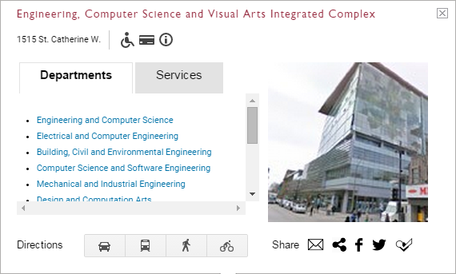
Feature #1
http://plancampus.umontreal.ca/ Campus Plan
Show the user the building he/she is currently in
Switch between SGW and Loyola campus
The user can hover over nearby buildings and get some basic information.

Slide 4
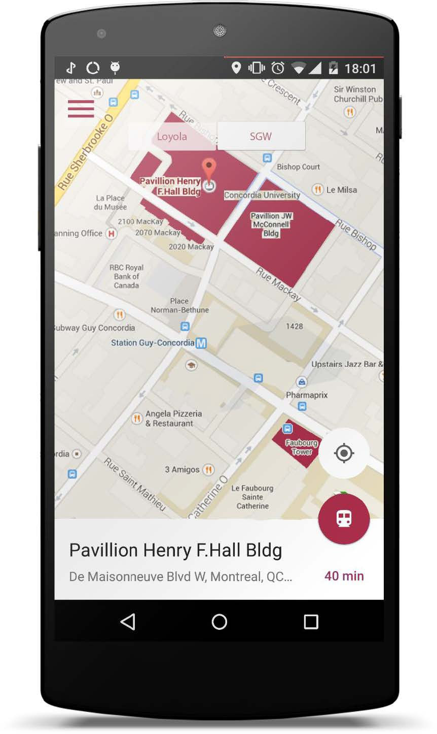
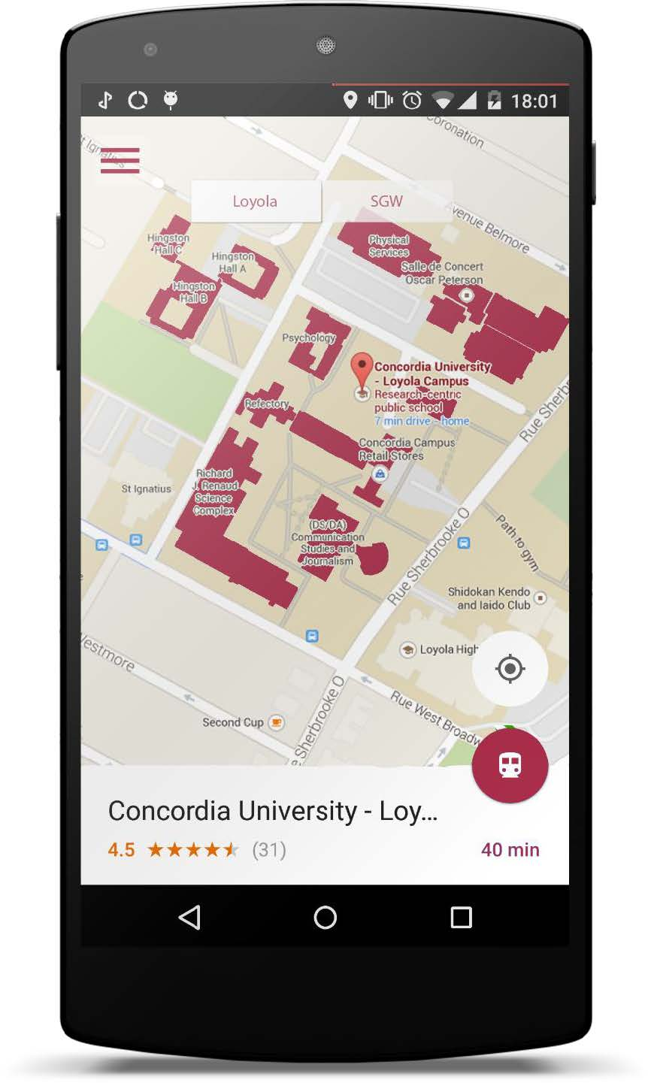

Slide 5
Feature #2
Show me outdoor directions from X to Y

Slide 6
Feature #2
The user selects a Start Building & Destination on the Campus Plan
Start Building can be determined based on the current location
Call Google directions service + Concordia Shuttle
Display directions on the Campus Plan

Slide 7
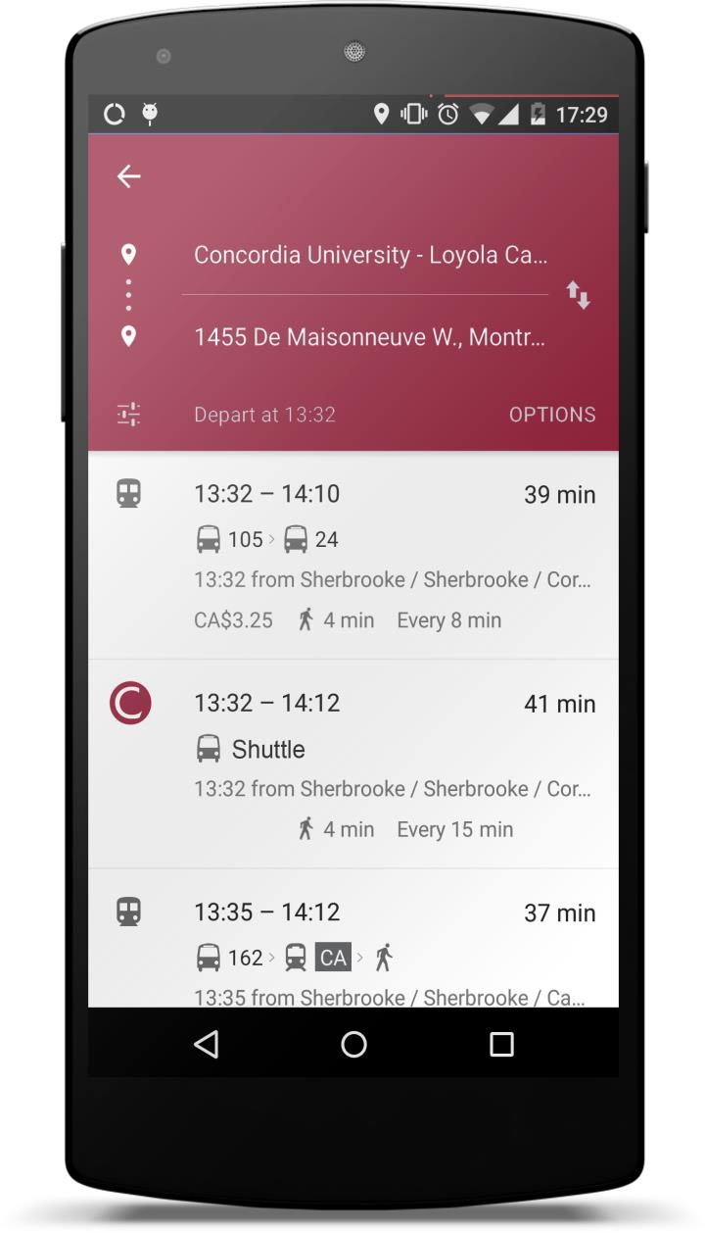

Slide 8
Feature #3
Show me directions to my next class

Slide 9

Feature #3
Time-aware and location-aware service
Based on Google Calendar Service, or Concordia Open Data API

Slide 10
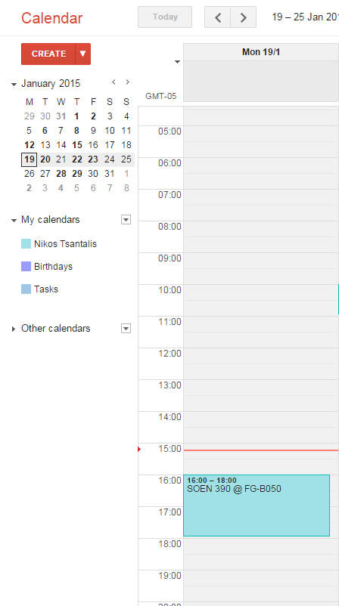
Feature #3
Connect to user’s calendar
Find next class
Find it’s location

Slide 11
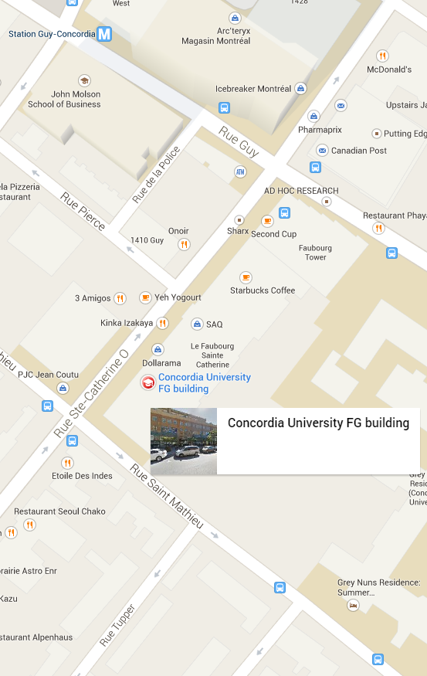
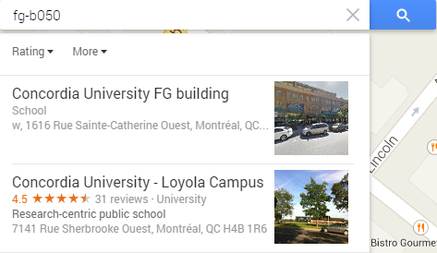
Feature #3
Find the building of the next class
Show directions from my current location

Slide 12
Feature #4
Show me indoor directions

Slide 13
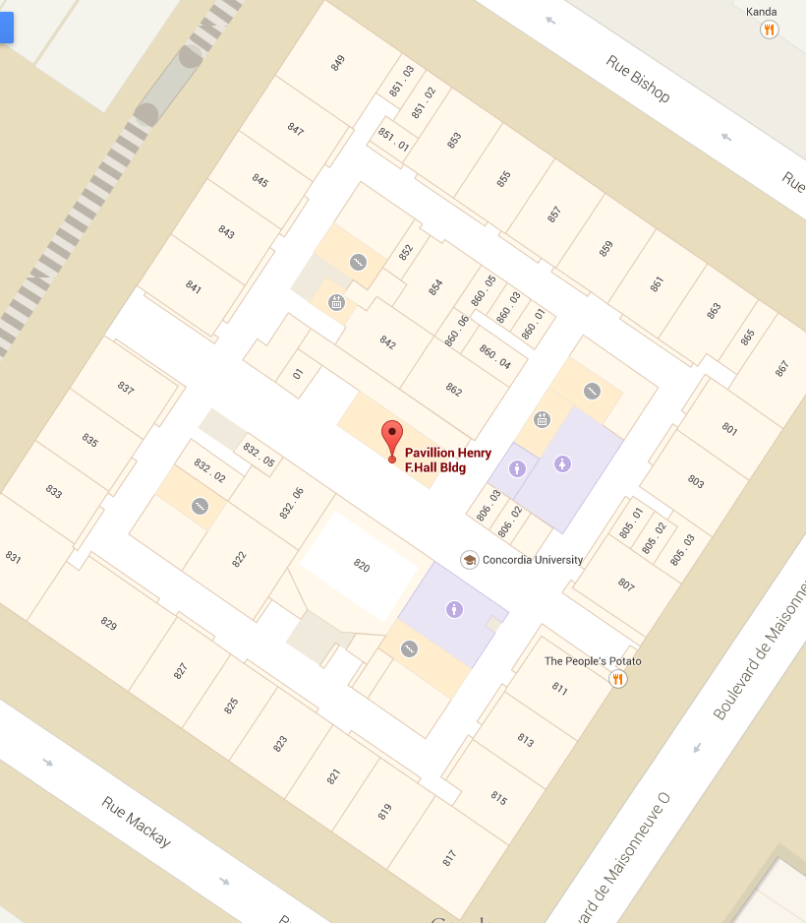
Feature #4
User selects starting room and destination room.
Show shortest path directions
Consider accessibility directions (avoid stairs)
Features 4 can be utilized in Feature 3 to show indoor directions to the destination classroom

Slide 14
Feature #5
Show me the nearest ??

Slide 15
Feature #5
?? can be: washroom, elevator, stairs, coffee shop, fast food, groceries store

Slide 16
Optional Feature #6
Smart Planner

Slide 17
Given a list of tasks, create a plan to execute all tasks
The plan should optimize (minimize) the total walking time
There are two kinds of tasks:
Tasks with a fixed start time (e.g., attend a class) and optional duration.
Tasks without any time constraints (e.g., buy coffee)
All tasks have a single or multiple locations that can be satisfied (e.g., “buy coffee” task has multiple nearby coffee shops)
The problem is essentially an optimization problem with time and location constraints, where the goal is to minimize the total travelling time. It can be considered as a variation of the Travelling salesman problem

