Slide 1
SOEN 390 Logistics
Dr. Nikolaos Tsantalis
Department of Computer Science and Software Engineering
Concordia University

Slide 2

Team formation
You are responsible for forming your own team
Rules:
Minimum #members: 8
Maximum #members: 10

Slide 3

Bidding document
Project bidding on Slack
Deadline: Friday, January 17th
Write a bidding document explaining why your team is qualified for the project/platform
Previous experience/knowledge
Programming skills in Java (Android), C# (Xamarin), HTML5/JavaScript/CSS (Ionic)
Testing frameworks
Research on similar mobile apps

Slide 4
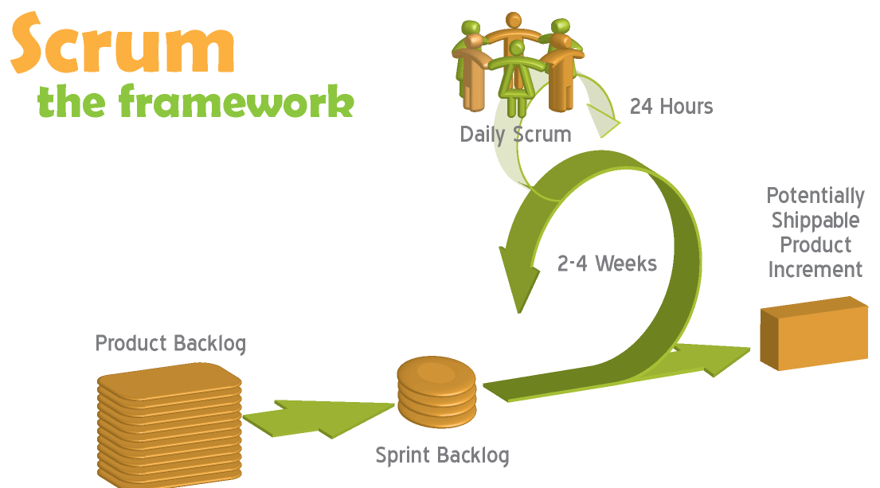
Development process
Fixed iterations (sprints) of 2 weeks
6 sprints in total
Every 2 sprints, a release is made (working prototype)
3 releases in total (releases will be marked, 30% each)
Lightweight documentation (incremental updates)

Slide 5










Development Platforms

Slide 6
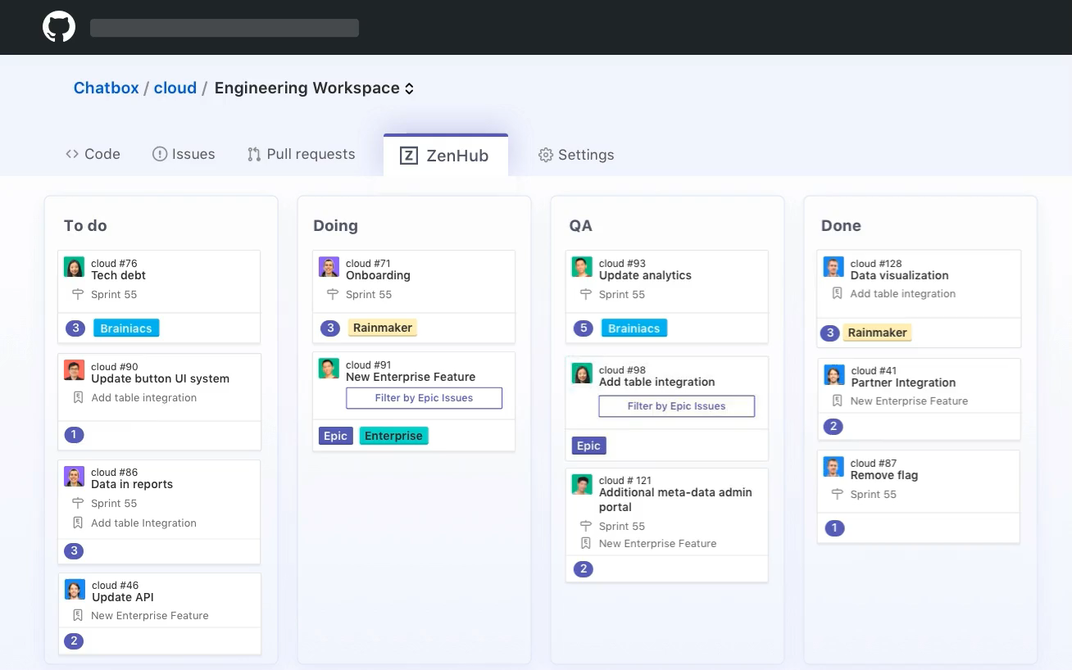
ZenHub

Slide 7

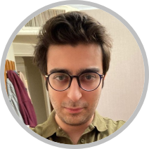
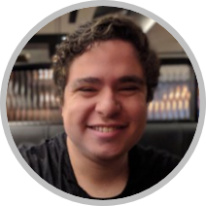
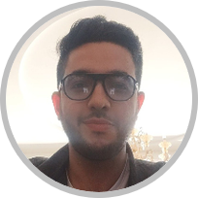
Sprint/Release structure
Meetings will be scheduled at
a time convenient for the
team members and the instructor
Nikolaos
Release
Meeting with
Teacher
Sprint N
Sprint N+1
Sprint N+2
week 1
week 2
week 3
week 4
week 5
week 6
Meeting with PO/Mentor
Meeting with PO/Mentor
Meetings will be scheduled at a time convenient for the team members and the TA
Pouria
Victor
Moein

Slide 8

Recommended Plan Sprint #1
Setup your GitHub repository and yml scripts for GitHub workflows
Create your project Backlog in ZenHub (make a user story for each project requirement)
Define the personas representing potential users and describe some of the tasks they will perform on the system. You should consider how to make your software accessible to more people. People with disabilities (color-blind, blind, deaf, people with hand injuries), illiteral people, or marginalized people.
Create UI mockups for the user stories you will implement in Sprint 2
Think about and document the design of your app (basic domain model, component diagram). Explore external libraries/frameworks that might be useful for your project and discuss their pros and cons.
Plan your Sprint 2 in ZenHub by adding some user stories from your backlog (add features than can be completed within 2 weeks)
Conduct and document your Sprint 1 Retrospective. Meet with your product owner and get feedback for your mockups and your backlog

Slide 9
Recommended Plan Sprint #2
Implement the planned features
Write unit tests for your code
Submit your features in Pull Requests. Assign team members for code review. There should be active discussions and suggestions for improvements.
Create UI mockups for the user stories you will implement in Sprint 3
Investigate how you can make automated System/UI tests for mobile apps. In the meantime, some team members will do manual system testing for the implemented features and report well documented bug reports on GitHub as issues.
Install and run SonarQube for your project. Summarize the issues detected by SonarQube and discuss how and when you will address them.
Conduct and document your Sprint 2 Retrospective. Meet with your product owner for acceptance testing and getting feedback
Prepare your presentation for the Instructor and practice it with all team members at least once.
Submit your Release 1 report on Slack
Plan your Sprint 3 in ZenHub by adding user stories from your backlog (add features than can be completed within 2 weeks)

Slide 10
Recommended Plan Sprint #3
Implement the planned features
Write unit tests for your code
Submit your features in Pull Requests. Assign team members for code review. There should be active discussions and suggestions for improvements. These suggestions could also include refactorings. Document systematically your refactoring efforts by collecting commits and PRs with specific types of refactorings
Create UI mockups for the user stories you will implement in Sprint 4
At this point you should have automated System/UI tests for all implemented features so far. You will do manual system testing for the ongoing features and report well documented bug reports on GitHub as issues.
Investigate potential design patterns that could be useful for your project. Justify their need in your project.
Investigate how you will conduct usability testing and create the required infrastructure (setup and try usability testing tools).
Plan your Sprint 4 in ZenHub by adding some user stories from your backlog (add features than can be completed within 2 weeks. Note that in the next Sprint you will conduct usability testing. Make a realistic plan)
Conduct and document your Sprint 3 Retrospective. Meet with your product owner for acceptance testing and getting feedback

Slide 11
Recommended Plan Sprint #4
Implement the planned features following the same practices (PRs, code reviews, unit tests)
Introduce design patterns in your project. Document commits where your design pattern instances were introduced and evolved (adding new abstract methods, adding new subtypes)
Address technical debt and security warnings from SonarQube. Update your SonarQube (code quality) report
Create UI mockups for the user stories you will implement in Release 3 (Sprints 5 and 6).
Add automated System/UI tests for the newly implemented features.
Recruit users and conduct your first usability testing. Collect and analyze your usability test results. Make well documented issues for UI improvements and bugs found during testing.
Conduct and document your Sprint 4 Retrospective. Meet with your product owner for acceptance testing and getting feedback
Prepare your presentation for the Instructor and practice it with all team members at least once.
Submit your Release 2 report on Slack
Plan your Sprint 5 in ZenHub by adding some user stories from your backlog (add features than can be completed within 2 weeks)

Slide 12
Recommended Plan Sprint #5
Address all UI issues discovered in usability testing
Implement the remaining planned features
Write unit tests for the new features
Submit your features in Pull Requests. Assign team members for code review. There should be active discussions and suggestions for improvements. These suggestions could also include refactorings. Document systematically your refactoring efforts by collecting commits and PRs with specific types of refactorings
Add automated System/UI tests for the newly implemented features.
Address technical debt and security warnings from SonarQube. Update your SonarQube (code quality) report
Plan your Sprint 6 in ZenHub by adding any remaining user stories from your backlog.
Conduct and document your Sprint 5 Retrospective. Meet with your product owner for acceptance testing and getting feedback

Slide 13
Recommended Plan Sprint #6
Conduct a second round of usability testing. Compare the current usability test results with the previous ones to show the improvement in user satisfaction or other usability metrics.
Add automated System/UI tests for all implemented features.
Address all remaining technical debt and security warnings from SonarQube. Update your SonarQube (code quality) report
Conduct and document your Sprint 6 Retrospective. Meet with your product owner for any remaining acceptance testing
Prepare your presentation for the Instructor and practice it with all team members at least once.
Submit your Release 3 report on Slack

Slide 14
How are you evaluated?
The instructor evaluates your software engineering practices
Planning
Team management
Reports (design, testing, quality)
Source code reviewing
Proper use of engineering tools
Research/investigation
Communication
Professionalism
The exact evaluation criteria can be found at marking.pdf

Slide 15

First meeting with the Product Owner
Schedule a meeting time that works for the team and PO.
Prepare the backlog with user stories before the visit
Prepare some UI prototypes before the visit
Make sure you leave the meeting with all your questions answered & doubts clarified
Be positive and enthusiastic

Slide 16

Tutorial Schedule
January 20, Zenhub
January 27, CI pipeline on GitHub
February 3, Testing Mobile apps
February 10, SonarQube
Q QA Monday 17:45-18:35
Q QC Monday 19:15-20:05
R SA Monday 17:45-18:35
R SC Monday 19:15-20:05

