Slide 1
HalfASCON
Asif Hasan

Slide 2
ASCON vs HalfASCON
ASCON | HalfASCON
1. Key Size = 128 bit | 1. Key Size = 64 bit
2. 320 bit internal state | 2. 160 bit internal state
3. Substitution layer word size = 64 bits. | 3. Substitution layer word size = 32 bits only.
4. Linear diffusion layer consists of XOR and right rotation of the 64-bit words. | 4. Linear diffusion layer consists of XOR and right rotation of the 32-bit words.
5. Selected by NIST. | 5. Cryptanalysis not tested.

Slide 3
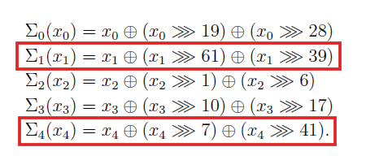
Linear Diffusion Layer
ASCON’s diffusion layer is designed for 64 bits.
Rotation constants > 32 are not applicable for HalfASCON.
Rotation constants are chosen on the basis of –
Branch number
Avalanche effect
Avoids symmetry
Covers both small and large shifts
Rotation constants are optimized for performance and lightweight.
Fig 1: ASCON Linear Diffusion Layer

Slide 4
Rotation Constants
Rotation Constants | ASCON |  | HalfASCON
 | Branch Number | Avg. Avalanche | Branch Number | Avg. Avalanche
19, 28 | 44 | 4.69% | 16 | 9.38%
61, 39 | 44 | 4.69% | Invalid | Invalid
1, 6 | 42 | 4.69% | 18 | 9.38%
10, 17 | 42 | 4.69% | 16 | 9.38%
7, 41 | 44 | 4.69% | Invalid | Invalid
31, 5 |  |  | 18 | 9.38%
3, 13 |  |  | 18 | 9.38%

Slide 5
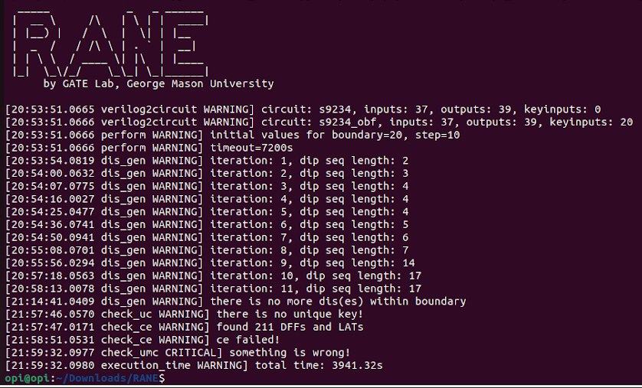
Logic-Locking with HalfASCON
Open-source obfuscation tools used –
RANE
NEOS
Limitations –
Only supports gate level netlist.
Doesn’t support locking mechanism in flip-flops.
Can only deobfuscate built-in designs.
Possible Solutions: Cadence JasperGold.
Fig 2: Deobfuscation using RANE.

Slide 6
Thank You

