Slide 1
Data Science Project
Asif Iqbal
DS-10 Dice Analytics

Slide 2
Motivation
The problem statement of the project is to predict :
‘Efficiency of cars’ in terms of ‘Miles per Gallon’.
To which certain Features like engine displacement, weigh of cars, acceleration, number of cylinders, horse power, model etc. would make a difference to number of ‘Miles per Gallon’.
The comparison of cars from different origin in terms of mileage.
To observes correlation among different features of cars.

Slide 3
About Dataset
Context:
The data is technical spec of cars. The dataset is downloaded from UCI Machine Learning Repository
Content:
Title: Auto-Mpg Data
Sources: (a) Origin: This dataset was taken from the StatLib library which is maintained at Carnegie Mellon University. The dataset was used in the 1983 American Statistical Association Exposition. (c) Date: July 7, 1993.
The data concerns city-cycle fuel consumption in miles per gallon, to be predicted in terms of 3 multivalued discrete and 5 continuous attributes.
Number of rows are 398 and 9 columns.
Missing Attribute Values: horsepower has 6 missing values

Slide 4
Data Attributes
mpg: continuous
cylinders: multi-valued discrete
displacement: continuous
horsepower: continuous
weight: continuous
acceleration: continuous
model year: multi-valued discrete
origin: multi-valued discrete
car name: string (unique for each instance)

Slide 5
Features Engineering
Manufacturing Country from origin(1>USA, 2>Europe, 3>Japan)
Power-to-Weight ratio from horsepower and weight.
Company Name from cars name.
Displacement in cc from displacement in Cu Inch (i.e. multiply by 16.3871).
Displacement in liter from cc. (i.e. dividing by 1000).
Categorizing horse power into Low, Mid, High bins.

Slide 6
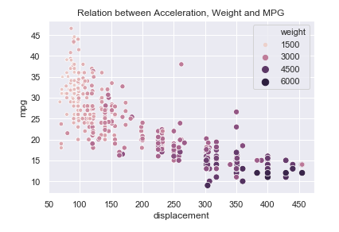
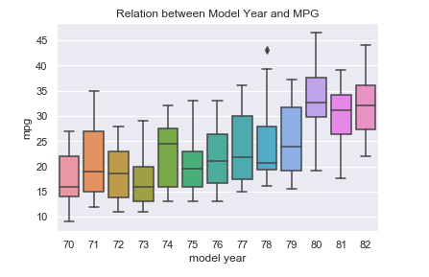
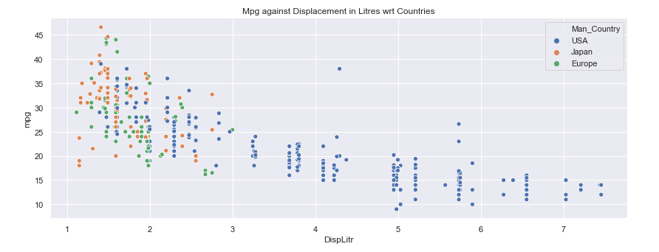
Basic Insights

Slide 7
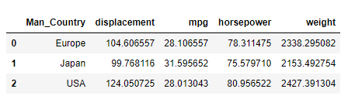
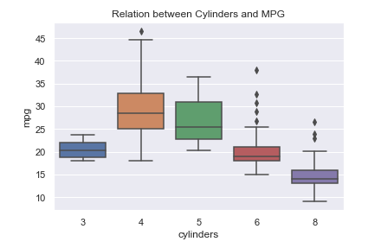
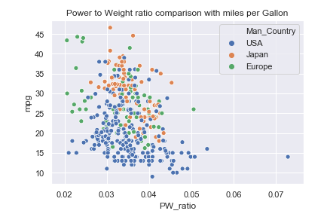
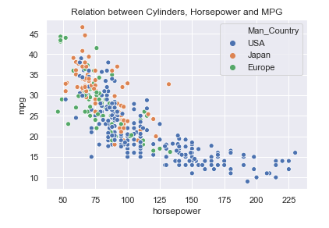

Slide 8
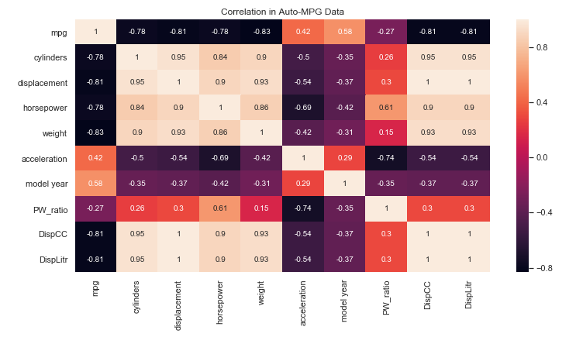

Slide 9
Model Comparison
Algorithms | Training Score | R2 Score | RMSE
Linear Regression | 0.861120 | 0.786013 | 3.622106
Polynomial Regression | 0.923501 | 0.646696 | 4.654157
Decision Tree Regressor | 0.943294 | 0.777069 | 3.697027
Random Forrest Regressor | 0.949041 | 0.806414 | 3.445121
XG Boost Regressor | 0.995600 | 0.823474 | 3.289813

Slide 10
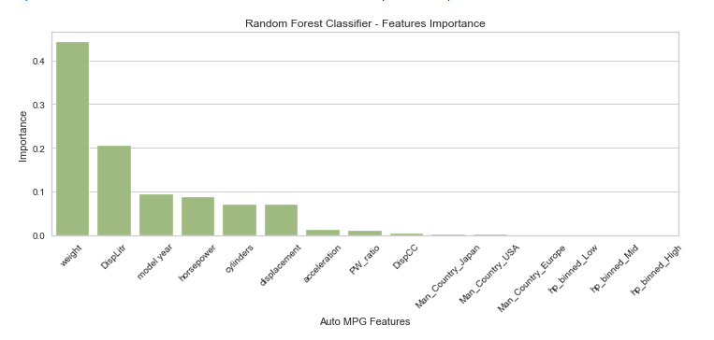
Tuned Parameters
Features Importance:
Tuned Hyperparameter:
First Test
Second Test
'max_depth': 5 'min_samples_leaf': 2 'n_estimators': 72
'max_depth’: 6 'min_samples_leaf': 2 'n_estimators’: 66

Slide 11
Model Comparison
No | Algorithm | Action | Training Score | R2 Score | RMSE
1 | Random Forest | First Run | 0.949041 | 0.806414 | 3.445121
2 | Random Forest | Tuned | 0.977891 | 0.821110 | 3.311773
ytest | Prediction
26.6 | 20.65443756
24.0 | 26.60073129
15.0 | 18.07084949
19.0 | 19.4975479
25.5 | 24.61083158

Slide 12


