Slide 1

Welcome to Online Health Consulter
Login as
Patient
Doctor
Admin

Slide 2

User Name Password
Auditi
*******
Login
Don't have an account click here to
Create account

Slide 3


Quick Health check Up
BMI CHECK UP
Health Reports
CORONA VIRUS CHECK
Doctors Online
DIABETES CHECK UP

Slide 4

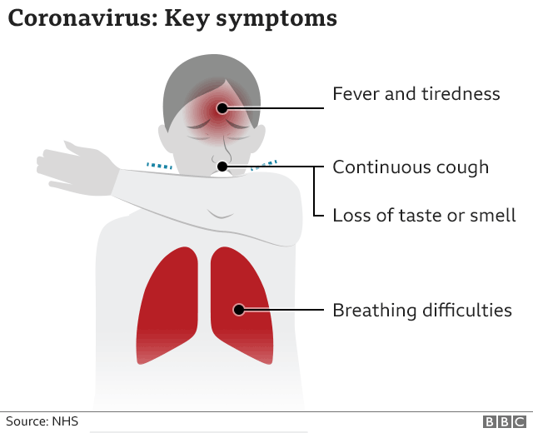
Check up for Symptoms of coronavirus
Do you have Fever?
Do you have Dry Cough?
Do you have Loss of taste and smell?
Do you have Difficulty breathing or shortness of breath?
Do you have Chest pain or pressure?
Do you have a rash on skin, or discolouration of fingers or toes?
Yes
Yes
Yes
Yes
Yes
No
Submit

Slide 5

Doctor's treatments of coronavirus
As you have fever take Ace/Napa tablets in every eight hours. If you have more than 103 degree celsius than take tablets in every six hours.
Cover your neck to keep it warm .
If you have chest pain and have difficulty to breath make sure you have oxygen cylinder to support you.
If you can not take proper measures at home visit this link : www.helporg.com . We will provide you every think you need
Next

Slide 6
Doctors suggestions
Stay home and rest
Drink plenty of food and eat nutritious food
Stay in separate room from another family member
Clean and disinfect frequently touched surfaces
Maintain a healthy diet, sleep, stay active, and make social contact with loved ones through the phone or internet
Next

Slide 7
Doctor's advice for prevention of coronavirus
Wear a mask
Clean your hands
Keep a safe distance
Don’t touch your eyes, nose or mouth
Cover your nose and mouth with your bent elbow or a tissue when you cough or sneeze
Stay home if you feel unwell
Next

Slide 8
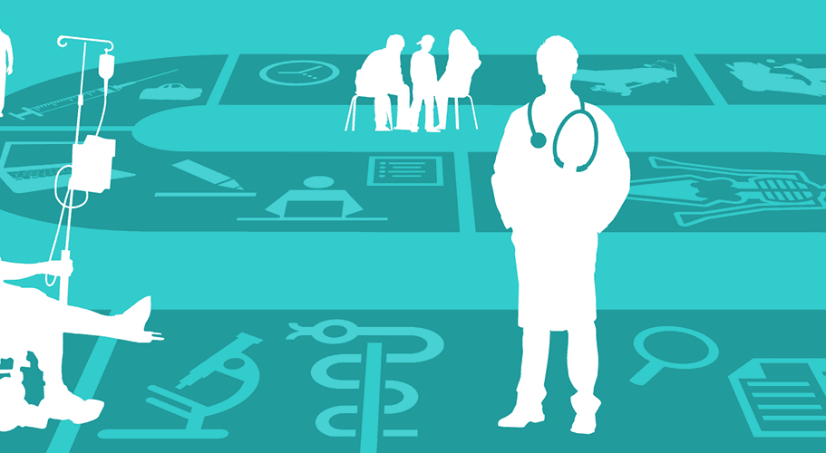




For any query please come again
Exit

Slide 9
Welcome to Online Health Consulter
Login as
Patient
Doctor
Admin

Slide 10
User Name Password
Doctor
*******
Login
Don't have an account click here to
Create account

Slide 11
Time schedule of today
BMI check up result pending of 4 patients
Health reports of patients
CORONA VIRUS check up result pending of 2 patients
Online Activity Status
DIABETES check up result pending of 3 patients

Slide 12
Patient 1: Rahim Patient 2: Karim

Slide 13
Symptoms of coronavirus
Do you have Fever?
Do you have Dry Cough?
Do you have Loss of taste and smell?
Do you have Difficulty breathing or shortness of breath?
Do you have Chest pain or pressure?
Do you have a rash on skin, or discolouration of fingers or toes?
Yes
Yes
Yes
Yes
Yes
No
Prescribe to the patient

Slide 14
Doctors suggestions
Reply
Send

Slide 15
Its been uploaded in Health reports of patients File section
Exit

