Slide 1


Slide 2

Heart Disease Prediction System Using Deep Learning with Multi-Class Classification

Slide 3
Group Members Introduction
Name: Asif Nawaz VuID:BC22041485
I am Asif Nawaz, This is my CS619 Final Year Project. As a final-year BSCS student at Virtual University, I designed and developed CardioPredict AI — an AI-powered web application that helps doctors assess a patient's heart disease risk in seconds.

Slide 4

INTRODUCTION OF PROJECT
Project Title: CardioPredict AI — Heart Disease Risk Assessment System
Introduction:
A web-based clinical decision-support tool that predicts a patient's heart disease risk as Low, Medium, or High. Built for healthcare professionals to assist in early diagnosis using AI. Trained on the UCI Heart Disease dataset (Cleveland + Hungarian, ~600 records).

Slide 5
Why it matters:
Cardiovascular disease is the #1 cause of death globally (WHO).
Early risk identification saves lives but requires costly tests and time.
An AI-assisted tool helps doctors triage patients faster with a single form.
Key Features
Patient registration, search, and complete prediction history per patient.
Three ML models compared side-by-side: ANN, Logistic Regression, Random Forest.

Slide 6
Key Features (con.)
Detailed result page with risk probability charts + clinical recommendations.
PDF / CSV export of prediction reports.
Admin panel for managing users and viewing patient reports.
Technology Stack
Frontend: Next.js 14, Tailwind CSS, Chart.js
Backend: FastAPI (Python), SQLAlchemy, JWT authentication.

Slide 7
Technology Stack (con.)
Database: MySQL 8
Machine Learning: TensorFlow / Keras, scikit-learn
Achievement
Best model (ANN) achieves 77.5% accuracy with 0.917 ROC-AUC on the t

Slide 8
Process Model:Iterative & Incremental Development Model
Why this model was chosen
The system has clearly separable modules (auth, patient management, ML prediction, admin) — perfect for incremental delivery.
Working software at the end of every iteration → continuous testing and feedback.
Allowed the ML pipeline to be refined as more data was added without disrupting the rest of the system.

Slide 9
Process Model:Iterative & Incremental Development Model
Iterations Followed
Iteration 1: Database schema + user authentication (register / login)
Iteration 2: Patient management + new prediction form
Iteration 3: ML model training (UCI Cleveland + Hungarian datasets)
Iteration 4: Results page, prediction history, PDF / CSV export
Iteration 5: Admin panel and patient reports

Slide 10
Key Advantages Realised
Bugs caught early instead of at the end of the project.
Each module was independently testable.
New features (real-time validation, country-code phone input) were added without rewrites.

Slide 11
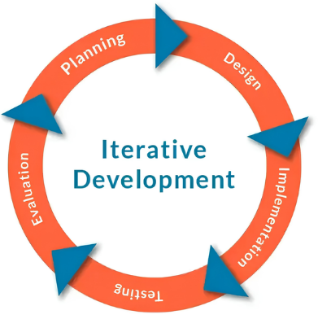

Slide 12
Actors Catalog
Actor | Type | Role / Responsibilities
Healthcare Professional (Doctor) | Primary | Registers / logs in, manages patient records, fills clinical input, runs heart disease risk predictions, views history, exports PDF / CSV reports.
System Administrator | Primary | Manages user accounts (activate / disable / promote to admin), views all patients across doctors, generates patient-level reports, monitors system data.
ML Prediction Engine | Secondary (system) | Receives feature vector, returns risk class (Low / Medium / High) with confidence score and probability distribution.
MySQL Database | Secondary (system) | Persists users, patients, health parameters, predictions, ML model registry.

Slide 13
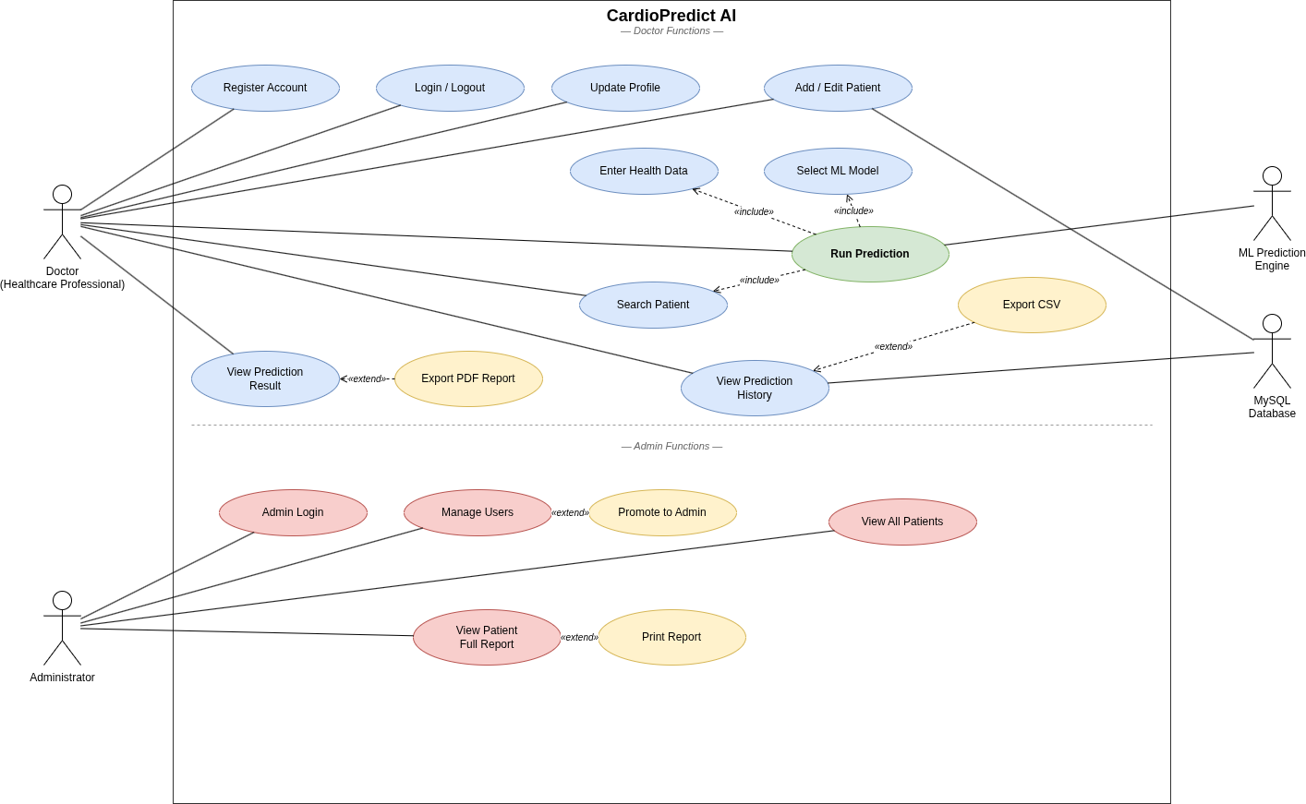
Use Case Diagram

Slide 14
Business Rules Catalog
# | Rule
BR-01 | Only registered healthcare professionals or admins can access the system.
BR-02 | Each username and email must be unique; both are checked in real-time during registration.
BR-03 | Passwords must be at least 8 characters with one uppercase, one lowercase, and one digit.
BR-04 | Patient first name and last name are required when creating a new patient record.
BR-05 | Each patient record is owned by exactly one doctor (the user who created it).
BR-06 | Clinical input fields must fall within valid medical ranges (e.g., Age 1–120, Resting BP 50–250, Cholesterol 0–600).
BR-07 | A prediction can only be saved if all 13 clinical features are provided.
BR-08 | Risk classification must be one of three classes: Low, Medium, or High.
BR-09 | Predictions are read-only once saved — they cannot be edited (preserves audit trail).
BR-10 | Only users with role = admin can access the /admin panel and modify other users.
BR-11 | The default admin account is created by create_admin.py and cannot be disabled by mistake.
BR-12 | All passwords are stored as bcrypt hashes; plain-text passwords are never persisted or logged

Slide 15
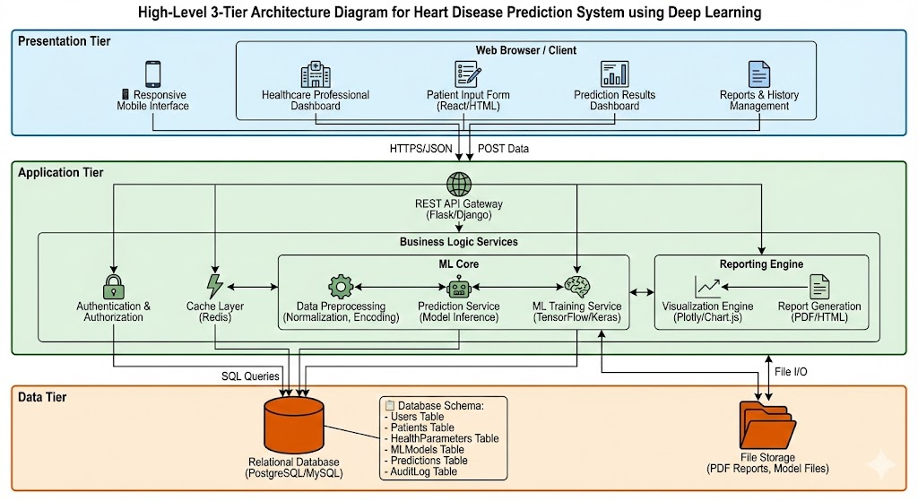
Architectural Design

Slide 16
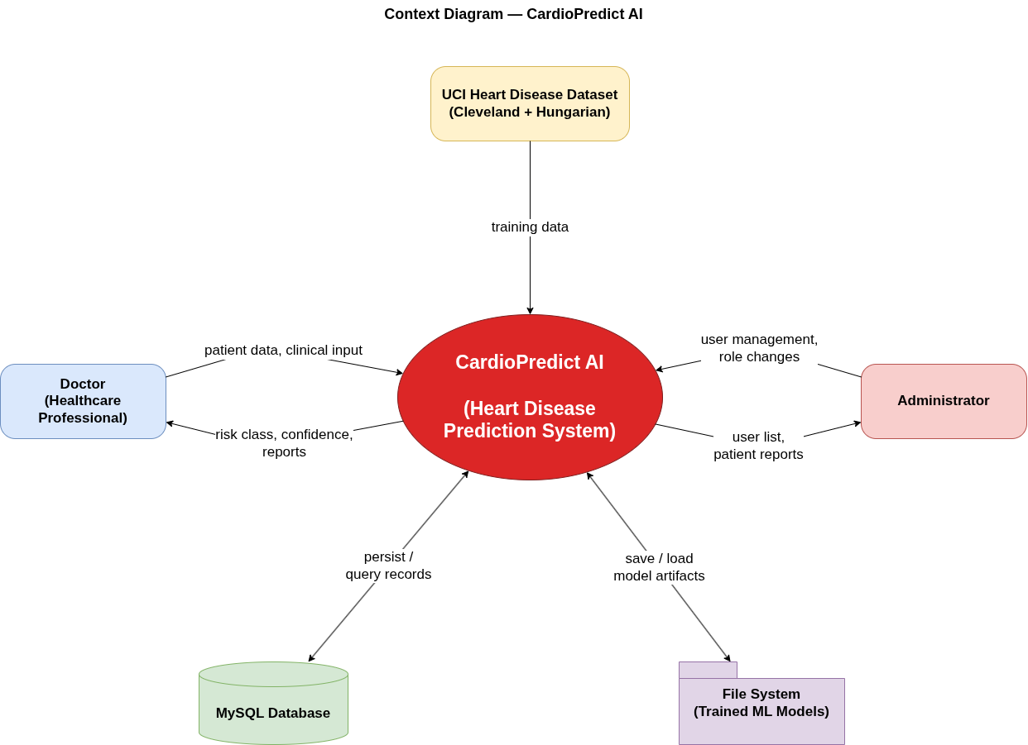
Project Scope

Slide 17
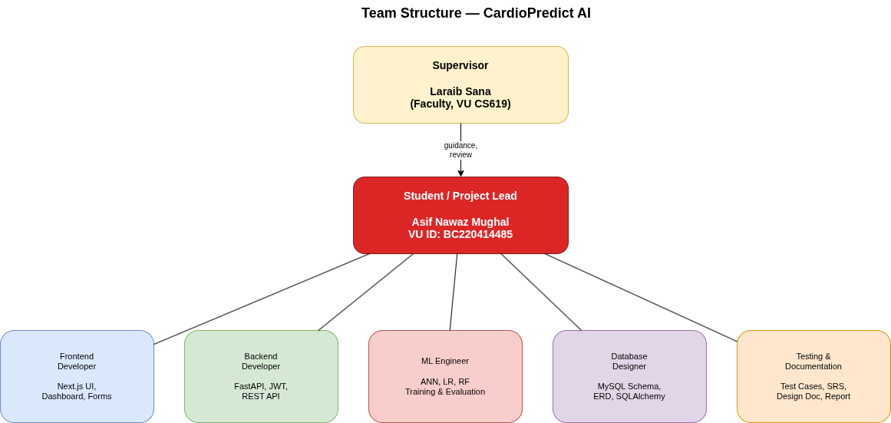
Team Structure

Slide 18
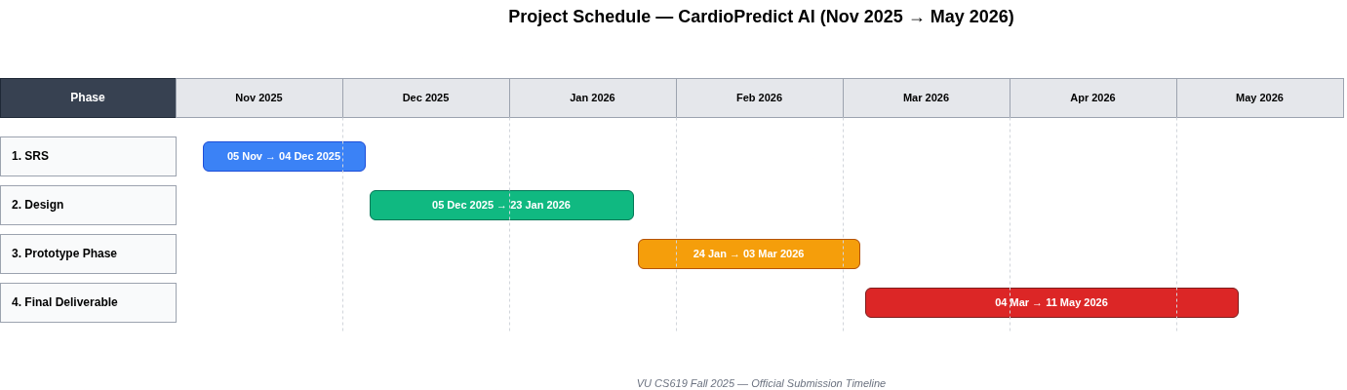
Project Schedule

Slide 19
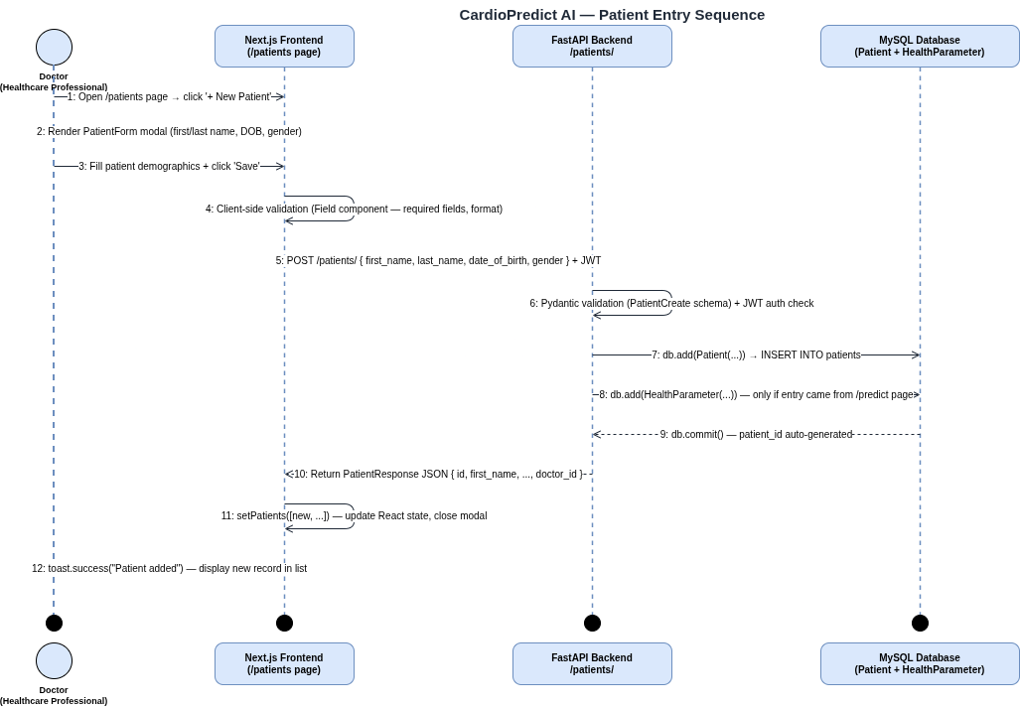
Sequence Diagrams
Patient Entry

Slide 20
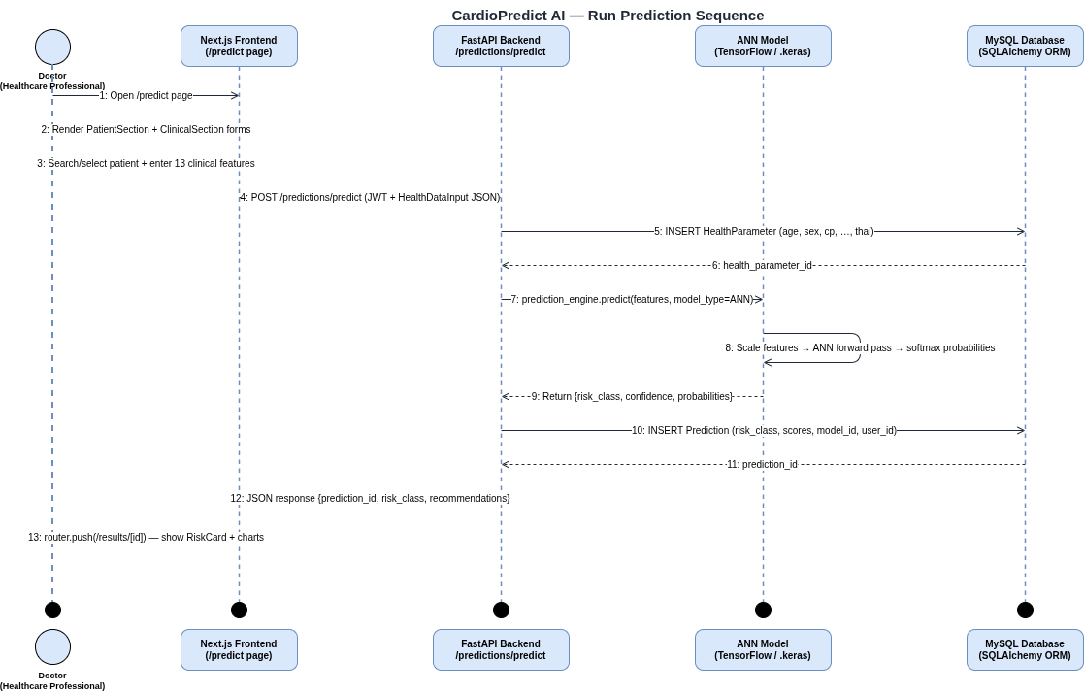
Sequence Diagrams
Prediction

Slide 21
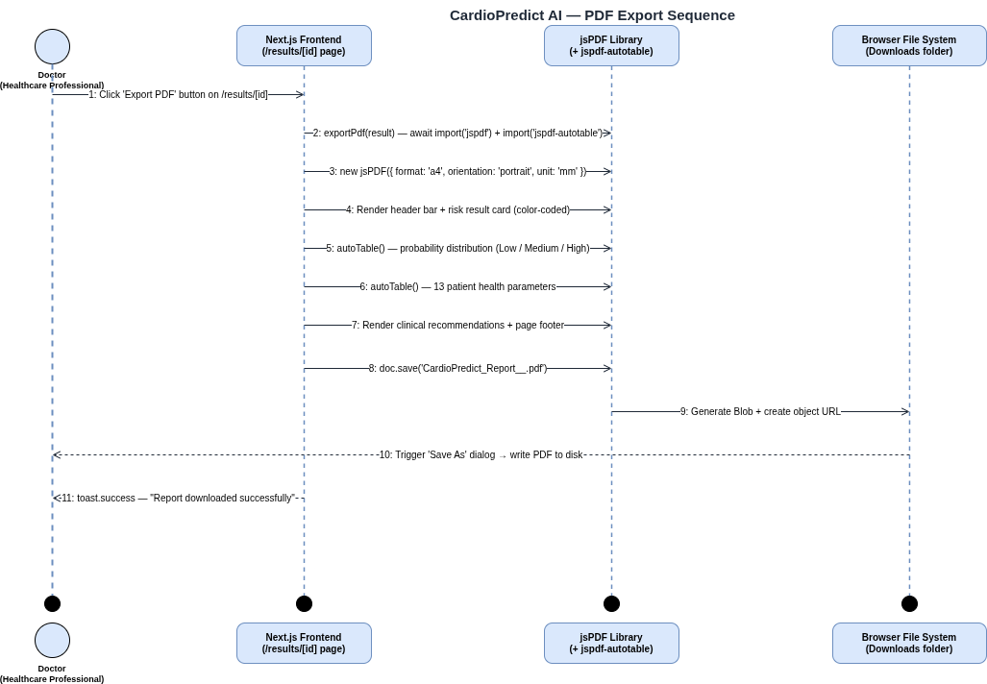
Sequence Diagrams
Export

Slide 22
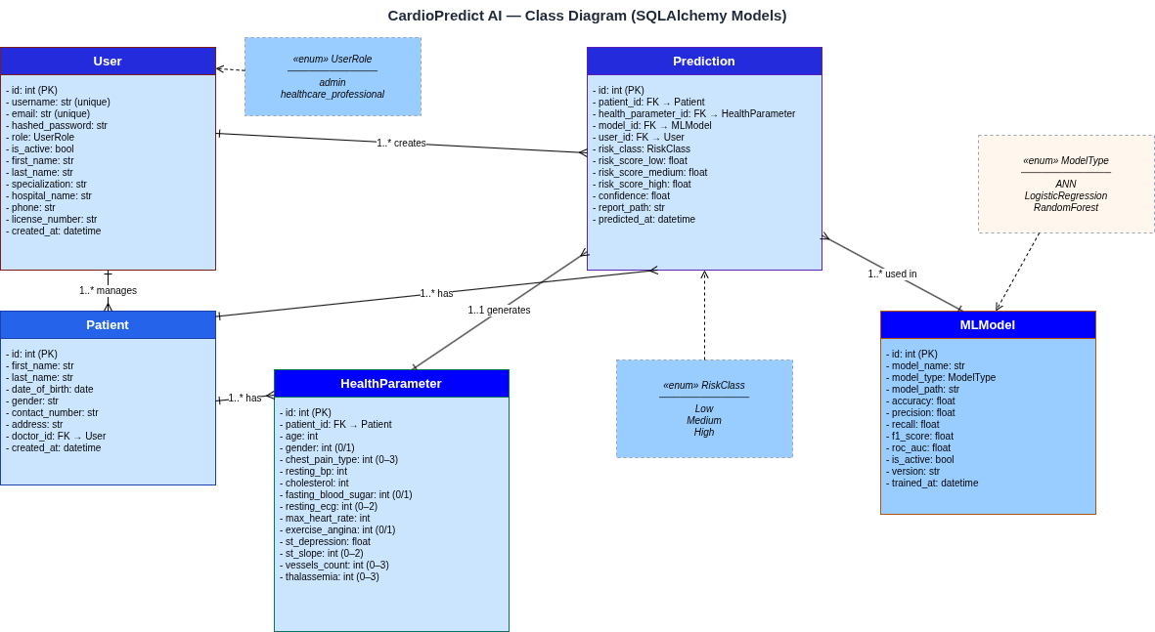
Logical Model/Class Diagram

Slide 23
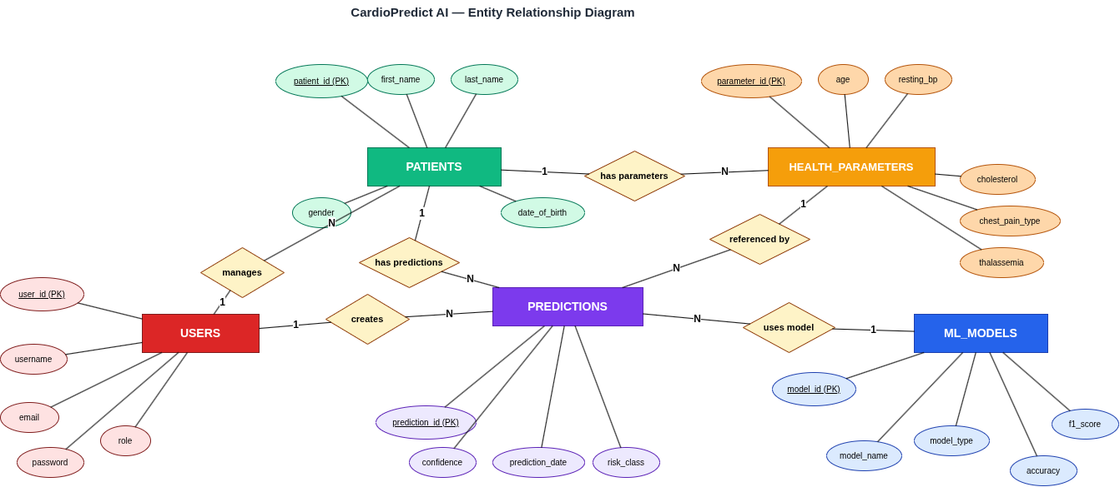
Entity-Relationship Diagram

Slide 24
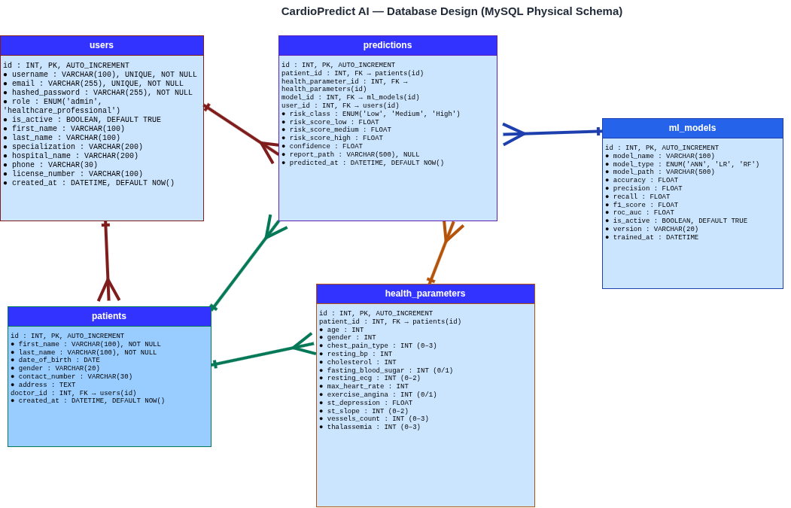
Database Design

Slide 25
User Interfaces
Screenshots of the main pages of CardioPredict AI captured from the running application are in next slides

Slide 26
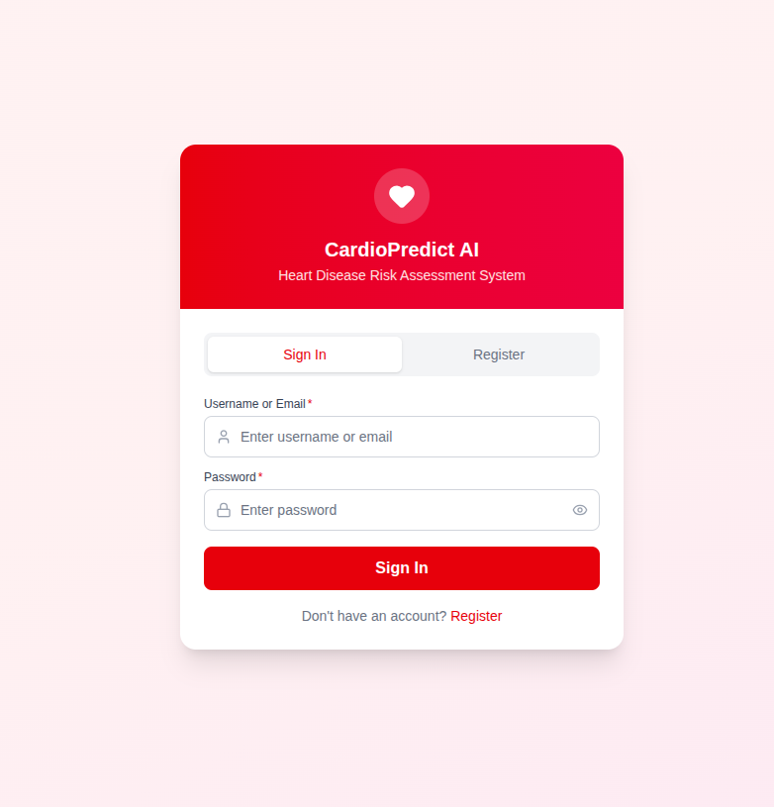
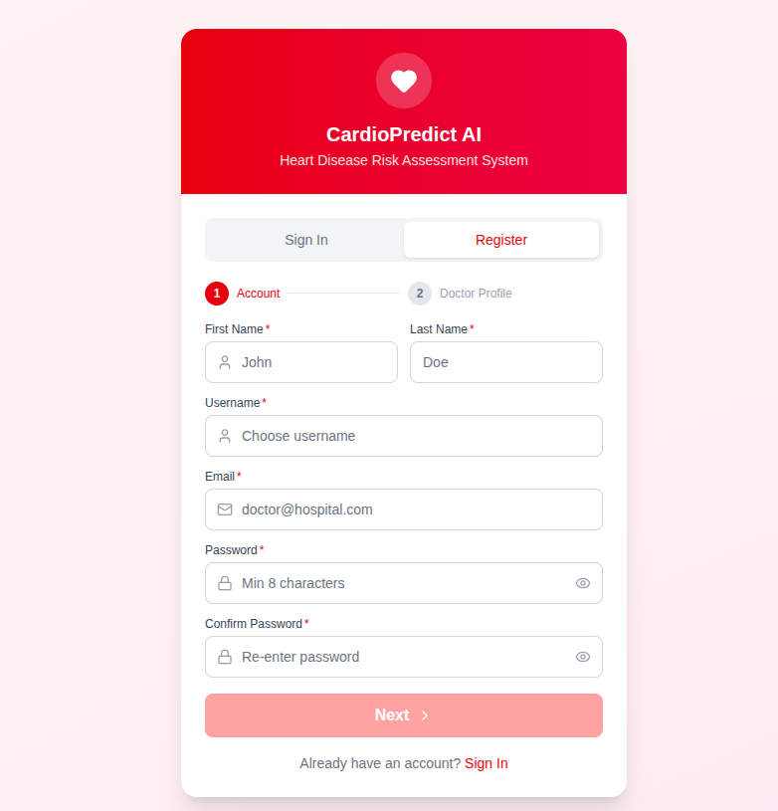
Login/Registration

Slide 27
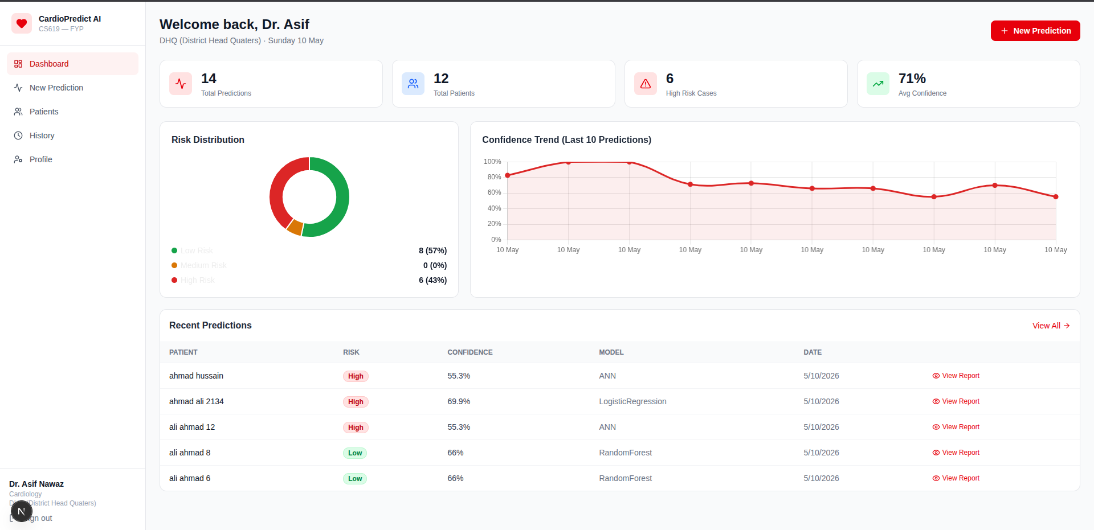
Dashboard

Slide 28
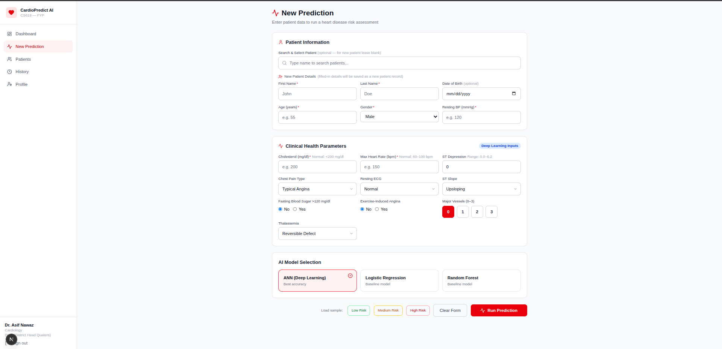
Data Entry

Slide 29
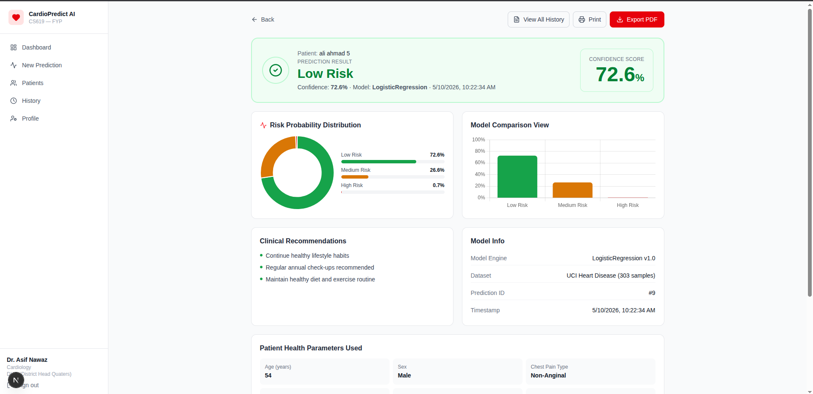
Report

Slide 30
Tools
Category | Tools / Technologies Used
IDE & Editors | Visual Studio Code, MySQL Workbench
Frontend Framework | Next.js 14, React 18, Tailwind CSS
Frontend Libraries | Chart.js, Lucide React, jsPDF, jspdf-autotable, react-hot-toast
Backend Framework | Python 3.10, FastAPI, Uvicorn
Backend Libraries | SQLAlchemy 2.0, Pydantic, python-jose, passlib, bcrypt, SQLAdmin
Database | MySQL 8 (InnoDB), PyMySQL
Machine Learning | TensorFlow / Keras, scikit-learn, pandas, numpy, matplotlib, seaborn, joblib
Version Control | Git, GitHub
API Testing | Postman, FastAPI Swagger UI (/docs)
Diagrams | draw.io / diagrams.net, Lucidchart
Documentation | LibreOffice Writer, OnlyOffice Impress
Operating System | Ubuntu Linux 24.04

Slide 31
Test Cases
ID | Test Name | Module | Expected Result | Status
TC-AUTH-001 | Valid User Login | Authentication | Token issued, dashboard loaded | ✅ Pass
TC-AUTH-002 | Invalid Credentials | Authentication | 401 + error toast | ✅ Pass
TC-INPUT-001 | Valid Patient Data Entry | Patient Module | Patient saved with ID | ✅ Pass
TC-INPUT-002 | Missing Required Fields | Patient Module | Inline validation error | ✅ Pass
TC-INPUT-003 | Invalid Range (Age 150) | Patient Module | "Age must be 1–120" | ✅ Pass
TC-MODEL-001 | Train ANN Model | ML Training | Test accuracy ≥ 75% | ✅ Pass
TC-PRED-001 | Run Heart Risk Prediction | Prediction | Risk class + probability returned | ✅ Pass
TC-PRED-002 | Probability Sum = 100% | Prediction | Low+Medium+High = 100 | ✅ Pass
TC-REPORT-001 | Export PDF Report | Reporting | PDF downloaded < 5 sec | ✅ Pass
TC-DB-001 | Foreign Key Constraint | Database | Invalid FK insert rejected | ✅ Pass
TC-SEC-002 | SQL Injection Prevention | Security | Input treated as literal | ✅ Pass
TC-USAB-001 | Real-time Form Validation | Usability | Inline error on field blur | ✅ Pas

Slide 32
Test Plan
A structured test strategy covering all critical functionality of the application, executed across 5 test categories.

Slide 33
Test Plan
Test Strategy
Category | What was verified
Unit Testing | Individual API endpoints, validation rules, ML prediction function
Integration Testing | Frontend ↔ FastAPI ↔ MySQL end-to-end flow
UI / Functional Testing | Manual walkthrough of every page (login, predict, history, admin)
Performance Testing | Prediction response time < 3 sec; PDF export < 5 sec
Security Testing | JWT auth, password hashing, SQL injection prevention, role-based access

Slide 34
Test Plan
Test Environment
OS: Ubuntu Linux 24.04
Browser: Chrome (latest)
Backend: FastAPI on localhost:8000 with MySQL 8
Frontend: Next.js on localhost:3000
Tools: Postman, Swagger UI (/docs), Chrome DevTools, manual testing
Result
20 / 20 test cases passed · 100% pass rate · 0 critical defects

Slide 35
Test Plan
Test Environment
OS: Ubuntu Linux 24.04
Browser: Chrome (latest)
Backend: FastAPI on localhost:8000 with MySQL 8
Frontend: Next.js on localhost:3000
Tools: Postman, Swagger UI (/docs), Chrome DevTools, manual testing
Result
20 / 20 test cases passed · 100% pass rate · 0 critical defects

Slide 36
# | Feature | Tested | Functional
1 | User Registration & Login | ✓ | ✓
2 | Real-time Username / Email Validation | ✓ | ✓
3 | Password Strength Rules (live checklist) | ✓ | ✓
4 | Add / Edit / Delete Patient | ✓ | ✓
5 | Search Patient | ✓ | ✓
6 | Run Heart Disease Risk Prediction | ✓ | ✓
7 | ML Model Comparison (ANN / LR / RF) | ✓ | ✓
8 | Prediction Result Page (charts + recommendations) | ✓ | ✓
9 | Prediction History with Filters | ✓ | ✓
10 | Export PDF Report | ✓ | ✓
11 | Export CSV (History) | ✓ | ✓
12 | Admin Panel Login (/admin) | ✓ | ✓
13 | Admin — Manage Users (Promote / Disable) | ✓ | ✓
14 | Admin — View All Patients | ✓ | ✓
15 | Admin — Patient Report (HTML + Print) | ✓ | ✓
16 | Toast Notifications (success / error) | ✓ | ✓
17 | JWT Authentication & Session Management | ✓ | ✓

Slide 37
Conclusion
CardioPredict AI successfully delivers a full-stack heart disease risk prediction system using deep learning. The ANN model achieves 77.5% accuracy and 0.917 ROC-AUC on UCI data. All 20 test cases passed. The system is functional end-to-end authentication, prediction, reporting, and admin panel.
Future work includes training on larger datasets, EHR integration, and adding explainable AI.
Sincere thanks to my supervisor Madam Laraib Sana for her guidance

Slide 38
Thanks! Any Questions

Slide 39
The End

