Slide 1
1
Project Overview
7 / 7
RISC-V SoC with ECC-Protected Memory
UVM tests passed
1,996
Capstone Project 03 · Verification Track · Team of Three
Fatima Azeemi · Asifa Siraj · Eemaan Jawaid Rao
scoreboard checks
Objective: a synthesizable RV32I core whose data memory corrects single-bit faults transparently and detects and reports double-bit faults, verified end to end with UVM.
0
errors

Slide 2
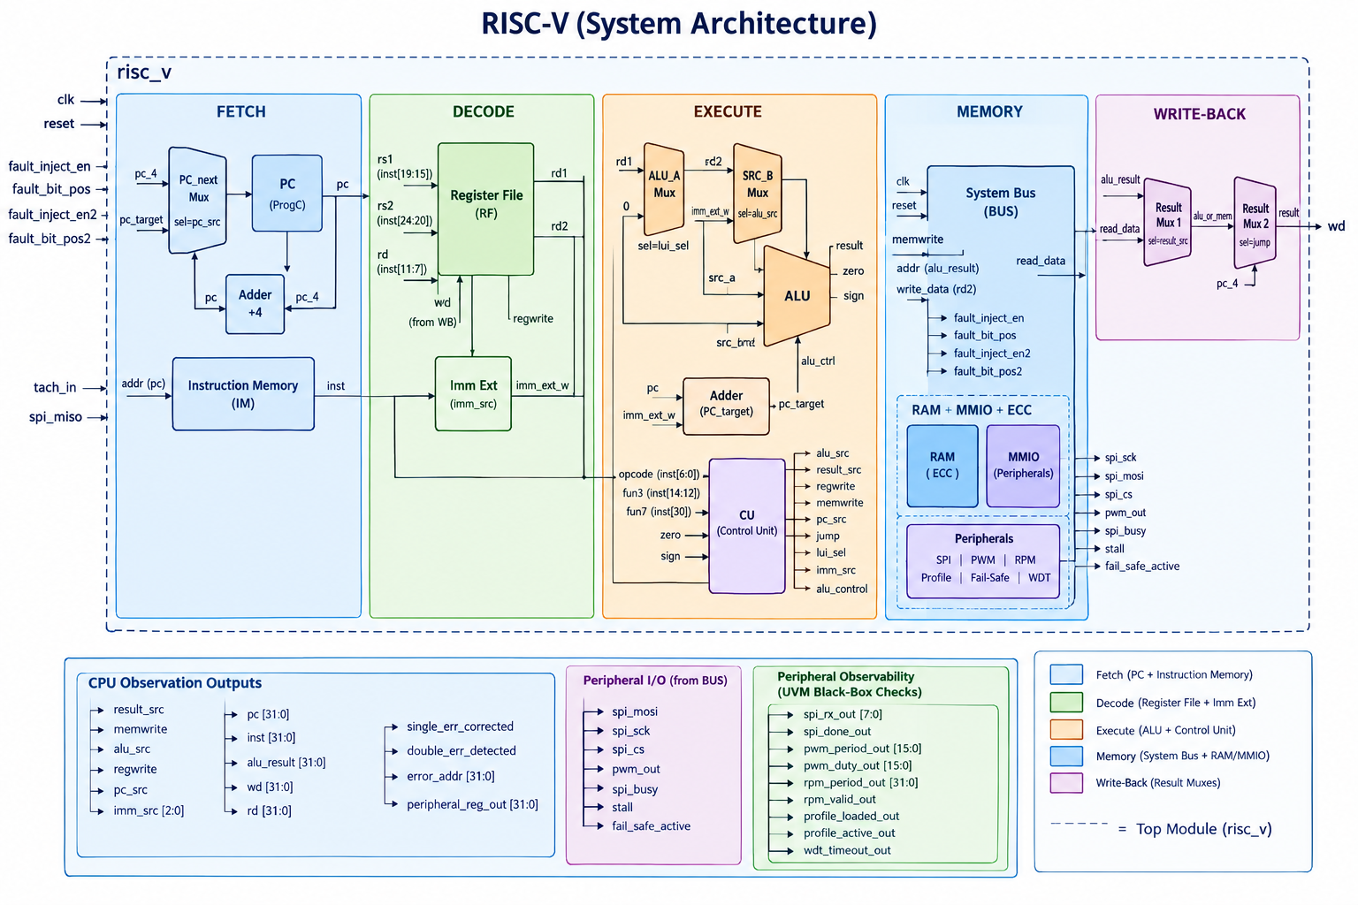
2
Architecture
Single-cycle RV32I
Fetch, decode, execute, memory and write-back complete in one clock. Only the PC, register file, RAM and peripheral registers are clocked.
Memory map
addr[31] = 0 → ECC RAM (16 × 39-bit words)
addr[31] = 1 → SPI · PWM · RPM · Profile · Watchdog / Fail-safe
Safety coupling
Uncorrectable ECC fault or watchdog timeout → fail_safe_active latches → PWM output forced off.

Slide 3
3
RTL Implementation
Core datapath
ECC subsystem
Peripherals
Single-cycle RV32I, 18 RTL modules in total
SEC-DED Hamming(39,32)
Memory-mapped at addr[31] = 1
pc · adder · mux · reg_file
imm_ext · instr_mem
alu · alu_control · control_unit · cu
ecc_encoder / ecc_decoder: 6 parity bits + 1 overall-parity bit
ecc_data_mem · fault_injector · error_status_reg
sys_bus: address decode, RAM / MMIO read mux
peripherals: SPI master, PWM, RPM, 8-word profile memory, watchdog + fail-safe
Key design decisions
ECC is transparent to the core: the CPU issues ordinary loads and stores.
Fault injection is verification-only logic, kept apart from the synthesizable codec.
One sticky fail-safe latch is fed by two independent triggers: an ECC double-bit fault and a watchdog timeout.

Slide 4
4
Verification Strategy
UVM test · 7 scenarios
7 test scenarios
golden clean baseline
single_bit SEC: fault corrected
double_bit DED + fail-safe trigger
mmio MMIO register path
stress random single + double faults
periph sustained SPI / PWM / RPM
failsafe watchdog → PWM off
risc_v_env
CPU + fault-injection agent
Peripheral agent
Scoreboard (reference model)
Functional coverage
DUT: risc_v · risc_v_if · 9 SVA assertions
Two agents drive and observe; the scoreboard predicts every transaction independently; coverage samples both agents.

Slide 5
5
Track-Specific Work: UVM Verification
2
10
How to read the coverage numbers
Functional: instr_cg 70.59%, periph_cg 83.33%, pc_cg 100%.
Statement and branch coverage on the ECC and peripheral RTL is 95 to 100% (peripherals: 99.2% statement, 95.6% branch).
The blended code-coverage figure is pulled down by toggle bins, the largest bin pool, because test data values stay numerically small.
All 9 SVA assertions hold across the 7 tests.
UVM agents
sequences (5 CPU, 5 peripheral)
84.64%
47.29%
functional coverage, merged over 7 tests
code coverage, blended, merged over 7 tests

Slide 6
6
Results and Evidence: Regression
Test | Instrs | Single-bit | Double-bit | Fail-safe cycles | Instr cov | Periph cov | Checks | Result
golden | 142 | 0 | 0 | 0 | 32.0% | 70.8% | 142 | PASS
single_bit | 113 | 103 | 0 | 0 | 42.9% | 70.8% | 113 | PASS
double_bit | 113 | 0 | 103 | 102 | 43.3% | 76.4% | 113 | PASS
mmio | 122 | 0 | 0 | 0 | 32.0% | 70.8% | 122 | PASS
stress | 142 | 136 | 126 | 125 | 66.7% | 76.4% | 142 | PASS
periph | 402 | 0 | 0 | 0 | 32.0% | 70.8% | 402 | PASS
failsafe | 962 | 0 | 0 | 482 | 32.0% | 81.9% | 962 | PASS
7 / 7
1,996
0
tests passed
scoreboard checks
scoreboard errors, UVM_ERROR, UVM_FATAL

Slide 7
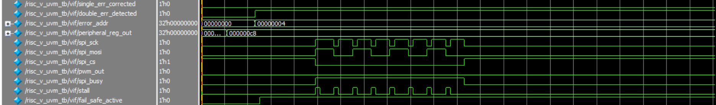
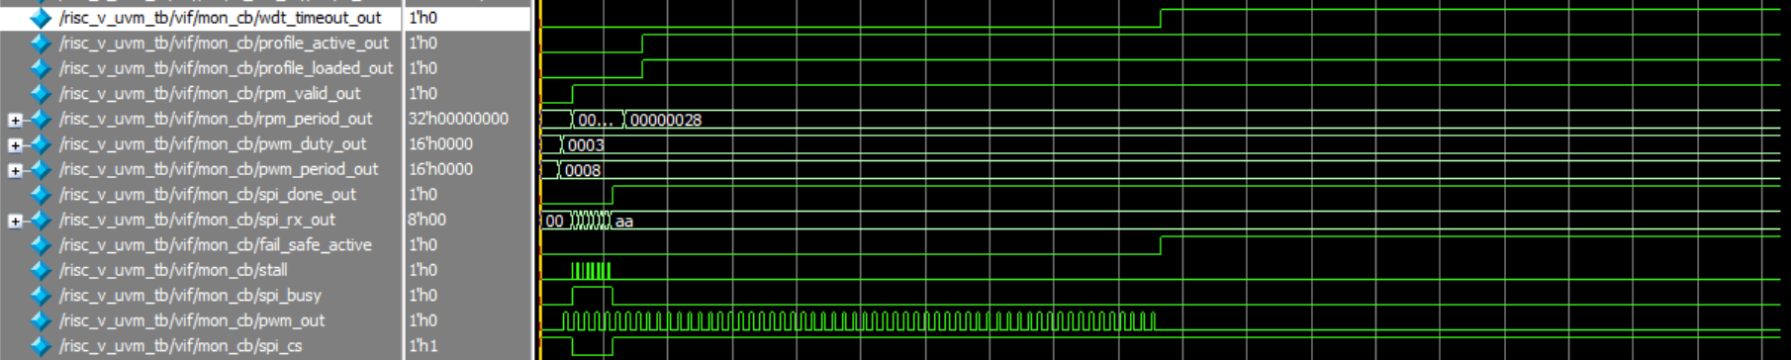
6
Results and Evidence: Waveforms
A · double_bit_test: two-bit fault → double_err_detected → fail_safe_active
Faults at bits 1 and 23 are uncorrectable: the decoder raises double_err_detected, error_addr latches 0x4, and fail_safe_active sets in the same window. The ECC subsystem drives the safety interlock.
B · failsafe_test: watchdog timeout → fail_safe_active → pwm_out forced low
With no tachometer edge for 256 cycles, wdt_timeout_out rises and fail_safe_active follows. pwm_out, toggling steadily before, stops at that instant. This is the second, independent trigger path.

Slide 8
7
Limitations and Remaining Work
ALU branch coverage: 36.36%
ECC bit-position sweep: 35.13% branch
Only add_sub and and_ are exercised by the current firmware. sll, slt, or and srl/sra are never taken.
All four fault-position categories (low, mid, high data, parity) are verified, but not all 32 individual Hamming positions.
Toggle coverage: 18 to 52%
Remaining work
Small-magnitude test data rarely toggles the upper bus bits. This is a data-diversity gap, not a logic-path gap.
Add firmware that exercises sll, slt, or, srl/sra. Sweep all 32 Hamming positions. Add wide-value data patterns. Physical design is out of scope for this track.

Slide 9
8
Individual Contributions
Fatima Azeemi
Asifa Siraj
Eemaan Jawaid Rao
Datapath · integration · test flow
Control · ECC codec · scoreboard
Memory · fault logic · sequences · coverage
Datapath RTL: pc, adder, mux, reg_file
ECC memory and bus integration: ecc_data_mem, sys_bus
Profile and fail-safe peripheral logic
UVM driver and monitor; test classes; build and run scripts
Control RTL: alu, alu_control, control_unit, cu
ECC encoder and decoder: Hamming(39,32)
SPI peripheral logic
UVM sequence item; scoreboard reference model
Memory and top-level RTL: imm_ext, instr_mem, risc_v
Fault injector and sticky status registers
PWM and RPM peripheral logic
UVM sequences and functional coverage model
Ran the 7-test regression and coverage merge

