Slide 1

Data Analytics
DAB100 Section 001
Group Number : 05
Team Member : Asif Ahmed, Ayushi Patel, Jay Prajapati, Neha Kumari, Veera Santhosh

Slide 2
TABLE OF CONTENTS
Project Proposal
Analysis Questions
Data Description
Data Transformation
Visualization
Dashboards
Linear Regression
Decision Tree
Conclusion

Slide 3

PROJECT PROPOSAL
Applying supervised machine learning techniques
Visualization to generate insights about the data
To prepare a dashboard for the high-level overview
Conclude our findings

Slide 4
ANALYSIS QUESTIONS
Which model and make emits the maximum and minimum CO2?
How does engine size of various vehicle classes impact the emission of CO2?
What is the correlation between number of cylinders and carbon footprint?
Which kind of fuel type produces the highest and lowest carbon dioxide?
What is the relationship between fuel consumption in the city, on the highway, and combined with CO2 emissions?
How does the type of transmission of vehicles affect the CO2 emissions?

Slide 5
DATA DESCRIPTION
The data set provides in depth knowledge of fuel consumption ratings and CO2 emissions
The data set includes data for the year 2019 to 2023
There are 5 dataset files for each respective year
Features of the data:
Year, Make, Model, Engine Size, Cylinder, Fuel Type, Fuel consumption

Slide 6






Data Collection
Data Integration
Data Transformation
Data Visualisation
Raw Data Files
Integrated Dataframe
Plots on prepared data
Data Cleaning
Dataset1
Dataset2
......
Data Pivot
Dataset5

Slide 7
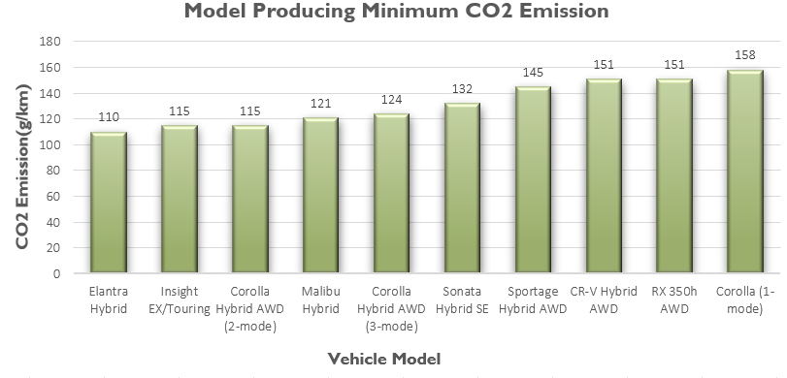
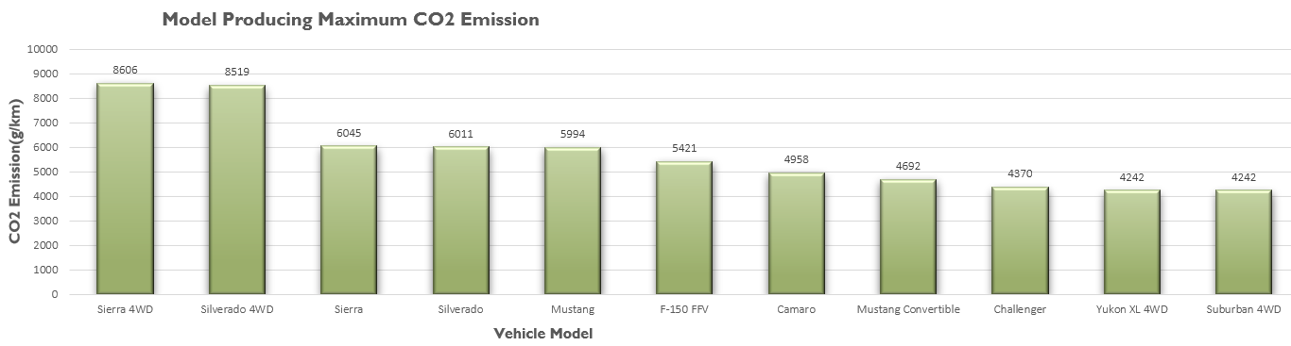
Q. Which model and make emits the maximum and minimum CO2?
Model producing Minimum CO2 Emission – Elantra
Model producing Maximum CO2 Emission - Sierra

Slide 8
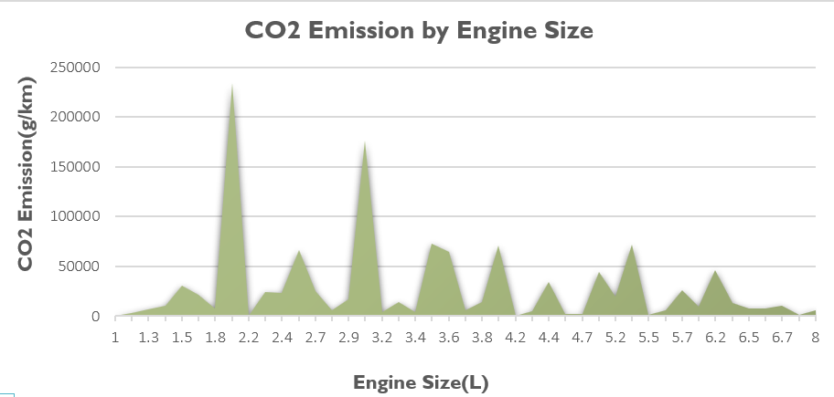
Q. How does engine size of various vehicle classes impact the emission of CO2?
Plot displaying CO2 emission by vehicle of different Engine Size
Engine size between 1.8-2.2 has the highest emission, followed by 2.9-3.2

Slide 9
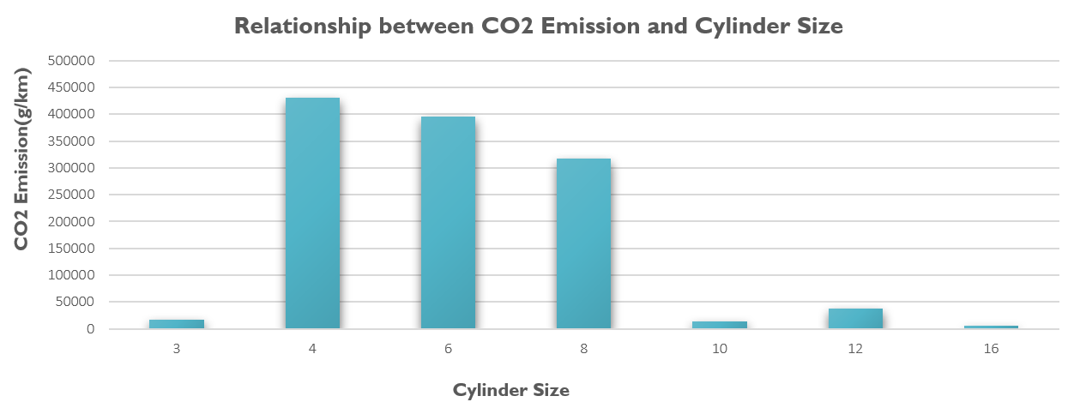
Q. What is the correlation between number of cylinders and carbon footprint?
Based on the data set, vehicles with 4 cylinders is having the highest emission followed by 6 and 8

Slide 10
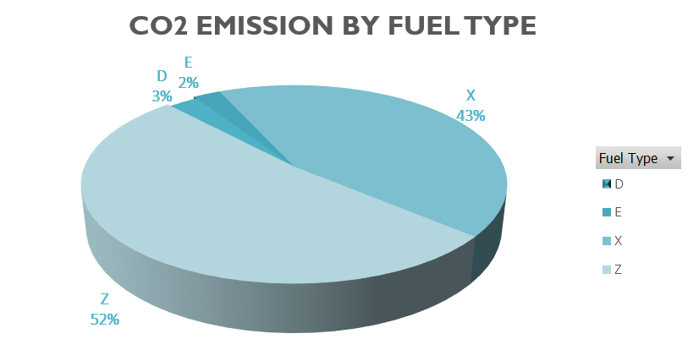
Q. Which kind of fuel type produces the highest and lowest carbon dioxide?
Pie chart displaying the CO2 emission based on fuel type
Fuel type Z has the highest emission followed by X

Slide 11
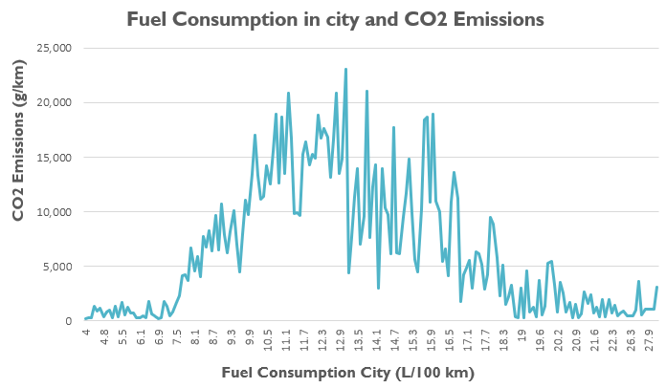
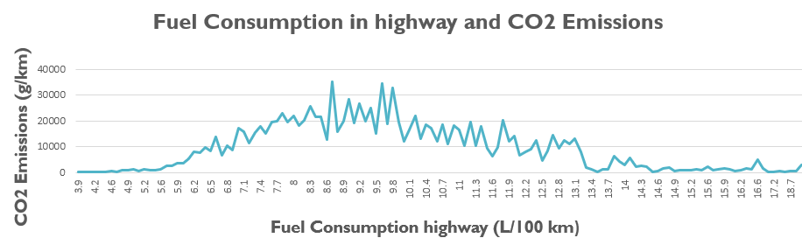
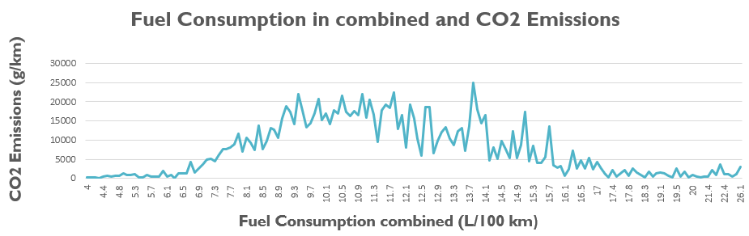
Q. What is the relationship between fuel consumption in the city, on the highway, and combined with CO2 emissions?
Graphs displaying the fuel consumption is city, highway and combined

Slide 12
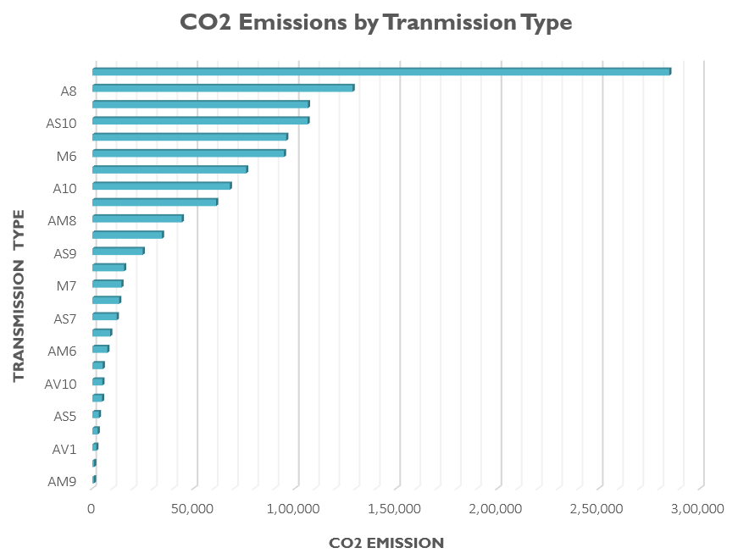
Q. How does the type of transmission of vehicles affect the CO2 emissions?
Graph displaying the CO2 emission based on transmission type
Transmission type A8 emits maximum CO2
Transmission type AM9 emits minimum CO2

Slide 13
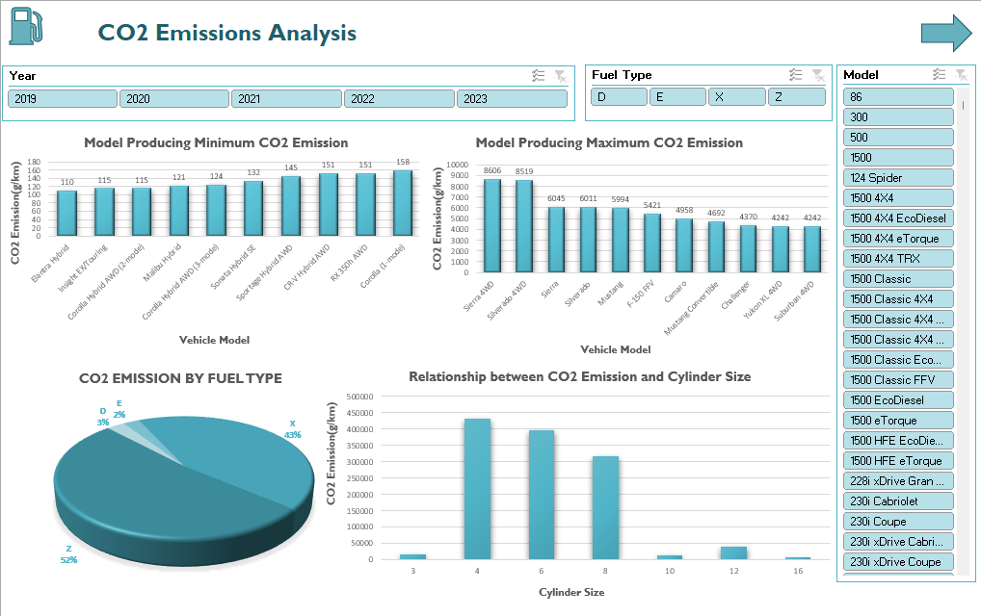
DASHBOARD 1

Slide 14
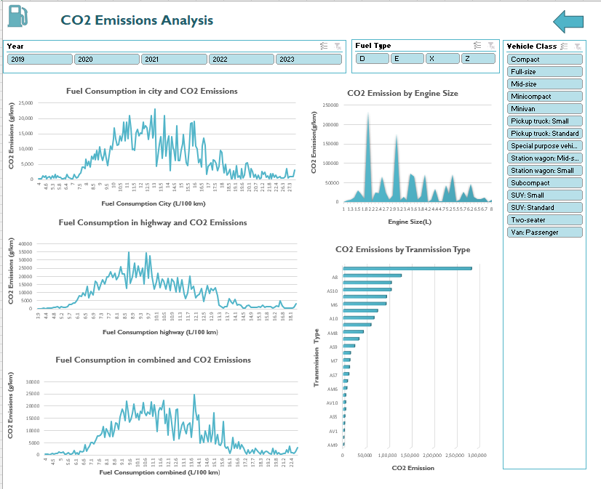
DASHBOARD 2

Slide 15
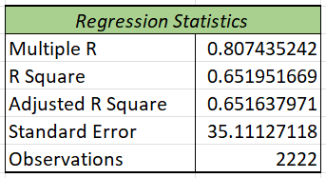
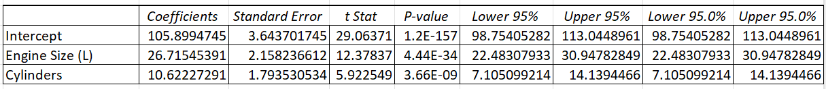
LINEAR REGRESSION
Linear regression model is trying to predict CO2 emission based on Engine size and Cylinder

Slide 16
DECISION TREE
Transmission
A7
A8
A9
Transmission
M4
C:4
C:6
C:4
C:6
No. of Cylinders
More than 4
F=X
F=Z
M4
M4
More than 4
F=Z
More than 4
Fuel Type
F=X
M4
L4
More than 4
Less than 4
L4
M4
Carbon Ratings
Less than 4
More than 4
Decision Tree Model to predict CO2 emission ratings based on Transmission type,
No. of Cylinders and Fuel Type

Slide 17

CONCLUSION
Based individual graphs, we tried to answer all the analysis questions
Dashboards are providing an overview of the dataset and representing how CO2 emission varies as per various factors
Linear model is having R-squared value of 0.65, which indicates that model explains 65% of our dataset

