Slide 1

Indian Economy (1990-2021) DAB 103 Section 001
Presented by:- Group 9

Slide 2






TEAM INTRODUCTION
ALISHA JAMES
ASIF AHMED
NEHA KUMARI

Slide 3
TABLE OF CONTENTS
Background / Motivation
Problem Statement
Project Proposal
Analysis Questions
Dataset Description
Exploratory Data Analysis
Data Cleaning, Transformation and Visualization
Data Analysis
Conclusion
Recommendations

Slide 4

BACKGROUND
As per International Monetary Fund (IMF), in the second quarter of year 2022, India surpassed United Kingdom (UK ) to emerge as the 5th largest economy in the world. (IMF. (n.d.). GDP, current prices. https://www.imf.org/external/datamapper/NGDPD@WEO/IND/GBR)
In 1990, India ranked 11th among the largest economies while UK was on 5^{th.}
Despite India being developing country, has left behind a developed economy UK in terms of Gross Domestic Product (GDP) growth, is a motivating factor behind this analysis.
At present, India is behind United States of America (USA), China, Japan and Germany.

Slide 5

PROBLEM STATEMENT
To examine how a developing economy i.e., India, has improved its position from 11th to 5th among the major economies of the world in terms of GDP over the last couple of decades, leaving behind United Kingdom.
Analysing the elements that influence GDP expansion, such as Gross Fixed Capital Formation (GFCF), Imports, Exports, Sectors, Foreign Direct Investments(FDI), Industrial value added, and how they contribute to the overall economic growth.
Analysis will assist Indian Economists to understand the Indian economy evolution and will aid them in making better economic policies for the country

Slide 6

PROJECT PROPOSAL
The objective of this analysis is to study the GDP growth of India in comparison to major economies during this transition phase (1990 – 2021).
Analysing the driving factors GDP, Imports, Exports, GFCF, Sectors, FDI & Industrial value added, behind this significant growth.
The analysis will be conducted in comparison with major economies such as US, China, Japan, Germany and UK
In addition to this, it will also identify the reasons behind India surpassing UK and becoming the 5th highest economy, despite being behind UK in many economic areas.

Slide 7

ANALYSIS QUESTIONS
What is the trend of the GDP for major economies between 1990-2021?
How does India's GFCF (%) to GDP compare with that of major economies?
What is the contribution of FDI (%) to GDP of major economies?
Which sector is having the major contribution to India’s GDP?
What is the contribution (%) of Exports and Imports on countries’ GDP year on year basis?
How does Exports and Imports (%) compare between India and UK ?
What is the pattern of Industrial value added (%) of countries over the years?

Slide 8

DATASET DESCRIPTION
Source: https://data.worldbank.org/indicator
Timeline: 1990 -2021
Countries: India, USA, China, Germany, Japan, UK
Indicators : GDP, Imports, Exports, GFCF, Sectors, FDI & Industrial value added
No. of Files download: 9 (All the indicators are available as separate excel files in raw format)
Datasets merging and transformation is required to prepare data for analysis

Slide 9
DATASET DESCRIPTION (Cont’d…)
Numerical Variables
GDP (current US$)
Agriculture, forestry, and fishing, value added (% of GDP)
Imports of goods and services (% of GDP)
Industry (including construction), value added (current US$)
Services, value added (annual % growth)
Exports of goods and services (% of GDP)
Foreign direct investment, net inflows (% of GDP)
Manufacturing, value added (% of GDP)
Gross fixed capital formation (% of GDP)
Categorical Variables
Country Name
Country Code
Year

Slide 10

Exploratory Data Analysis
Observed Issue | Solution
The indicators are available in separate excel files. | All the files need to be merged in one dataframe before utilizing it for analysis
Indicator values are present as rows whereas years are present as columns. | Data transposition is required to bring the data in desired format.
Files have unwanted rows, columns and sheets. | Data subset
The data present in excel files is for all the countries in the world (from 1960 till 2021) and Null values are present for some of the indicators. | Data filtering
Column names are not present in correct format | Columns renaming

Slide 11






Data Collection
Data Integration
Data Transformation
Data Visualisation
Raw Data Files
Integrated Dataframe
Data Subset
Plots on prepared data
Dataset1
Dataset2
Data Filter
..........
Data Pivot
Dataset9

Slide 12
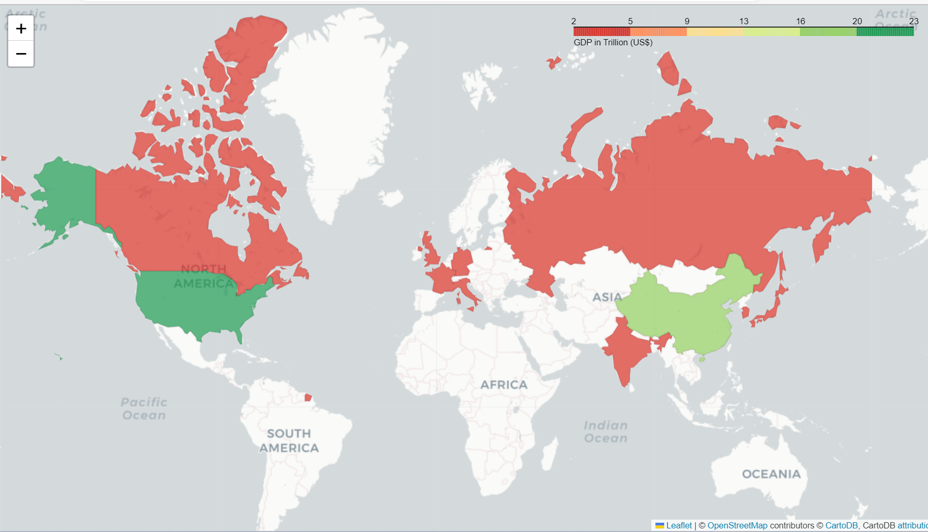
Top 11 Economies of the world as per 2021 (in terms of GDP)
RUS
CAN
GBR
DEU
FRA
USA
ITA
KOR
CHN
JPN
IND

Slide 13
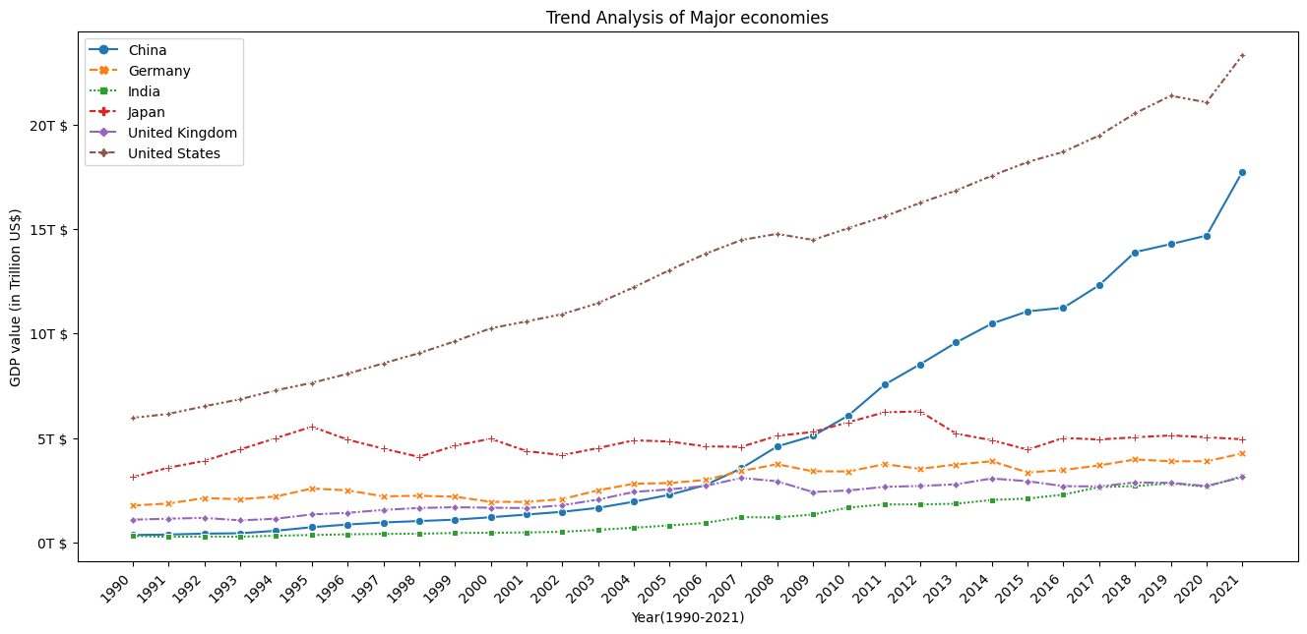
Q. Trend Analysis of GDP of the major economies from 1990-2021
Since year 2000, there is a gradual increase in the GDP growth rate of the Indian economy as compared to other economies. In the span of last two decades, it has reached at par with UK GDP.

Slide 14
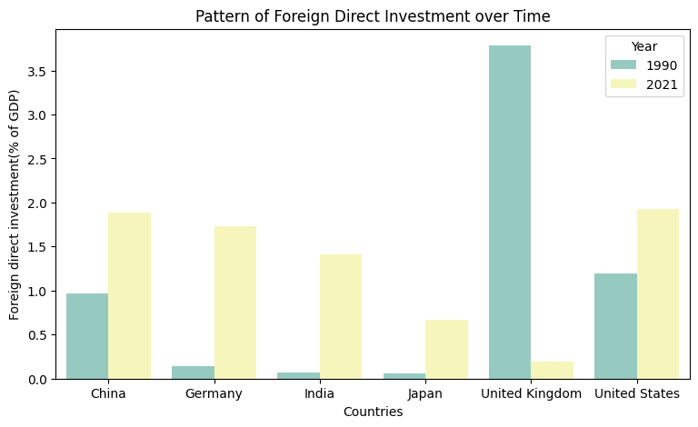
Q. What is the pattern of Foreign Direct Investments (FDI) % to GDP of major economies?
There is a significant rise in FDI in India from 0.2% to 1.5% which represents more than a threefold rise.
Meanwhile, FDI in United Kingdom has drastically declined during last two decades

Slide 15
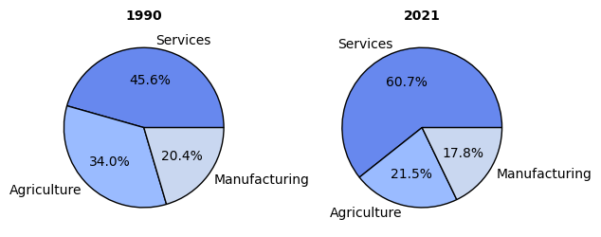
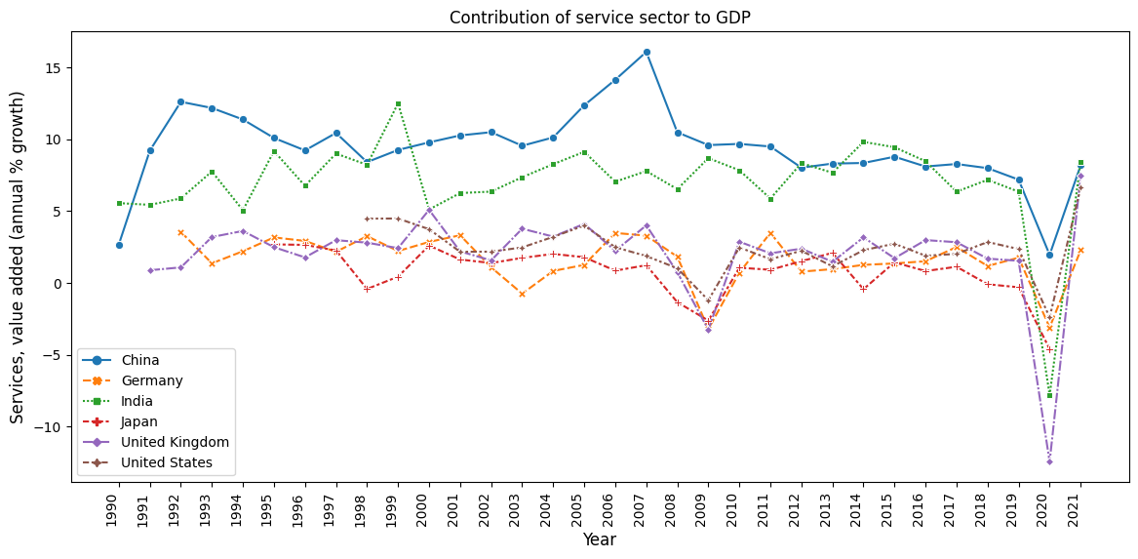
Q. Which sector is having the major contribution to India’s GDP?
First plot shows that Service sector in India has undergone remarkable growth by 15% over the years whereas growth rate in other segments remained stagnant or declined.
Second plot demonstrates that the annual % growth in India’s service sector has consistently outplaced that of the UK.
These findings signify the notable contribution of service sector to India’s GDP.

Slide 16
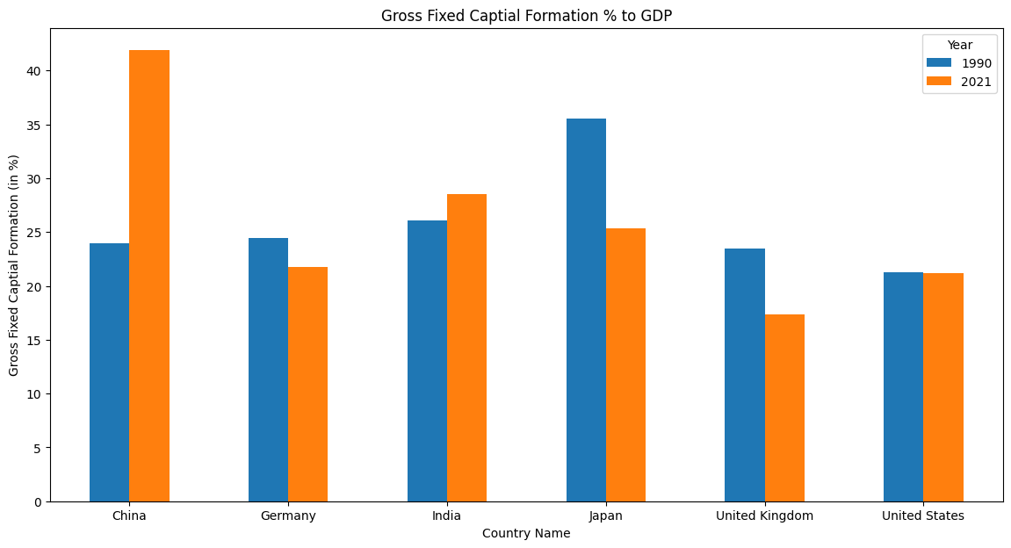
Q. India’s Gross Fixed Capital Formation (GFCF) % to GDP in comparison with the major economies
India and China have experienced growth in terms of GFCF
Other economies have experienced
a significant downfall
India’s GFCF % to GDP in 2021 was 28%

Slide 17
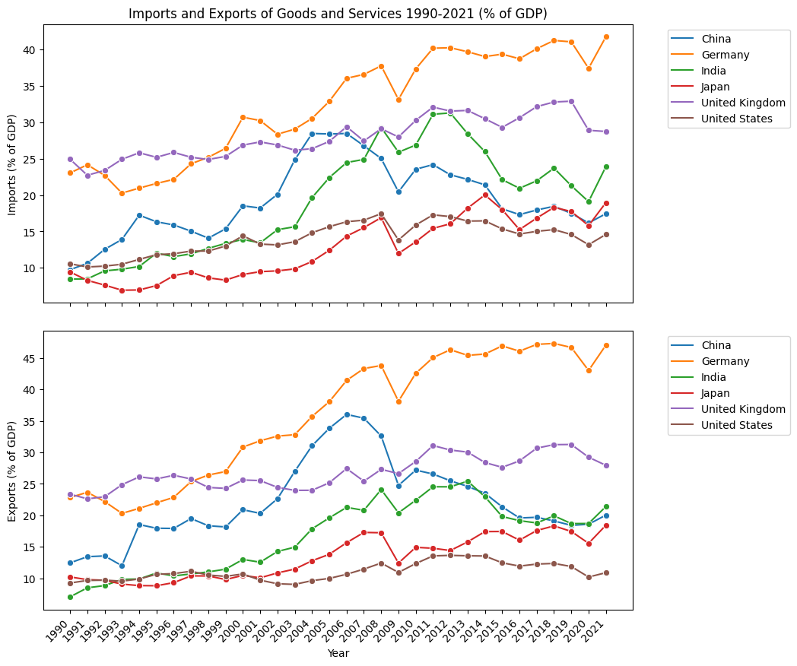
Q. What is the contribution (%) of Exports and Imports on countries’ GDP year on year basis?
An upward trend can be seen for Imports of goods and services for all the countries including India over decades(1990-2021).
Exports of goods and services of India has improved over the years and in the year 2020, it has surpassed China.

Slide 18
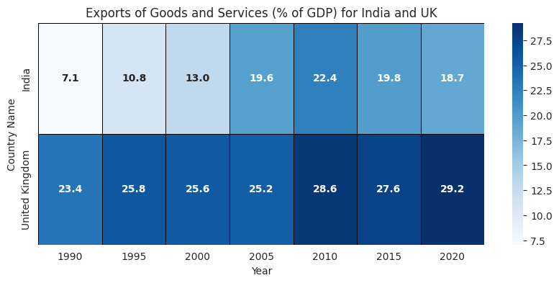
Q. How does Exports (%) compare between India and UK ?
The overall percentage of exports of goods and services (% of GDP) has increased over the years by more than twice (11% change). The same can be observed for United Kingdom. However, there is not much increase in percent change from 1990 to 2021 and it has just raised by 6 percent.

Slide 19
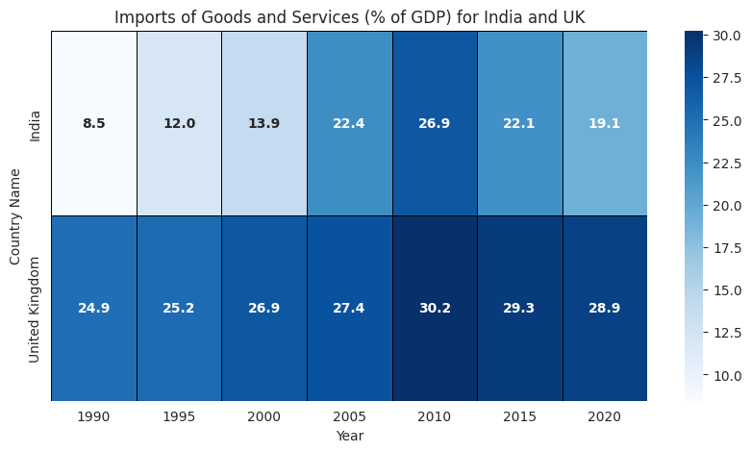
Q. How does Imports (%) compare between India and UK ?
The imports of goods and services for India has grown over the decades but it is less than United Kingdom in all the years as can be seen in above plot. Despite that, the attention is required to lower the imports in coming years so that it can benefit more in economic growth of India.

Slide 20
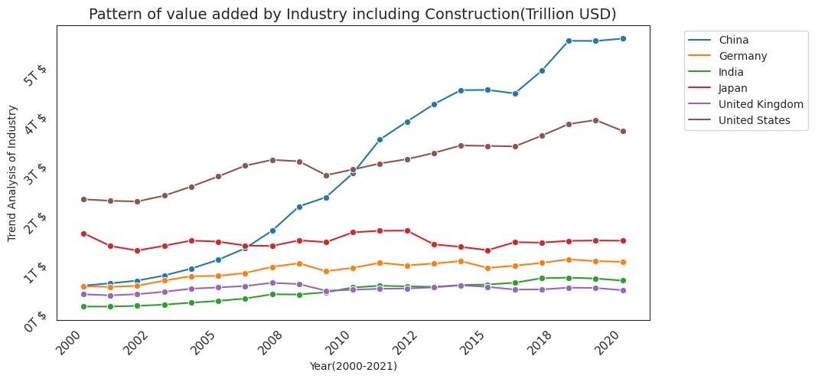
Q. What is the pattern of Industrial value added (%) of countries over the years?
The overall contribution of industrial sector to GDP of India has increased but the growth is not significant as is apparent from above line graph. In 2014, the value added by India’s industrial sector has crossed United Kingdom’s industry contribution.

Slide 21

CONCLUSION
India’s FDI sector has experienced a significant rise in contribution to GDP
Service sector is having a major contribution to the India’s economic growth
Marginal increase is evident in India’s GFCF contribution to GDP
Rise in the overall percentage of Exports of goods and services (% of GDP) over the years
Dependency of India’s economy on imports has been increased
Though the Industrial contribution to GDP has increased but the growth is not significant

Slide 22

RECOMMENDATIONS
India should initiate some policies to become self sufficient economy and keep a tap on its imports
Despite increase in Exports, there is still lot needs to be done in this sector to utilise its full potential
India should focus on how it can enhance its industrial sector, as it will further increase the revenue and will also leads to increase in employment opportunities

Slide 23
LINKS
Jira : https://analyticalproject2022.atlassian.net/jira/software/projects/AP/boards/1
Jira Dashboard : https://analyticalproject2022.atlassian.net/jira/dashboards/10001
Github : https://github.com/Nehak9980/DAB103_Project

Slide 24
REFERENCES
https://stackoverflow.com/questions/20908018/import-multiple-excel-files-into-python-pandas-and-concatenate-them-into-one-dat
https://www.iconfinder.com/icons
https://icons8.com/icon/117561/microsoft-excel-2019
Plotly colours list - 📊 Plotly Python - Plotly Community Forum
plotly.express.line — 5.14.1 documentation
python - Adding a Title or Text to a Folium Map - Stack Overflow

Slide 25
THANK YOU

