Slide 1
EXPLORATORY DATA ANALYSIS
MADE BY DORA

Slide 2
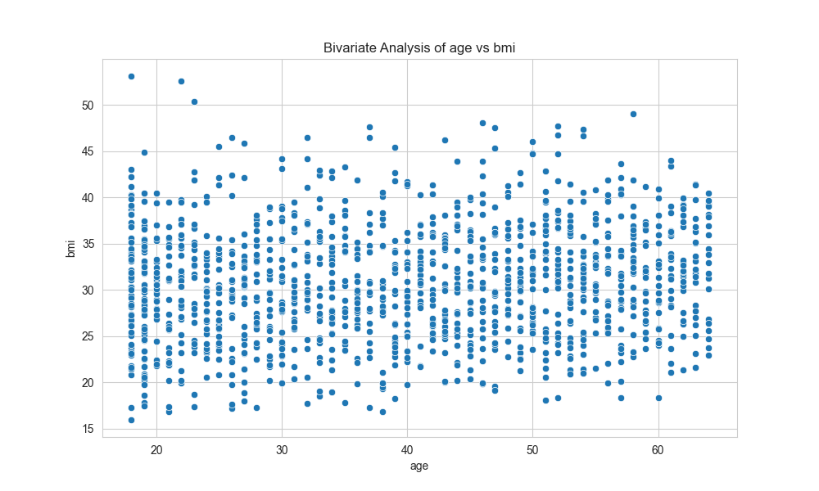
CHART - BIVARIATE AGE VS BMI

Slide 3
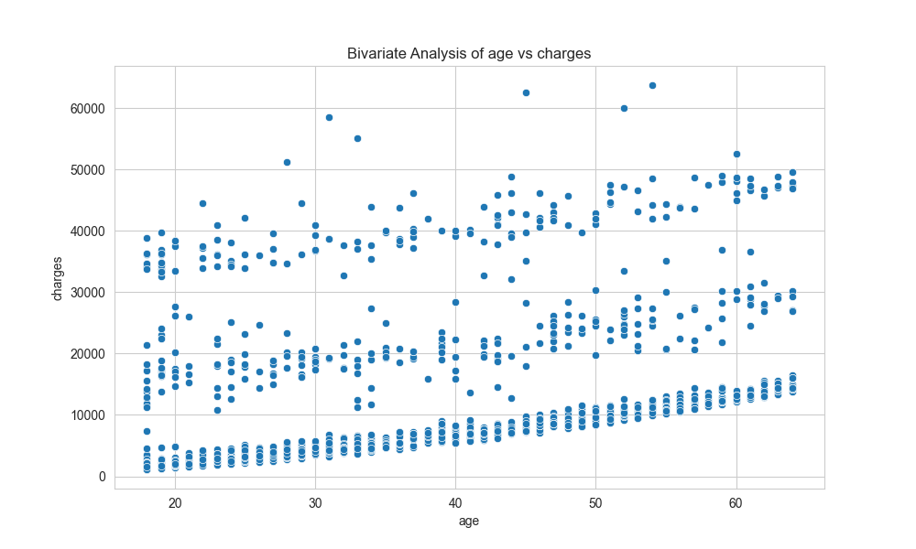
CHART - BIVARIATE AGE VS CHARGES

Slide 4
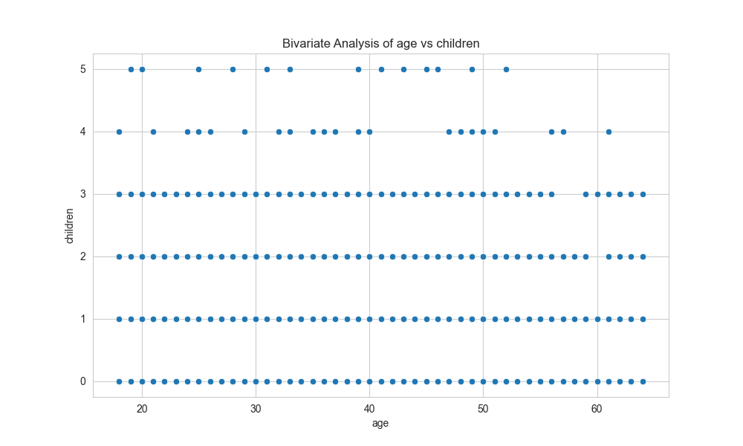
CHART - BIVARIATE AGE VS CHILDREN

Slide 5
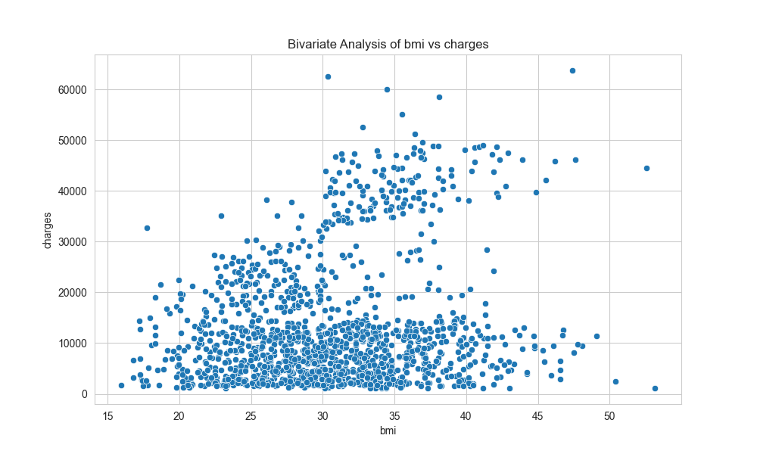
CHART - BIVARIATE BMI VS CHARGES

Slide 6
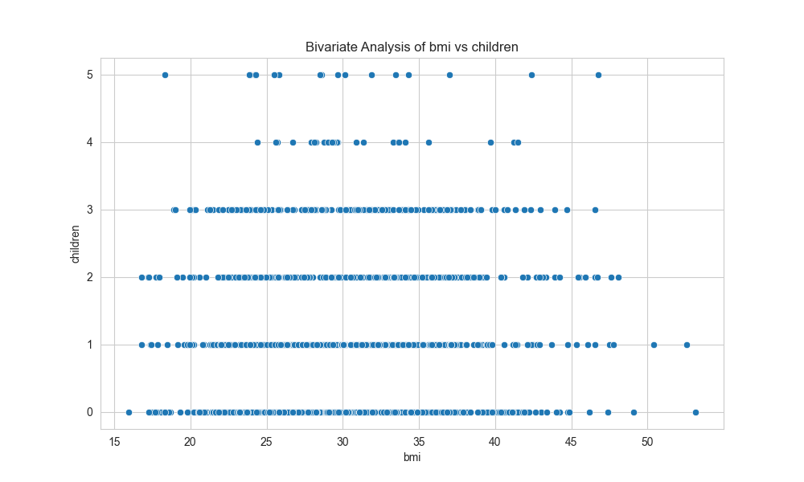
CHART - BIVARIATE BMI VS CHILDREN

Slide 7
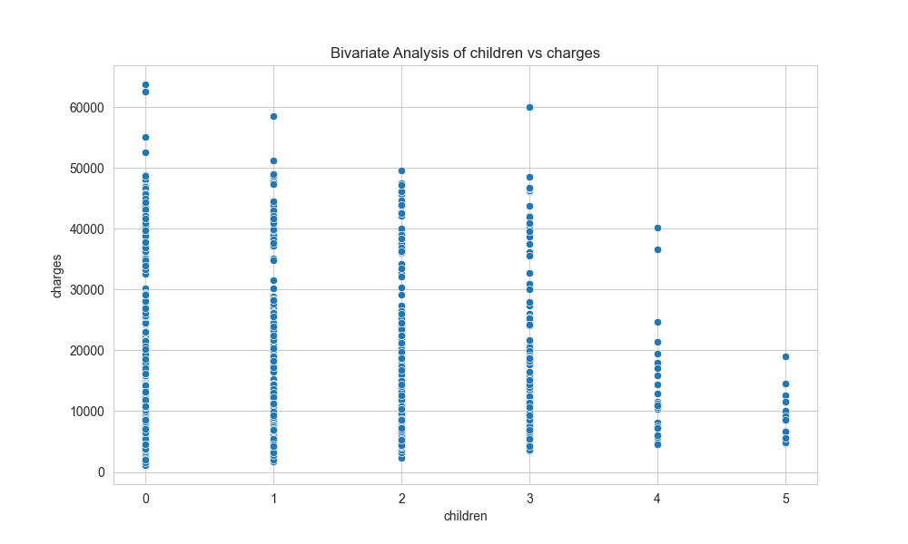
CHART - BIVARIATE CHILDREN VS CHARGES

Slide 8
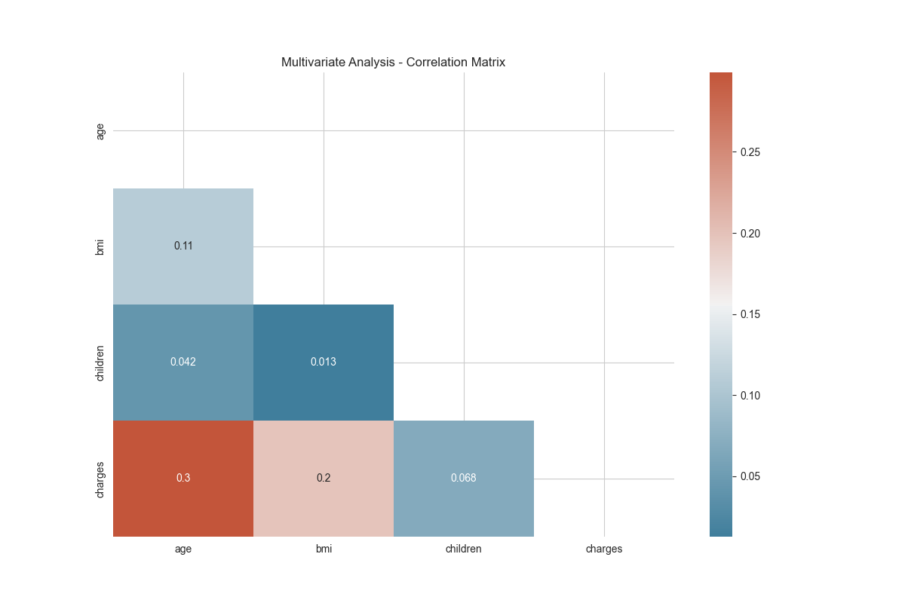
CHART - CORRELATION MATRIX

Slide 9
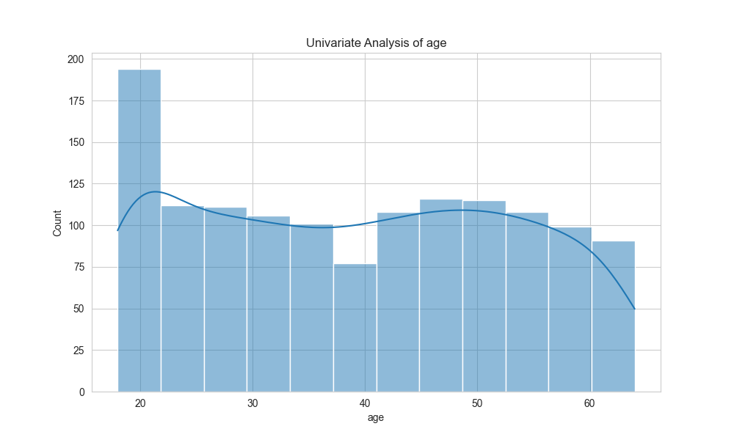
CHART - UNIVARIATE AGE

Slide 10
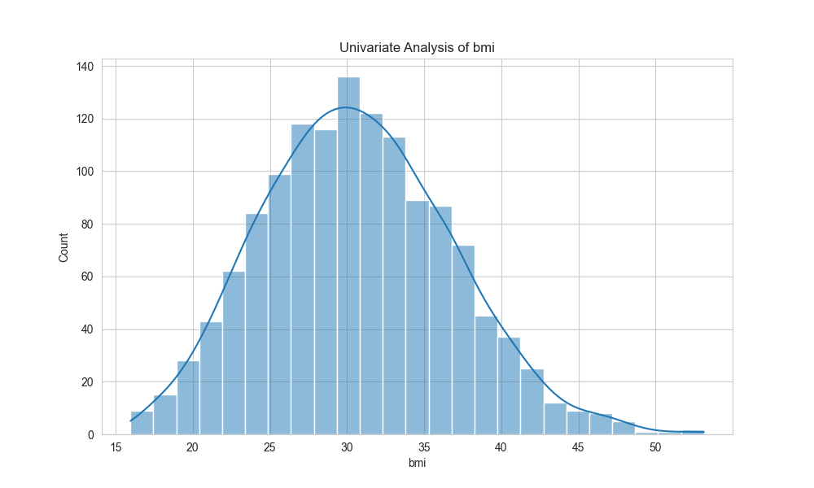
CHART - UNIVARIATE BMI

Slide 11
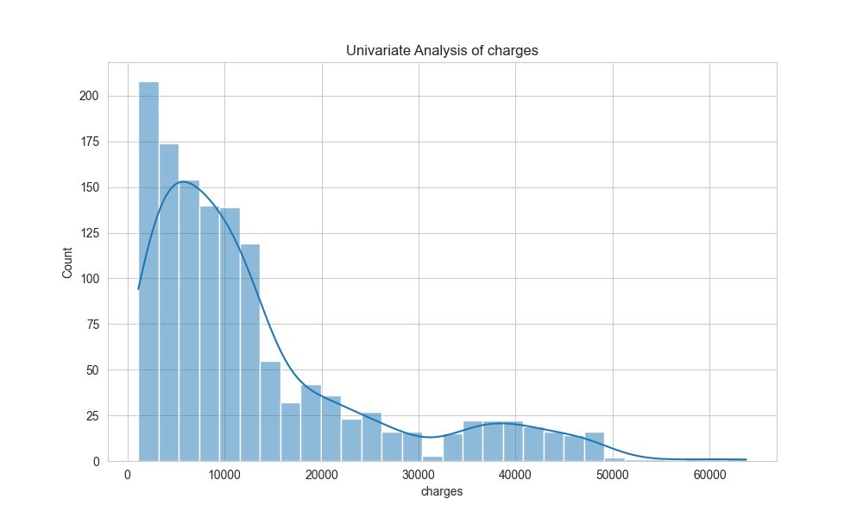
CHART - UNIVARIATE CHARGES

Slide 12
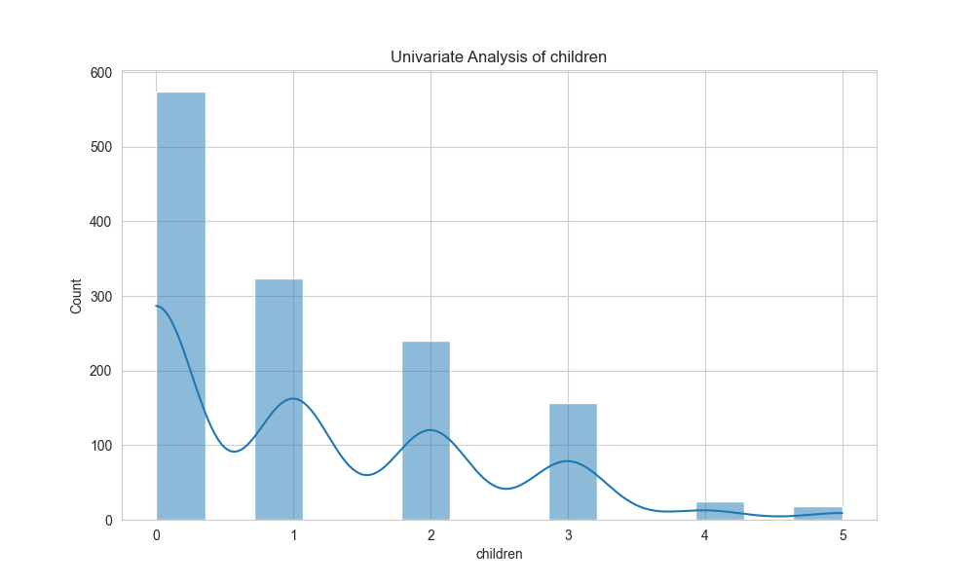
CHART - UNIVARIATE CHILDREN

Slide 13
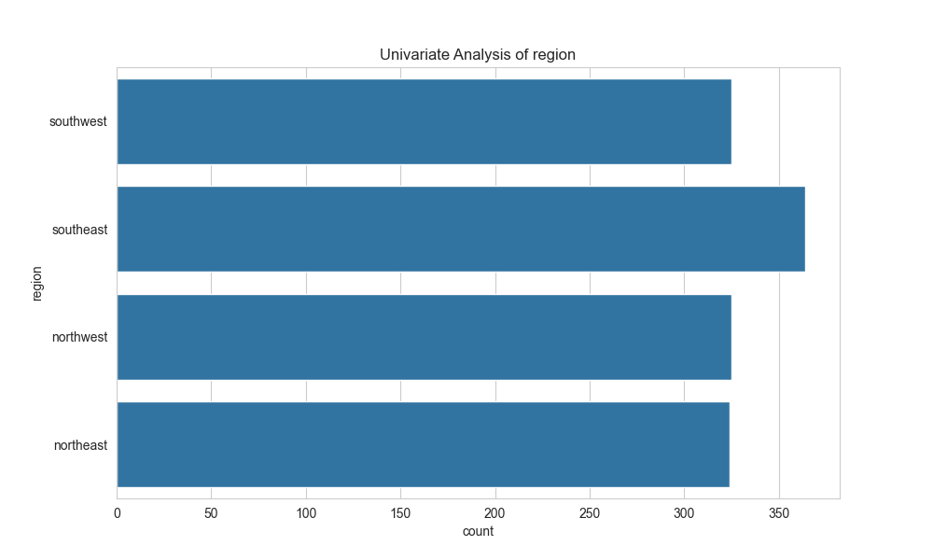
CHART - UNIVARIATE REGION

Slide 14
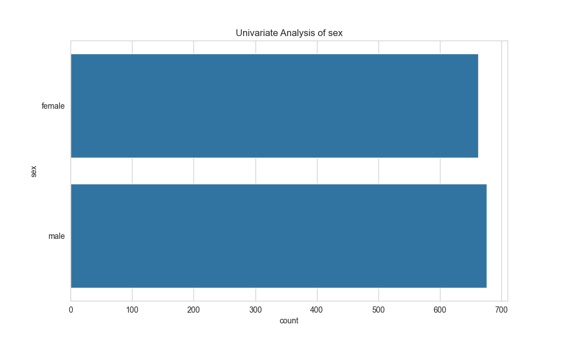
CHART - UNIVARIATE SEX

Slide 15
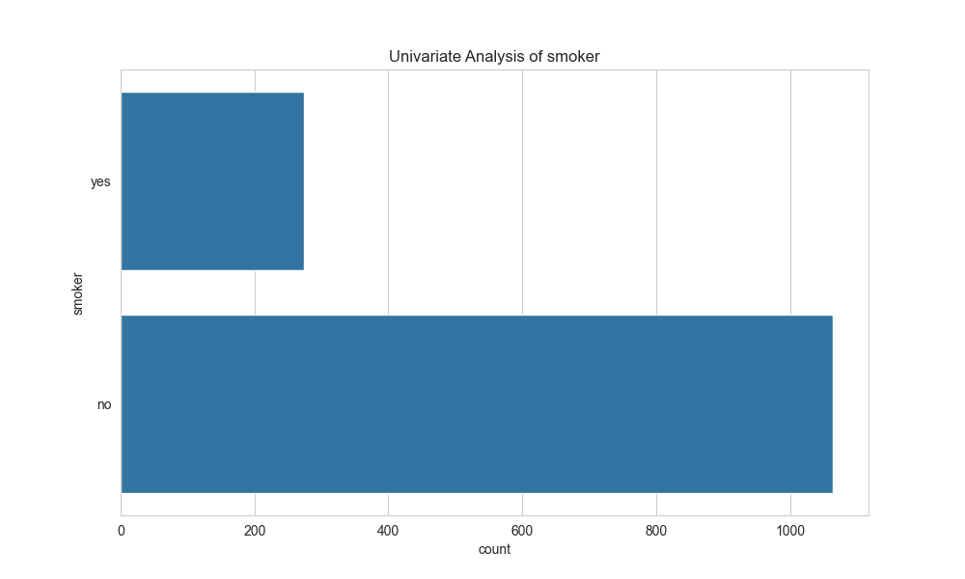
CHART - UNIVARIATE SMOKER

