Slide 1
EXPLORATORY DATA ANALYSIS
MADE BY DORA

Slide 2
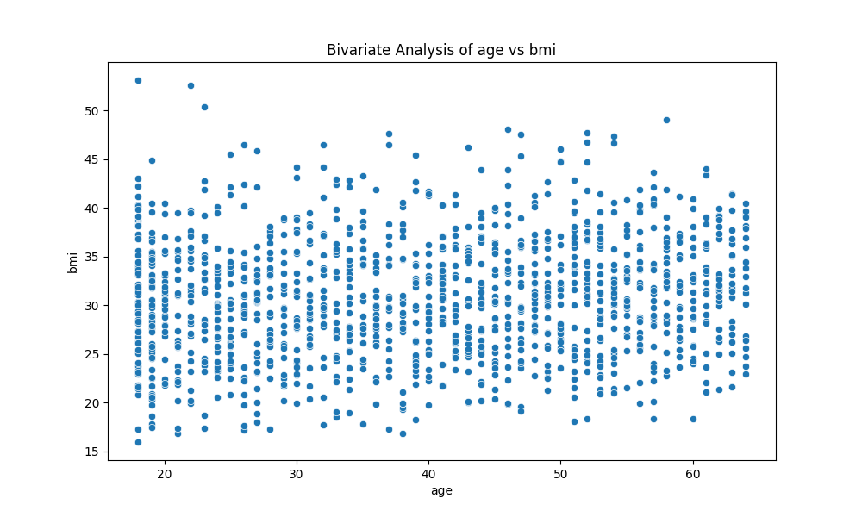
CHART: BIVARIATE AGE VS BMI

Slide 3
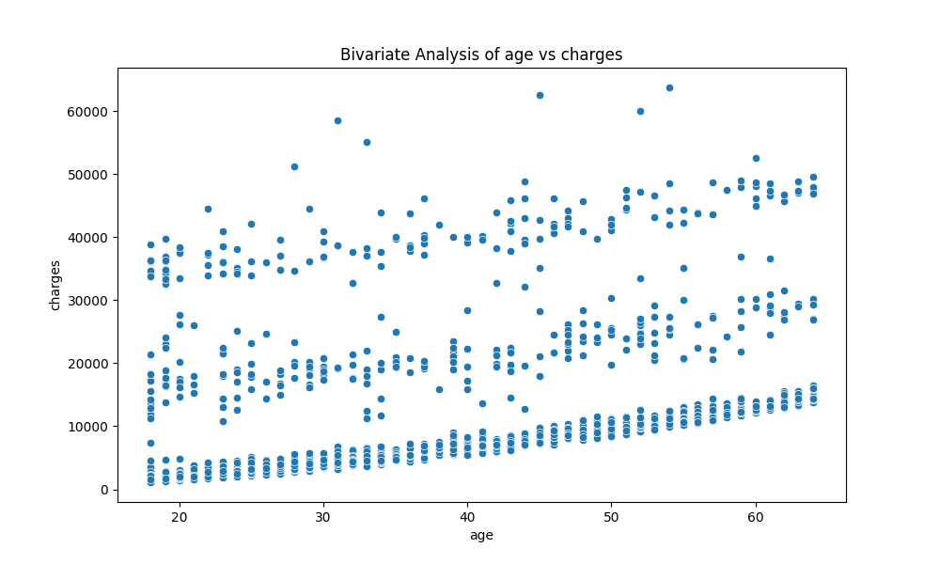
CHART: BIVARIATE AGE VS CHARGES

Slide 4
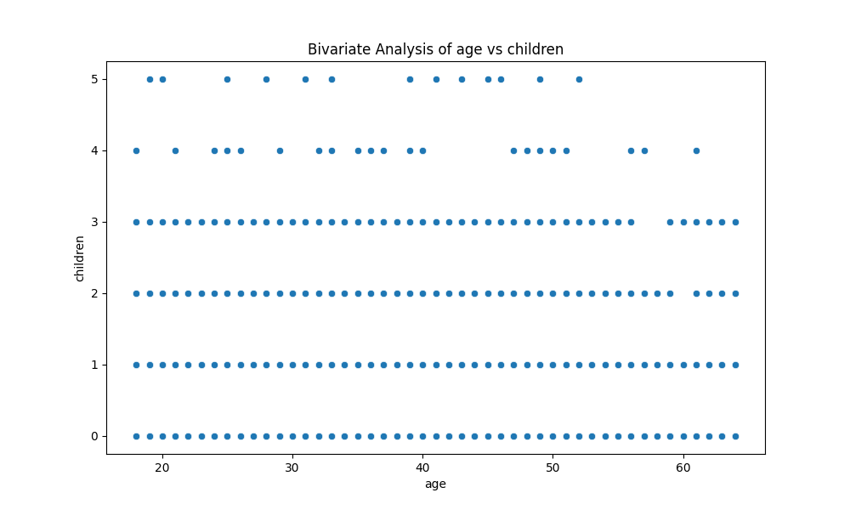
CHART: BIVARIATE AGE VS CHILDREN

Slide 5
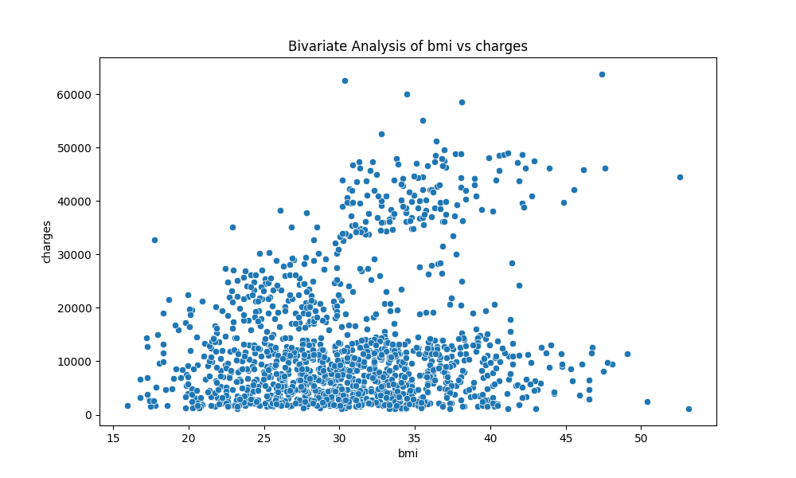
CHART: BIVARIATE BMI VS CHARGES

Slide 6
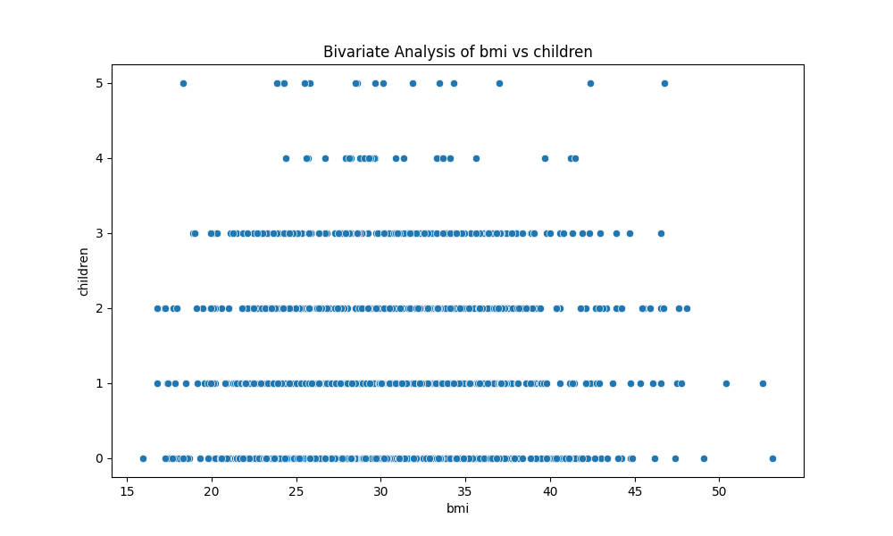
CHART: BIVARIATE BMI VS CHILDREN

Slide 7
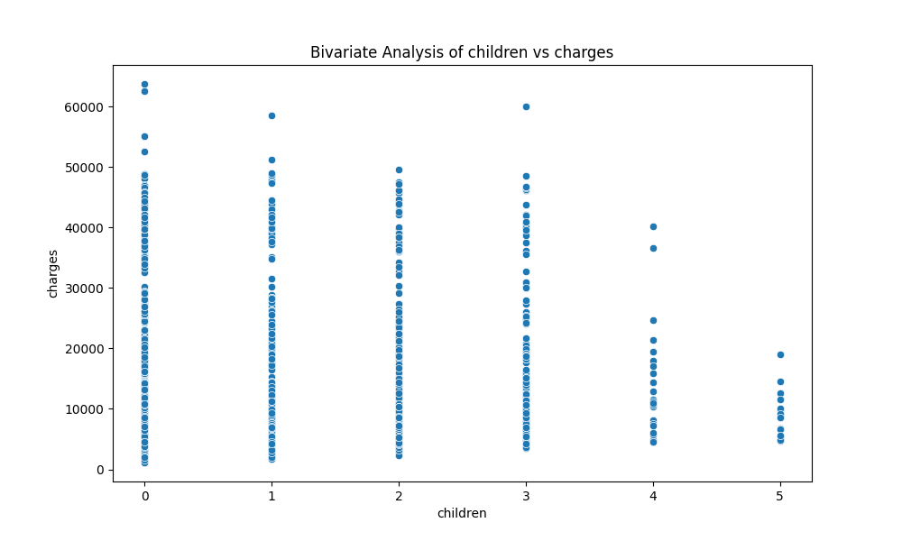
CHART: BIVARIATE CHILDREN VS CHARGES

Slide 8
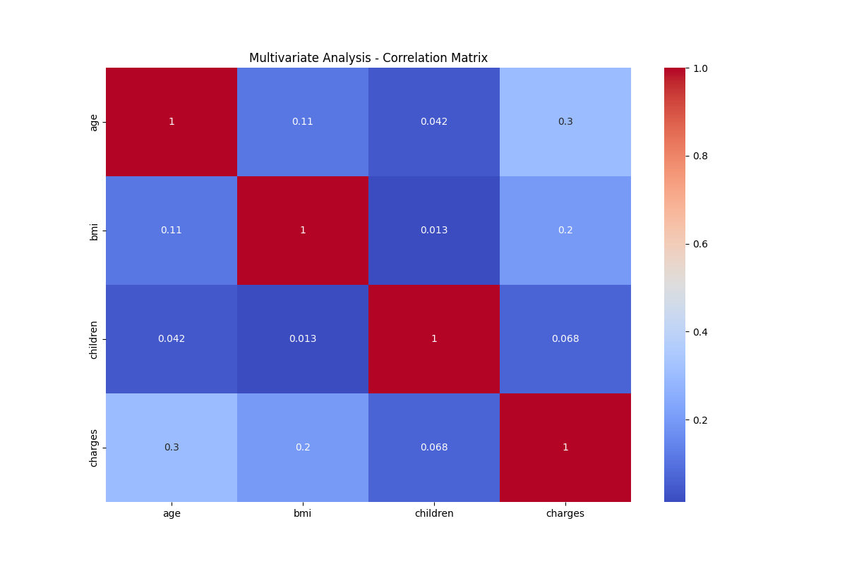
CHART: CORRELATION MATRIX

Slide 9
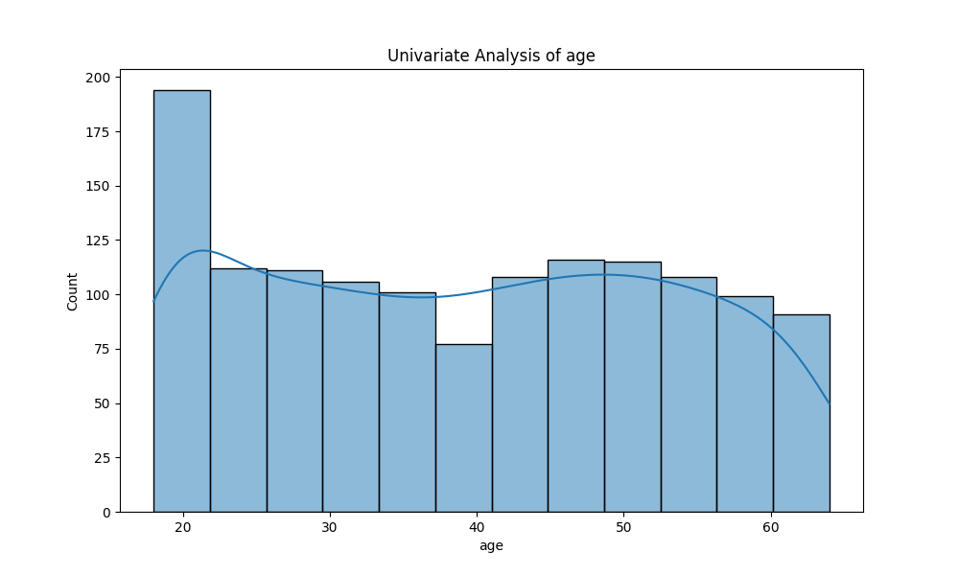
CHART: UNIVARIATE AGE

Slide 10
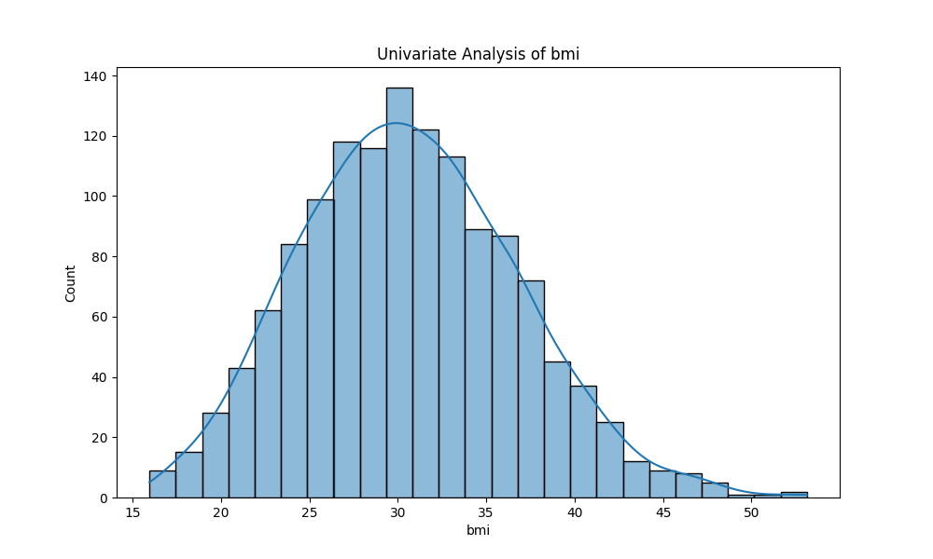
CHART: UNIVARIATE BMI

Slide 11
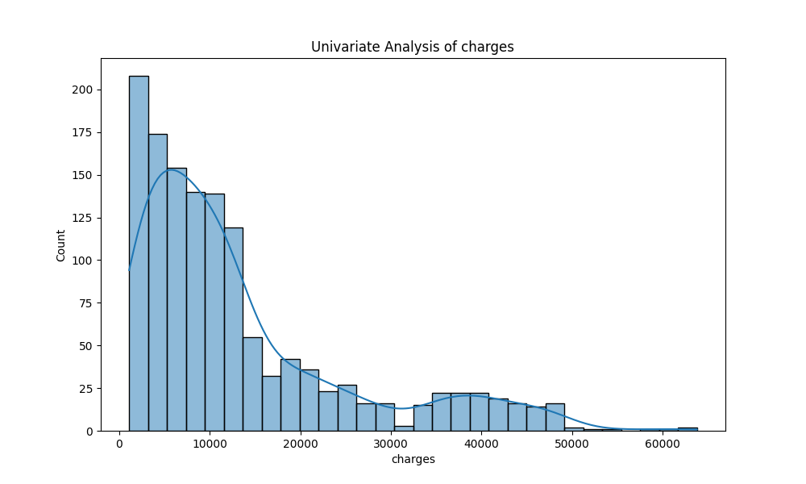
CHART: UNIVARIATE CHARGES

Slide 12
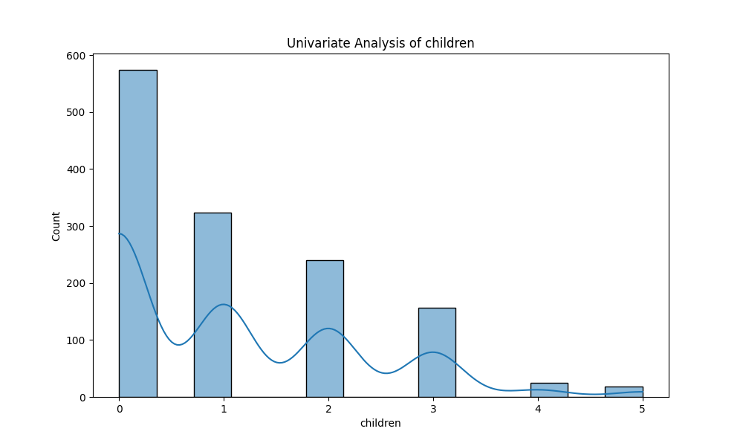
CHART: UNIVARIATE CHILDREN

Slide 13
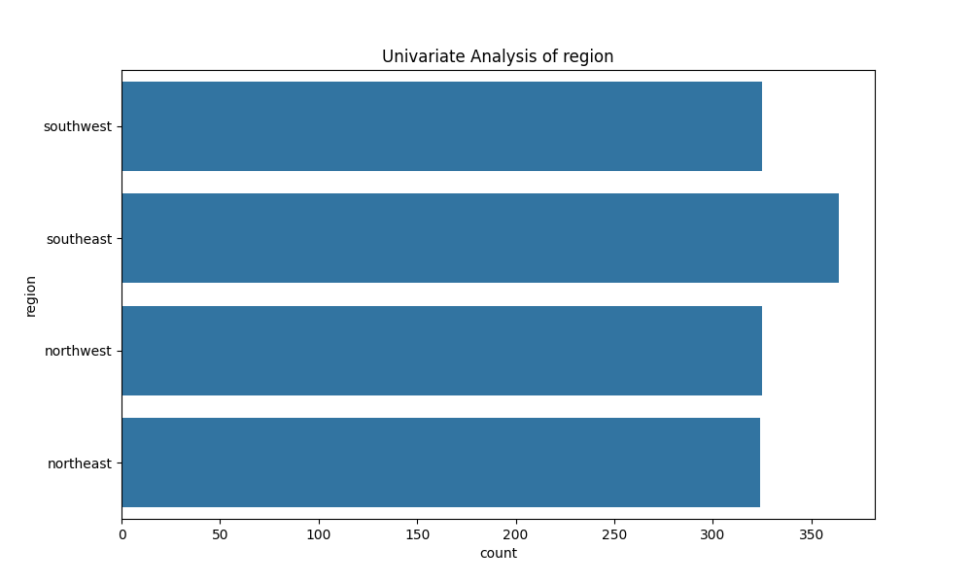
CHART: UNIVARIATE REGION

Slide 14
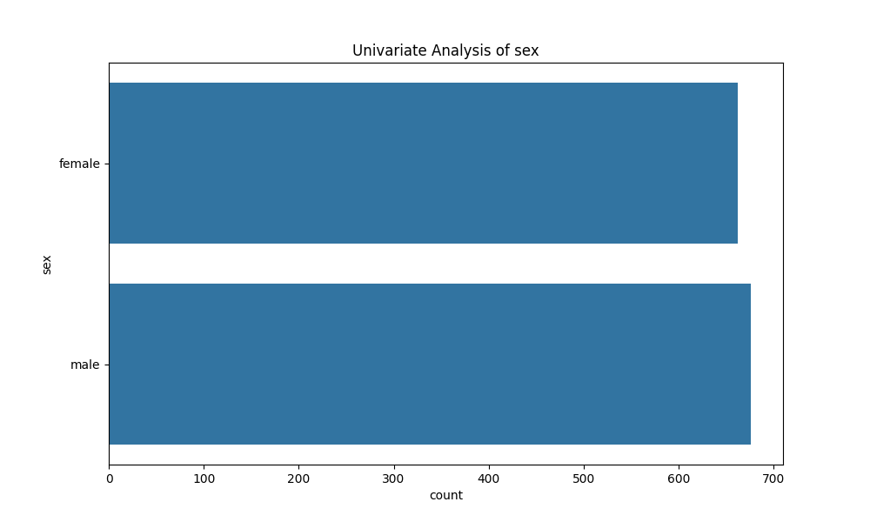
CHART: UNIVARIATE SEX

Slide 15
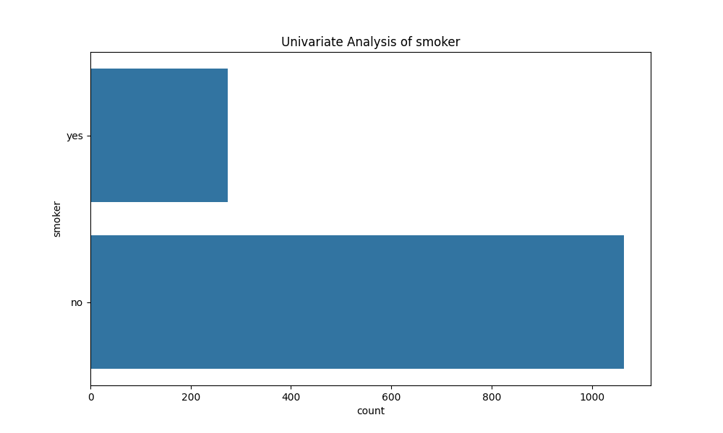
CHART: UNIVARIATE SMOKER

