Slide 1
Exploratory Data Analysis
Insights from the Dataset

Slide 2
Statistical Analysis - univariate_analysis.txt
age sex bmi children smoker region charges
count 1338.000000 1338 1338.000000 1338.000000 1338 1338 1338.000000
unique NaN 2 NaN NaN 2 4 NaN
top NaN male NaN NaN no southeast NaN
freq NaN 676 NaN NaN 1064 364 NaN
mean 39.207025 NaN 30.663397 1.094918 NaN NaN 13270.422265
std 14.049960 NaN 6.098187 1.205493 NaN NaN 12110.011237
min 18.000000 NaN 15.960000 0.000000 NaN NaN 1121.873900
25% 27.000000 NaN 26.296250 0.000000 NaN NaN 4740.287150
50% 39.000000 NaN 30.400000 1.000000 NaN NaN 9382.033000
75% 51.000000 NaN 34.693750 2.000000 NaN NaN 16639.912515
max 64.000000 NaN 53.130000 5.000000 NaN NaN 63770.428010

Slide 3
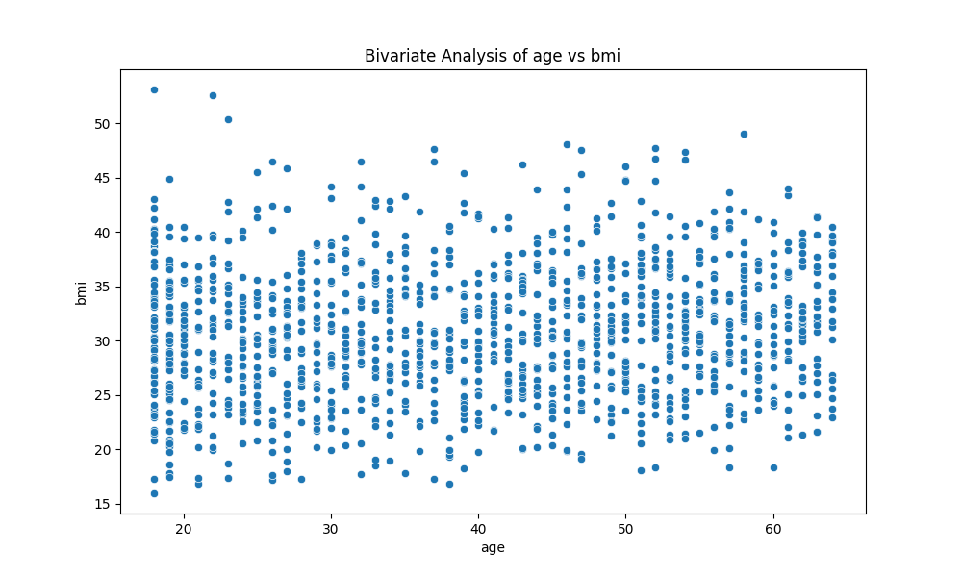
Chart - bivariate_age_vs_bmi.png

Slide 4
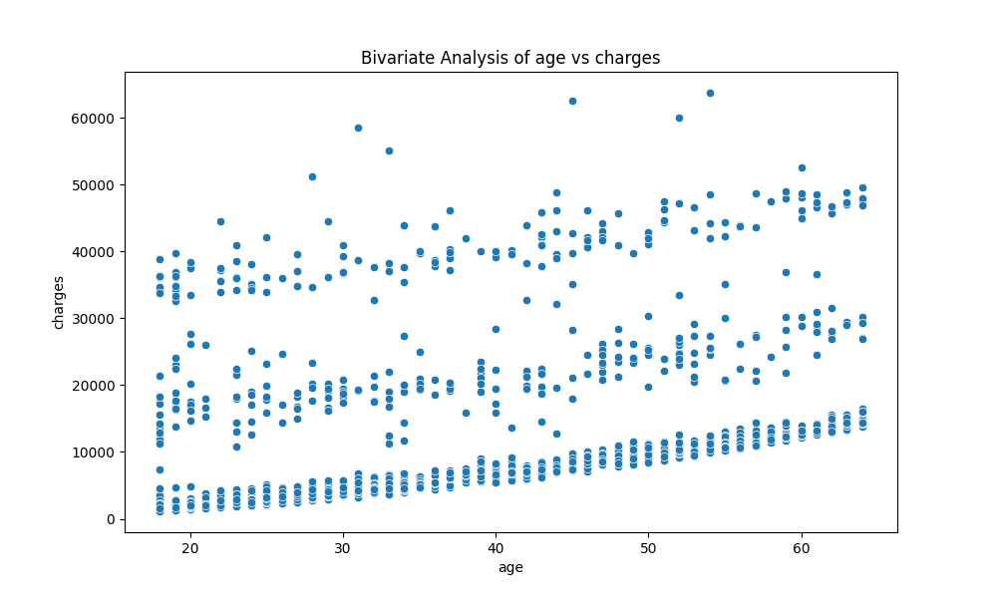
Chart - bivariate_age_vs_charges.png

Slide 5
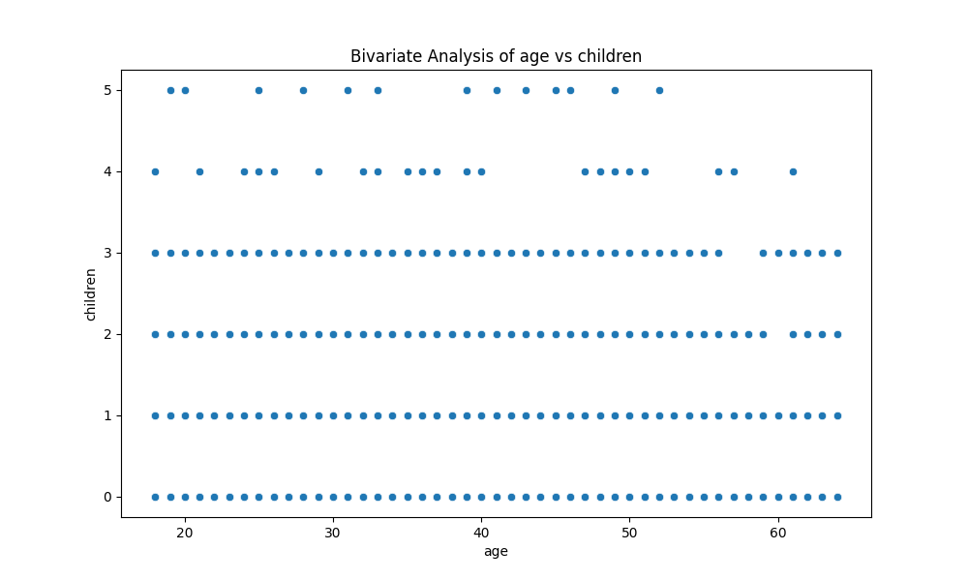
Chart - bivariate_age_vs_children.png

Slide 6
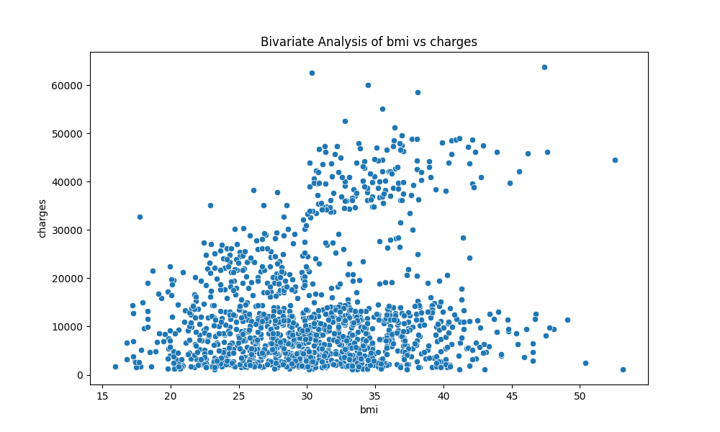
Chart - bivariate_bmi_vs_charges.png

Slide 7
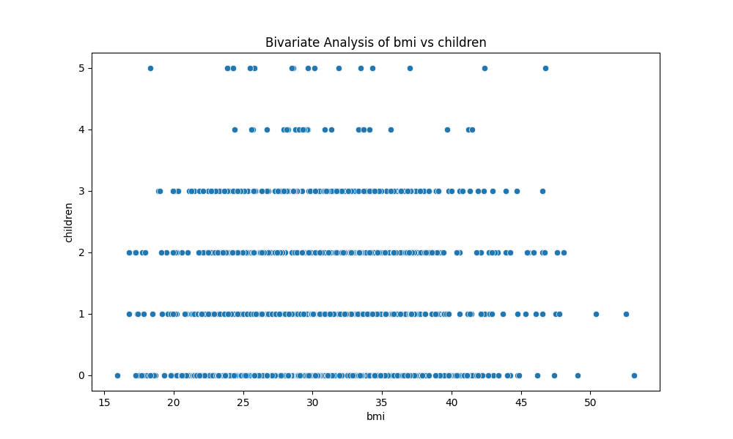
Chart - bivariate_bmi_vs_children.png

Slide 8
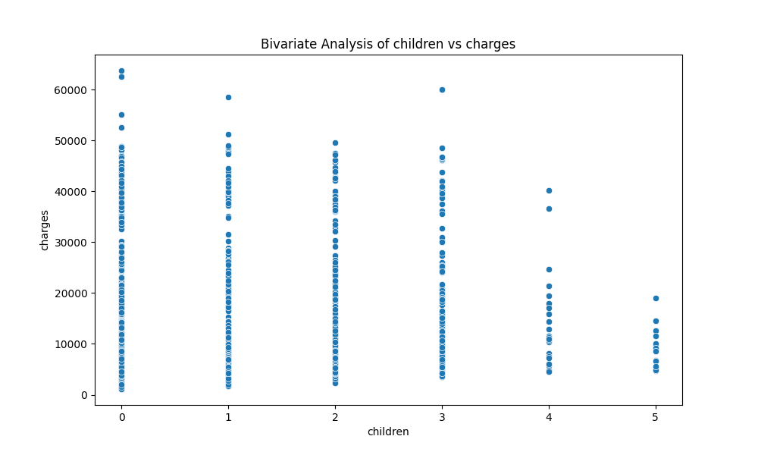
Chart - bivariate_children_vs_charges.png

Slide 9
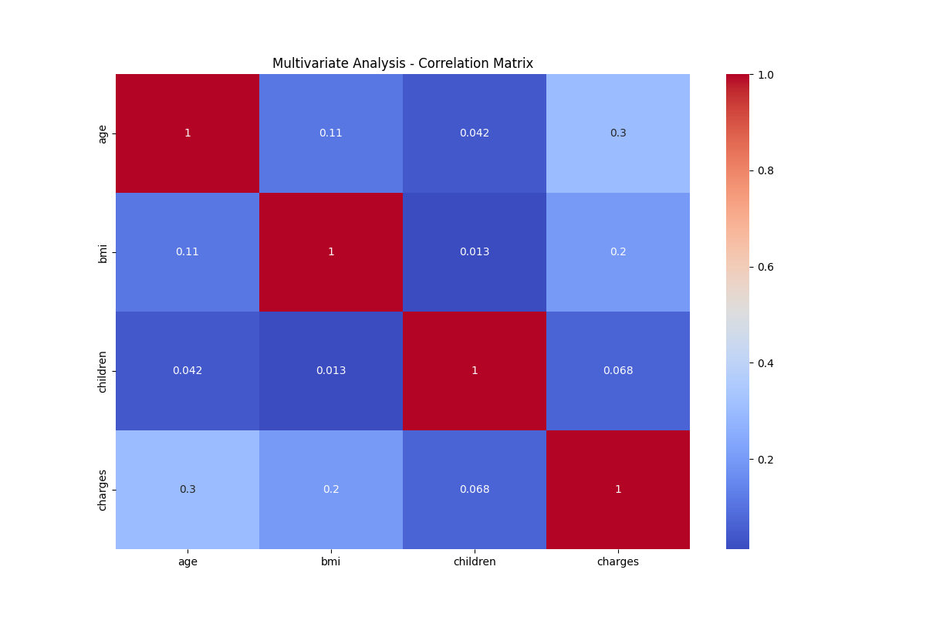
Chart - correlation_matrix.png

Slide 10
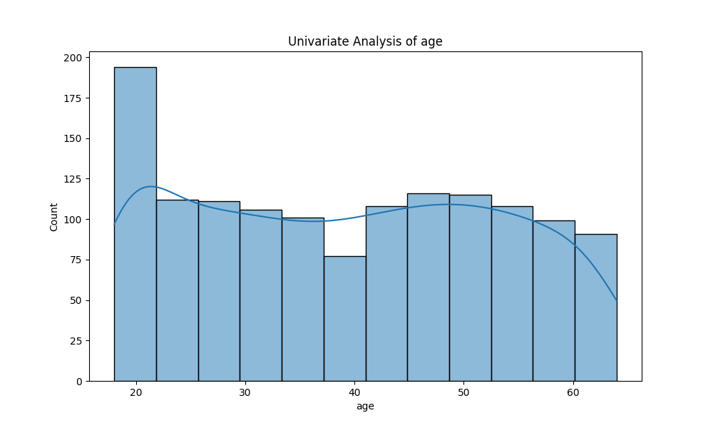
Chart - univariate_age.png

Slide 11
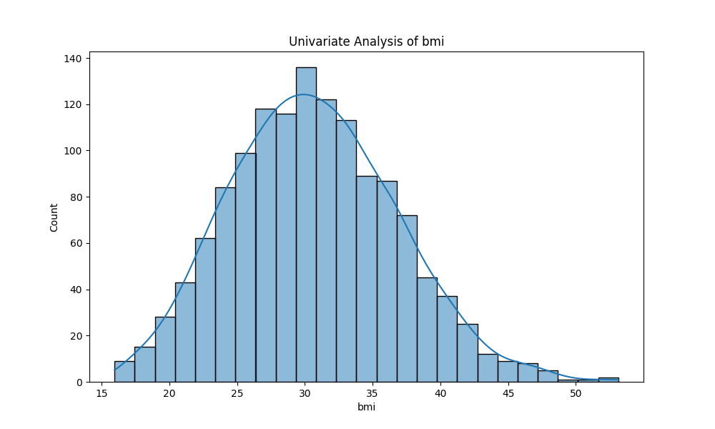
Chart - univariate_bmi.png

Slide 12
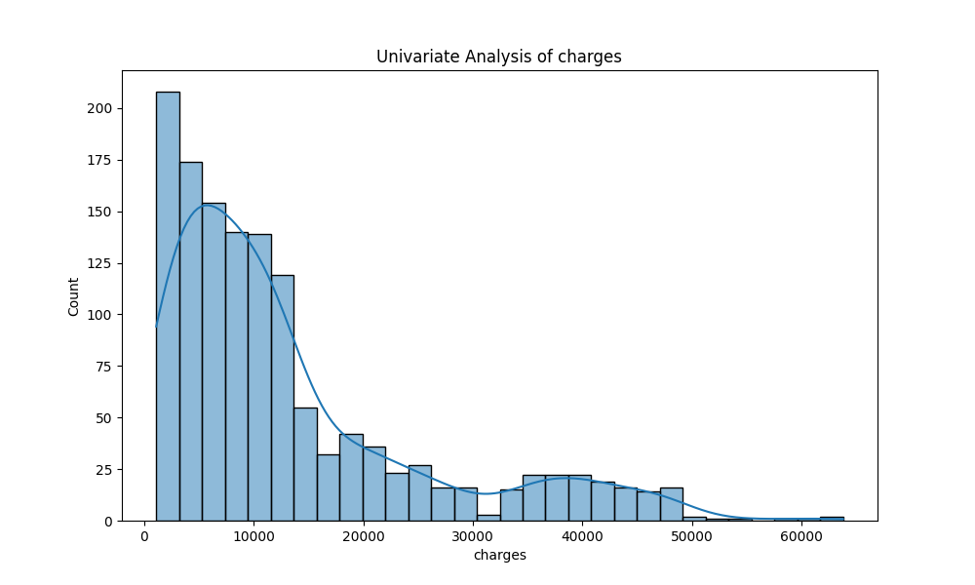
Chart - univariate_charges.png

Slide 13
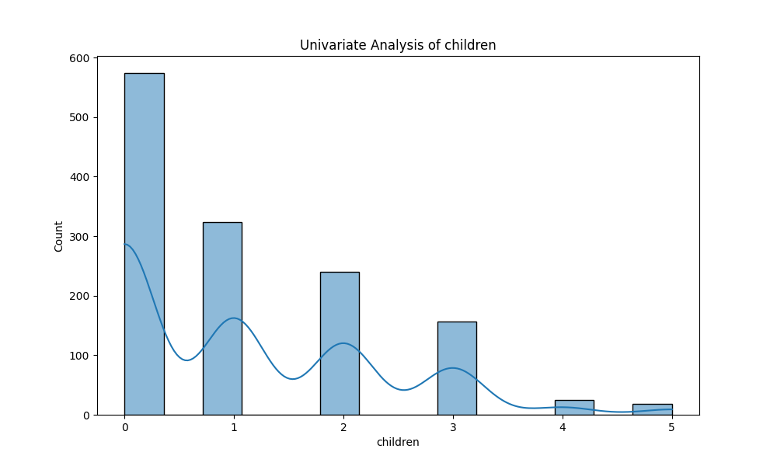
Chart - univariate_children.png

Slide 14
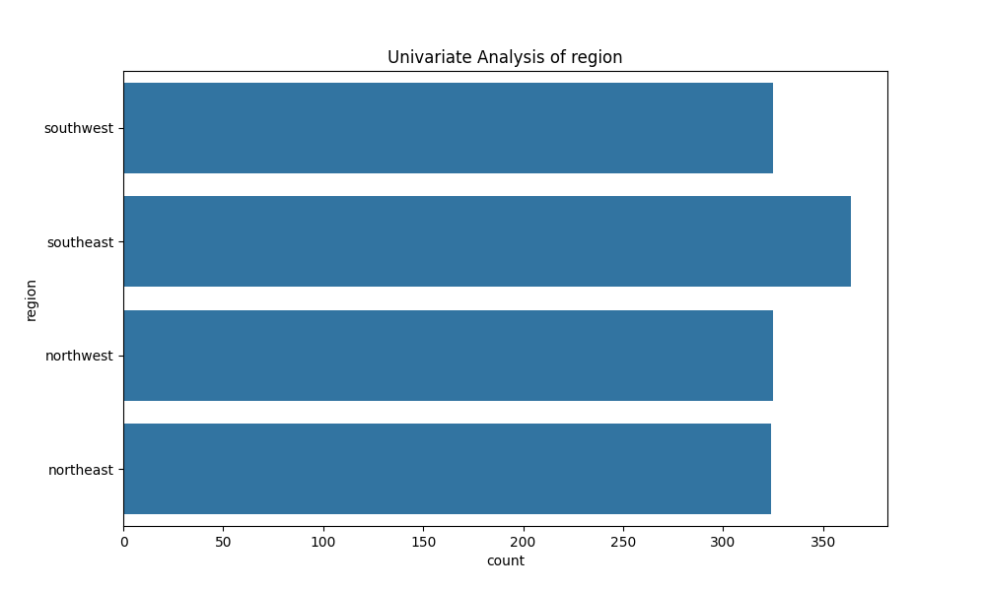
Chart - univariate_region.png

Slide 15
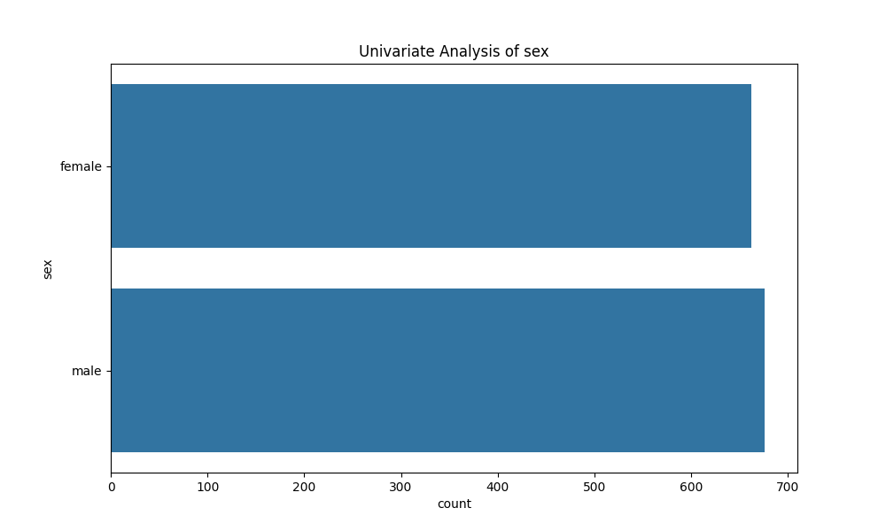
Chart - univariate_sex.png

Slide 16
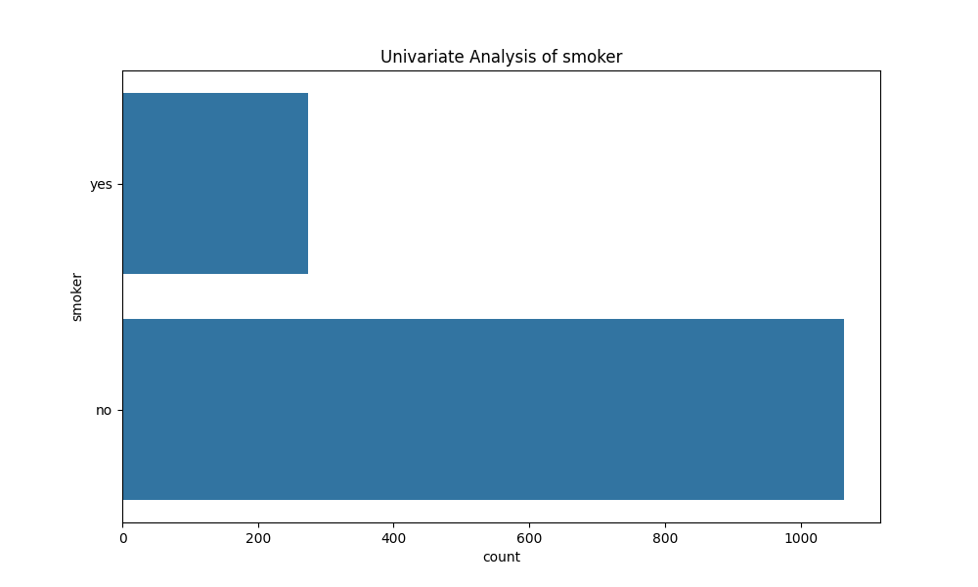
Chart - univariate_smoker.png

