Slide 1
Exploratory Data Analysis
Insights from the Dataset

Slide 2
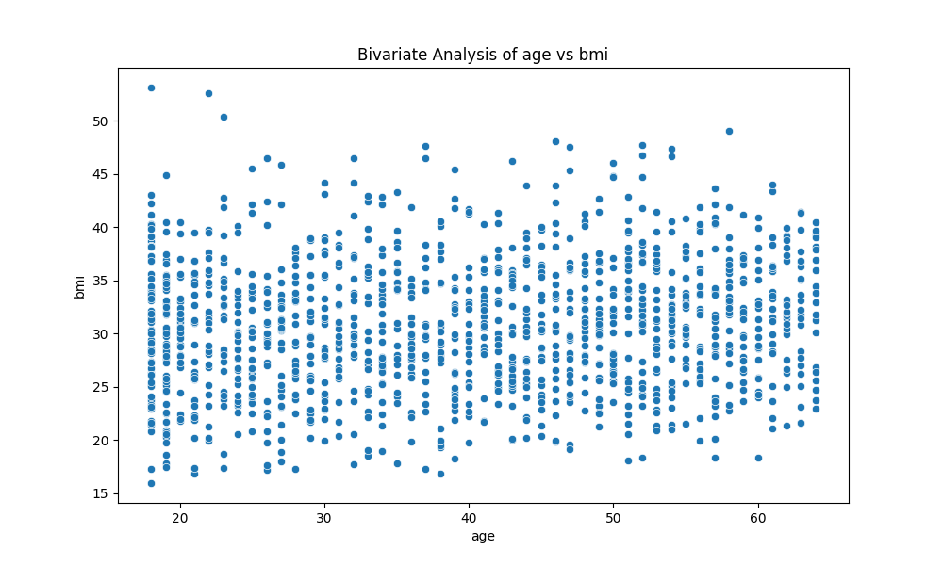
Chart - bivariate_age_vs_bmi.png

Slide 3
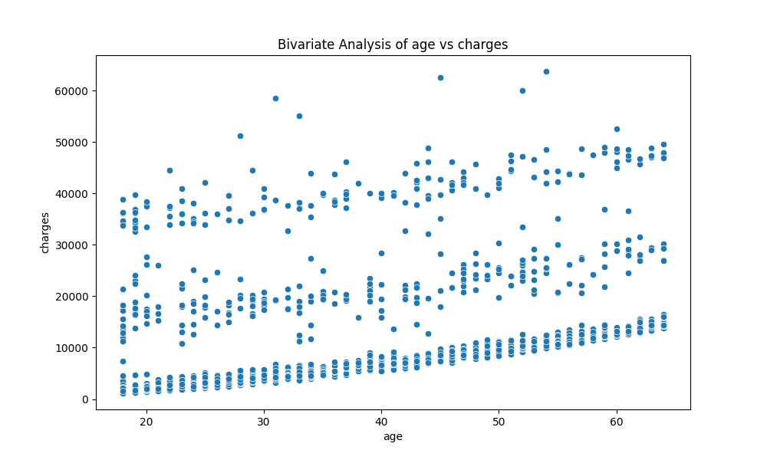
Chart - bivariate_age_vs_charges.png

Slide 4
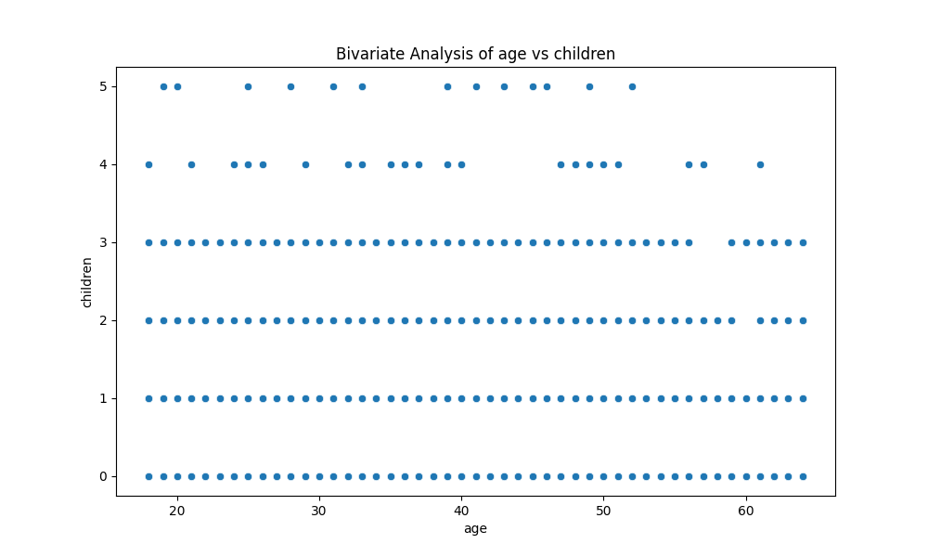
Chart - bivariate_age_vs_children.png

Slide 5
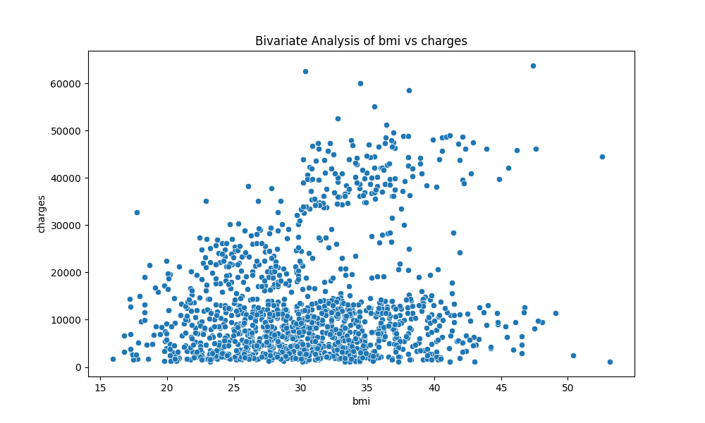
Chart - bivariate_bmi_vs_charges.png

Slide 6
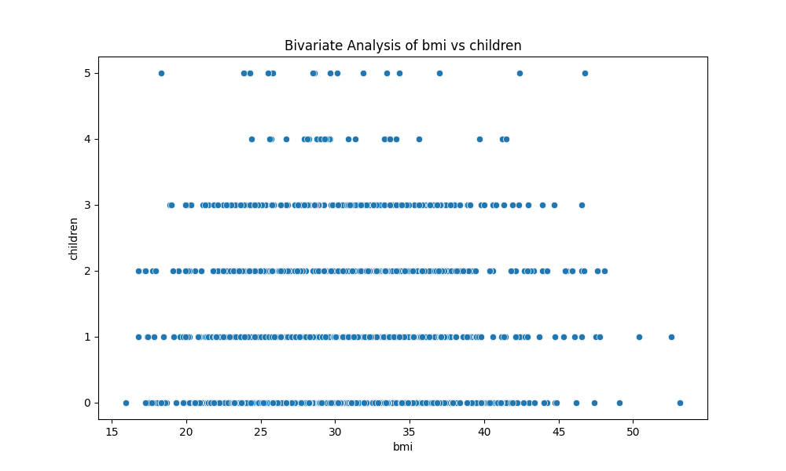
Chart - bivariate_bmi_vs_children.png

Slide 7
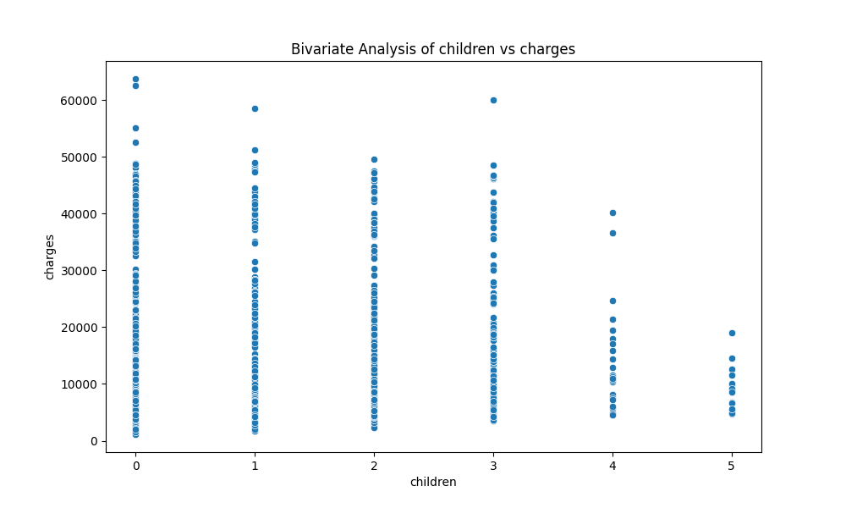
Chart - bivariate_children_vs_charges.png

Slide 8
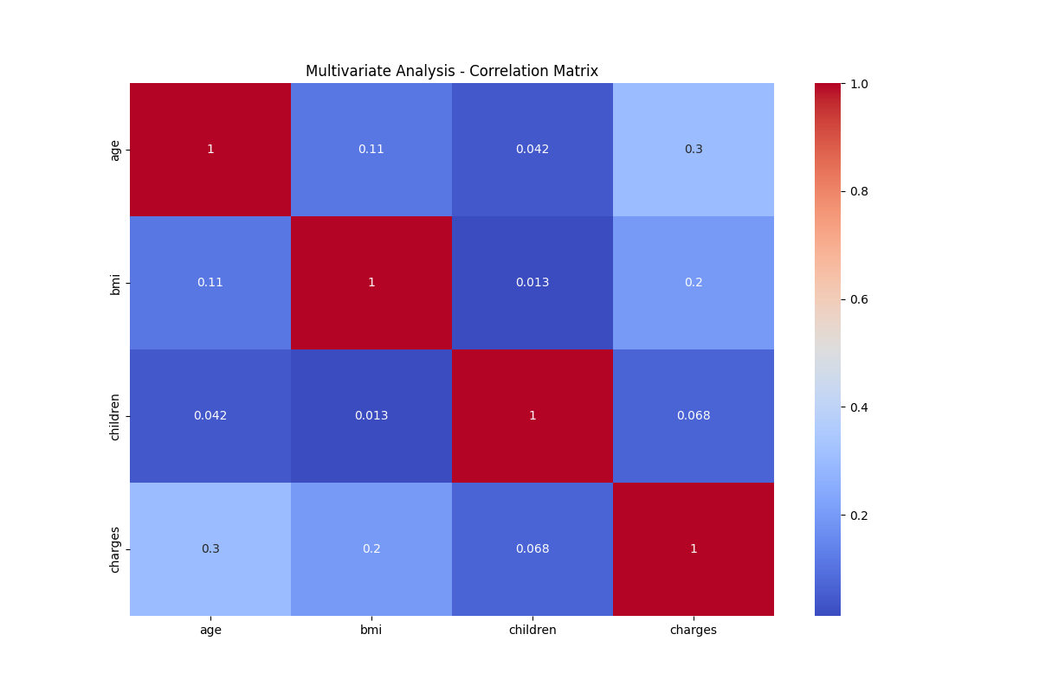
Chart - correlation_matrix.png

Slide 9
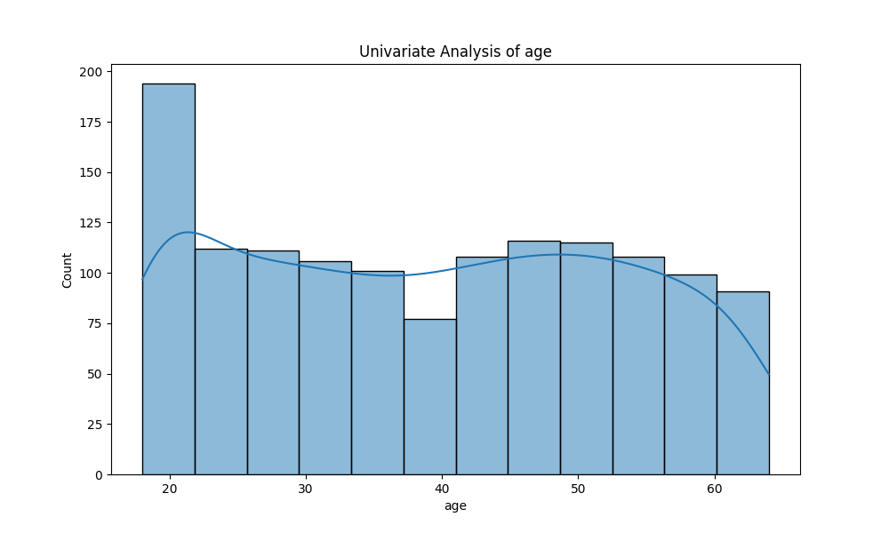
Chart - univariate_age.png

Slide 10
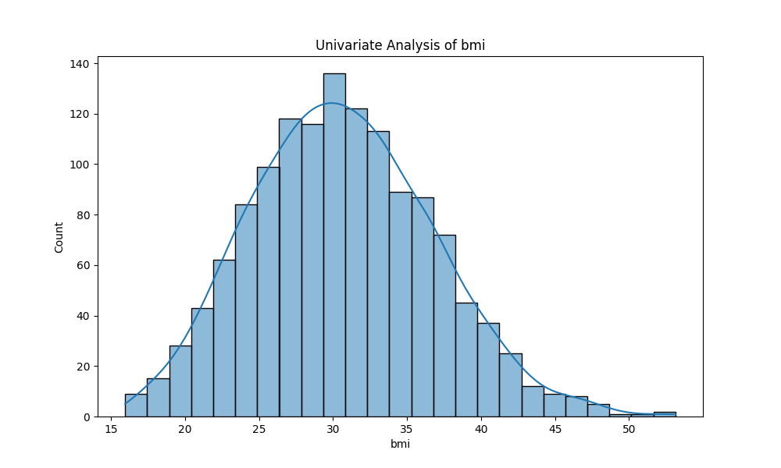
Chart - univariate_bmi.png

Slide 11
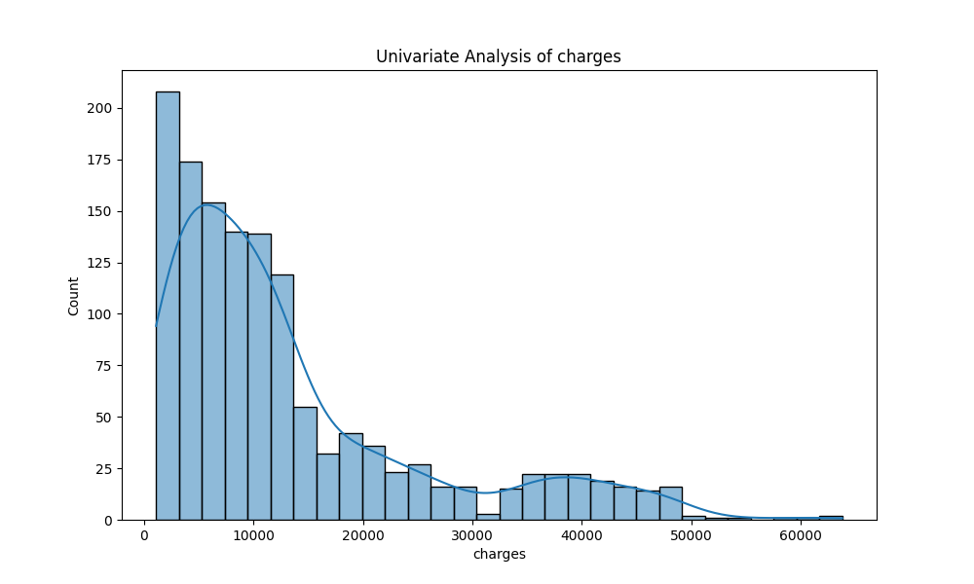
Chart - univariate_charges.png

Slide 12
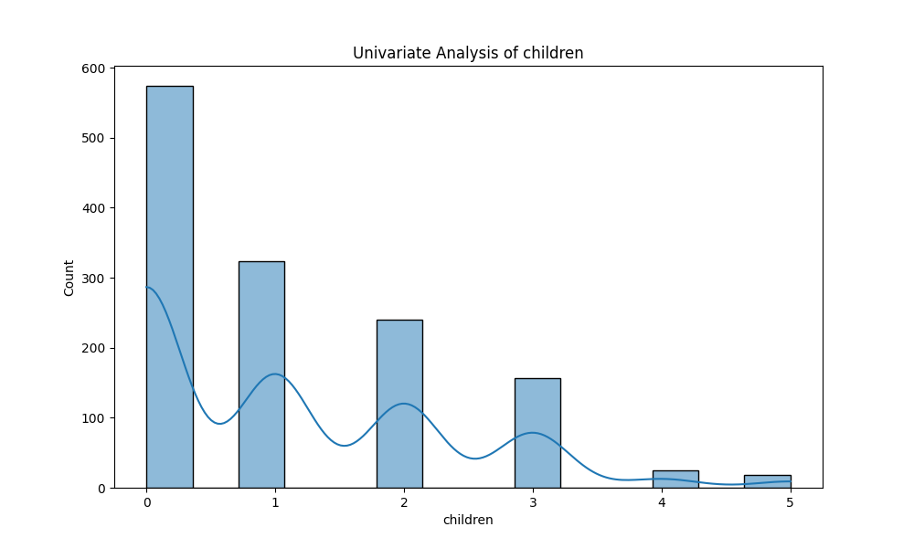
Chart - univariate_children.png

Slide 13
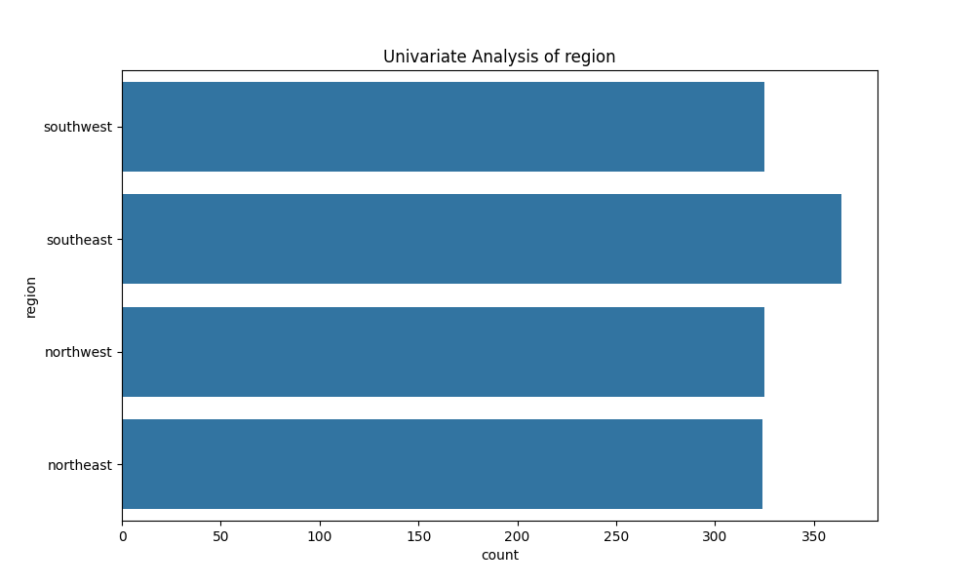
Chart - univariate_region.png

Slide 14
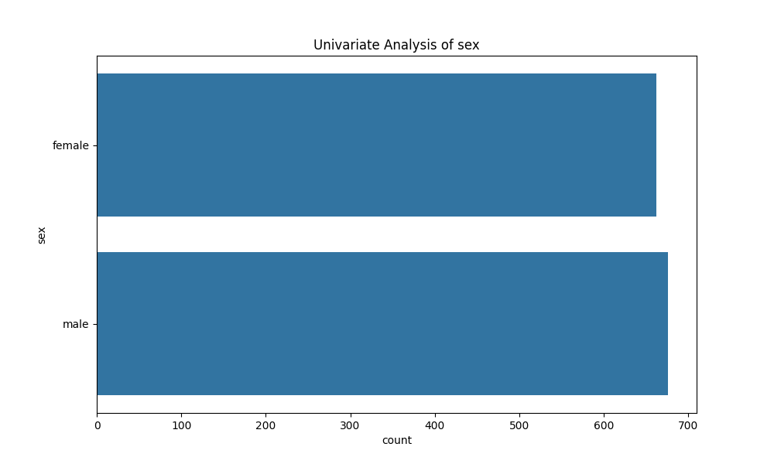
Chart - univariate_sex.png

Slide 15
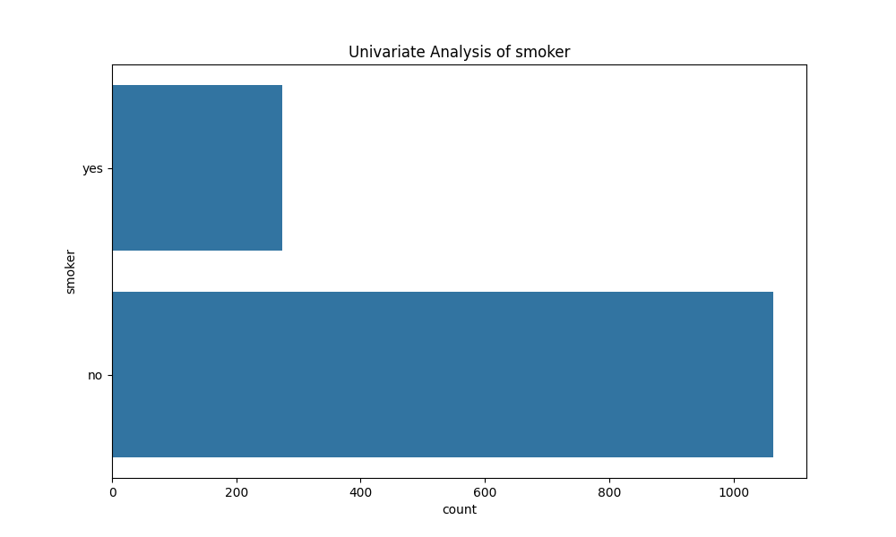
Chart - univariate_smoker.png

