Slide 1
TORNADO PREDICTION & RELIEF
TEAM ASV
TEAM MEMBERS:
ARAVIND - CSE,2nd Year
ASIFF - CSE,2nd Year
SURYA - CSE,2nd Year
SREENATH - CSE,2nd Year
VENKATESH - CSE,2nd Year

Slide 2
PROBLEM STATEMENT
One the most dangerous natural calamity is Tornado. Tornadoes mostly occur due to collision of undirectional winds forming, spiral band of minimum 25 feet height, taking everything that comes in it’s way.
Due to high velocity winds and the pressure difference created a Tornado can be able to suck anything that comes in its way.

Slide 3
SOLUTION
We have come up with a solution using Artificial Intelligence and Machine Learning and IOT for better solution for this problem.
AI: Using previous data sets we train up using Machine Learning and the information retrieved by sensors will compared with data sets and accuracy of the calamity will be predicted.
IOT: Here we use sensors such as BMP180 and ESP8266 to get the necessary parameters like temperature, Pressure and humidity to pass information to AI.
Satellite Communication and Rescue measures.

Slide 4
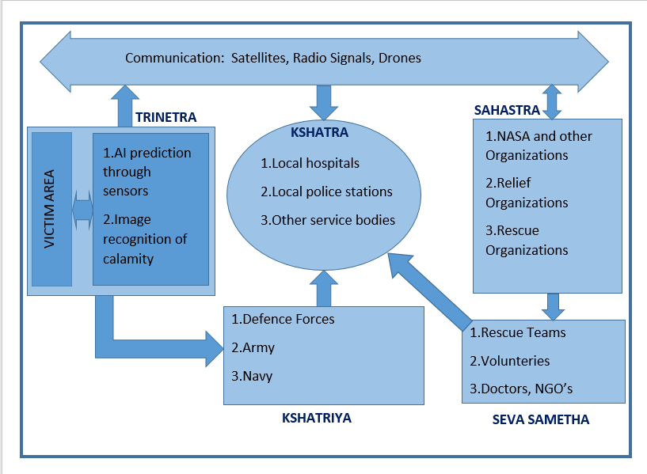
PROTOTYPE BLOCK DIAGRAM

Slide 5
TECHNOLOGY STACK
Artificial Intelligence and Internet of Things.
Satellite Communication.
Alert messaging to service organizations.
Alert teams allocating the victim area before the disaster occurrence.
Drones for conformation of disaster, for image recognition of calamity, alerting the people in victim area.
Deep Learning techniques of image recognition.

Slide 6
CHALLENGES
To predict type of disaster.
To estimate range of disaster.
To alert the service bodies in victim area and spread the message as fast as possible.
To make all living bodies stay in safe zones.
To send rescue teams to victim area and control maximum loss of economic wealth.

Slide 7
CONTACT US
NAME : S.ASIFF
MOBILE NO : 8978200896
EMAIL ID : asiffshaik1999@gmail.com
NAME : N.ARAVIND REDDY
MOBILE NO : 8978671239
EMAIL ID : reddyaravind838@gmail.com
NAME : K.SRINATH
MOBILE NO : 8074817385
EMAIL ID : kothakotasrinath471@gmail.com
NAME : VENKATESH YEKBOTE
MOBILE NO : 9182330390
EMAIL ID : venkateshy921@gmail.com
NAME : P.CHIDIVILAS SURYA
MOBILE NO : 9177851069
EMAIL ID : chidvilassurya.p@gmail.com

Slide 8
THANK YOU
WE WOULD LIKE TO THANK THE SMART BRIDGE AND IBM FOR GIVING THIS WONDERFUL OPPURTUNITY
-TEAM ASV
THE END

