Slide 1

MARKET INTELLIGENCE
GLOBAL RESTAURANT BENCHMARKS
Zomato
Restaurant Intelligence Dashboard
GEOGRAPHY
COVERAGE
SIGNAL BASE
15 Countries · 141 Cities
9,551 Verified Outlets
1.49M Diner Reviews
Notes:
Welcome everyone. Today we are walking through the Zomato Restaurant Intelligence Dashboard, exploring global performance across 9,551 restaurants and 1.49M customer votes.

Slide 2

STAKEHOLDER VALUE
One dashboard, three people who win
01
02
03
Diners
Restaurateurs
Zomato Leadership
Find genuine top-rated dishes and trustworthy restaurants faster, cutting through unrated noise.
Pinpoint exactly what sells, audit competitors on pricing tiers, and learn why specific cuisines command higher loyalty.
Monetize actionable market data, identify expansion targets, and power recurring merchant subscriptions.
Notes:
Explain the tripartite value proposition: customers gain discovery clarity, restaurateurs gain competitive diagnostics, and Zomato accelerates platform monetization.

Slide 3
MARKET OVERVIEW
The market at a glance: 9,551 restaurants in 15 countries
9,551
1.49M
141
2.67
599.60
TOTAL RESTAURANTS
TOTAL VOTES
CITIES TRACKED
AVERAGE RATING
AVG COST / PERSON
Across 15 countries
14,98,645 votes (1,498,645 customer ratings)
Metro and secondary markets
Out of 5.0 scale
Standard domestic currency
Interactive slicing: A rating-range slicer and filters for restaurant, cuisine, price, country and city enable custom cohort analysis.
Core Insight: 22% of outlets lack initial review momentum, dragging the platform average down.
Notes:
Highlight the five key baseline KPIs: total outlets, total votes, geographic reach across 141 cities, the modest 2.67 global average rating, and typical spend.

Slide 4
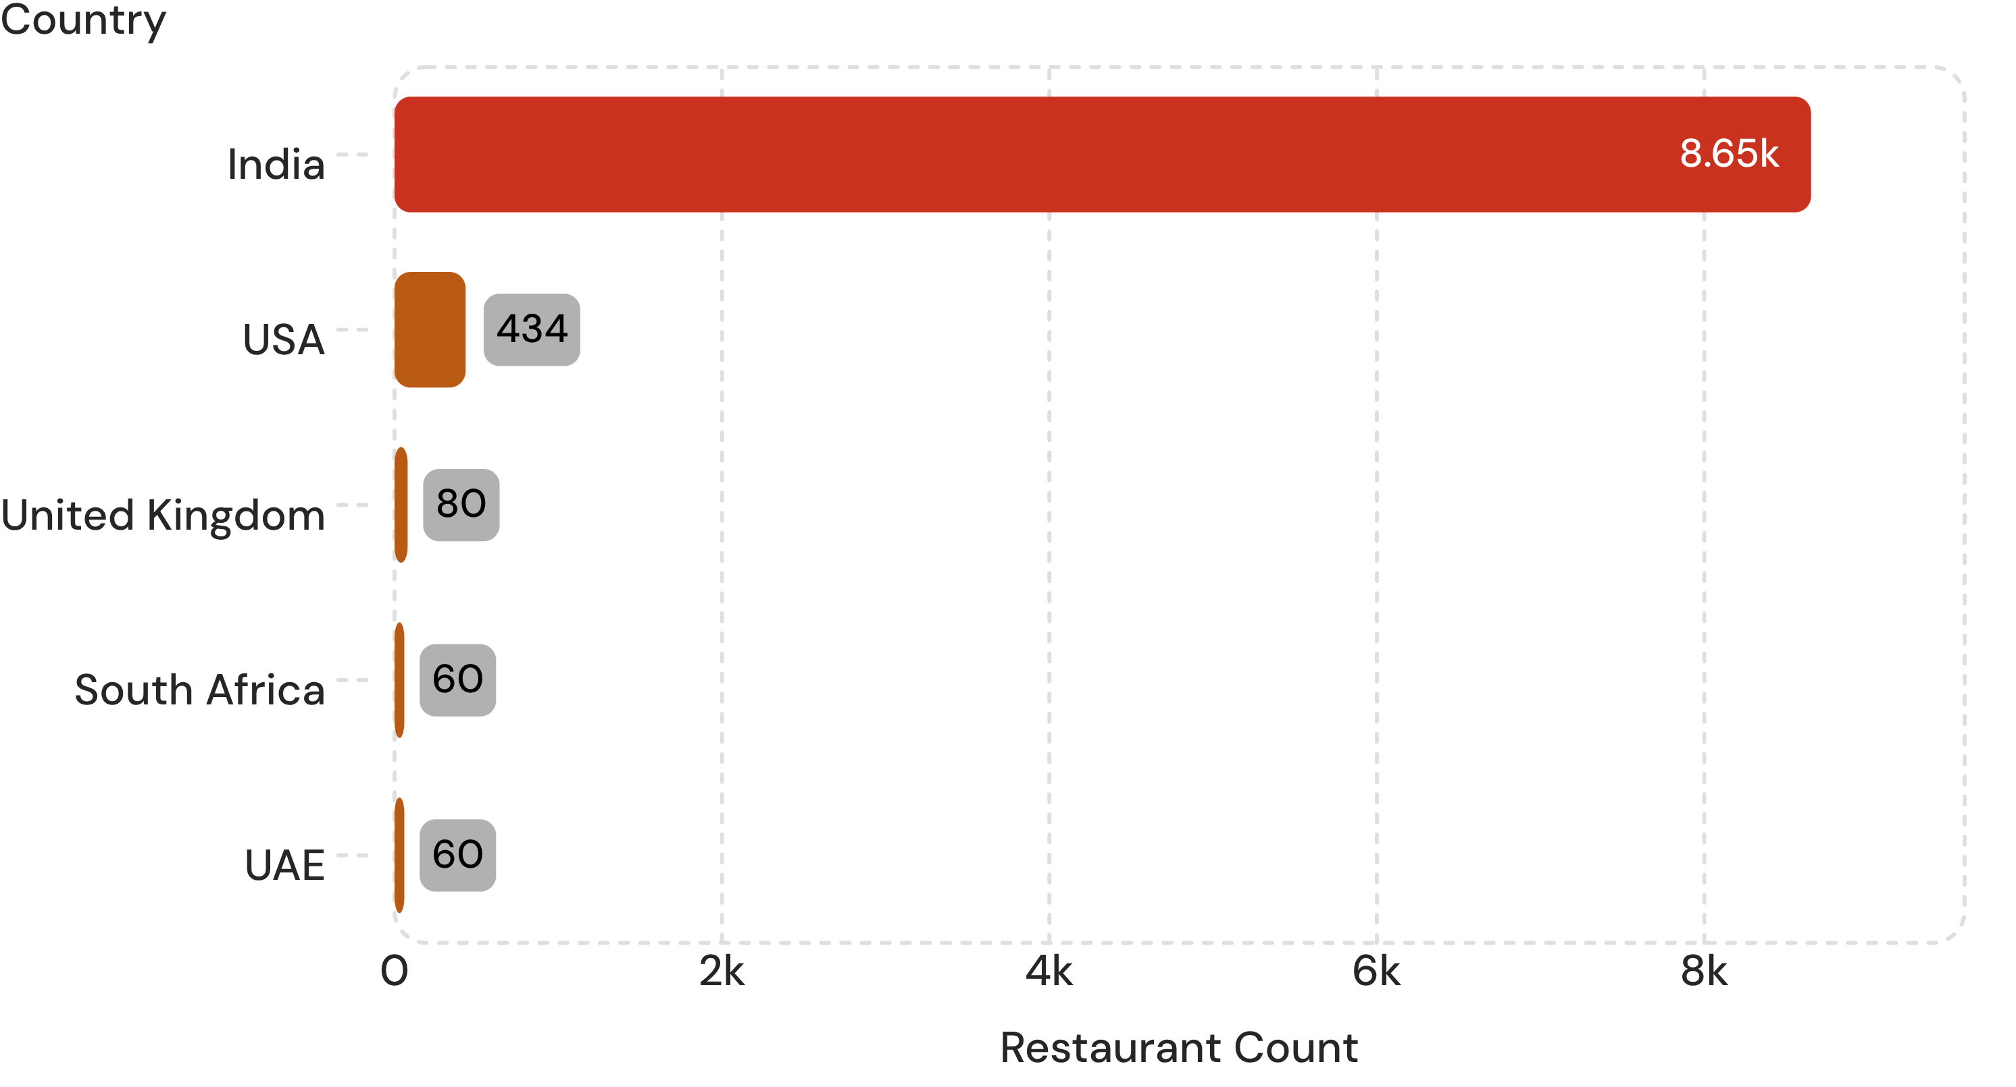
GEOGRAPHIC FOOTPRINT
Country to city drill-down shows where the market sits
90.6%
Share concentrated in India
City-level drill-down
Clicking any country reveals inner urban distribution across Delhi NCR, Mumbai, and Bangalore, separating hyper-competitive clusters from underserved pockets.
Business Problem Solved
Informs strategic expansion: operators see exactly where supply is saturated and where unmet dining demand offers room to grow.
Top 5 of 15 tracked national markets by registered outlet volume. India: 8,652.
Notes:
India represents the vast majority of volume with 8,652 locations, followed by the US with 434 and the UK with 80. Point out the strategic city drill-down value.

Slide 5
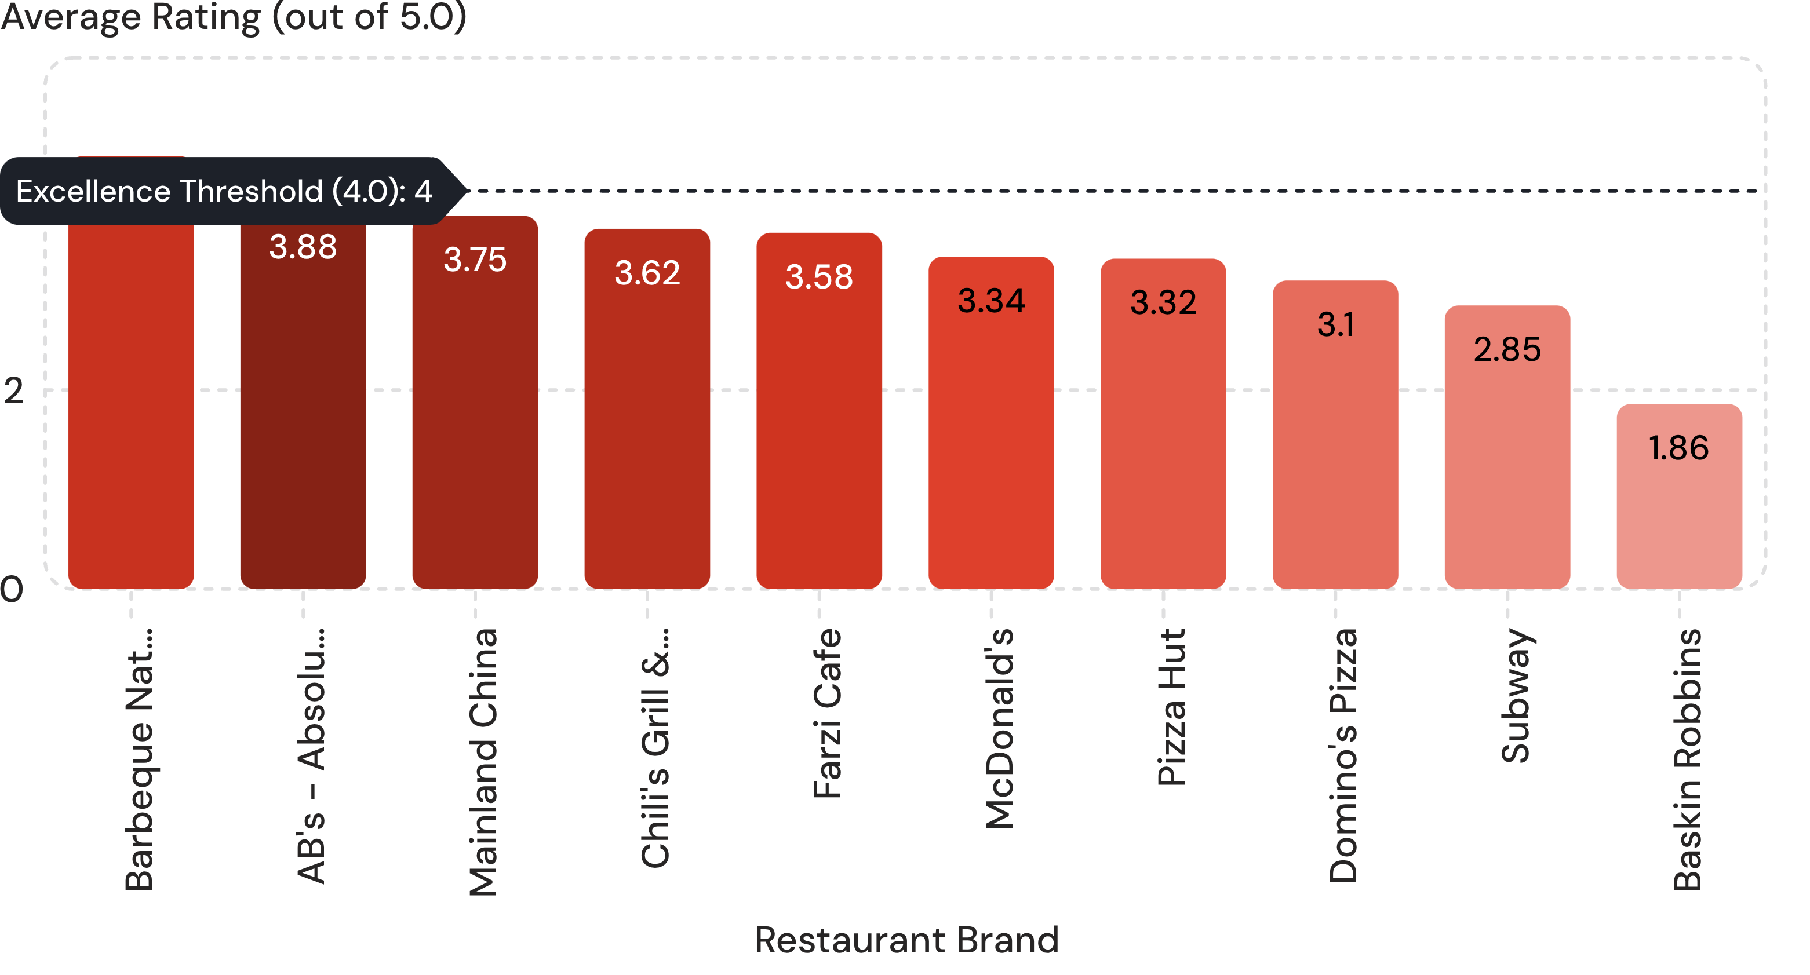
CHAIN BENCHMARKING
Top 10 restaurants: only Barbeque Nation clears 4.0
4.35
Barbeque Nation leads all major chains
The QSR scale penalty
High-volume fast food struggles with consistency: McDonald's (3.34) and Pizza Hut (3.32) cluster near average, while Baskin Robbins falls to 1.86.
Business Problem Solved
Enables operators to benchmark customer satisfaction against peers and uncover operational friction at scale.
Top multi-outlet brands benchmarked by diner satisfaction scores.
Notes:
Emphasize that Barbeque Nation is the sole major multi-outlet chain exceeding the 4.0 threshold at 4.35, while massive QSR franchises battle mid-tier fatigue.

Slide 6
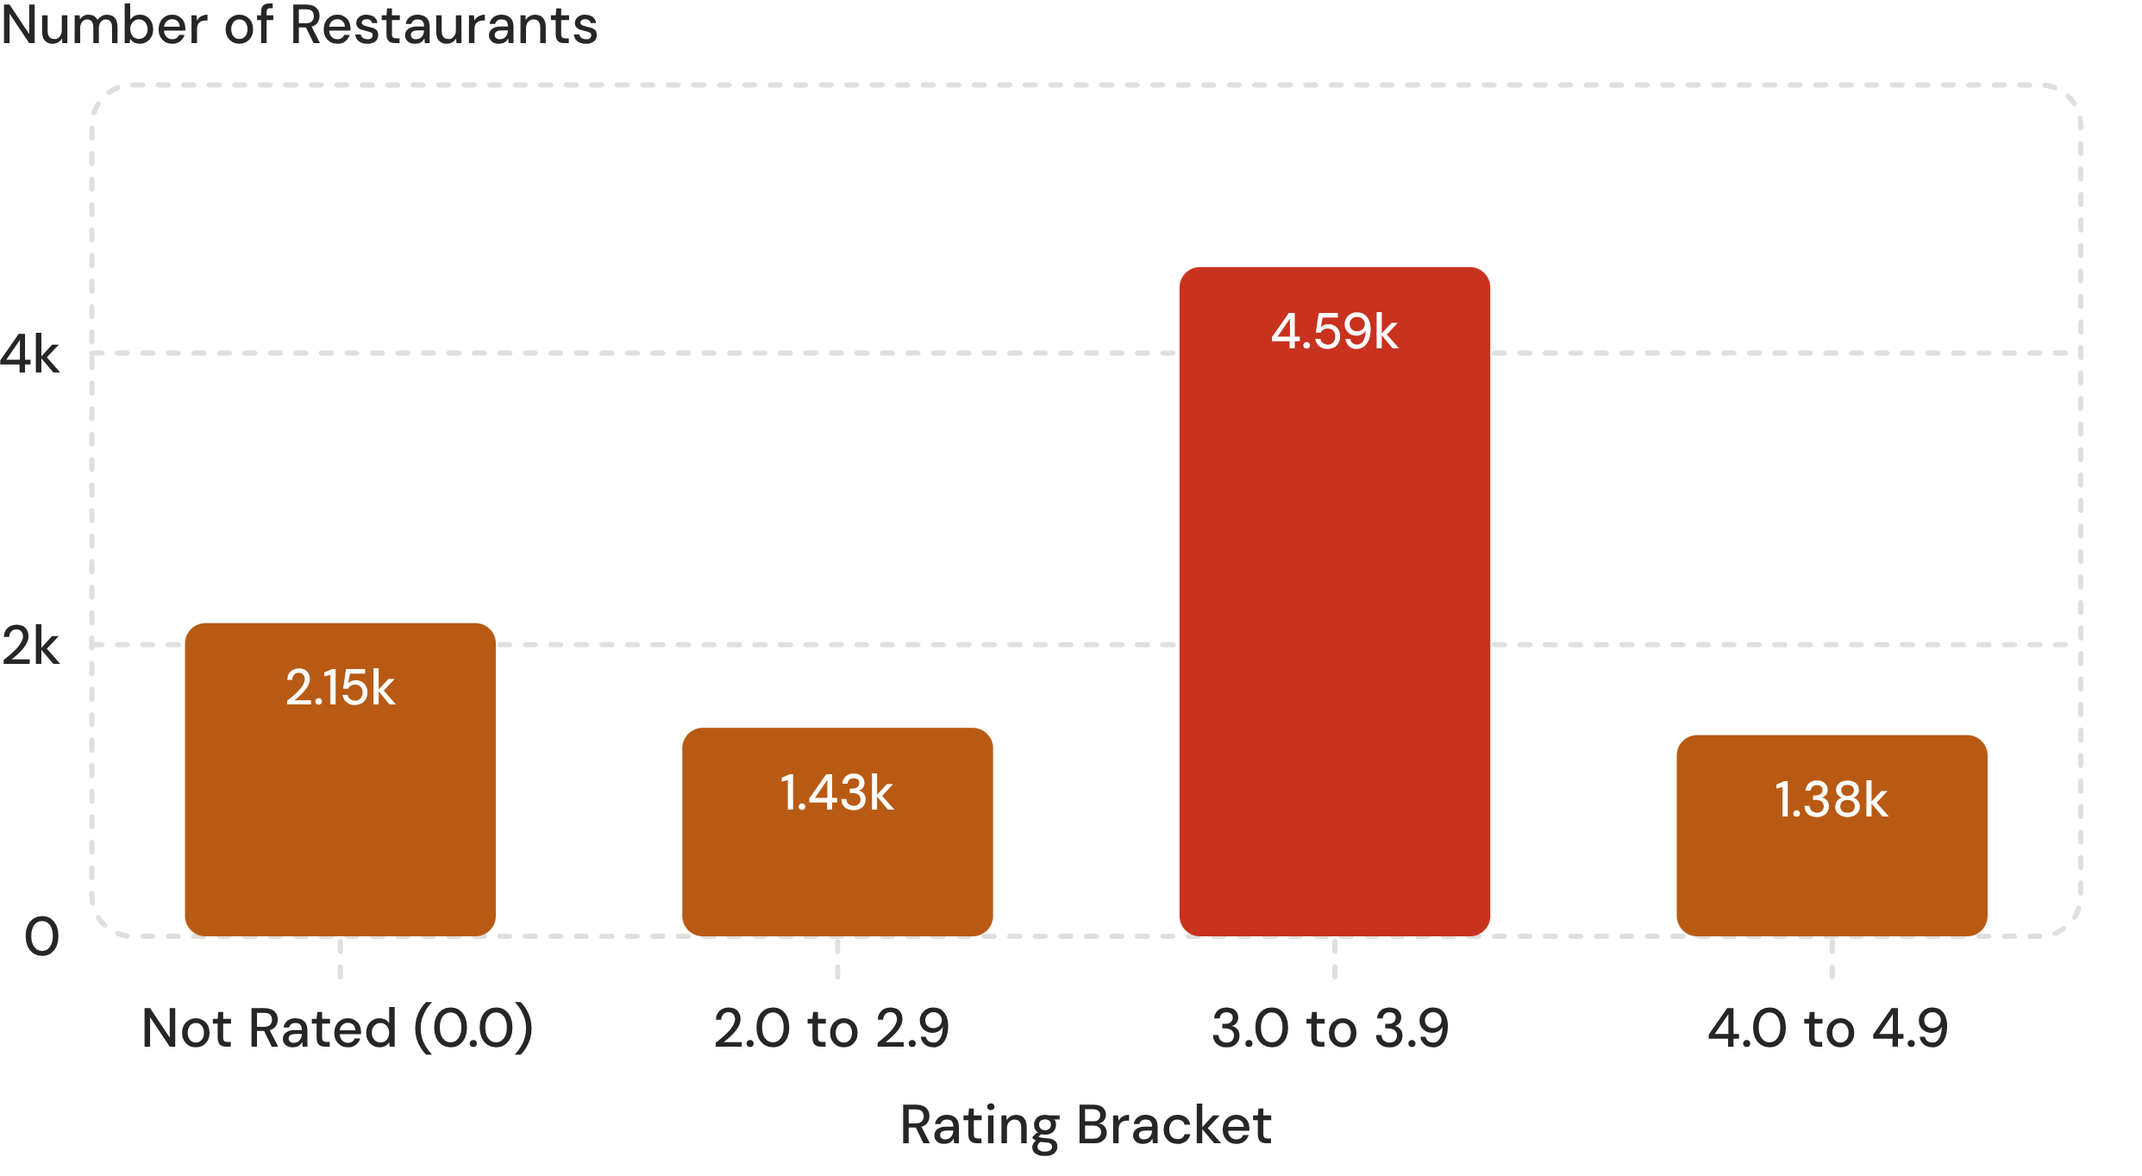
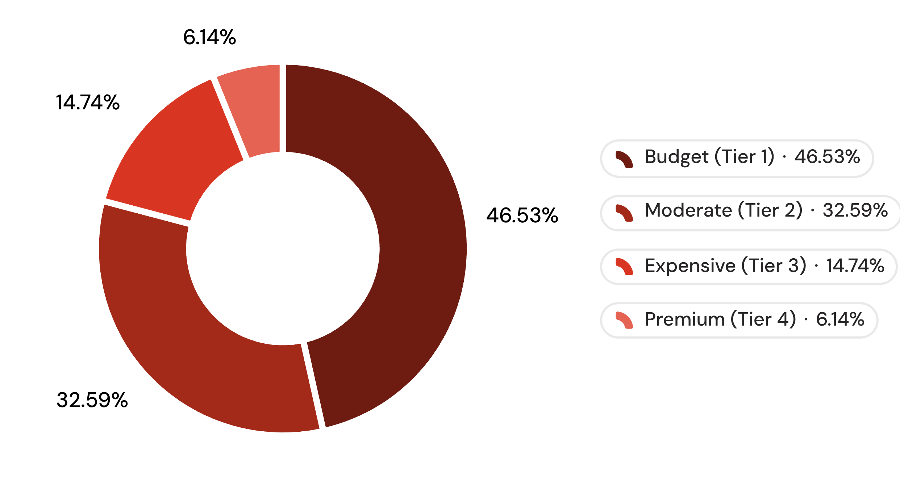
MARKET SHAPE
Most restaurants sit mid-rated and budget-priced
Rating bands: 48% cluster at 3.0 to 3.9
Price tiers: budget and moderate hold 79.1%
Business problem: only 1,380 restaurants reach 4.0+, and 2,148 are unrated, so review campaigns matter.
Business problem: premium is just 6.14% of outlets, so upscale niches in dense zones are underserved.
Notes:
Nearly half of all restaurants sit in the 3.0 to 3.9 band, and 2,148 remain unrated. Budget restaurants are 46.5% and moderate 32.6%, while premium is only 6.14%, leaving clear room upscale.

Slide 7
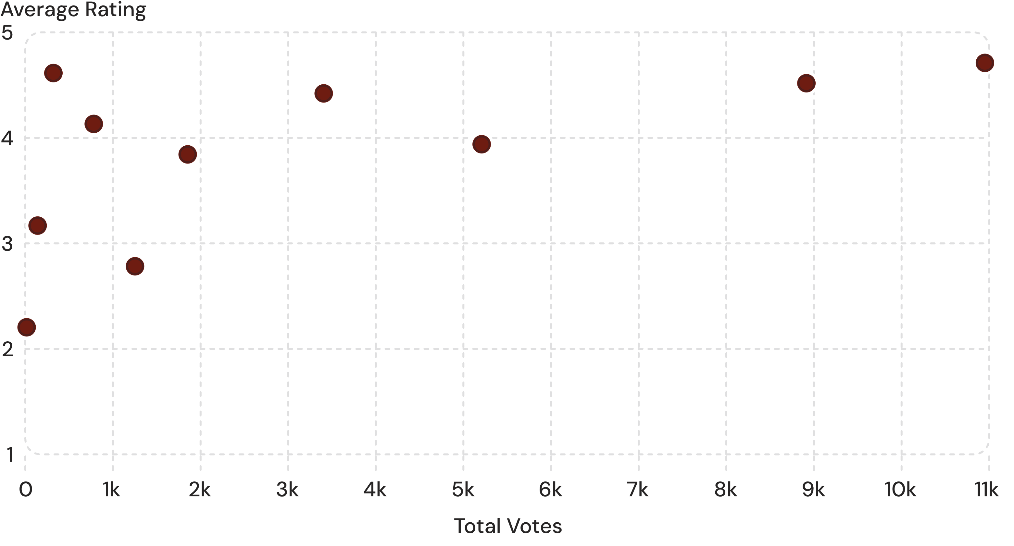
CORRELATION ANALYSIS
Rating vs votes: popularity is not the same as quality
<2,000
Votes for the vast majority
Unmasking hidden gems
A handful of icons exceed 10,000 reviews, but smaller artisanal bistros frequently secure 4.6+ ratings with fewer than 500 votes.
Business Problem Solved
Separates proven favourites and hidden gems from weak performers with many votes.
Sampled cohorts across vote counts and average rating scores.
Notes:
Explain the quadrant insight: high votes show viral visibility or longevity, but boutique outlets with under 1,000 votes often boast higher customer satisfaction.

Slide 8
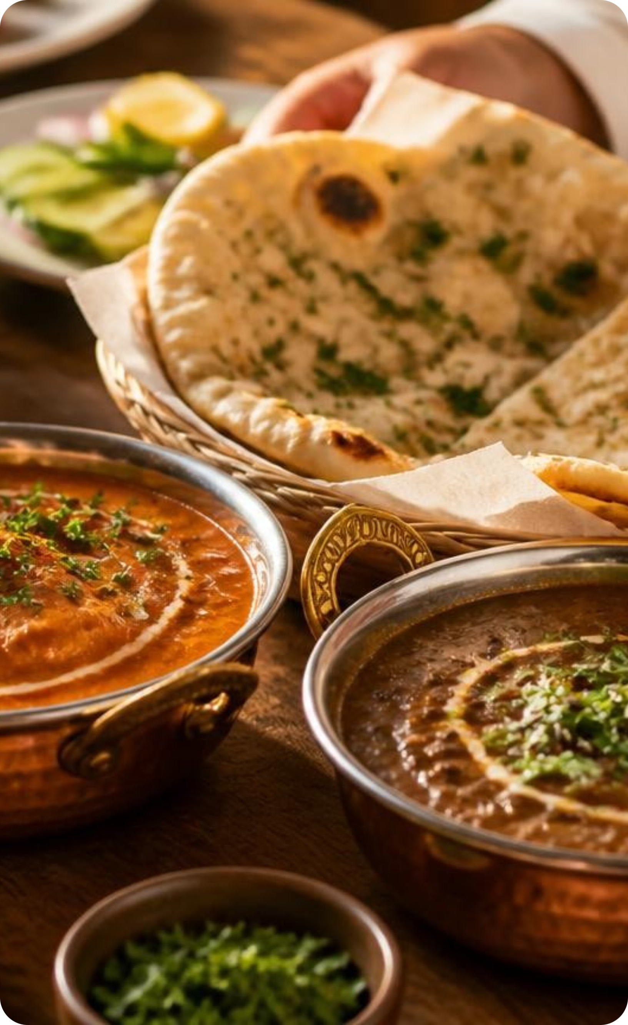
CATEGORY DYNAMICS
Cuisine intelligence: North Indian leads on every count
1,826
#1
CUISINES TRACKED
NORTH INDIAN
Varieties across platform menus.
Most listed; most votes.
CUISINE COHORT | VOLUME / VOTES | AVG SCORE
North Indian | Platform Leader | 3.65
Chinese & Fast Food | High Listing Density | 3.15
Sunda & Indonesian | 5,514 Lead Votes | 4.90
Business Problem Solved: Guide menu and kitchen investments: launch staples or build niche loyalty.
Notes:
While North Indian commands the largest total share of listings and votes, niche authentic cuisines like Indonesian and specialized regional concepts capture top-tier 4.9 ratings.

Slide 9
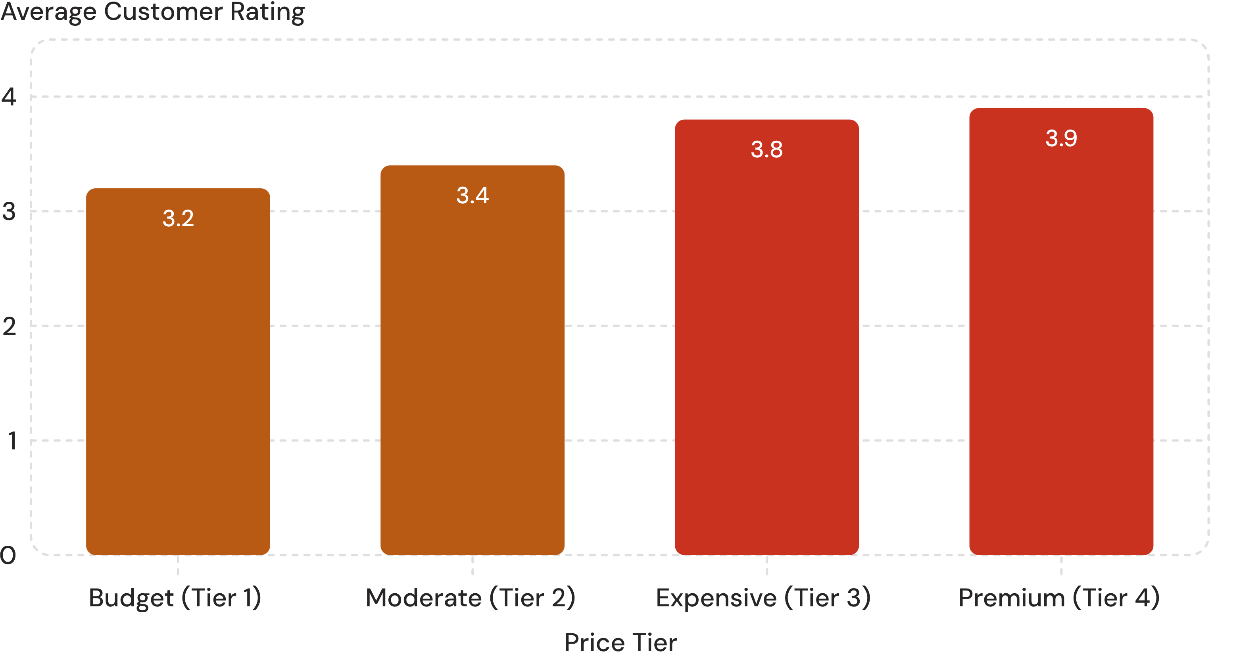
EXECUTIVE TAKEAWAY
Price pays off in ratings
+0.7
Rating leap from Budget to Premium
Investment pays back
Diners consistently reward higher price points with elevated satisfaction scores, as higher margins translate into superior ingredients, hospitality, and dining ambiance. Stacked charts show cuisine mix by price tier and how ratings split across cuisines.
Business Problem Solved
Gives restaurant owners clear empirical validation to invest in elevated culinary quality and service rather than competing in a destructive race to the bottom.
Direct correlation between pricing category and average diner rating.
Notes:
Conclude with this strategic verdict: higher spend directly correlates with higher customer appreciation. Restaurateurs who invest in quality and experience win on Zomato.

Slide 10
WHAT TO DO NEXT
From charts to decisions for each audience
Customers
Restaurant owners
Zomato
Filter by cuisine, price, location and rating
Find low-rated areas
Track performance and improve menu and service
Sell paid analytics
Drive more orders and retention, and review commission
NEXT
Dish-level insight and recommendations: restaurant performance on sales, revenue and orders, advanced market-opportunity analysis, and clear recommendations for owners.
Notes:
Close on the three audiences: customers filter for what they want, owners act on low-rated areas and menu gaps, and Zomato monetises analytics. Next comes dish-level insight and owner recommendations.

