Slide 1

Crime Pattern Detection in San Francisco Using Apriori and Clustering Algorithm

Slide 2
Supervised By
Tohedul Islam
Assistant Professor
American International University-Bangladesh

Slide 3
Group Members
Abdullah-Al-Mahadi (17-33324-1)
Islam,Md.Asiful (17-33100-1)
Iftekhar Rahman (17-33302-1)
Hossain Imran (17-33458-1)

Slide 4
Outline
Motivation
Research Questions
Background Study
Methodology
Data Collection
Data Pre-processing
Data Mining Techniques
Results and Findings
Result Analysis
Visualization
Discussion
Future Works
Generate More Pattern
More Datasets
Conclusion

Slide 5
Motivation
01
Murder case
Different types of theft
Breaking law
Increasing criminal offecnce
02
Crime predection
To take necessary step earlier.
To help law enforcement agencies
03
It is related our life

Slide 6
Research Questions
How can we detect crime pattern?
What attributes should consider and to detect crime pattern?
Does this research paper fulfill the objective?

Slide 7
Background Study
Crime prediction using Data mining techniques.
Learning
2. Detection
Learning purpose of crime detection
Supervised and Unsupervised learning.
Analysis of a large amount of datasets
Detect the crime type
Find out a comparison in which day criminal offences occur too much

Slide 8
Background Study
2. Crime Analysis Based on Association Rules Using Apriori Algorithm
Learning
2. Detection
Learning purpose of crime analysis
Association role mining(Apriori Algorithm)
Using the Datasets of NIBRS (National Incident-Based Reporting System).
Detect the crime type
Find out the gender of criminal

Slide 9
Background Study
3. Crime Analysis using K-Means Clustering
Learning
2. Detection
K-Means Clustering
Crime dataset used is an offences recorded by the police in England and Wales by offence and police force area from 1990 to 2011
To identify crime trend over years and can be used to design precaution methods for future.

Slide 10
Background Study
4. Crime Pattern Detection Using Data Mining
Learning
2. Detection
Using k-Means clustering algorithm
Clustering Techniques.
Detection of crime region.

Slide 11
Why is our model different?
Based on real data
Specific day and time
Using Apriori algorithm and K-means Clustering both together.

Slide 12
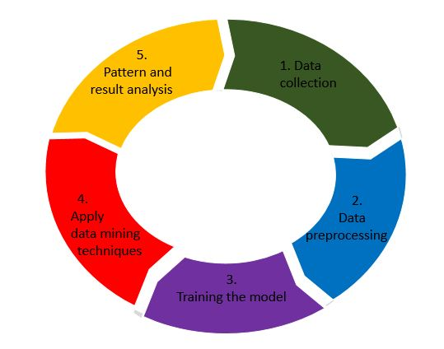
Methodology

Slide 13
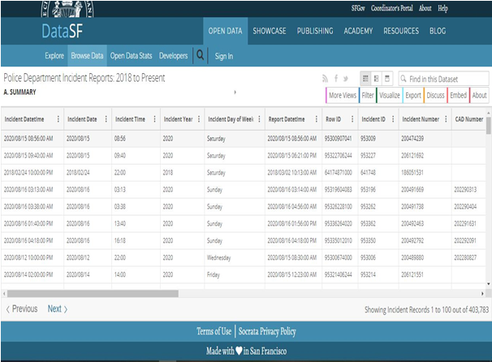
Data Collection
Collect the real data set of police department
After collecting the data, analysis the attribute

Slide 14
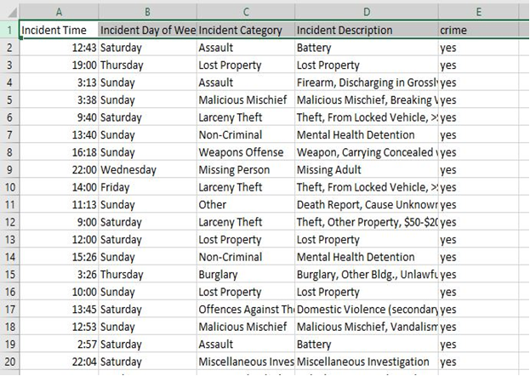
Data Pre-processing
Data cleaning
Attribute selection
Remove noisy data

Slide 15
Training
No of instances = 500
No of attributes = 5
Attribute type = Nominal

Slide 16
Data mining techniques to detect pattern
Using data mining techniques to see the actual predictions that our model has
made for the test data.
Association Rule Mining
Clustering

Slide 17
Association Rule Mining For pattern Generate
Algorithm = Apriori
Advantages
Easy to implement
Use light itemset property
Very fast

Slide 18
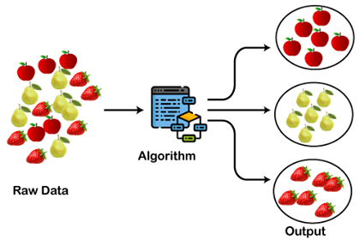
Clustering For pattern Generate
Algorithm=K-means clustering
Relatively simple to implement.
Scales to large data sets.
Easily adapts to new examples.
Figure: K-means clustering

Slide 19
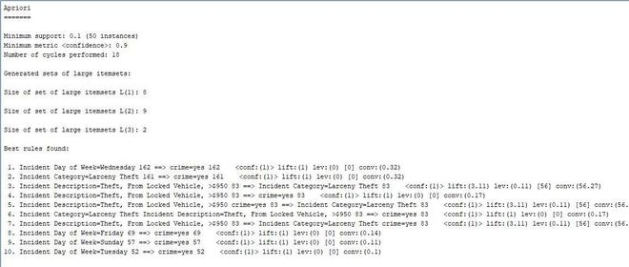
Result for Apriori Algorithm
Figure : Apriori Algorithm metric type confidence

Slide 20
Results and Findings
The most crime happened on Wednesday about 162 offences.
Second most crime happened on Friday about 69 offences.
The most crime category is larceny theft it’s about 161 cases
The most crime description found is theft from locked vehicles

Slide 21
Result for K-Means Clustering Algorithm
No. Cluster | Time | Day | Incident type | Incident description | Clustered(%)
0 | 12.00 | Wednesday | fraud | credit card fraud | 61%
1 | 8.30 | Thursday | theft | Theft from locked vehicle | 39%
2 | 00.00 | Sunday | fraud | Access card info | 10%
3 | 13.30 | Thursday | theft | Theft from locked vehicle | 1%
4 | 00.00 | Saturday | other | Miscellaneous | 7%

Slide 22
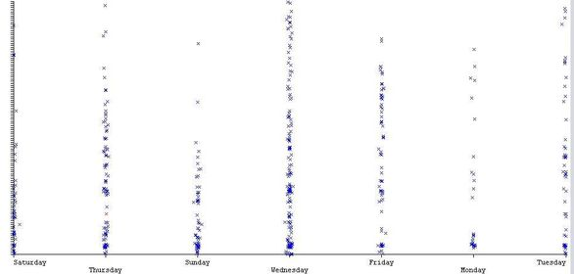
Visulization

Slide 23
Limitations
Small dataset
Can’t use numeric data
Noisy data interrupts the system

Slide 24
Future Work
Research with large dataset
Generate more pattern
Use more algorithm
Will work with more city’s datasets

Slide 25
Conclusion
To make communities vulnerable to public safety.
Faster detection.
Will help police department or others law enforcement agencies .
to enhance the efficiency and effectiveness of investigative and intelligence research.

Slide 26
References :
1) Chao Yang, Hongbo Liu, Yeqing Sun, Ajith Abraham 2012 Multi-Knowledge Extraction From Violent Crime Datasets Using Swarm Rough Algorithm 12th International Conference On Hybrid Intelligent Systems (His)
2) Jieling Jin, Yuanchang Deng 2017 A Comparative Study On Traffic Violation Level Prediction Using Different Models 4th International Conference On Transportation Information And Safety (Ictis)
3) Sachin Kumar and Durga Toshniwal 2015 A Data Mining Framework To Analyze Road Accident Data Journal Of Big Data,
4) Adesola Falade*, Ambrose Azeta, Aderonke Oni, Isaac Odun-ayo 2019 Systematic Literature Review of Crime Prediction and Data Mining https://doi.org/10.18280/rces.060302

Slide 27
References Contd..
5) Abhinav Srivastava, Amlan Kundu, Shamik Sural and Arun K. Majumdar 2008 Credit Card Fraud Detection Using Hidden Markov Model IEEE Transactions On Dependable And Secure Computing 5
6) G.C. Oatley, J. Zeleznikow, B.W. Ewart, “Matching and Predicting Crimes,” In Applications and Innovations in Intelligent Systems XII in Proceedings of AI2004, The Twenty-fourth SGAI International Conference on Knowledge Based Systems and Applications of Artificial Intelligence. Ann Macintosh, Richard Ellis and Tony Allen Ed. London: Springer, , pp. 19-32, 2004.
7) R. William Adderley, “The use of data mining techniques in crime trend analysis and offender profiling,” Ph.D. thesis, University of Wolverhampton, Wolverhampton, England , 2007.

Slide 28


Slide 29
Thank You

