Slide 1

Welcome To My Presentation

Slide 2
Presentation Topic:Economic Indicators Data Analysis of Various country.
Presenting By: Asiful Islam Rakib
ID:01-029-02
Course No:Computer Fundamentals and Office Applications (CFOA)

Slide 3
Methodology
Introduction
Basic Terms in Excel
PIVOT TABLE
PIVOT CHART
SLICERS
Conclusion

Slide 4
Introduction
Microsoft Excel enables users to format, organize and calculate data in a spreadsheet. By organizing data using software like Excel, data analysts and other users can make information easier to view as data is added or changed. Excel contains a large number of boxes called cells that are ordered in rows and columns.

Slide 5
Basic term in my presentation
Pivot Table
Select a cell in the source data or table range. Go to Insert > PivotTable. Choose where you want the PivotTable to be placed. Select Insert on new sheet to place the PivotTable in a new worksheet or select the cell where you want the new PivotTable placed in the Destination field. Select Insert. You can use a PivotTable to summarize, analyze, explore, and present summary data.
Row Labels | Max of Population(Millions)
Antigua and Barbuda | 0.099
Argentina | 45.842
Aruba | 0.109
Barbados | 0.289
Belize | 0.43
Bolivia | 11.8
Brazil | 212.609
Chile | 19.718

Slide 6
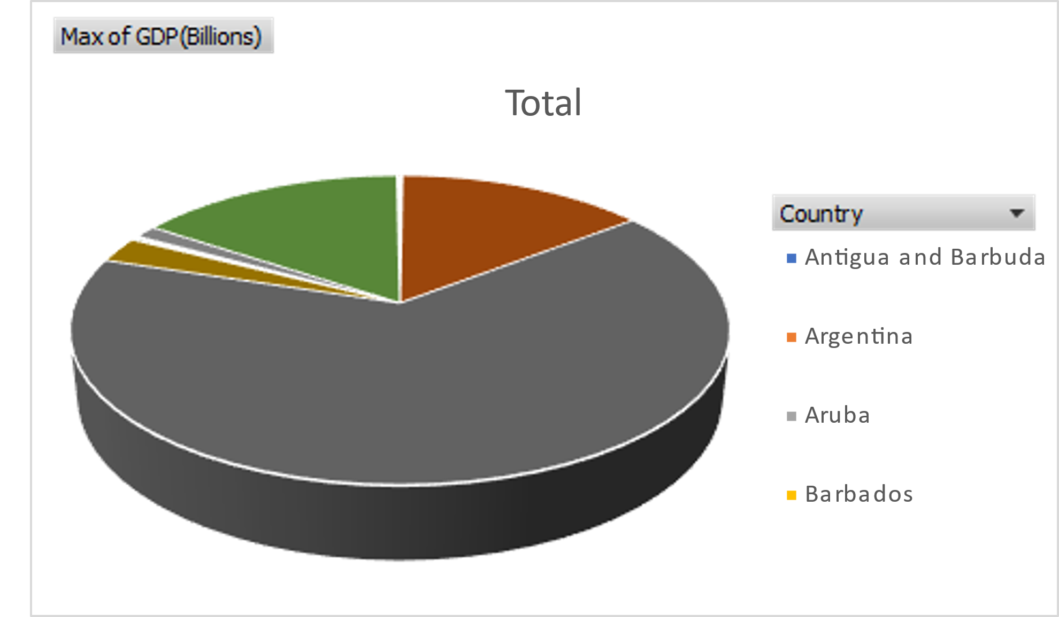
Pivot Chart
Create a chart from a PivotTable · Select a cell in your table. · Select Insert and choose PivotChart. · Select a chart. · Select OK. Pivot Charts provide graphical representations of the data in their associated PivotTables.

Slide 7
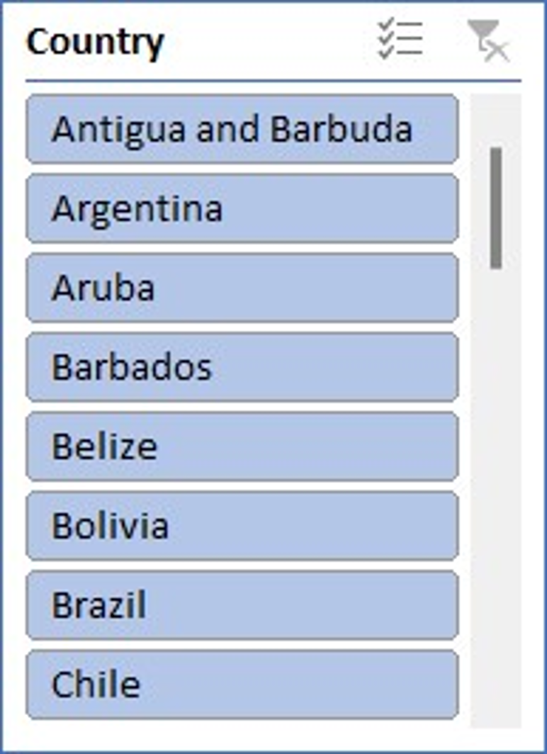
Slicers in Pivot
Slicers in Excel make tables appear interactive and can help you visualize the same data with different criteria. The pivot table summarizes the entire table in a report, and slicers help you to visualize slices of the whole table.

Slide 8
Conclusion
Microsoft Excel is a powerful and easy-to-use application for data analysis and reporting. In this post, we have learned the importance of basic Excel formulas and how they provide us extra ability to perform complex calculations. Furthermore, we have learned about various ways of adding formulas to worksheets and looked in detail at the essential basic Excel formulas.

Slide 9
Thank You

