Slide 1
Got-Wine?
Team Viper:
Asiha Braxton-Garvin
Ida Kalley
Alex Schanne
Jessie Lynch
Carmen Ngui

Slide 2
Introduction
Notes:
For our first data science project, we decided to analyze winery reviews on Yelp to determine what attributes influence positive Yelp reviews within this business category, focusing on location and price. In addition to narrowing our project scope in terms of attributes, we decided to focus exclusively on wineries within the US. This helps to keep some of the 'unmeasured' or intangible variables, like cultural expectation and economic continuity, more consistent because as we will go into further during our concessions and discussion, there are many parts of these data that may lead to inaccurate representation of trends.
We acknowledge these shortcomings and present to you our best effort based on the provided data from the Yelp API and our existing skill set. We chose the Yelp API because it was free and accessible and met the needs of this project. We have no relationship with it or any of the wineries mentioned in the following data, therefore we have no conflict of interests to report.
We hope that the following discussion will be fun and useful for anyone wondering about winery experience in the US. And look forward to continuing to build on our skills used in the project to improve our analysis going forward. Please enjoy!

Slide 3
Hypothesis
Observable correlations may exist between attributes of wineries, such as:
Location | Price
Location | Rating
Location | Number of reviews of winery guests/Yelp site visitors
Price | Rating

Slide 4
Questions & Considerations | Query & Interpretation
How can we use the data available to interpret any existing relationships?
What data points should we focus on?
How should we best display the relationships?
What assumptions are we bringing to our discussion?
How to avoid our own bias?
What are the intangible/unmeasured factors influencing our findings?
How does the number of reviews per each winery influence the other data points, like ratings?

Slide 5
Data Sources
Yelp API
Robust Dataset
Accessible & Open for re-use
Available Free of Charge
Data Size | Review Attributions
Ample sample size more apt to broader representations of data/reviews.
Self-biasing Group
*Note: because we used Yelp and data contribution is widely open to anyone, to contribute their reviews, data on Yelp does tend to be self-biasing, meaning that the group is not controlled. Anyone is permitted to write very positive or very negative reviews.
Notes:
*Note: because we used Yelp and data contribution is widely open to anyone, to contribute their reviews, data on Yelp does tend to be self-biasing, meaning that the group is not controlled. Anyone is allowed to write very positive or very negative reviews.

Slide 6
Data Cleaning
API Calls | Result
First data review/query was that of US wineries. | US data for CA only, limited to 50 wineries
Second data review limited the API call to 20 wineries from each of the 50 states. | Some of the states did not have 20 wineries, however this query produced a selection across the US.
After our second data query, we reviewed data for consistency of attributes across each winery. | Some wineries did not have specific data attributes. Modified API call to include specific attributes, like price, helping to ensure that the relationships we compared were consistent.
Not all reviews had ratings available for each attribute, like that of price, factoring into the interpretation/manipulation process of the dataset.
Notes:
Proximity played role in data retrieval of winery, due to specifications on location queries/miles.
Note: We were unable to change our data set as there were inconsistent numbers of reviews per winery. This is a function of Yelp being a publicly collected dataset on a free website.
Note: inconsistencies included lack of price attributions of all reviews, as well as wineries included among results of neighboring states as a result of proximity and variations in quantity of wineries in each state to query.

Slide 7
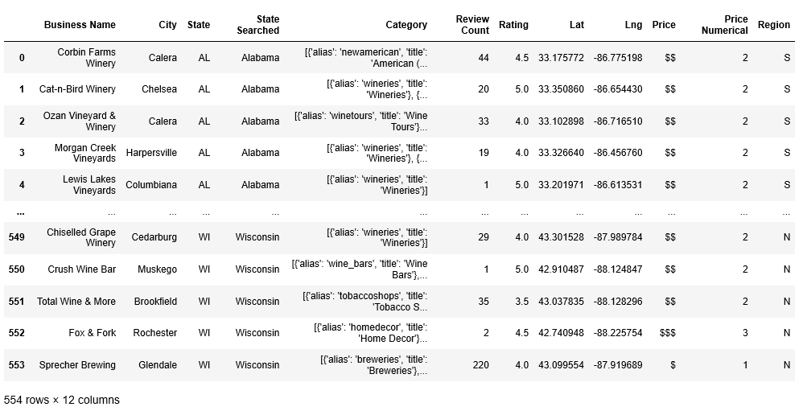
Data Collection & Manipulation
Create Dataframe
Notes:
Now we will be moving along to the Data Collection and Manipulation section. As previously mentioned, when pulled information from the Yelp API to collect the responses based on specific parameters and organized the data into a dataframe. As we began manipulating the data, we noticed that although we only queried for 20 wineries in each state, some states were appearing more often than others. This then prompted us to add a column that included the state being searched for that response. When then learned that some responses returned wineries from states in close proximity to the one being search. For example, if we queried for New Jersey, it might return a winery in New York. This then prompted us to consider trends in different regions of the US and we added a column to include that. It was also mentioned that we wanted to explore pricing trends, however that API returns the price point in a series of dollar signs. We then converted this into usable data, by representing the data numerically. The next slide will show an snippet of coding used to assign the region and convert the price points.

Slide 8
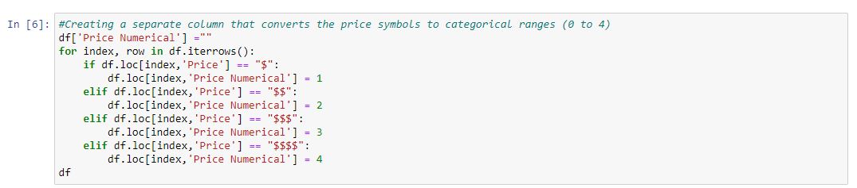
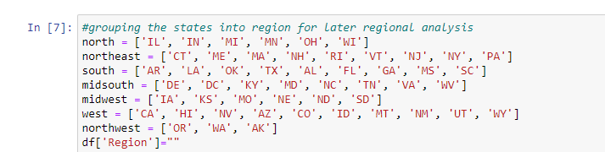
Data Cleaning & Manipulation Methods
DataFrame Manipulation(s): Assigned Numerical Value to Yelp’s Price Point System & Regions
Notes:
Price range
regions

Slide 9
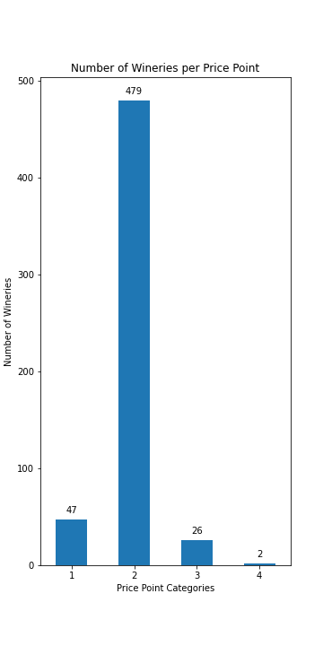
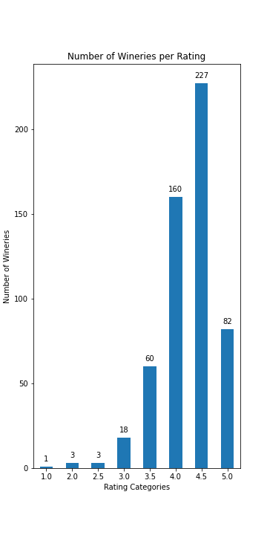
Data Analysis
Notes:
No moving on to the Analysis. First, we looked into the number of wineries per price point and the number of wineries per Rating. We found that the majority of wineries are within the moderate ($$) price range, as opposed to the expensive ($$$) or very expensive ($$$$) price ranges. This finding is significant in our further exploration of rating versus price breakdown and location versus price breakdown which we will show on the next slide.

Slide 10
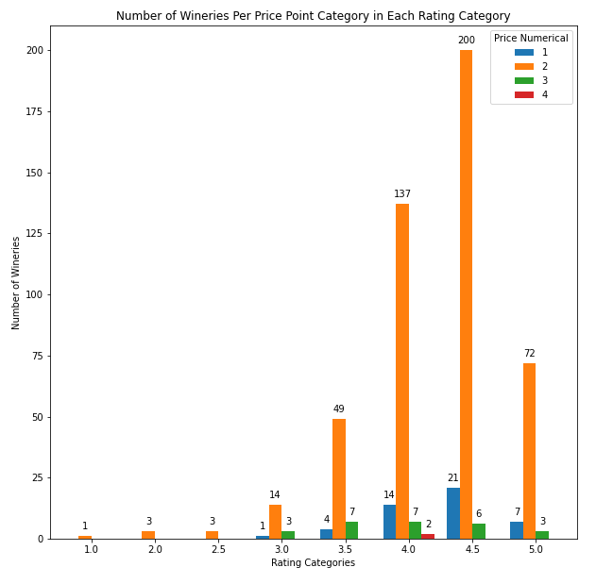
Data Analysis
Notes:
Now if you are in this class you know Ed drives home the point the best way to show correlation between to data points is to us a scatter plot. I know what Ed, Madison and all the other students are thinking. When I told you we would be looking at the relationship between price and rating next, you probably expected a scatter plot and I can assure you we tried that first. When we tried it, it did not come out as expected, showing a positive, negative or not correlation. We then had out ah ha moment. For every price point, there is a limited number of rating it can relate to and vice versa. So we transitioned back to the bar graphs. We altered out dataframe to group by rating and show the frequency of each price point per rating.
We found that within each rating category, the moderately priced wineries were the leaders, but that seems to be a function of the data. That being said we also find that the two wineries that are within the very expensive price range in our dataset are not in the top-rated category, and in fact only warrant a 4.0 star rating. While our dataset cannot conclusively state that ratings are uninfluenced by price, it does suggest that further analysis is warranted to determine if pricier wineries are reviewed with more stringent criteria, or a ‘finer eye’.
Next we will explore our regional trends.

Slide 11
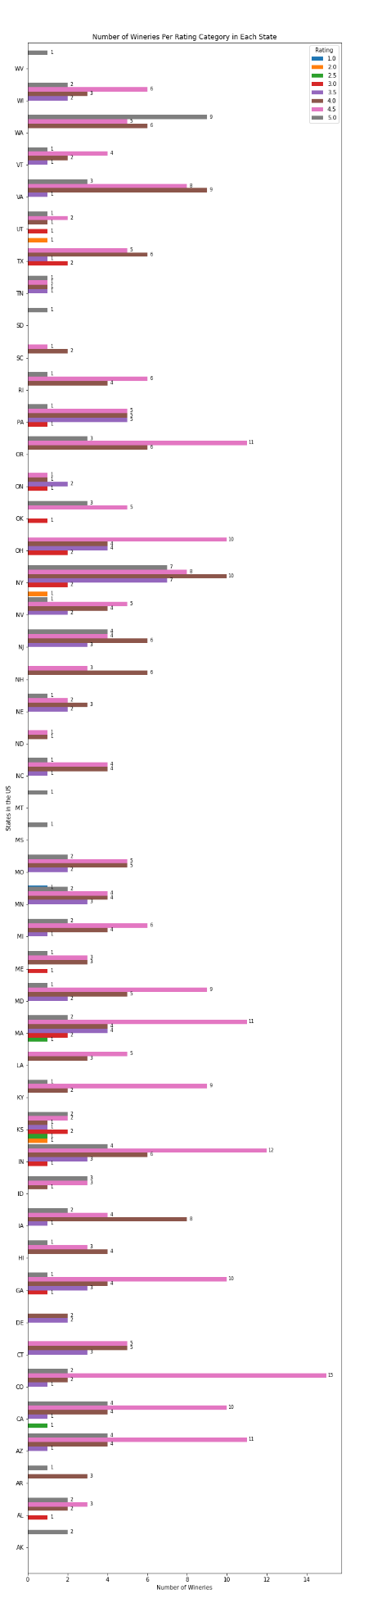
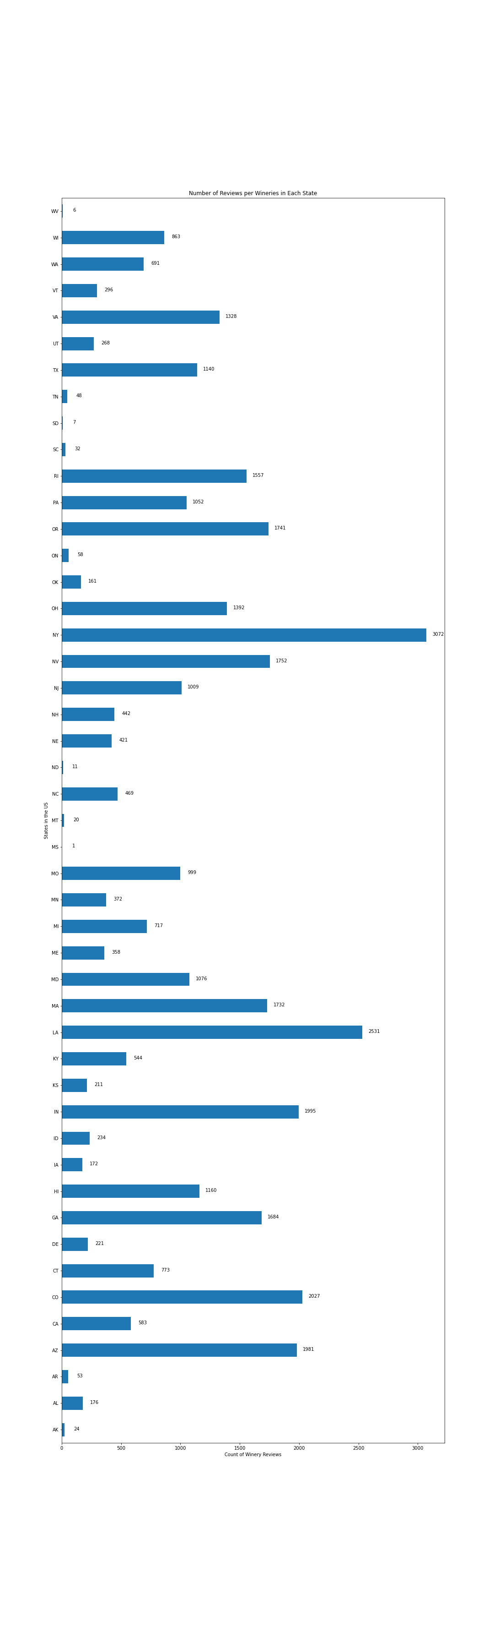
Data Analysis
Wineries Per Rating
in each State
Mouse-over to view full images.
Review Count Per State
Notes:
One of the first things we saw when looking at the results was the distribution of the data. For instance, as we mentioned before, some of the states did not have up to 20 wineries. For example, West Virginia only had one winery to include from Yelp. This is not to say that there may not be more wineries in West Virginia, but because they were not included in Yelp, we did not have access to their data.
Having established the number of wineries per state, we then looked at the number of reviews in those states. This gives an approximate for the number of visitors to each state. This helped to determine which winery had richer or more reliable results. We then tempered our findings with the understanding that the data is skewed.

Slide 12
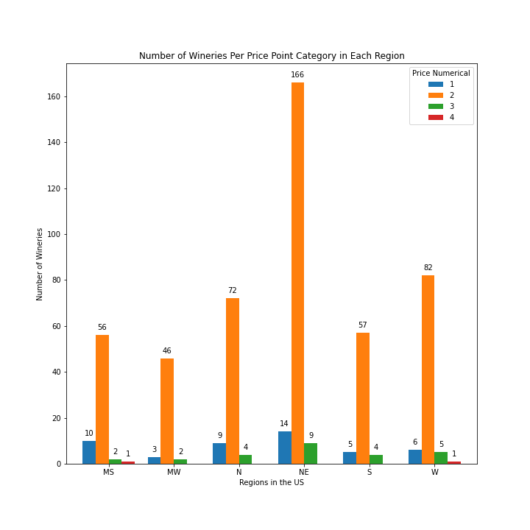
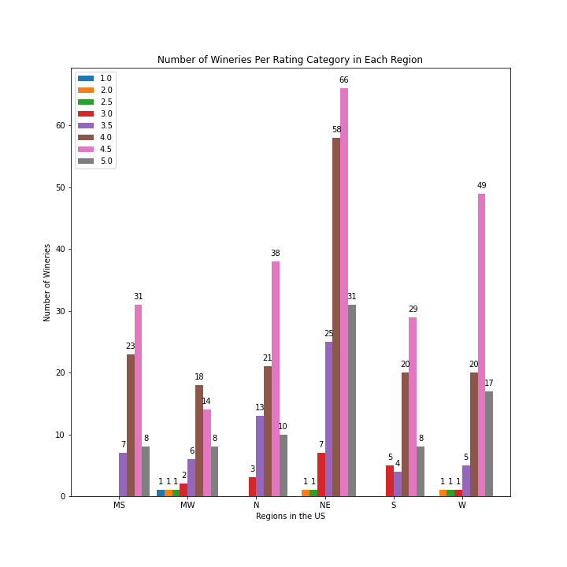
Data Analysis
Notes:
From there, we look at the breakdown of wineries within regions of the US. Before discussing this, we note that certain regions have more states included in them. Similar to our earlier notes, this means that certain regions have more winery data to review. This particularly comes to light when we review the heatmap. We created three separate heat maps to compare, one for review count, one for ratings and one for price. This makes it easier to visualize what we had been seeing the bar graphs. These attributes like price and ratings do not seem to be correlated but rather seem to be influenced by location. More densely populated and more traveled areas seem to yield greater numbers of reviews (and perhaps visitors) than less densely populated areas. For instance, places like the Midwest seem to have more scattered and weaker heat markers on our maps than do coastal areas like California and the Northeast. If we had more time, we would have looked more at how climate and soil in different areas may affect wine production and wine sales. We also would have tried to compare wine sales with other alcoholic beverages and alcohol consumption in those areas to see if those factors affect winery experiences. Although our analysis does provide some insight into the winery reviews of Yelp across the US, upon reflection, we believe that looking at percentages rather than total numbers would have been a more reliable way to look at the data. This would help weight the data so that we could make conclusions regardless of the number of wineries within certain areas. This could have also helped us weight our analysis based on number of reviews or we could have gathered our data based on wineries with a certain number of reviews.

Slide 13
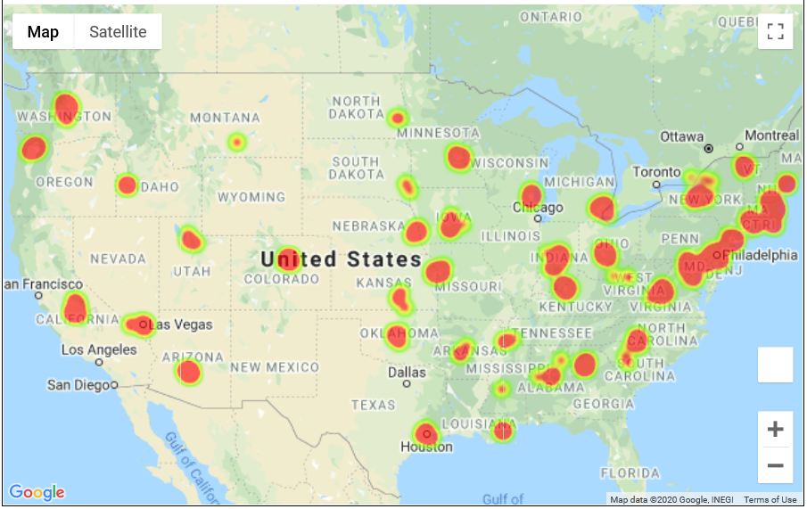
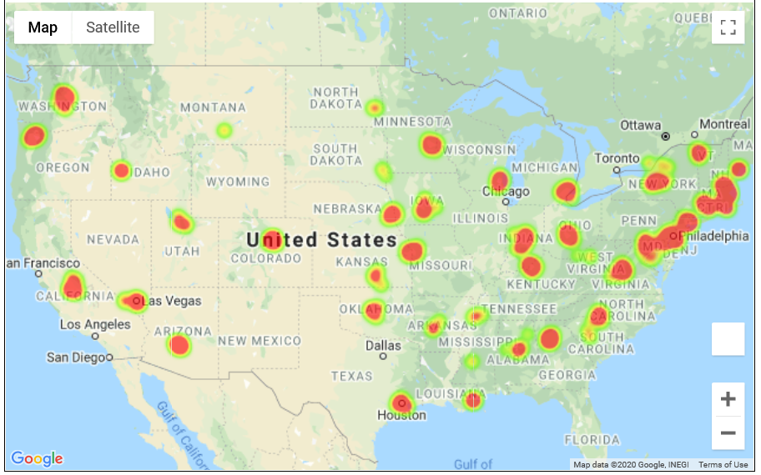
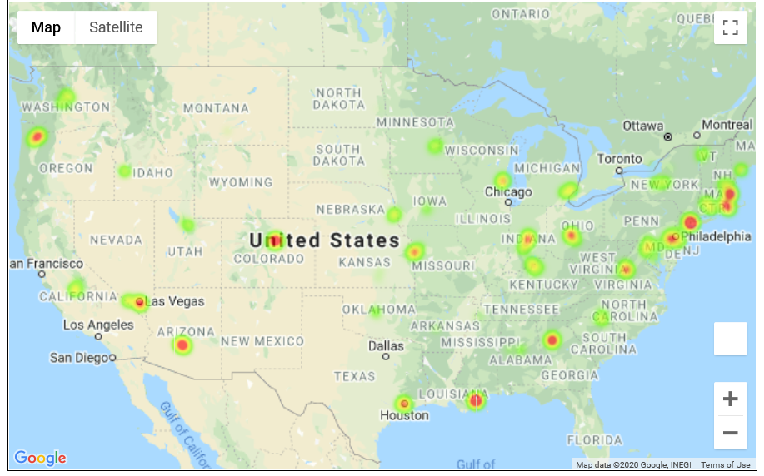
Data Analysis
Rating
Price
Review Count

Slide 14
Findings | Conclusion
Location appears to be the most influential factor in experience/perception.
We did not find a significant relationship between price and ratings, counter to our hypothesis that pricier wineries may have nicer offerings and therefore receive more positive reviews.
Nor did we find a significant relationship between price and location.
More analysis is needed and this, merely a starting point for analysis on attribute relationships within winery experience perception.
Notes:
Based on our review of Yelp API winery data, we see that location appears to be the most influential factor in experience perception as measured by user ratings and number of ratings. We did not find a significant relationship between price and ratings, counter to our hypothesis that pricier wineries may have nicer offerings and therefore receive more positive reviews. Nor did we find a significant relationship between price and location. We thought we might find pricier wineries in locations like New York or California, however the one of the two wineries within the dataset was actually in the Midwest, counter to our expectations.
The firmest conclusion we can report is that more analysis is needed and this is merely just a starting point for analysis on attribute relationships within winery experience perception. We recommend that future analysis focus on location and experience perception and how other factors may influence that relationship.

Slide 15
Conclusion & Further Considerations
Factors that may have influenced these outcomes:
Given more time we would include other datasets; and consider more aspects that may be relevant to the trends in consumer wine/winery preferences.
Characteristics of climate and soil, their potential influence on the quality of the ingredients and production of wine, and how varied quality, or perception of it, might be in each state’s environment.
The use of a free, public, and user-dependent source, users’ self-selecting bias, niche cultures, micro economies and the differences in winery experience offerings.
Notes:
Any other factors that may have influenced these outcomes? In other words, maybe mention that given more time you would include another piece of data because it may have influenced the accuracy of your results, etc.
As we talk about in previous sections, we would have liked to look at climate and soil characteristics and their influence on wine production and wine quality in each state. We also would have liked to establish a more reliable collection of data collected specifically for this analysis. Some of the other factors that may have influenced our results were included in our concession statement and they include the use of a free, public, and user dependent API, user’s self-selecting bias, niche cultures, micro economies and the differences in winery experience offerings.

