Slide 1
Got-Wine?
Team Viper:
Asiha Braxton-Garvin
Ida Kalley
Alex Schanne
Jessie Lynch
Carmen Ngui

Slide 2
Introduction
For our first data science project, we decided to analyze winery reviews on Yelp to determine what attributes influence positive Yelp reviews within this business category, focusing on location and price. In addition to narrowing our project scope in terms of attributes, we decided to focus exclusively on wineries within the US. This helps to keep some of the 'unmeasured' or intangible variables, like cultural expectation and economic continuity, more consistent because as we will go into further during our concessions and discussion, there are many parts of these data that may lead to inaccurate representation of trends.
We acknowledge these shortcomings and present to you our best effort based on the provided data from the Yelp API and our existing skill set. We chose the Yelp API because it was free and accessible and met the needs of this project. We have no relationship with it or any of the wineries mentioned in the following data, therefore we have no conflict of interests to report.
We hope that the following discussion will be fun and useful for anyone wondering about winery experience in the US. And look forward to continuing to build on our skills used in the project to improve our analysis going forward. Please enjoy!

Slide 3
Hypothesis
We suspected we might uncover that ---
Observable correlations may exist between attributes of wineries, such as:
Location | Price
Location | Rating
Location | Number of reviews of winery guests/Yelp site visitors
Price | Rating

Slide 4
Questions & Considerations | Query & Interpretation
How can we use the data available to interpret any existing relationships?
What data points should we focus on?
How should we best display the relationships?
What assumptions are we bringing to our discussion?
How to avoid our own bias?
What are the intangible/unmeasured factors influencing our findings?
How does the number of reviews per each winery influence the other data points, like ratings?

Slide 5
Data Sources
Yelp API
Robust Dataset
Accessible & Open for re-use
Available Free of Charge
Data Size | Review Attributions
Ample sample size more apt to broader representations of data/reviews.
Self-biasing Group
Inherent bias in who/where/why reviews were posted - and how this contributed to accumulation and reasoning behind ratings - was acknowledged as a separate entity from the pre-existing, inevitable, subjectivity based upon Yelp and the objective purpose it aims to serve.
Notes:
*Note: because we used Yelp and data contribution is widely open to anyone, to contribute their reviews, data on Yelp does tend to be self-biasing, meaning that the group is not controlled. Anyone is allowed to write very positive or very negative reviews.

Slide 6
Data Cleaning
API Calls | Result
First data review/query was that of US wineries. | US data for CA only, limited to 50 wineries
Second data review limited the API call to 20 wineries from each of the 50 states. | Some of the states did not have 20 wineries, however this query produced a selection across the US.
After our second data query, we reviewed data for consistency of attributes across each winery. | Some wineries did not have specific data attributes. Modified API call to include specific attributes, like price, helping to ensure that the relationships we compared were consistent.
Note: inconsistencies included lack of price attributions of all reviews, as well as wineries included among results of neighboring states as a result of proximity and variations in quantity of wineries in each state to query.
Notes:
Proximity played role in data retrieval of winery, due to specifications on location queries/miles.
Note: We were unable to change our data set as there were inconsistent numbers of reviews per winery. This is a function of Yelp being a publicly collected dataset on a free website.

Slide 7
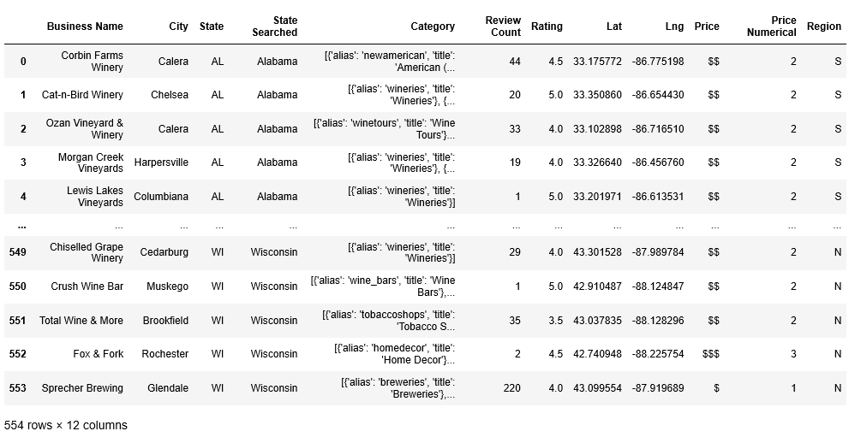
Data Collection & Manipulation
Create Dataframe
Notes:
Intro to dataframe, data retrieval - query/proximity issues due to location - so some calls resulted in wineries from other states

Slide 8
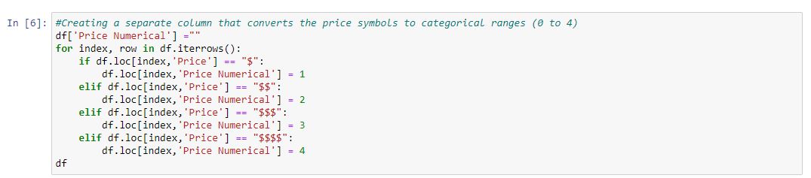
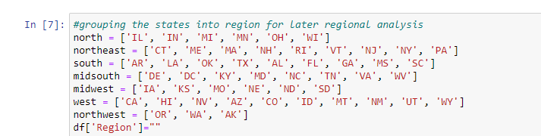
Data Cleaning & Manipulation Methods
DataFrame Manipulation(s): Assigned Numerical Value to Yelp’s Price Point System & Regions
Notes:
Price range
regions

Slide 9
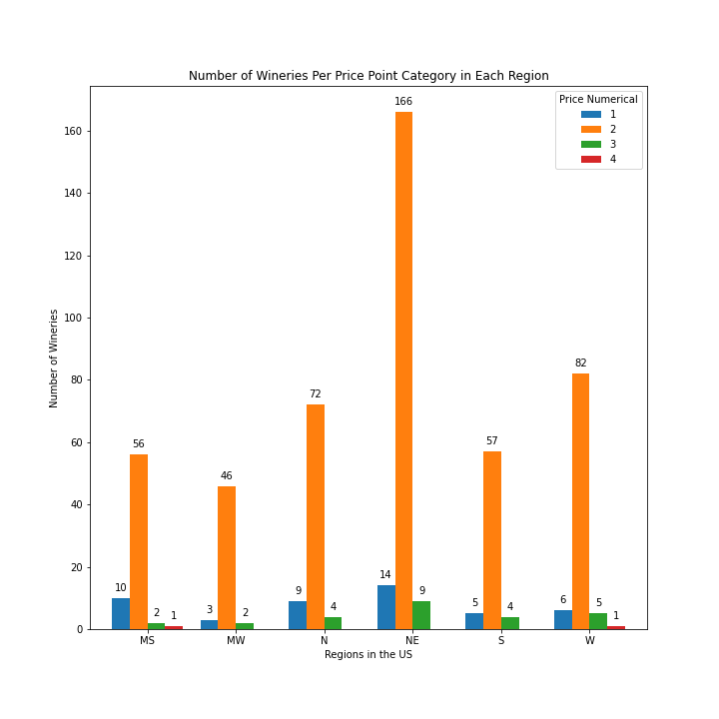
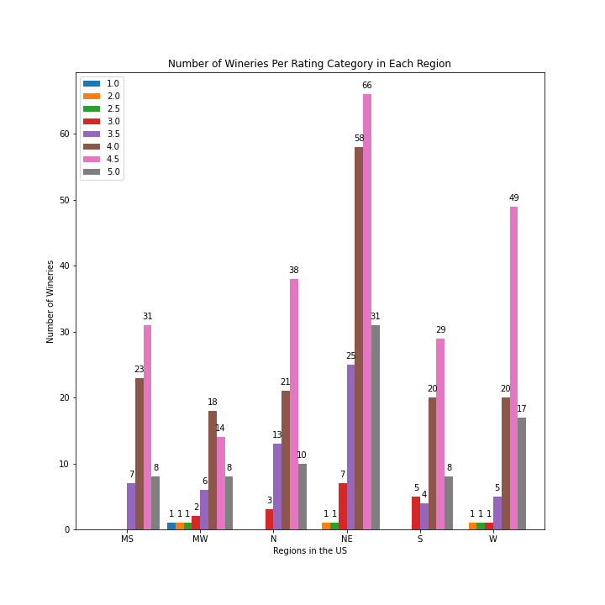
Data Analysis
Notes:
Price point per category/number of wineries/regions in US
2. Number of wineries per rating category in each rating
Bar graphs,heat maps to do analysis - typically to display correlations scatterplots, but price/ratings finite - scatterplots were not clear in the this application

Slide 10
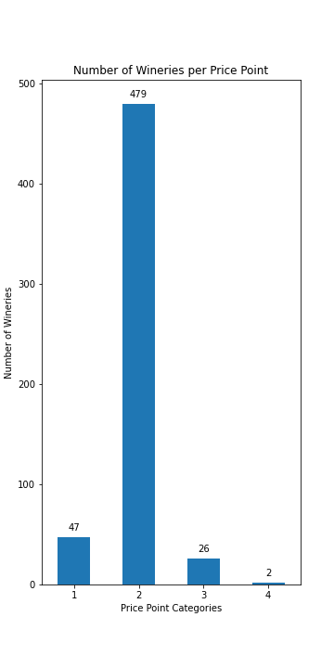
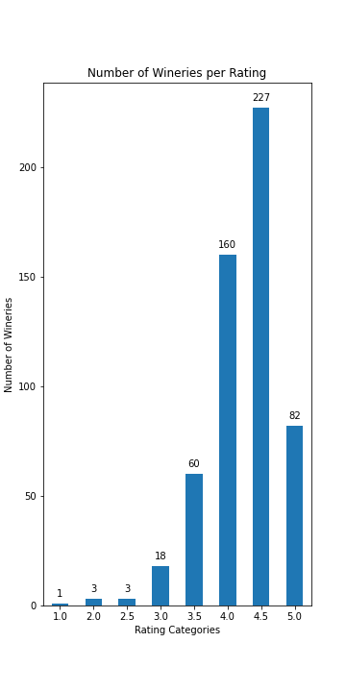
Data Analysis
Notes:
Number of wineries per price point
Number of wineries per rating
Bar graphs,heat maps to do analysis - typically to display correlations scatterplots, but price/ratings finite - scatterplots were not clear in the this application
Bar graphs,heat maps to do analysis - typically to display correlations scatterplots, but price/ratings finite - scatterplots were not clear in the this application

Slide 11
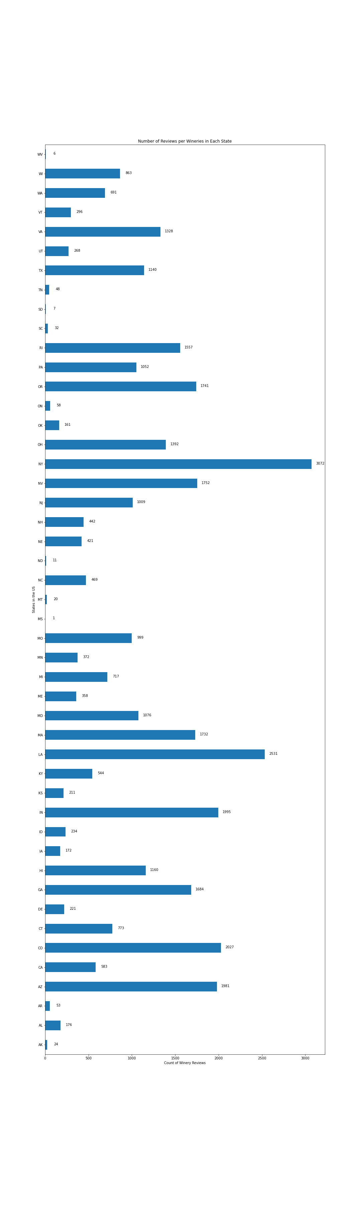
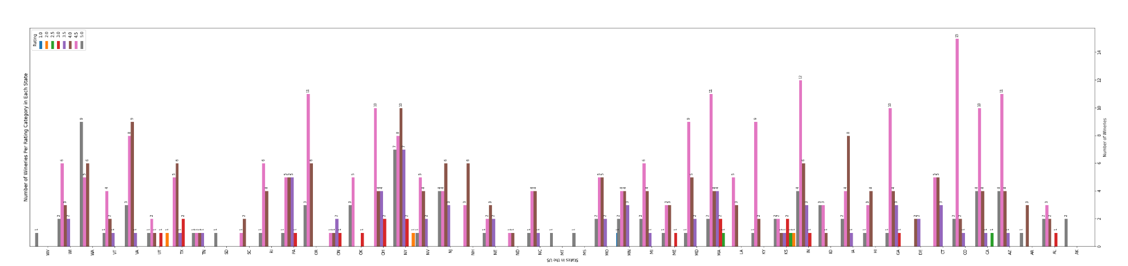
Data Analysis
Review Count Per State
Mouse-over to view full images.
State Wineries Per Rating
Notes:
### edit these slides and ID Number of wineries per price point
Number of wineries per rating
Bar graphs,heat maps to do analysis - typically to display correlations scatterplots, but price/ratings finite - scatterplots were not clear in the this application
Bar graphs,heat maps to do analysis - typically to display correlations scatterplots, but price/ratings finite - scatterplots were not clear in the this application

Slide 12
Findings | Conclusion
Location appears to be the most influential factor in experience/perception.
We did not find a significant relationship between price and ratings, counter to our hypothesis that pricier wineries may have nicer offerings and therefore receive more positive reviews.
Nor did we find a significant relationship between price and location.
More analysis is needed and this, merely a starting point for analysis on attribute relationships within winery experience perception.
Notes:
Based on our review of Yelp API winery data, we see that location appears to be the most influential factor in experience perception as measured by user ratings and number of ratings. We did not find a significant relationship between price and ratings, counter to our hypothesis that pricier wineries may have nicer offerings and therefore receive more positive reviews. Nor did we find a significant relationship between price and location. We thought we might find pricier wineries in locations like New York or California, however the one of the two wineries within the dataset was actually in the Midwest, counter to our expectations.
The firmest conclusion we can report is that more analysis is needed and this is merely just a starting point for analysis on attribute relationships within winery experience perception. We recommend that future analysis focus on location and experience perception and how other factors may influence that relationship.

Slide 13
Conclusion & Further Considerations
Factors that may have influence these outcomes:
Given more time we would include other datasets; and consider more aspects that may be relevant to the trends in consumer wine/winery preferences.
Characteristics of climate and soil, their potential influence on the quality of the ingredients and production of wine; and how varied quality, or perception of it, might be in each state’s environment.
The use of a free, public, and user-dependent source, users’ self-selecting bias, niche cultures, micro economies and the differences in winery experience offerings.
Notes:
Any other factors that may have influenced these outcomes? In other words, maybe mention that given more time you would include another piece of data because it may have influenced the accuracy of your results, etc.
As we talk about in previous sections, we would have liked to look at climate and soil characteristics and their influence on wine production and wine quality in each state. We also would have liked to establish a more reliable collection of data collected specifically for this analysis. Some of the other factors that may have influenced our results were included in our concession statement and they include the use of a free, public, and user dependent API, user’s self-selecting bias, niche cultures, micro economies and the differences in winery experience offerings.

