Slide 1
VGA controller with ATMEGA32

Slide 2
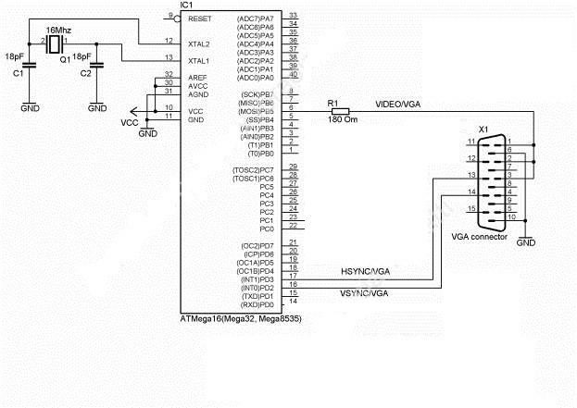
Schematics

Slide 3
Result

